Slide 1
Horizontal Stress Rotation Due To Reservoir Depletion ARMA 21-1748 Osman Hamid RGU/Saudi Aramco June 2021

Slide 2
Outline
Stress Rotation Background
Stress Rotation Assessment
Single wellbore analysis:
Image log interpretation
Finite Element modeling around producing wellbore
Field operations
Drilling events (mainly mud losses due to changing in well azimuth)
Orientation of hydraulic fractures
Field scale assessment
Finite Element modeling due to injection and depletion
Sensitivity Analysis
Impact of stress rotation in operations

Slide 3
Stress Rotation Background

Slide 4
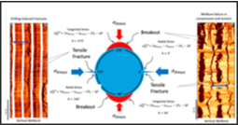
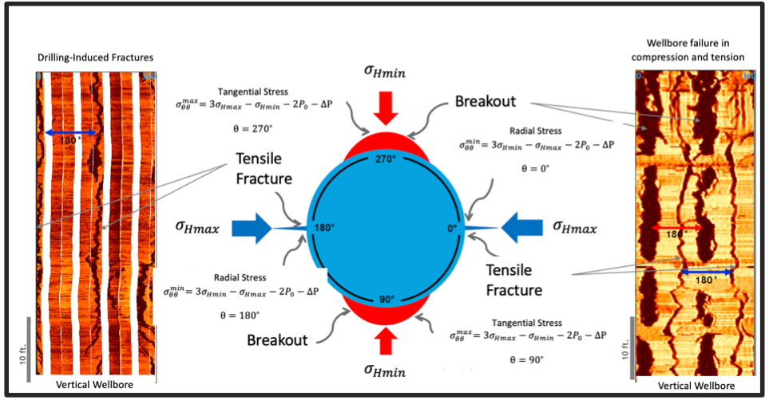
Horizontal stress direction from wellbore breakouts and drilling-induced fractures

Slide 5
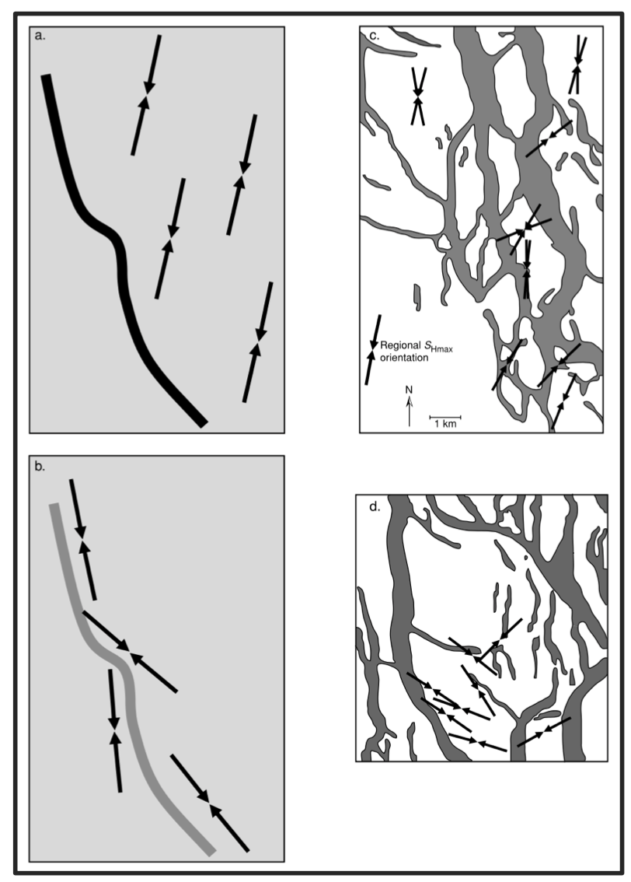
Horizontal stress rotation (a and b conceptual model before and after production respectively-Zoback 2007) (c and d from Arcabuz–Culebra field in Mexico - before and after production respectively Wolhart et al. 2000)

Slide 6
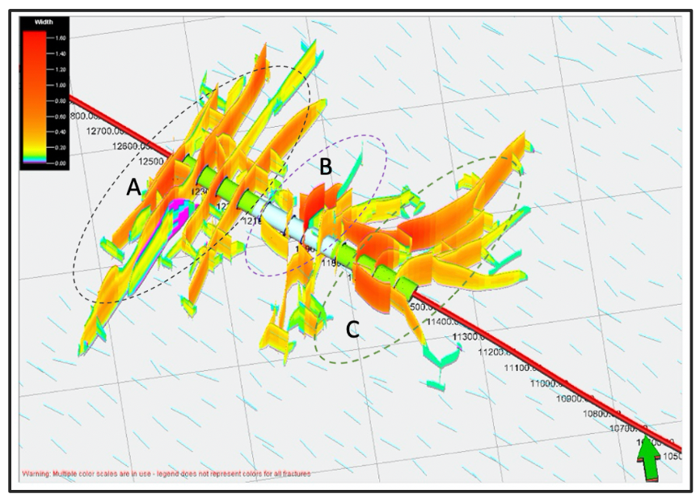
Hydraulic fracture network generated during first treatment stage, (b) Hydraulic fracture network developed during first and second treatment stage, and (c) Hydraulic fracture network generated during third treatment stage (Modified after Yew and Weng 2015)

Slide 7
Stress Rotation Assessment

Slide 8
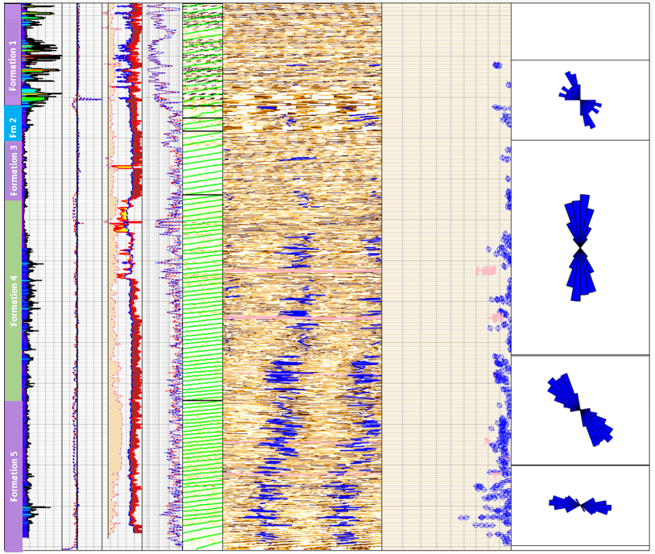
Horizontal stress rotation interpreted from image log in a vertical well

Slide 9
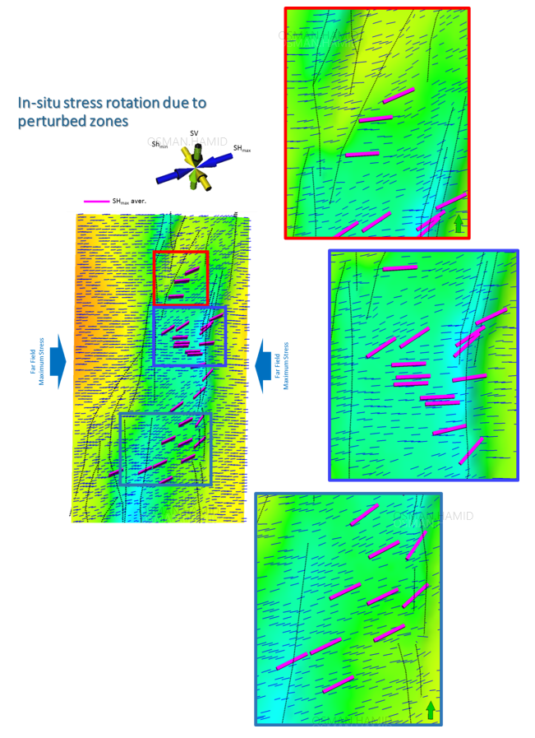
Regional horizontal stress rotation

Slide 10
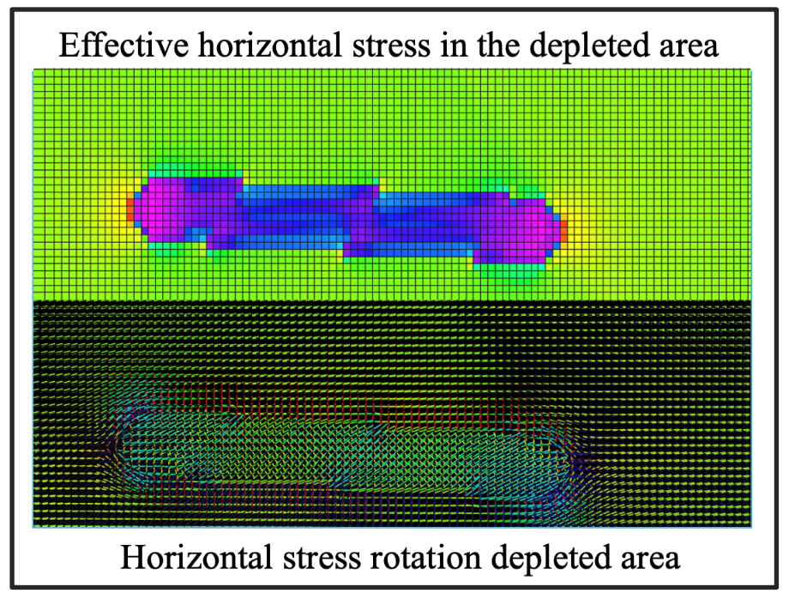
Horizontal stress rotation interpreted Finite Element Simulation

Slide 11
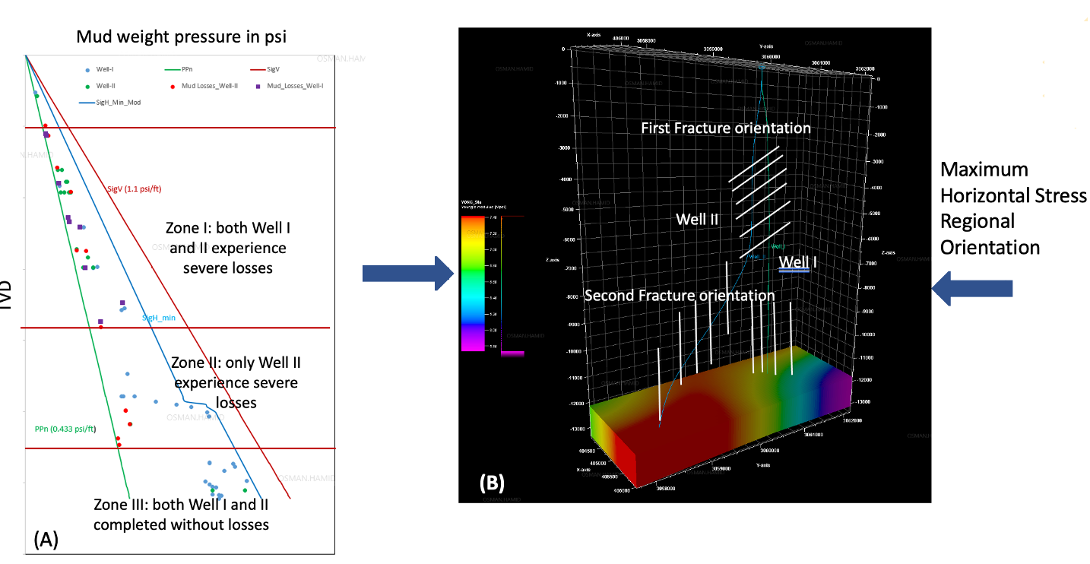
Horizontal stress rotation concluded from severe lost circulation while drilling

Slide 12
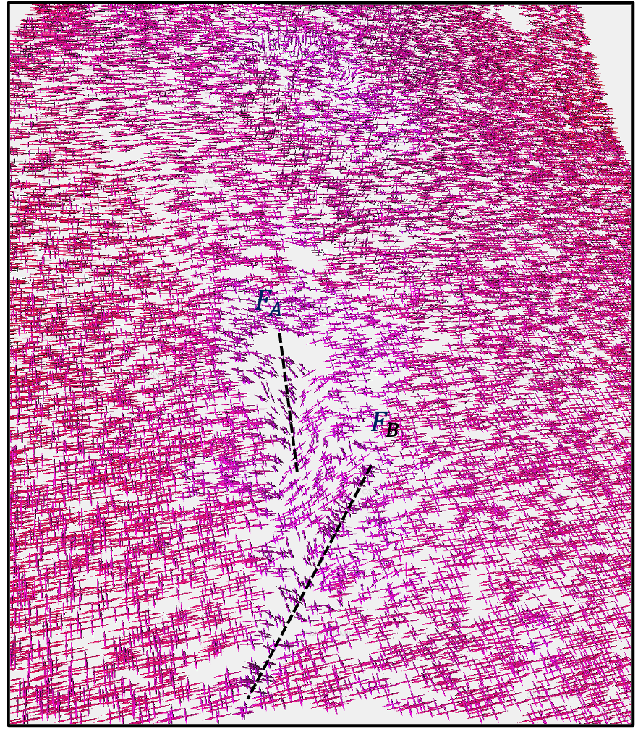
Horizontal stress rotation modeling using Finite Element

Slide 13
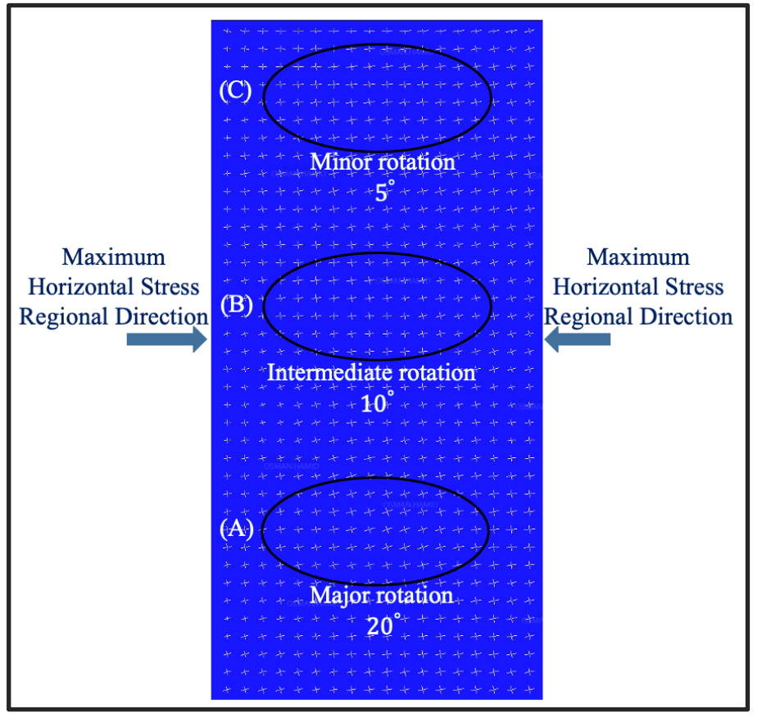
Horizontal stress rotation for three depletion scenarios

Slide 14
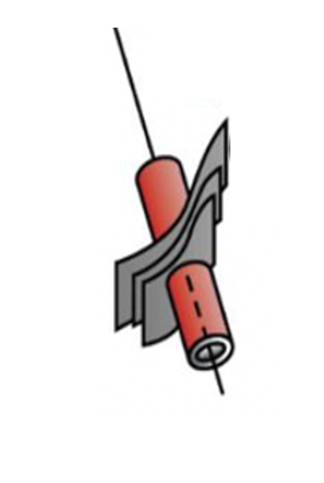
Impact of Stress Rotation on HF Propagation
Original direction of $σ_{Hmin}$
$${345}^{°}$$
$σ_{Hmax}$ rotated by
$${35}^{°}$$
Hydraulic fracture rotation following the new direction of $σ_{Hmax}$

Slide 15
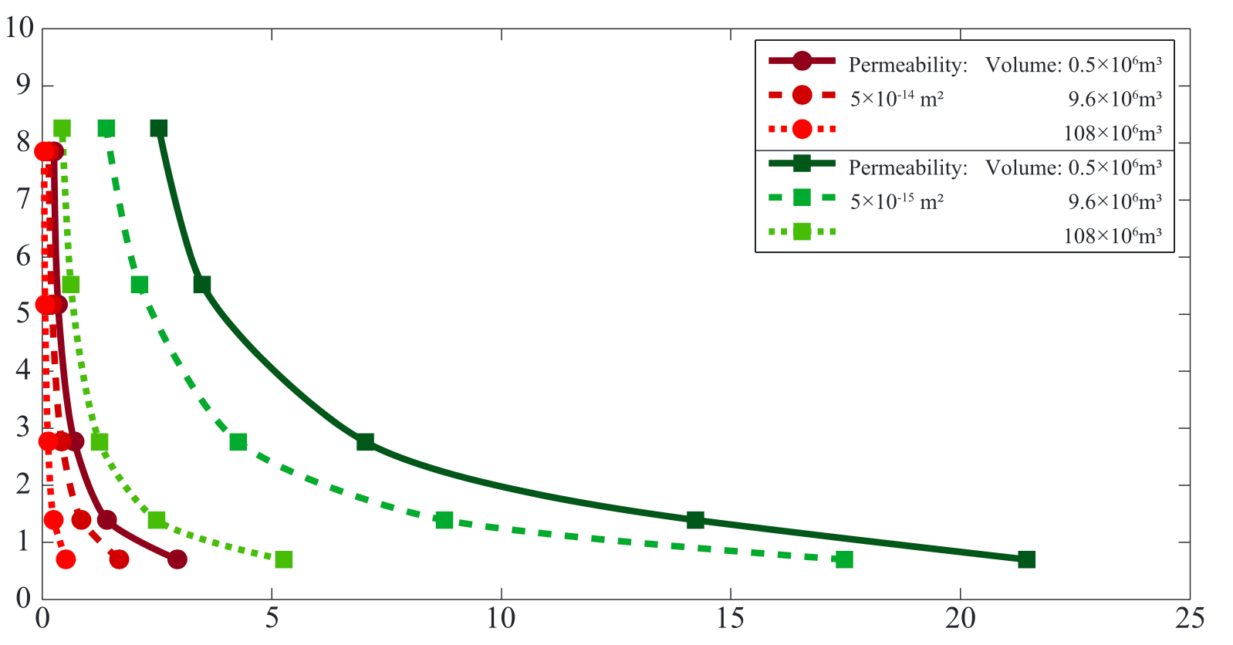
Relationship Between Permeability and Stress Rotation
$$\left(σ_{1}{−σ}_{3}\right) MPa$$
Stress Rotation $\left[°\right]$
Impact of stress re-orientation on field development
Ziegler et al. 2017

Slide 16
Conclusion and Recommendations
This research has investigated the horizontal stress rotations due to multiple tectonics events as indicated by circulation losses during drilling operations and depletion.
Finite Element Models have been conducted to characterize the stress rotation.
The orientation of the horizontal stresses (𝜎!) can be reoriented due to number of factors, including:
Multiple tectonic forces acting into a reservoir
Impact of hydrocarbon production or fluid/gas injection in high fractured/faulted areas
Impact of multi-stage hydraulic fracture that generated stress perturbation in the vicinity of the fractures.

