Slide 1
Relations between corporate economic performance, environmental disclosure and greenhouse gas emissions: New insights
MMBD1139
The 2nd International Conference on Modern Management based on Big Data (MMBD2021) (Nov. 8-11, 2021)
Omaima Hassan & Peter Romilly
Robert Gordon University & Ecmetrika Consultancy and Research

Slide 2
PUBLICATION
MMBD1139
This presentation is based on the following published paper:
Hassan OAG, Romilly P. (2018). Relations between corporate economic performance, environmental disclosure and greenhouse gas emissions: New insights. Bus Strat Env.,27:893–909. https://doi.org/10.1002/bse.2040
Correspondence:
Omaima Hassan
Email: o.hassan@rgu.ac.uk

Slide 3
The purpose of the study
MMBD1139
to examine the associations and causations between corporate economic performance (CEP),
environmental disclosure (CED) and greenhouse gas emissions (GHG), using a large, longitudinal,
multicounty dataset disaggregated between developed and developing countries.

Slide 4
MOTIVATIONS
MMBD1139
There is an extensive empirical literature on the associations between CEP, CED, and GHG. A review of this literature shows that it typically focuses on the pairwise relations between these variables, and use cross-section data for one country or, at best, a few countries.
However, if the three variables of interest are co-determined, prior findings are potentially biased (i.e., omitted variable bias).

Slide 5
MOTIVATIONS- Continued
MMBD1139
In addition, prior studies report mixed results which could be due to:
methodological and measurement problems in the constructs of interest;
lack of a temporal dimension in the data;
inadequate sampling procedures.
This results in inconsistent findings and inability to replicate and generalise these findings to different settings.
Furthermore*, there is a lack of research on the direction of causation between the variables of interest (Nollet, Filis, & Mitrokostas, 2016). There is, for example, a lack of direct empirical evidence on the impact of prior environmental disclosure on current environmental performance (Luo, Lan, & Tang, 2012; Matisoff, 2013; Lewis et al., 2014).
Notes:
* Please refer to the reference list in the paper for any cited paper in the slides.

Slide 6
RELATED LITURATURE
MMBD1139
Al-Tuwaijri et al. (2004) investigate the associations among corporate environmental and financial performance and disclosure; comparing the OLS estimations with 2SLS and 3SLS estimations.
They utilise a cross-sectional sample of 198 US ‘Standard & Poors 500’ firms.
They use a self-constructed disclosure index to measure the extent of environmental disclosure.
They measure environmental performance using the ratio of toxic waste recycled to total toxic waste generated. This measure is probably less representative of environmental performance for some firms than industry- specific measures. Additionally, it does not consider the relative toxicity of the waste being recycled, and aggregates all waste into one medium.

Slide 7
CONTRIBUTIONS
MMBD1139
Firstly, this study employs a simultaneous equation system to allow for potential endogeneity between CEP, GHG, and CED, an approach similar to that of Al-Tuwaijri et al. (2004), but utilising panel rather than cross-section data and a wider range of firm-level and country-level control variables.
Secondly, our time series data enables an analysis of the direction of causation between the key variables, a response to recent research calls by Walls et al. (2012) and Nollet et al. (2016).

Slide 8
CONTRIBUTIONS- Continued
MMBD1139
Thirdly, in contrast, the current study employs a measure of environmental disclosure which is available for a large number of companies and countries over multiple time periods.
Fourthly, we use a relatively new proxy for environmental performance, i.e., GHG emissions, which are acknowledged as one of the most important components of corporate environmental performance (Dragomir, 2012, p. 225).
Finally, in contrast to prior studies that focus on one or a few countries, our research model is estimated on a multi-country dataset disaggregated between developed and developing countries.

Slide 9
HYPOTHESES DEVELOPMENT
MMBD1139
H1: There is no association between environmental disclosure and environmental performance.
H2: There is no association between environmental performance and financial performance.
H3: There is no association between financial performance and environmental disclosure.

Slide 10
RESEARCH SAMPLE
MMBD1139
Our final sample includes a total of 1,607 firms with 9,120 firm-year observations from 45 countries worldwide, comprising 1,392 companies from developed countries (8,121 firm-year observations) and 215 companies from developing countries (999 firm-year observations).
Company-level data for this study are collected from Bloomberg database, whereas country-level data on GDP and corporate governance are from the World Bank. The date of enforcement of the Kyoto Protocol per country is collected from the United Nations website.

Slide 11
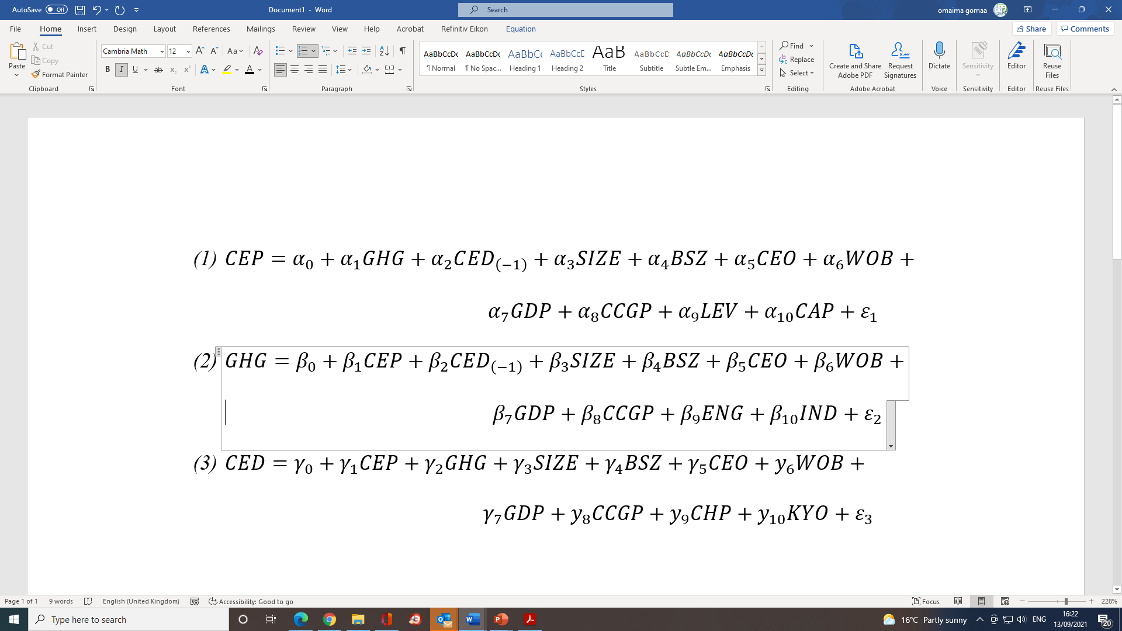
RESEARCH MODEL
MMBD1139

Slide 12
METHODOLOGY
MMBD1139
The associations between GHG, CEP and CED are examined by means of structural equations controlling for potential endogeneity and employing a range of control variables.
The pairwise-causations between GHG, CEP, and CED are examined by means of Granger-causality tests.

Slide 13
RESULTS- TESTS of ASSOCIATIONS
MMBD1139
 | Full Sample |  |  | Developed countries |  |  | Developing countries
Dependent variable | CEP | GHG | CED | CEP | GHG | CED | CEP | GHG | CED
CEP |  | -1.659 (0.234) | 11.616 (0.000) |  | -2.759 (0.062) | -10.645 (0.000) |  | -3.325 (0.085) | 14.716 (0.000)
GHG | -0.037 (0.000) |  | 0.258 (0.000) | -0.026 (0.000) |  | -0.119 (0.001) | -0.071 (0.007) |  | 1.380 (0.000)
CED(-1) | 0.014 (0.000) | 0.041 (0.007) |  | -0.015 (0.000) | 0.078 (0.000) |  | 0.044 (0.000) | 0.301 (0.000)
Controls
Intercept
S.E. of regression | 1.16 | 15.34 | 17.14 | 1.05 | 15.87 | 16.07 | 1.56 | 11.55 | 24.03
N | 7513 | 7513 | 7513 | 6729 | 6729 | 6729 | 784 | 784 | 784

Slide 14
RESULTS- TESTS of CAUSATIONS
MMBD1139
Null hypothesis | Full sample |  | Developed countries |  | Developing countries
 | Wald-stat. | Decision | Wald-stat. | Decision | Wald-stat. | Decision
Dependent variable: CEP
GHG does not Granger-cause CEP | 11.648ª (0.003) | Reject | 13.287ª (0.001) | Reject | 0.317 (0.854) | Accept
CED does not Granger-cause CEP | 9.271ª (0.010) | Reject | 15.041ª (0.001) | Reject | 2.592 (0.274) | Accept
GHG, CED do not Granger-cause CEP | 22.467ª (0.000) | Reject | 29.555ª (0.000) | Reject | 3.045 (0.550) | Accept
Dependent variable: GHG
CEP does not Granger-cause GHG | 0.714 (0.700) | Accept | 1.154 (0.562) | Accept | 0.988 (0.610) | Accept
CED does not Granger-cause GHG | 1.314 (0.518) | Accept | 0.513 (0.774) | Accept | 4.268 (0.118) | Accept
CEP, CED do not Granger-cause GHG | 2.100 (0.717) | Accept | 1.691 (0.792) | Accept | 4.925 (0.295) | Accept
Dependent variable: CED
CEP does not Granger-cause CED | 1.586 (0.453) | Accept | 3.838 (0.147) | Accept | 2.962 (0.227) | Accept
GHG does not Granger-cause CED | 10.065ª (0.007) | Reject | 5.253^{c} (0.072) | Reject | 21.929^{c} (0.000) | Reject
CEP, GHG do not Granger-cause CED | 11.294^{b} (0.024) | Reject | 8.952^{c} (0.062) | Reject | 23.806^{c} (0.000) | Reject
N | 6042 |  | 5452 |  | 590

Slide 15
CONCLUSION
MMBD1139
A robust result is that lower emissions are strongly associated with better economic performance.
After pretesting for stationarity, we find evidence of a one-way causation from emissions and environmental disclosure to economic performance, but no evidence of reverse causation.
We also find strong evidence of a one-way causation from emissions to disclosure, but no evidence of reverse causation.

Slide 16
IMPLICATIONS
MMBD1139
The overarching policy implication is that environmental performance, as measured by greenhouse gas emissions, plays a crucial role in the formulation of business strategy at the firm level and government environmental policy at national and international levels.

Slide 17
MMBD1139

