Slide 1
GAS FLOW MECHANISMS IN FRACTURED LOW PERMEABILITY RESERVOIRS Evans Ogoun, Florence Aisueni, Priscilla Ogunlude and Professor Edward Gobina Centre for Process Integration and Membrane Technology, School of Engineering, Robert Gordon University, Aberdeen AB10 7QB, UK Corresponding Author: E-mail: e.gobina@rgu.ac.uk; Phone: +44(0)1224262348

Slide 2
CONTENT OUTLINE
Introduction/overview
Aim
Materials and methods
Data summary
Results and discussion
Conclusion
Questions
Slide 1

Slide 3
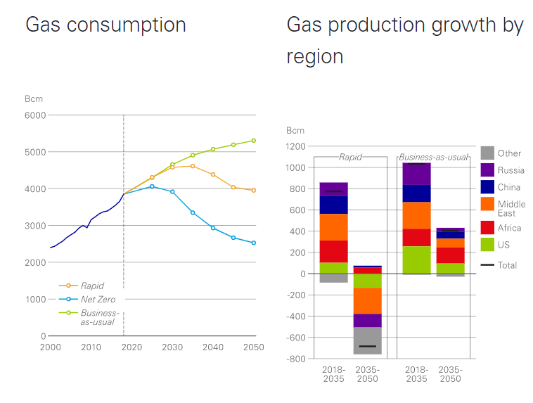
INTRODUCTION/OVERVIEW
Gas demand and production has enhanced the diversification of economic activities from oil, with United State of America, China and Middle East in full swing unconventional gas revolution.
Slide 2

Slide 4
INTRODUCTION/OVERVIEW
Unconventional gas reservoirs usually have very low matrix permeability, less than 0.1mD and a matrix porosity of less than 10%.
Unconventional reservoirs in most cases require hydraulic fracturing/fracking to liberate gas at economical quantity to the wellbore.
The reservoirs produce at a low flow rate under radial flow conditions without hydraulic fracturing, but after a successful fracture treatment the mechanism of the gas flow in the formation changes from radial flow to linear flow.
Slide 3

Slide 5
RESEARCH AIM
This research is designed to experimentally study the factors that influence the gas flow mechanism in low permeability reservoir.
Slide 4

Slide 6
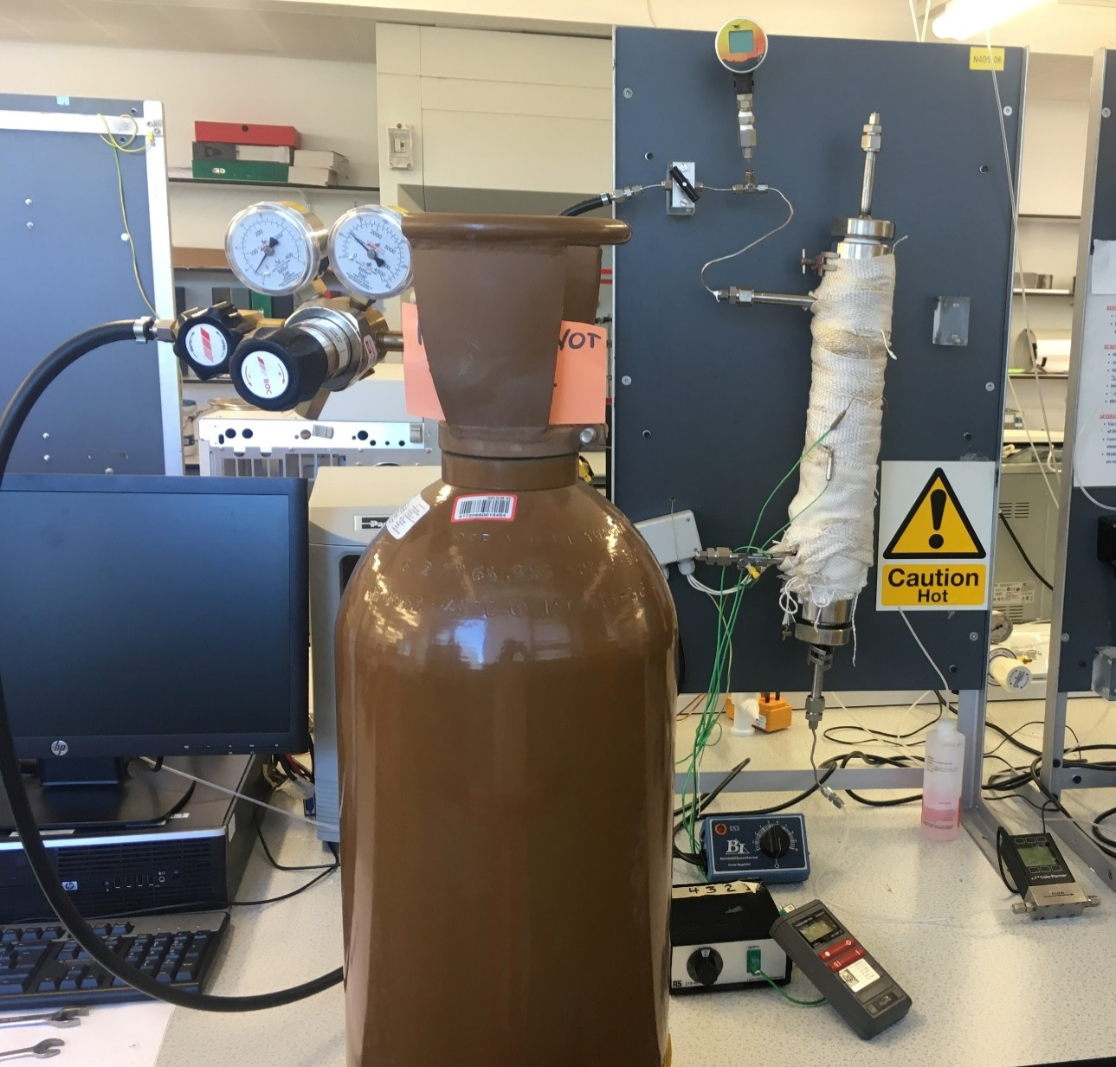
MATERIALS AND METHODS
(1) pressure gauge
(2) pressure valve
(3) gas regulator
(4) gas cylinder
(5) thermometer
(6) thermocouple transducer
(7) flow meter
(8) heat regulator
(9) heat jacket and
(10) core holder.
Slide 5

Slide 7
MATERIALS AND METHODS
Areal and cross-sectional view of membranes used
Experimental set-up
Slide 6

Slide 8
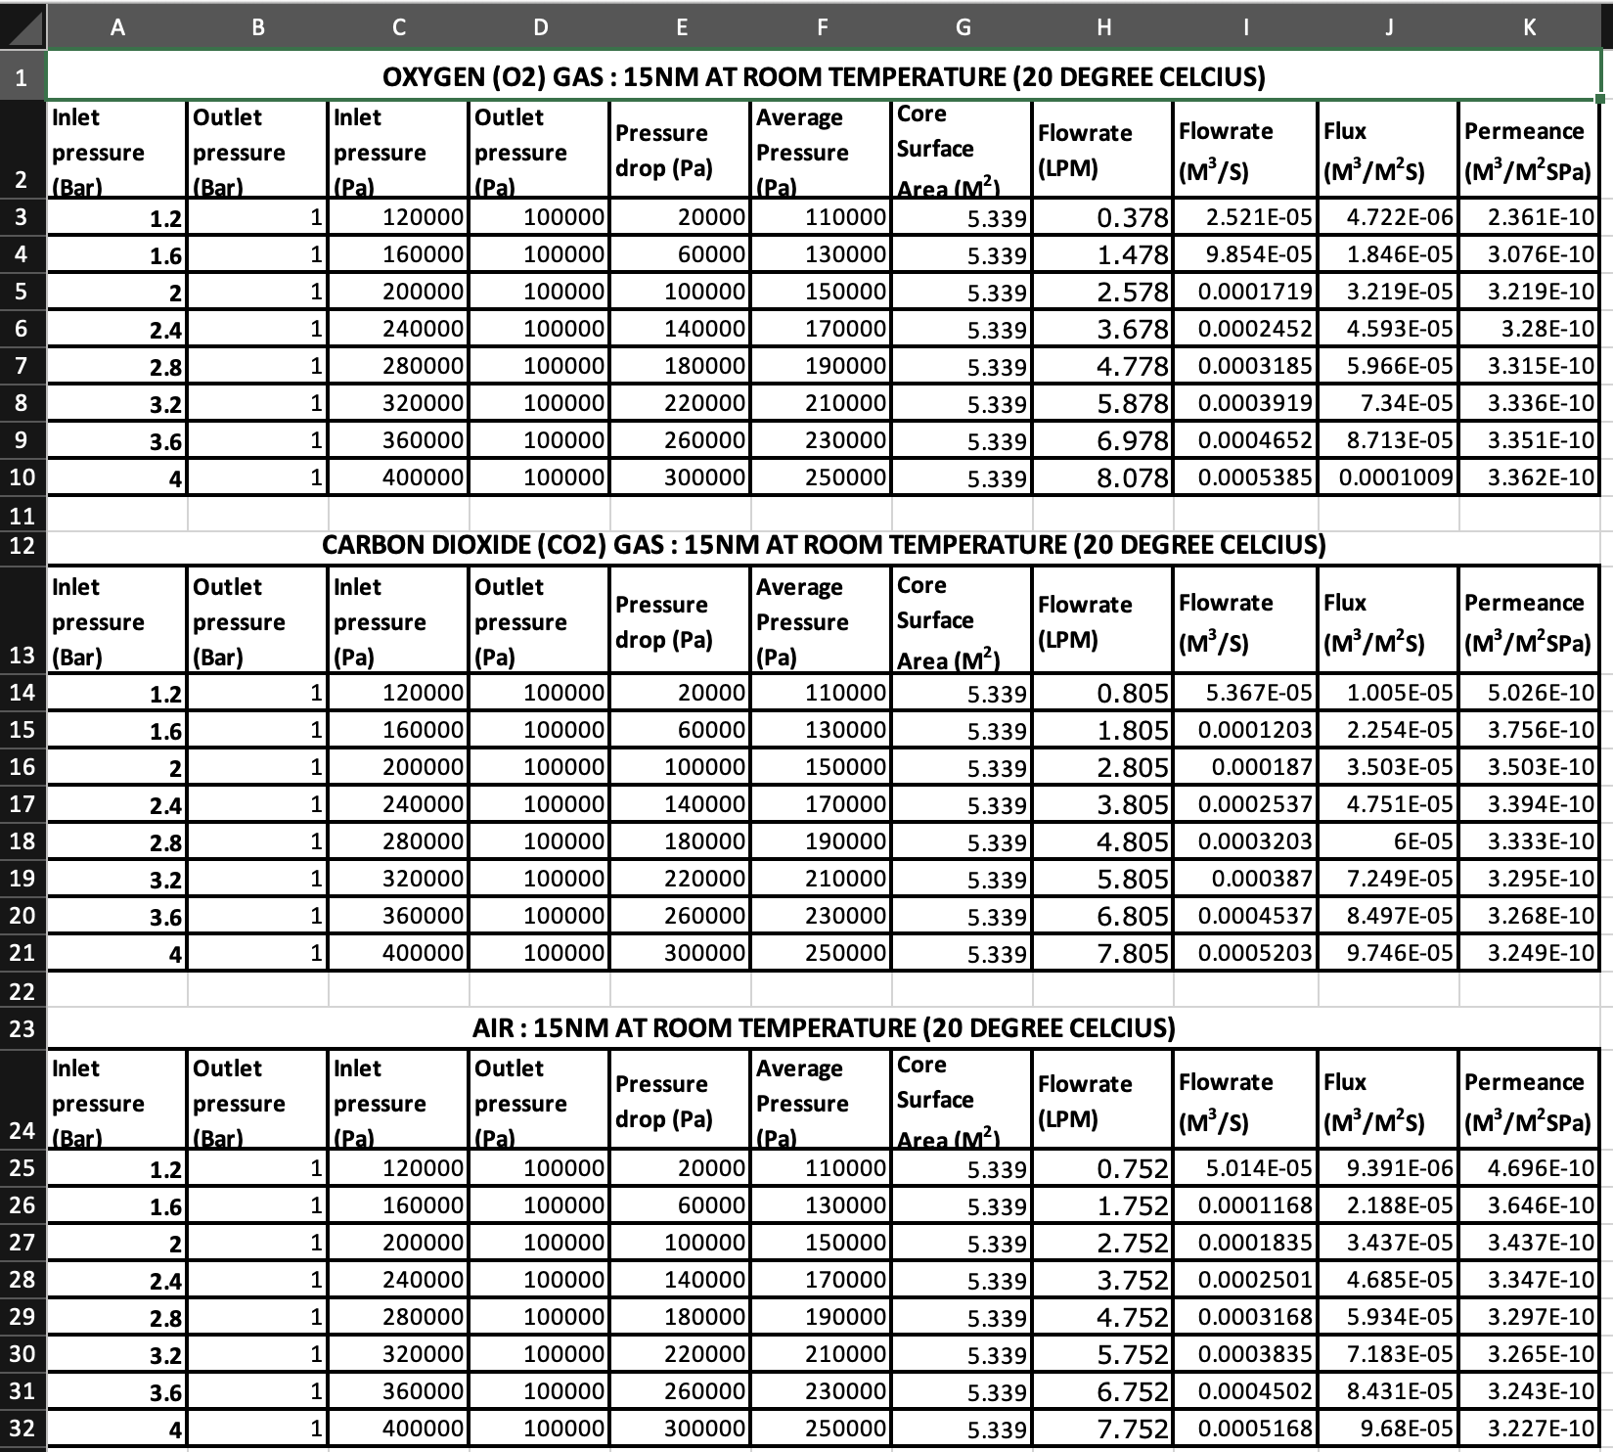
DATA SUMMARY
Slide 9

Slide 9
RESULTS/DISCUSSION
EFFECT OF PRESSURE DROP ON FLUX FOR THE DIFFERENT GASES AT ROOM TEMPERATURE.
Effect of pressure drop on flux for the different gases at room temperature
Effect of pressure drop on flux for the different gases at room temperature
Slide 10

Slide 10
RESULTS/DISCUSSION
EFFECT OF AVERAGE PRESSURE ON PERMEANCE FOR THE DIFFERENT GASES AT ROOM TEMPERATURE
Effect of average pressure on permeance for the different membranes at temperature 200º
Effect of average pressure on permeance for the different gas at room temperature
Slide 11

Slide 11
RESULTS/DISCUSSION
EFFECT OF PRESSURE DROP ON FLUX FOR THE DIFFERENT GASES AT ROOM TEMPERATURE AT DARCY’S REGION
In Darcy flow the proportionality constant κ, is called the Darcy permeability, and is used to characterize the porous medium. Thus, the Darcy formula for linear displacement is given by equation
q/A =Q = −κΔP/μδ
The flux Q was plotted against the pressure drop ΔP with the slop of the graph equals −κ/μδ
Slide 13

Slide 12
CONCLUSION
The matrix permeability of unconventional gas reservoir is usually very low, less than 0.1 milli Darcy and requires fracture treatment for effective productivity.
The long-term productivity of fractured gas reservoirs is directly controlled by the matrix flow and due to the low permeability of these reservoirs the flow velocity within the matrix tends to be very low
Gas flow behaviour for O₂, CO₂ and Air was analysed, and the results obeyed the criteria that governs low permeability unconventional reservoirs by dividing the flow stages into Darcy (linear) and Non-Darcy (radial) flow.
The Darcy region was investigated to establish the absolute permeability and how fluid viscosity affects the rate of flow. The results indicates that gases with higher viscosity tends to have lower flow rate. Confirming Darcy’s equation that permeability of a porous medium is inversely proportional to the viscosity of the fluid.
Slide 14

Slide 13
Thank you for listening

