Slide 1
Effect of Hydrodynamic & Microstructural parameters on Ceramic Membrane for Oil-in-water Separation
By
Florence Aisueni, Edward Gobina
Robert Gordon University

Slide 2
Outline
Introduction
Aim
Experimental
Result
Discussion
Conclusion & further work
References

Slide 3
Introduction
Industrial activities has increased continuous generation of oily wastewater all over the world.
The removal of oil from water has been explored by several methods which includes, electrochemical, biological, UV irradiation, hybrid technologies, coagulation & flocculation as well as the use of membrane technologies
ceramic membranes used for the treatment of water and wastewater has an asymmetric microstructure containing a dense active layer at the top and relatively porous large particle size substrate under

Slide 4
Aim
This research aims to determine the effect of microstructure and hydrodynamics in relation the permeability or water flux in ceramic membrane for the usage of oil-in-water emulsion separation.
Measure porosity of unmodified membrane
Determine pore size of unmodified membrane using N2 adsorption/desorption
Measurement of contact angle of membrane with Attension Thetalite
Determine permeate flux using cross-flow microfiltration rig set up

Slide 5
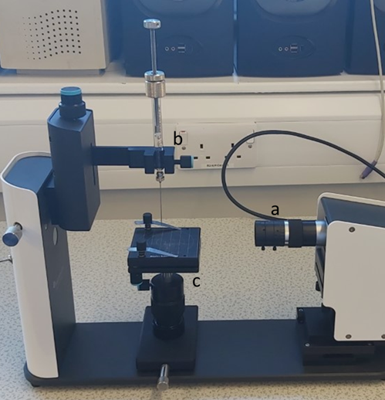
experimental
To determine the overall porosity (Ɛ) of unmodified 6000nm ceramic membrane, the equation one below was used:
$ε\left(\%\right)=\left(\frac{W_{w}−W_{d}}{d_{w }x V}\right)×100$
To observe the surface hydrophilicity of the unmodified ceramic membrane and compare with existing literature, contact angle (CA) was determined with the Attension Thetalite meter
In the process of microfiltration experiment, membrane permeate flux (J, L/m2 h) was calculated by the equation below:
$J= \frac{Q_{p}}{A × t}$

Slide 6
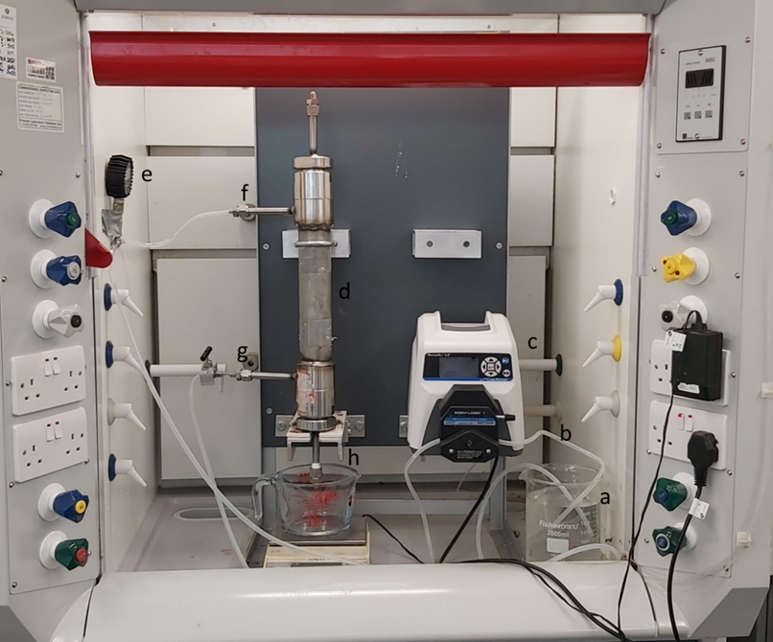
Experimental continued…
Crossflow microfiltration rig set up
Image of a homemade crossflow rig setup: a-feed tank, b-tubing, c-peristaltic pump, d-membrane module, e-pressure gauge, f-membrane module inlet, g-retentate, h-permeate

Slide 7
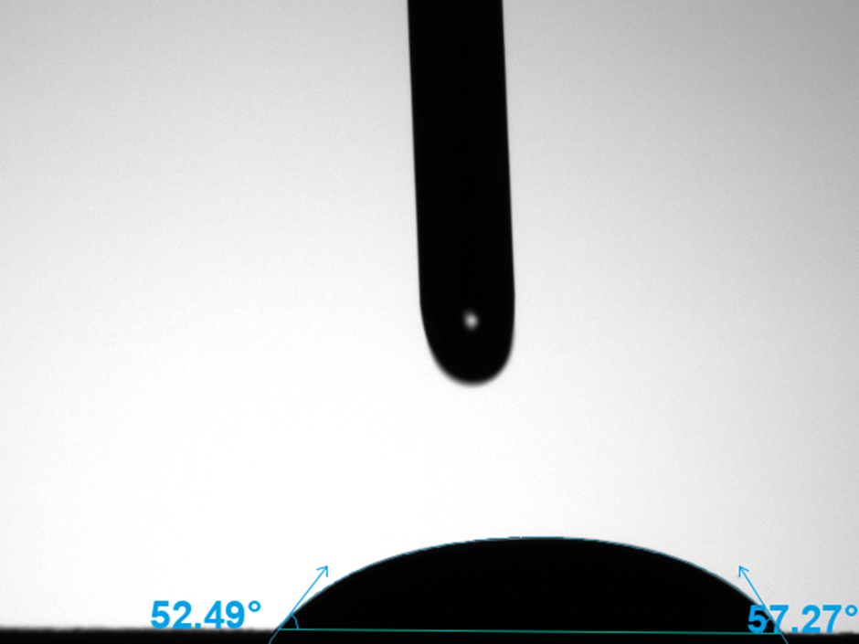
Results
The porosity of the 6000nm unmodified ceramic membrane was calculated to be 23%.
The mean contact angle of unmodified 6000nm ceramic membrane at 0.2 milliseconds is about 54.88⁰

Slide 8
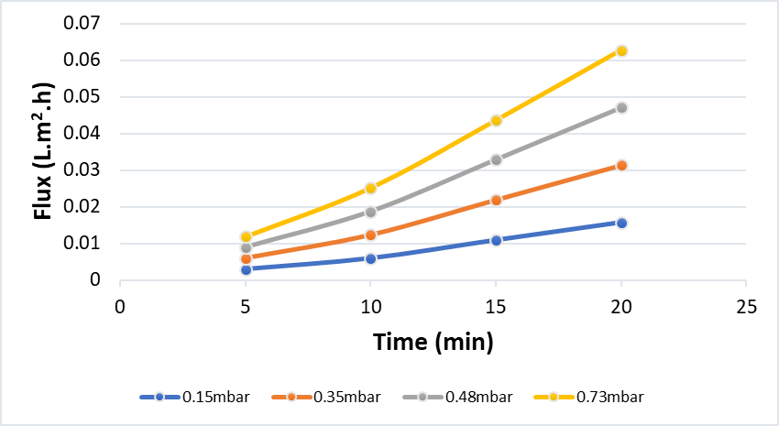
Result Continued…
Permeate flux against time of unmodified 6000nm ceramic membrane at four distinct pressure drop in cross-flow mode of microfiltration for pure water feed

Slide 9
Discussion
The porosity result calculated is similar to porosity of 6000nm unmodified ceramic membrane found in literature. Although for the separation of O/W emulsion CM might have to be modified to increase porosity.
This result indicates that the unmodified 6000nm ceramic membrane is not very hydrophilic and as such might require some modification to be more hydrophilic and suit the separation of oil-in-water emulsion.
As illustrated the ceramic membrane permeate flux was in ascending order of 15 > 35 > 48 > 73mbar. Indicating that an increase in pressure will increase flux over time.

Slide 10
Conclusion and Further work
Porosity of unmodified 6000nm ceramic membrane been 23%, contact angle and are factors that can affect permeate flux
The higher the porosity and contact angle, the higher the permeate flux
Increase in pressure of feed during microfiltration increases permeate flux.
Further Work:
O/W emulsion will be prepared and used as feed in place of pure water to determine the porosity, contact angle and flux of 6000nm for the purpose of comparison.
6000nm ceramic membrane will be modified with nanoparticles such as iron oxide to determine effect on contact angle, porosity and permeate flux.

Slide 11
References
BOLTO, B. et al., 2020. A Review on Current Development of Membranes for Oil Removal from Wastewaters. Membranes, 10(4), pp. 65
PENDERGAST, M.M. and HOEK, E.M., 2011. A review of water treatment membrane nanotechnologies. Energy & Environmental Science, 4(6), pp. 1946-1971
SURESH, K. and PUGAZHENTHI, G., 2017. Cross flow microfiltration of oil-water emulsions using clay based ceramic membrane support and TiO2 composite membrane. Egyptian journal of petroleum, 26(3), pp. 679-694
YUAN, Y. and LEE, T.R., 2013. Contact angle and wetting properties. Surface science techniques. Springer. pp. 3-34

Slide 12
Thank you

