Slide 1
Gas Injection Power Requirements in Gas Enhanced Oil Recovery (EOR)
By
Dr Ofasa Abunumah, Priscilla Ogunlude, Prof Edward Gobina
Centre for Process Integration and Membrane Technology
School of Engineering
The Robert Gordon University, Aberdeen, UK
December, 2021.

Slide 2
Table of Content
Research Overview
Methodology
Phase 1- Data Mining
Phase 2- Experiments
Coupling of Phase 1 and 2
Conclusion

Slide 3
Overview
These gases distinctive characteristics might couple with the reservoirs geological settings differently, such that the compressor ratings (power and size) required to achieve a certain compression and displacement would differ from gas to gas and from one reservoir layer to another.
The aim of the study is to identify the gas and geological settings that enable compressor ratings optimisation in gas EOR processes.
Globally, 70% of oil droplets are trapped in layers of reservoir pores. 10-40% of the trapped oils can be displaced by gases (CH₄, N₂, Air, CO₂) in an immiscible gas enhanced oil recovery (IGEOR) process.
Research Rationale

Slide 4
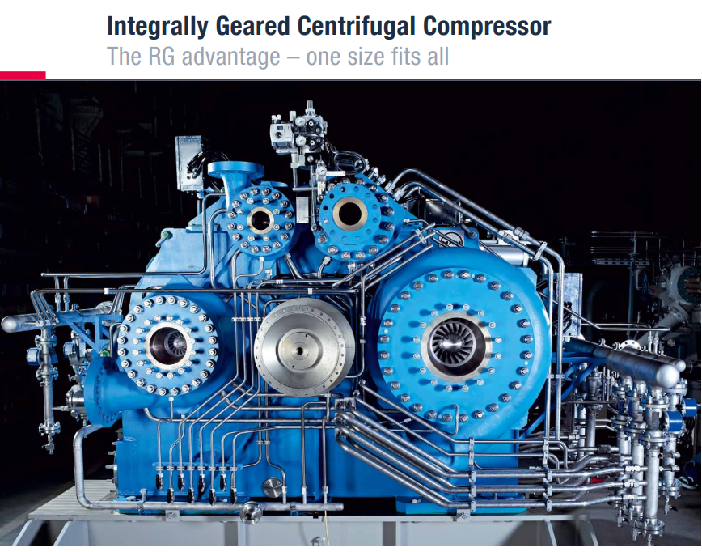
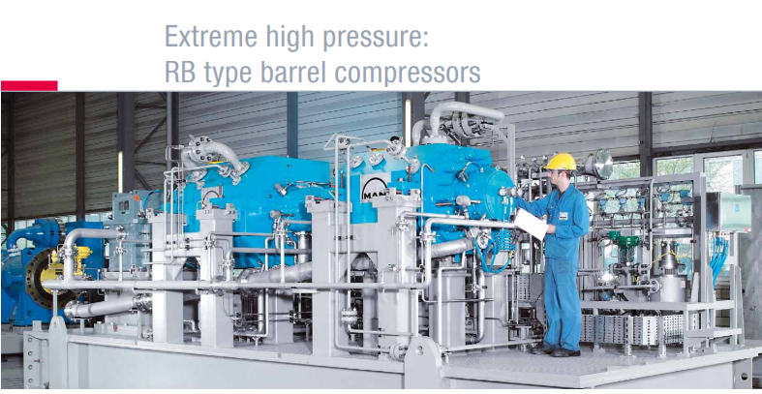
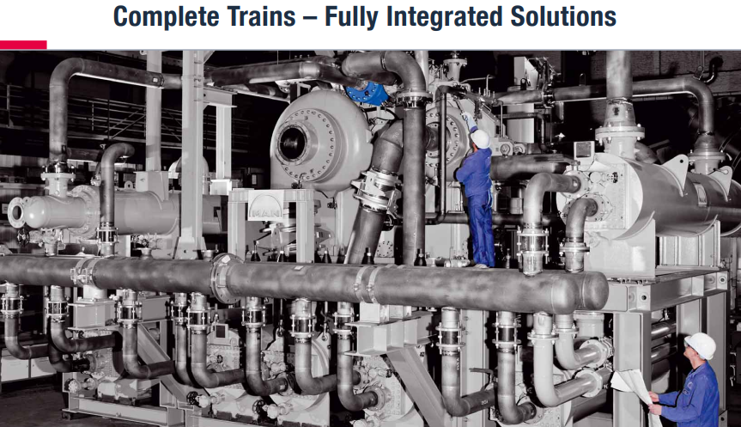
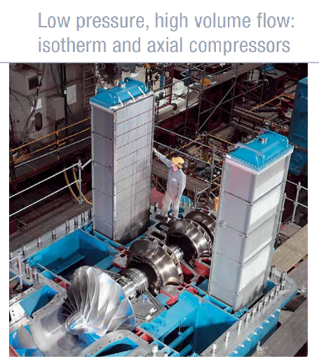
Overview
Figure 1 Showing different types, ratings and sizes of compressors ranging from 4 to 10 stages, with speed and pressure requirements ranging from 8,000-48,000rpm and 20-180bar. Powered by electric motor.
According to what is known of fluid dynamics and porous media parameters, it is expected that the coupling of these two would inform the required compressor specification for effective injection and gas-oil displacement in EOR projects
Source: https://mandieselturbo.com/docs/default-source/shopwaredocuments/forward-thinkinge37da7a0c5b64851b3175821c9acdc8a.pdf?sfvrsn=6

Slide 5
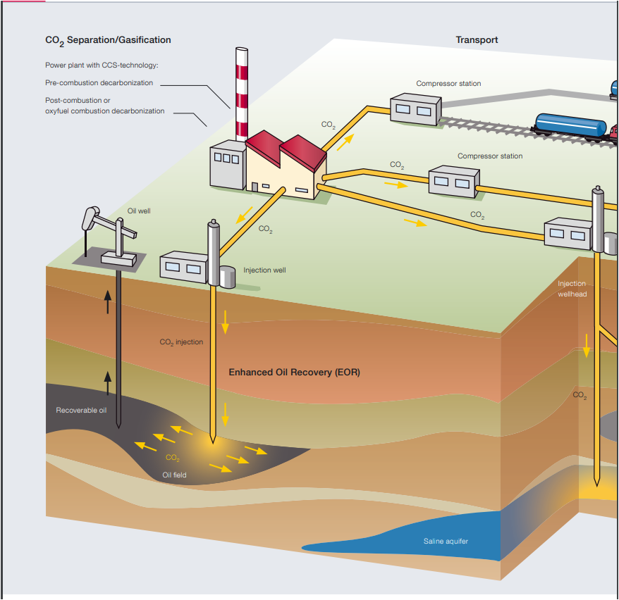
Overview
Figure 2 The layout for CO₂ gas injection show the compressor station is a major unit in EOR projects, hence a significant economic and technical centre, such that it affects:
Power cost
Well density
Injection direction
Gas cost
Recovery efficiency
Source: https://mandieselturbo.com/docs/default-source/shopwaredocuments/forward-thinkinge37da7a0c5b64851b3175821c9acdc8a.pdf?sfvrsn=6

Slide 6
Methodology
Stages
Objective
Method
# Theories, principles and practices that describe fluid dynamics .
# Identify quantities (Structural and Fluid), functions and indicators relevant for the acquisition and evaluation of CRs in EOR processes.
# Characterise gas EOR reservoirs by identified quantities, functions and indicators.
# Determine degree of functional and parametric relationships.
# Design gas experiments to measure CRs indicators.
# Characterise EOR gases by measured indicators and determine their Competitiveness.
Literature Review
Data Mining
Gas Experiments

Slide 7
Fluid Dynamics
Law & Theory
Darcy’s Law
Fick's Law
Bernoulli’s Law
Practice & Application
Enhanced Oil/Gas Recovery
Gas Separation
Catalytic Reaction
Water treatment
Insulation
Ideal Gas Law
Hagen- Poiseuille’s Law
Knudsen
Carbon Caption and Storage

Slide 8
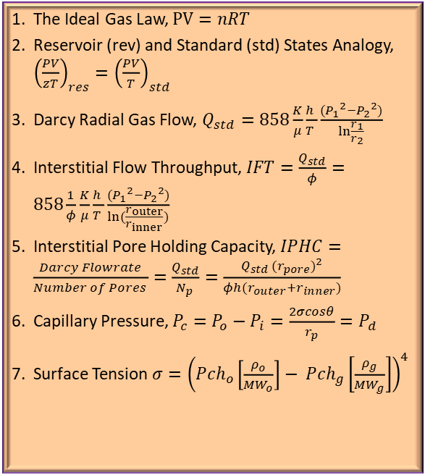
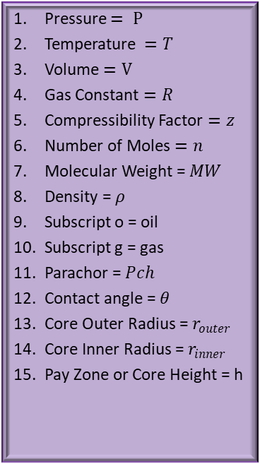
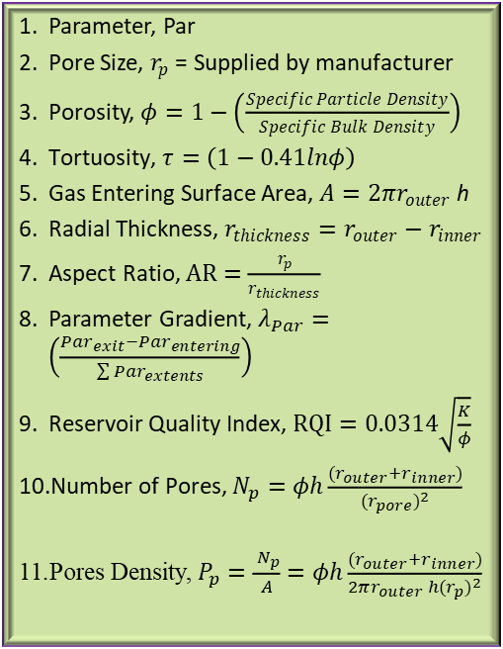
Quantities, Functions and Indicators
A: Fluid Quantities
B: Structural Parameters (Geological and Geometrical)
C: Parametric Functions (Fluid and Engineering)
Pressure $= P$
Temperature $=T$
Volume $=V$
Gas Constant $=R$
Compressibility Factor $=z$
Number of Moles $=n$
Molecular Weight = $MW$
Density = $ρ$
Subscript o = oil
Subscript g = gas
Parachor = $Pch$
Contact angle = $θ$
Core Outer Radius = $r_{outer}$
Core Inner Radius = $r_{inner}$
Pay Zone or Core Height = h
Parameter, Par
Pore Size, $r_{p}$= Supplied by manufacturer
Porosity, $φ=1−\left(\frac{Specific Particle Density}{Specific Bulk Density}\right)$
$\text{Tortuosity}\text{,} τ=\left(1−0.41lnφ\right)$
Gas Entering Surface Area, $A=2πr_{outer}$h
Radial Thickness, $r_{thickness}=r_{outer}−r_{inner}$
Aspect Ratio, $AR=\frac{r_{p}}{r_{thickness}}$
Parameter Gradient, $λ_{Par}=\left(\frac{{{Par}_{exit}−Par}_{entering}}{\sum{{Par}_{extents}}}\right)$
Reservoir Quality Index, $RQI=0.0314\sqrt{\frac{K}{φ}}$
Number of Pores, $N_{p}=φh\frac{(r_{outer}+r_{inner})}{{(r_{pore})}^{2}}$
Pores Density, $P_{p}=\frac{{ N}_{p}}{A}=φh\frac{(r_{outer}+r_{inner})}{2πr_{outer} h{(r_{p})}^{2}}$
The Ideal Gas Law, $PV=nRT$
Reservoir (rev) and Standard (std) States Analogy, ${\left(\frac{PV}{zT}\right)}_{res}={\left(\frac{PV}{T}\right)}_{std}$
Darcy Radial Gas Flow, $Q_{std}=858\frac{K}{μ}\frac{h }{T }\frac{({P_{1}}^{2}−{P_{2}}^{2})}{\ln{\frac{r_{1}}{r_{2}}}}$
Interstitial Flow Throughput, $IFT=\frac{Q_{std}}{φ}=858\frac{1}{φ}\frac{K}{μ}\frac{h }{T }\frac{({P_{1}}^{2}−{P_{2}}^{2})}{\ln{(\frac{r_{outer}}{r_{inner}}})}$
Interstitial Pore Holding Capacity, $IPHC=\frac{Darcy Flowrate}{Number of Pores }=\frac{Q_{std}}{N_{p} }=\frac{Q_{std} {(r_{pore})}^{2}}{φh(r_{outer}+r_{inner})}$
Capillary Pressure, $P_{c}=P_{o}−P_{i}=\frac{2σcosθ}{r_{p}}=P_{d}$
Surface Tension $σ={\left({Pch}_{o}\left[\frac{ρ_{o}}{{MW}_{o}}\right]− {Pch}_{g}\left[\frac{ρ_{g}}{{MW}_{g}}\right]\right)}^{4}$

Slide 9
Evaluation Method
Evaluation
Compressor ratings (Power and Size) are functions of the injection pressure, energy and momentum required for gas-oil displacement to occur in an EOR process and reservoir.
Capillary Pressure (CP) and Displacement Pressure (DP) can effectively be adopted as the Indicators of injection pressure in laboratory scale.
Indicators & Description
Capillary Pressure (CP): Minimum pressure required to overcome fluid flow resistance in a porous or reservoir media.
Displacement Pressure (DP): Minimum pressure required to displace fluid (gas) through a porous media.
Data Acquisition
Capillary pressure is obtained from global EOR field data using parametric function.
Displacement pressure is experimentally determined from the intercept of the backward extrapolation of the graph of Injection Pressure vs Flow Rate.
CP and DP are technically equal and are influenced by similar properties such as pore size.

Slide 10
Method Summary
Objective Function:
Compressor Ratings
Adopted Indicators:
Capillary Pressure (CP) and Displacement Pressure (DP)
Optimisation Extrema Requirements:
Minima CP and DP
EOR Competitiveness- Lowest CP
Gas Competitiveness- Lowest DP

Slide 11
Phase 1: Data Mining Results
From Figure 3 the following can be deduced:
Gas EOR reservoirs can be characterised by capillary pressure.
The mean values of the respective gas CPs indicate that reservoir implementing CH₄ EOR process requires the least pressure, hence the least CRs.
While Air requires the most CRs.
The most clustered capillary pressure is Air. The coefficient of variation (CV) suggest that Air is the most sensitive to compressor rating selection.
N₂ has the highest CV, hence the least sensitive to compressor rating selection.
Consequently, the competitive Ranking for CRs in the field data:CH₄ > N₂ >CO₂ >Air.
The data mining outcome thus gave the impetus for the experimental design.
Figure 3 Scatter plots of the CP profiles of the respective gas EOR processes implemented in 450 reservoir projects.

Slide 12
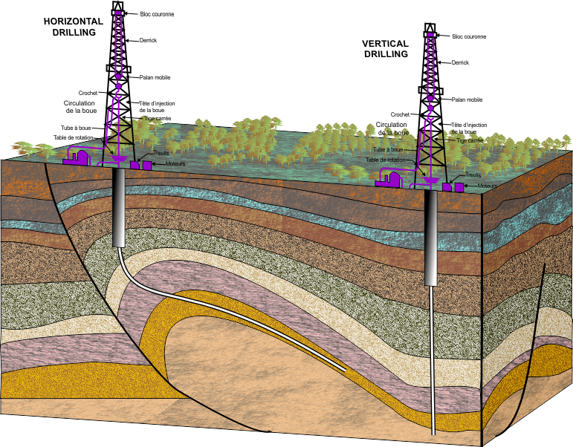
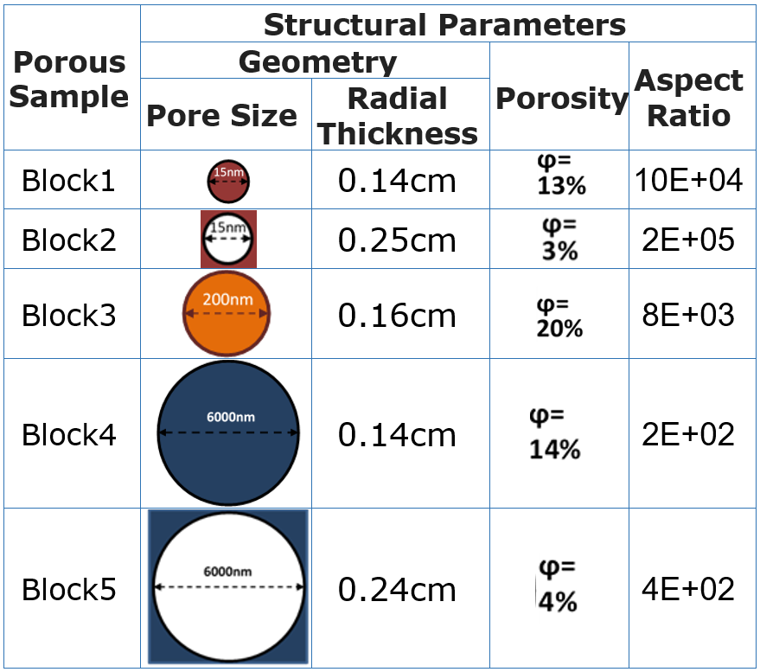
Phase 2: Media Structural Parameters
Table 1 Showing 5 porous samples used in the experiment and their structural characteristics representing of 5 geological layers.
Figure 4 Showing reservoir geological layers with different structural parameters that leads to structural rhythms and gradients that may affect CP and DP.

Slide 13
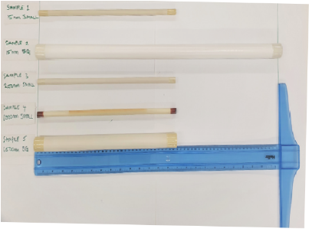
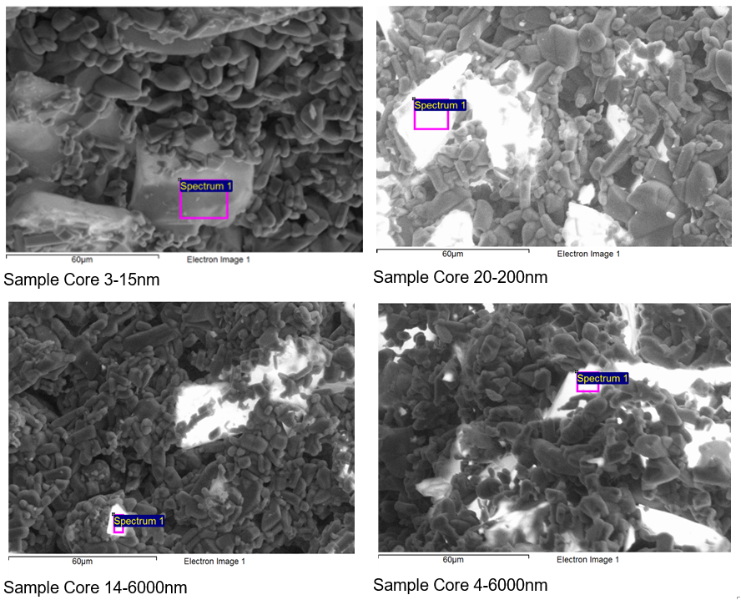
Phase 2: Media Structural Parameters
Figure 5 Showing 4 of the porous core samples (Sample 2, 3, 4 and 5), their relative dimensions and their EDXA morphologies.

Slide 14








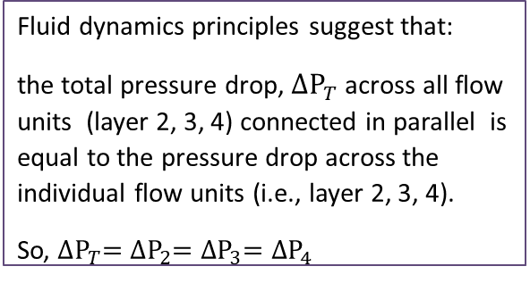

Phase 2: Connections & Configurations
Figure 6 Showing 5 reservoir layers with geological sections (yellow highlights) that are representative of parallel (A) and series (B) flow connections and structural configurations with distinct pressure profiles. The pressure profile influences the compressor ratings.
Fluid dynamics principles suggest that:
the total pressure drop, ${∆\text{P}}_{T}$across all flow units (layer 4, 3, 2) connected in series is the summation of pressure drop across the individual flow units (i.e., layer 4, 3, 2).
So, ${∆\text{P}}_{T}=\sum_{i}^{3}{{∆\text{P}}_{i}}={∆\text{P}}_{4}+{∆\text{P}}_{3}+{∆\text{P}}_{2}$
$${∆\text{P}}_{T}$$
$${∆\text{P}}_{4}$$
$${∆\text{P}}_{3}$$
$${∆\text{P}}_{2}$$
$${∆\text{P}}_{T}$$
Fluid dynamics principles suggest that:
the total pressure drop, ${∆\text{P}}_{T}$across all flow units (layer 2, 3, 4) connected in parallel is equal to the pressure drop across the individual flow units (i.e., layer 2, 3, 4).
So, ${∆\text{P}}_{T}={∆\text{P}}_{2}={∆\text{P}}_{3}={∆\text{P}}_{4}$
$${∆\text{P}}_{2}$$
$${∆\text{P}}_{3}$$
$${∆\text{P}}_{4}$$

Slide 15
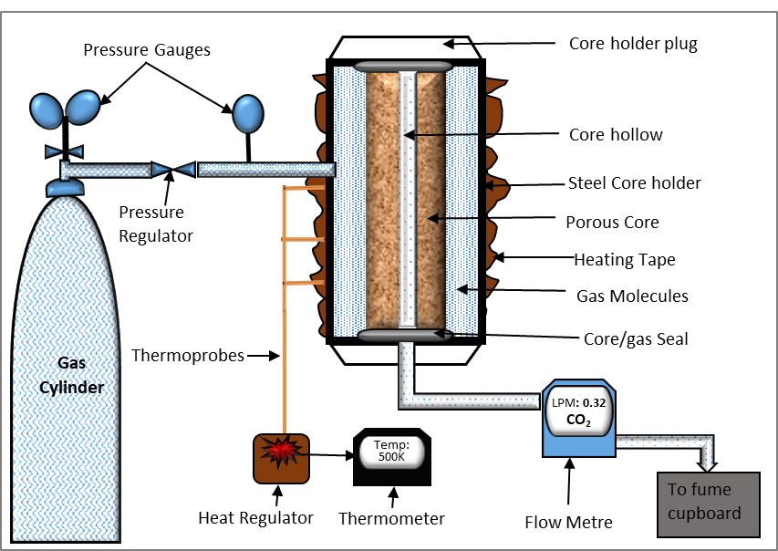
Phase 2: Gas Experiments
Procedure:
Gas is injected into porous media setup at constant pressure and core temperature. Permeation rate records are taken at steady state and 1atm.
Operating Condition:
Temperature range 293-673K
Pressure range 20-300KPa
Experimental Data:
1,097 runs.
8,777 data points.
Figure 7 schematic of experimental set up.

Slide 16
Phase 2: Experimental Results
The bar chart in Figure 8 indicates that CO₂ consistently required the least DP in Sample 2,3,4, and 5. Hence satisfying the extremum criteria of minimum CRs.
Sample 1 has the least coefficient of variation (CV). Furthermore, CH₄ and N₂ have the least DPs. The outcome in Sample 1 could be due to transport mechanism, such as the Knudsen characterisation, thereby allowing the fluid flows to be influenced by the respective gas molecular weights.
The CV is relatively high for Sample 4 (6000nm) and 5 (6000nm). The high CV values suggest that Sample 4 and 5 have the most significant DP discrimination for the gases. Therefore implying that pore size is a critical factor that influence the respective gas CRs.
Figure 8 Showing the DP profiles in samples 1,2,3,4 and 5 and the degree of DP discrimination by each sample.

Slide 17
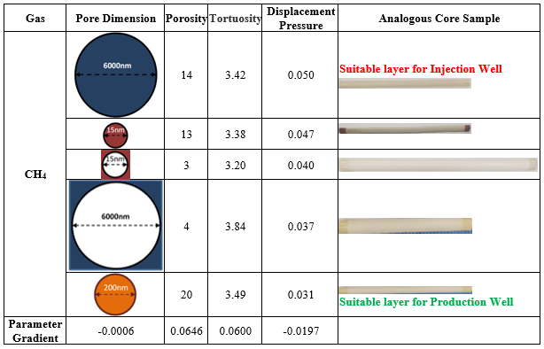
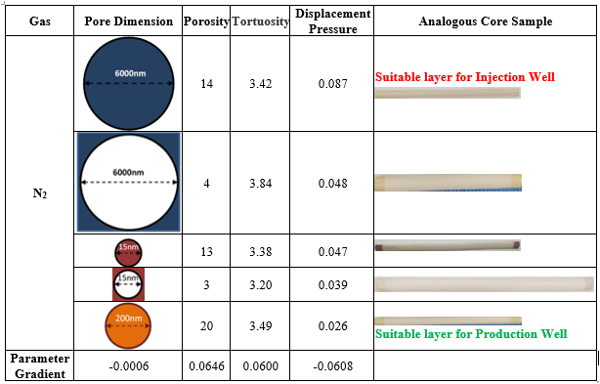
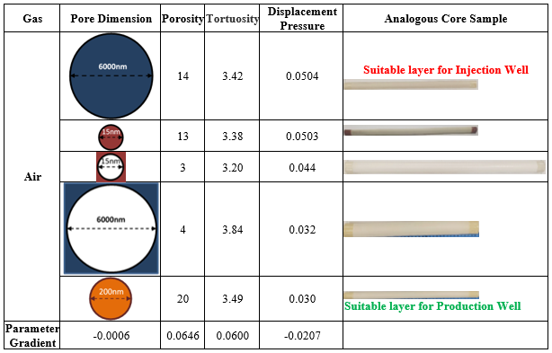
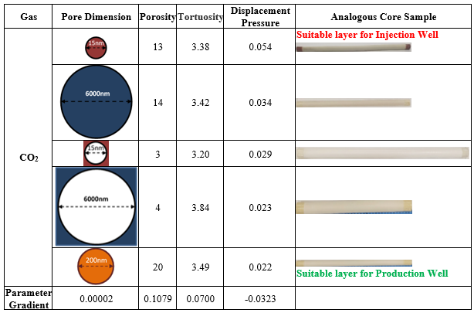
Phase 2: Experimental Results
It is observed in Figure 9 that the respective gases optimise DP via different compound structural routes or rhythms.
The structural gradients and well topologies for N₂ and CH₄ are similar, but the rhythms are different. CH₄ and Air share the same structural approach (rhythm, gradient and topology).
CO₂ has a unique structural approach.
For all gases, the layer with 20% porosity is the most suitable for placing the production well.
a
b
c
d
Figure 9 Showing the structural approaches (rhythms and gradients) that optimise CRs for (a) CH₄, (b) N₂, (c) Air, (d) CO₂.

Slide 18
Coupling of Phase 1 & 2 Results
The scatter plots in Figure 10 offer a qualitative and quantitative comparison of field and experimental data in a heterogeneous reservoirs settings.
The mean values of the gas DP suggest N₂ requires a relatively high CRs, while CO₂ requires the least ratings. Therefore, CO₂ is the most competitive gas for heterogeneous system.
In the two graphs, the CV analyses shows Air injection power rating is the most affected by structural variability or reservoir heterogeneity.
a
b
Figure 10 Show the displacement pressure profile for (a) gas EOR processes by data mining and (b) EOR gases by experimental method.
Consequently, experimentally determined competitive Ranking for CRs:
CO₂ >Air > CH₄ > N₂
Data Mining determined competitive Ranking for CRs:
CH₄ > N₂ >CO₂ >Air

Slide 19
Conclusion/Contribution/Recommendation
The competitive ranking for compressor power and sizing requirements is experimentally determined as:
CO₂ >Air > CH₄ > N₂
Knowledge: Study can be directly applied in selecting gas and screening reservoirs for GEOR processes to minimise power cost.
Practice: Facilitates engineers’ selection of gas based on process objectives, reservoir structural heterogeneity & rhythm.
Two-phase study of oil and gas is encouraged.

Slide 20
Thank you
for
Listening

