Slide 1
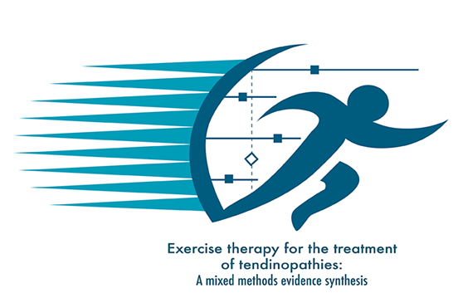
Exercise therapy for the treatment of tendinopathies: A scoping review
Alexander L, Morrissey D, Swinton P, Pavlova A, Moss R, Shim J, Harrison I, Greig L, Parkinson E, MacLean C, Mitchell L, Brandie D, Tzortziou Brown V, Cooper K
This project is funded by the National Institute for Health Research (NIHR) [HTA - Project: NIHR129388]. The views expressed are those of the author(s) and not necessarily those of the NIHR or the Department of Health and Social Care.
K Cooper & L Alexander are Director and Deputy director (respectively) of Scottish Centre for Evidence-based Multi-professional Practice: a JBI Centre of Excellence

Slide 2
Background & research question:
JBI Scoping Review Methodology¹
Participants – all tendinopathy, any age, gender
Concept – Exercise
Context – Any setting, Very high HDI²
9 databases; 5 trial registries; 6 grey literature sources
1998-2020; all languages
Iterative data extraction
Synthesis guided by ICON health related domains & TIDieR checklist
Tendinopathy is common
Exercise is most common treatment.
Need for mapping of evidence to inform research and evidence synthesis
Review question:
What evidence has been reported on exercise interventions and outcomes for the treatment of tendinopathy?
22,550 studies identified
555 included (119 SR; 436 primary)

Slide 3
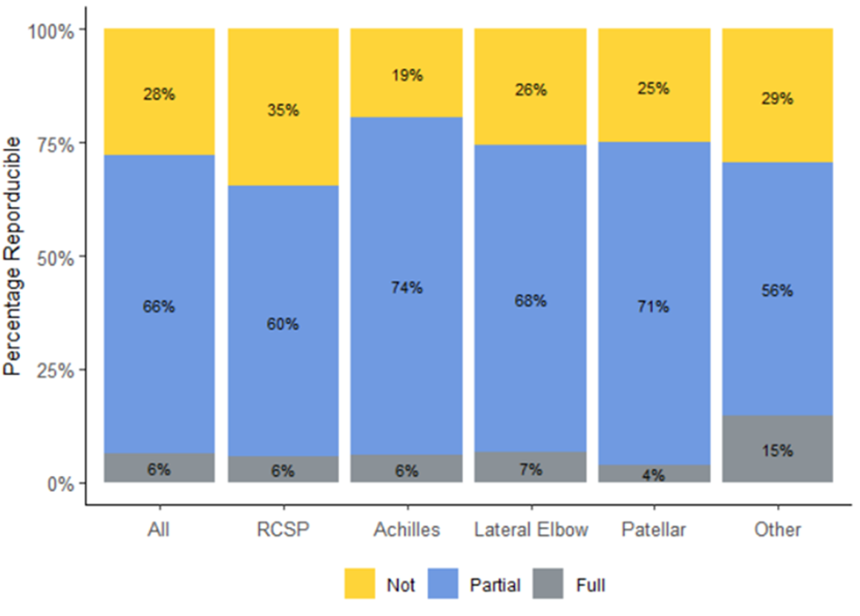
Results
25,490 participants, mean age range 15-65 years
Main tendinopathies: rotator cuff, achilles, patellar & lateral elbow
66% partially reproducible
28% not reproducible
Reproducibility of exercise across tendinopathy (TIDieR checklist)

Slide 4
Results
Adherence – planned 152 (35%), reported in 89 (20%)
Self report
Mean adherence range 16-100%, average 77%
Varied subjective ratings for “excellent”, “good”, “moderate”, “Poor”
Outcomes
Disability most common domain – rotator cuff, achilles & patellar
Physical function capacity – lateral elbow
Most common outcome tools – VAS, VISA scales, SPADI, Dynamometer, goniometer, CMS, DASH, Ultrasonography, PRTEE, NPRS

Slide 5
Conclusion
Research recommendations:
Transparent participant reporting
Compliance with reporting checklist required esp adherence
Capturing Lived experience of patient (& practitioner)
Conduct adequately powered studies
First comprehensive map of exercise for tendinopathy and outcomes reported
Lyndsay Alexander: l.a.alexander@rgu.ac.uk
@lynzalexander
@Ex4Tendinopathy

