Slide 1
Greenhouse gas emissions, corporate environmental policy and disclosure
Omaima Hassan
Robert Gordon University, UK

Slide 2
Purpose
This study explores whether and how corporate environmental policies (CEPs) influence greenhouse gas emissions intensity (GHG) and/or voluntary environmental disclosure (CED).

Slide 3
Importance
This study is important for two reasons:
  Firstly, if corporate environmental policies are proven to be effective in tackling environmental issues, protecting the natural environment, and enhancing corporate transparency, then less or no regulatory intervention would be needed.
  Secondly, prior empirical literature on the effect of environmental legislations and international frameworks on corporate environmental performance have reported mixed results, which implies that regulatory intervention might not be always effective in tackling environmental issues, protecting the natural environment, and enhancing corporate transparency.

Slide 4
Motivations
  1) The link between environmental policies and greenhouse gases:
    The empirical evidence on this link is inconclusive.
    Most of the empirical evidence is gathered using survey method.
    Small sample size and either fails or is unable to consider the dynamics of this relationship.
    country focused which hinders the generalisability of their results.
    Most of the evidence so far is about an indirect relationship.

Slide 5
Motivations- Con.
2) The link between environmental policies and environmental disclosure:
  relatively few prior studies exist, with no prior attempt to investigate the dynamics of such a relationship.
  Most prior studies on environmental disclosure utilise subjective self-constructed disclosure indices and textual analysis studies, which make the results of these studies hard to replicate and compare.

Slide 6
Contributions
The current study investigates the dynamic direct relationship between corporate environmental policies and GHG for a large longitudinal multi-country sample using historical data which makes the results of this study generalisable and replicable.
The current study is a direct response to recent research calls (Trumpp et al., 2015; Albertini, 2017; Dragomir, 2018) to examine the relationship between the managerial dimension and the operational dimension of corporate environmental performance.

Slide 7
Contributions- Con.
The current study uses Proprietary Bloomberg environmental disclosure score which is available for numerous companies and countries worldwide, which allows the results of this study to be replicable and comparable.
The temporal aspect of the novel dataset allows for studying the dynamics of the interrelationships among the variables of interest, in contrast to cross-sectional studies.

Slide 8
Related literature and hypotheses development
1) Corporate environmental management and greenhouse gas emissions intensity
According to the neo-institutional theory, proactive environmental performers adopt environmental policies to drive actions to reduce GHG. Alternatively, reactive environmental performers might adopt environmental policies to discharge their environmental responsibility without reducing GHG.
A review of the empirical evidence also shows mixed results. Accordingly, the current study tests the following non-directional null hypothesis:
H1: There is no significant association between corporate environmental policy and greenhouse gas emissions intensity.

Slide 9
Related literature and hypotheses development
2) Corporate environmental management and environmental disclosure
According to the neo-institutional theory, proactive environmental performers might try to distinguish themselves from passive environmental performers by providing more environmental disclosure voluntarily. Alternatively, passive environmental performers might try to defend or preserve their legitimacy through cheap talk.
The empirical evidence, although limited, also indicates a positive association between corporate environmental management practices and environmental disclosure, accordingly the current study tests the following hypothesis:
H2: There is a positive association between corporate environmental policy and disclosure.

Slide 10
Research sample
The study utilizes a novel sample of S&P Global 1200 companies from 2009 to 2017, which allows international reach. The initial sample consists of 1187 companies with 10683 firm-year observations.
Due to missing observations on the different variables in the research model, the final common sample consists of 899 companies with 6835 firm-year observations from 29 countries worldwide. When two lags of the variables of interest are introduced to the analysis, the common sample size is further reduced to 4776 firm-year observations.

Slide 11
Research method
It employs vector autoregression (VAR) analysis, a non-structural approach, to model the relationships among the variables of interest and address potential endogeneity problem, and Granger causality tests to indicate the direction of causation.

Slide 12
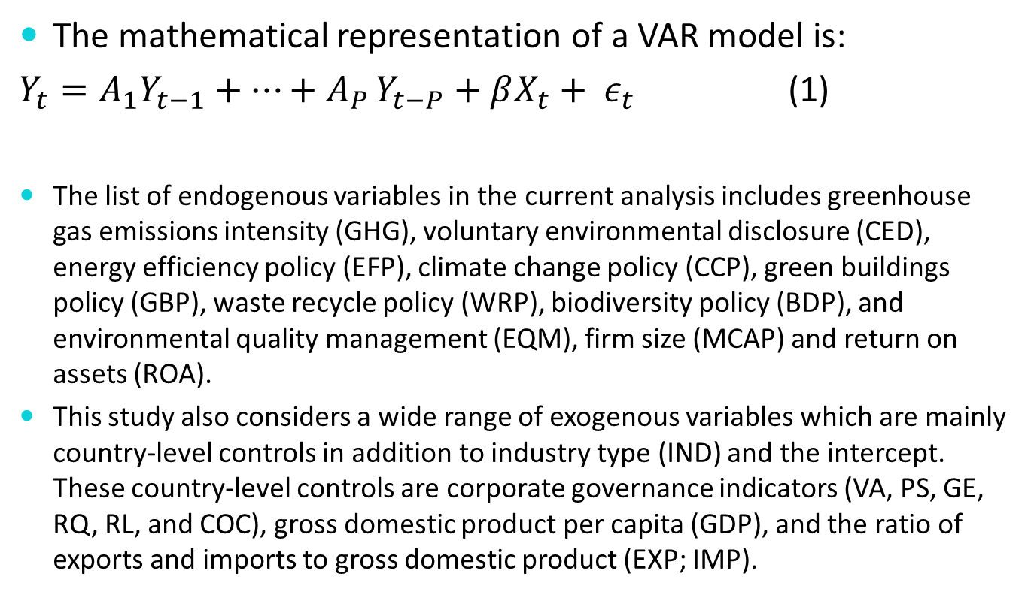
Research Model
The mathematical representation of a VAR model is:
$Y_{t}=A_{1}Y_{t−1}+…+A_{P }Y_{t−P}+βX_{t}+ ε_{t}$ (1)
The list of endogenous variables in the current analysis includes greenhouse gas emissions intensity (GHG), voluntary environmental disclosure (CED), energy efficiency policy (EFP), climate change policy (CCP), green buildings policy (GBP), waste recycle policy (WRP), biodiversity policy (BDP), and environmental quality management (EQM), firm size (MCAP) and return on assets (ROA).
This study also considers a wide range of exogenous variables which are mainly country-level controls in addition to industry type (IND) and the intercept. These country-level controls are corporate governance indicators (VA, PS, GE, RQ, RL, and COC), gross domestic product per capita (GDP), and the ratio of exports and imports to gross domestic product (EXP; IMP).

Slide 13
Results
After pretesting for stationarity, the VAR results show that corporate environmental policy does not influence GHG or CED.
However, the results from Granger-causality tests show some bilateral causations between GHG and each of GBP and WRP, and between CED and WRP. While there is no evidence of a one-way causation from CEPs to GHG, there is a strong evidence of a reverse causation from GHG to CEPs such as CCP, BDP and EQM.
Likewise, while there is limited evidence of a one-way causation from CEPs to CED, there is a strong one-way causation from CED to CCP, BDP and EQM.

Slide 14
Conclusions and implications
The influence of corporate environmental policies on GHG and/or CED is not homogenous across all environmental policies but rather dependent on the type of environmental policy under investigation.
There are some bilateral causations between GHG and each of GBP and WRP, and between CED and WRP. This can be further investigated in future studies to see the structure of such a relationship and whether we can use this to derive actions to reduce GHG and improve CED.

Slide 15
Conclusions and implications- Con.
There is no evidence of a one-way causation from CEPs to GHG, but there is a strong evidence of a reverse causation from GHG to CEPs such as CCP, BDP and EQM. Likewise, there is limited evidence of a one-way causation from CEPs to CED, but there is a strong one-way causation from CED to CCP, BDP and EQM. These results suggest that most corporate environmental policies are potentially used to discharge environmental responsibility rather than to derive actions to improve the extent of GHG and/or CED.

Slide 16
Thank you!
Any questions?

