Slide 1
Low-income parents’ perspectives and experiences of engaging with early years health professionals about financial challenges and income maximisation.
Flora Douglas¹, Emma MacIver¹, Tracy Davis², Chris Littlejohn²
f.douglas3@rgu.ac.uk
May 2022
Robert Gordon University: School of Nursing, Midwifery and Paramedic Practice, Aberdeen, Scotland
NHS Grampian Public Health Directorate , Aberdeen, Scotland

Slide 2
Study rationale and aims
Child Poverty Act 2017
- Child Poverty Action Plans 2018-2022
- Tackling Child Poverty Delivery Plan 2022-2026
Investigation of early implementation of the Financial Inclusion Pathway within the NHS Grampian area in relation to clinical practice, and the experience of care.
Low-income parents’ perspectives and experiences of engaging with early years health professionals about financial challenges and income maximisation
Every Child, Every Chance: The Tackling Child Poverty Delivery Plan 2018-22 (www.gov.scot)
Supporting documents - Best Start, Bright Futures: tackling child poverty delivery plan 2022 to 2026 - gov.scot (www.gov.scot)
Notes:
Background
In a similar vein to wishing to understand health professionals experiences of the FIP, this element of the study was concerned to understand parents’ perspectives about the acceptability or impact of this initiative in relation to its aim.

Slide 3
Methods
Interview topics
household context
their perspectives and experiences of financial issues conversations during routine health care
perspectives of the benefits and possible negative consequences of the FIP concept
Interviews were transcribed and thematically analysed FD and EMacI.

Slide 4
Participant Profile
12 mothers of children under one year of age or pregnant and living on their own
2 women lived with a partner.
11 lived in Aberdeen City
8 participants unemployed, 2 worked full-time, 1 part-time and one was on maternity leave from work.
2 participants were seeking work and one was taking a year out from university
Most were claiming Universal Credit.
Recruited via family nurse partnership practitioners and health visitors - interviews - spring and summer of 2021.

Slide 5
Main themes identified
Living with poverty
Experiences of help with financial matters
Discussing financial issues risks
Raising the issue
Perceived intervention benefits

Slide 6
Discussing financial issues risk(s)
Budgeting and going without
Fear of embarrassment
Living with debt
Child protection concerns
Food insecurity
Partner’s income affecting benefit entitlements
Fear of exacerbating abusive relationships
I've got a few letters saying that I'm supposed to paying £100, I think it was £127 per month.....and now I've got a balance that says £586.80 is paid within 14 days....of this letter, which I got today...or, my debt will be passed to the Sheriff’s Office for collection… so, they've done this without a phone call, without notifying me through text or phone….because I don't even, you know, I can't, I can't afford that.
I was working actually when I was pregnant, pregnant......I was working until, I think it was eight and a half months really......erm, and because of the abuse......abusive relationship I was in, I wasn't almost allowed to talk to anyone about anything. So, it would've been difficult to bring up finances and things…..so, it was purely about, purely about pregnancy
Notes:
Recurrent themes associated with parent’s careful budgeting to make ends meet and going without food and other personal expenditures as a related coping strategy, featured in the current study.
This is a recurrent theme from a study of low-income family’s experiences of parenting on a low income in Aberdeen City that I was commissioned to undertake in 2020.
Personal experiences of food insecurity and concerns about the nutritional quality of the food they could feed their children, were also commonly reported in thins study as it was in 2020.
However, admissions of living with debt featured more prominently in this study compared to the previous study.
Having insufficient income to cover the costs of living, council tax and other debt associated with overpayment of benefits due to changed circumstances stories, were commonplace.
Struggling with challenging debt repayment plans stories were also commonplace.
Financial disempowerment due to the impact of a partner’s income of the women/mother’s eligibility for benefits was also a more obvious theme compared to the previous study.
Critically …participants expressed there were or could be significant personal risks associated with disclosing financial hardship to health professional.
These included it raising child protection concerns, - leading to referral so social services, exacerbating existing abusive partnership relationships and the fear of associated shame and embarrassment experienced in admitting hardship. These acted as powerful barriers to raising or discussing the issue.
It is notable that professional participants are also sensitive and aware that parents might experience those challenges too.

Slide 7
Raising the issue
COVID
Whose responsibility?
Continuity of carer
Positive referral assessments
Unmet need when finance is not discussed
Mixed picture re referral agency experiences
Trust and rapport
Positive framing of benefits claiming
I've, erm, asked for advice before from the Citizen's Advice and it's just, it wasn't what you expected kind of thing. So, I just haven't......approached them since.
well I mean, I think it's seems really appropriate that it's a midwife, cause I suppose you're kind of like, you're going through that pregnancy journey with them and, you know, it's probably when you worry about these kind of things the most
Notes:
For the few clients who had had experience of conversations and support from their health professionals about financial issues, those were reported to be positive and appreciated by those individuals concerned.
There is a mixed picture about the benefits gained by parents from those financial services consulted or referred on to.
Client’s experiences about not finding out about entitlements until after they became ineligible, and theirs and health professional participants ‘concerns about ‘newly poor’ parents and their lack of knowledge and expertise in claiming social assistance indicates unmet need in this client group.
In terms of parent participant’s thoughts about their recommendations that would enable conversations about financial challenges with health professionals – having carer continuity, building trust and rapport, and framing conversations about claiming benefits as a positive parenting act, featured prominently.
Whose responsibility it should be to raise this issue in the first place, from parents’ perspectives’, is less clear. A few indicated that they did not think it should be the professional who should raise it as it would cause embarrassment. Others were more inclined to view it as a professional responsibility.

Slide 8
Perceived intervention benefits
Changing public perceptions – reducing stigma
Raising awareness - benefits entitlements
First time, young and lone parents
pregnancy is never easy anyway, and if you're a young mother, or you don't have the support, or you don't have the finance, know what I mean, it is nice to talk I think having someone to talk about finances to, and just to give you a clearer head is beneficial…because people, and, people would rather suffer in silence, know what I mean, how much people go without food or, their kids, know what I mean, go without heating because they are too scared to ask for the help.., I'd maybe be more willing to tell them then maybe like, oh, look, I'm really struggling
Notes:
There was strong support amongst our parent participants for FIP concept associated with health professionals discussing financial matters.
In terms of Perceived benefits of the FIP included: reducing stigma associated with claiming benefits.
Raising awareness about benefit entitlements was linked to reducing the likelihood of missing the opportunity to gain more income during pregnancy and the early post childbirth period.
Perceived particularly beneficial to first time parents, lone parents, and young parents as illustrated in this quote – which talks about the tendency of people to remain silent about their financial struggles.

Slide 9
Discussion/Conclusions
Study limited by sample profile - valuable insights to compare with health professionals’ associated views and experiences.
Health visitors and family nurse partnership practitioners good sources of help and support regarding financial challenges.
Less clear about midwives’ role but…… getting financial and benefits advice as early as possible in pregnancy or early childbirth was recommended as key to gaining maximum benefits entitlements.
Perceptions of problems arising after disclosing financial difficulties to health professionals …is a barrier to conversations that could lead to a financial advice referral.

Slide 10
Discussion/Conclusions
Establishing trust and rapport, careful and sensitive enquiry, positive framing of income maximisation and carer continuity are perceived to aid discussion of financial challenges.
Unclear and mixed picture regarding hard outcomes associated with the Financial Inclusion Pathway income maximisation intent.
Meanwhile, insufficient household income, debt-caused-by-deductions and experiences of food insecurity remain significant challenges for lone parents and those on low incomes.
Findings are important in light of the 2022-2026 Child Poverty Delivery Plan, the socio-economic COVID fall out and the current cost of living crisis.

Slide 11
Questions arising from the study
1. What advice are parents receiving who are not in the social security system and / or may not know they are entitled to apply or too embarrassed to talk about applying for benefits they may entitled to?
2. To what extent do parents act on the referrals made to them by health professionals?
3. What happens when those parents act on the referral advice?
4. What is the extent of maternal food insecurity and how is this impacting on the health of pregnant and post postpartum women in the northeast?
5. How is household food insecurity experience is impacting infant food security?
6. In the context of existing NHS staff recruitment and retention issues, how economic distress caused to parents and young families by the COVID socio-economic fallout and the current cost of living crisis, might increase risk of staff burnout?

Slide 12
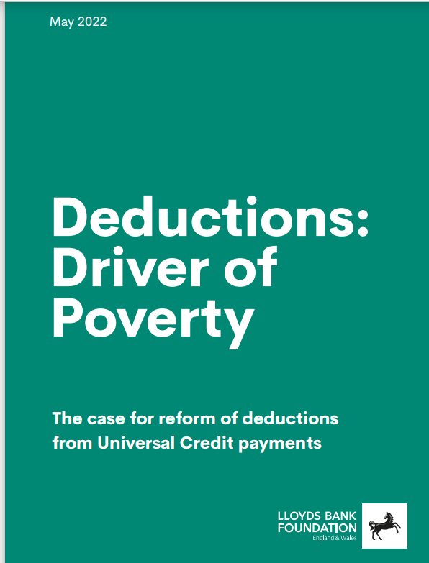
deductionsreport.pdf (lloydsbankfoundation.org.uk)

