Slide 1
What happened to audit fees during the coronavirus pandemic ?
Omaima Hassan and Xin Zhang
Presented at the 32nd Audit & Assurance Conference, May 5-6, 2022, Central Birmingham, UK.

Slide 2
Purpose
This study explores the extent and significance of abnormal (unexpected) audit fees during the coronavirus pandemic using a sample of four European countries over the period 2014 to 2020.

Slide 3
Background
The emergence and widespread of COVID-19 and the containment measures applied worldwide have affected businesses irrespective of their size, sector, or country of operation, and the audit profession is no exception.
There were concerns that this situation might undermine audit quality, hence different professional and regulatory bodies have issued guidance to auditors.
Academic investigation on the effect of COVID-19 on audit so far is limited and tends to be desk research only. A few empirical papers have emerged, but they are domestic (Egypt, Jordan, Sweden) and tend to focus on the effect of COVID-19 on audit quality.

Slide 4
Background- Continued
The International Federation of Accountants (IFAC, 2020) expressed concerns about the possibility that auditors might come under pressure to reduce the level of audit fees, which might impair audit quality:
“In the current environment, the auditor may face additional pressure to reduce the level of the audit fee for services in progress or to be provided. The IESBA publication highlights that there may be threats to compliance with the fundamental principles of professional competence and due care if the fee quoted is so low that it may be difficult to perform the engagement in accordance with applicable technical and professional standards for that price. The level of fees (or if they are overdue) might create a self-interest or intimidation threat to independence and auditors should apply the conceptual framework to identify, evaluate and address such threats.”

Slide 5
Background- Continued
However, the potential effect of COVID-19 on audit fees is not clear:
  On the one hand, the unprecedented economic conditions during COVID-19 and lockdown restrictions have affected numerous businesses negatively and several busted. In such a situation, it is not unnormal to negotiate the level of audit fees down to reduce costs.
  On the other hand, there is an extraordinary level of uncertainty which impacts management estimates and judgement (e.g., accounting estimates, impairment tests, and going concern assumption) which might increase the risk of errors or fraud. This means that auditors could spend more time and effort reviewing a business which induces higher audit fees.
  So, the effect of COVID-19 on audit fees is an open research question.

Slide 6
Research hypothesis
COVID-19 could have driven actual audit fees up or down beyond normal expectations which gives rise to abnormal audit fees.
However, abnormal audit fees can exist for reasons other than COVID-19, for example omitted variable bias in the audit fee estimation model. If the pandemic is the main driver of these abnormal audit fees, we should see significant differences in the extent of abnormal audit fees during the pandemic compared to those of previous years (Ettredge et al., 2014).
H1: abnormal audit fees during the pandemic are significantly different from those of the pre-pandemic period, ceteris paribus.

Slide 7
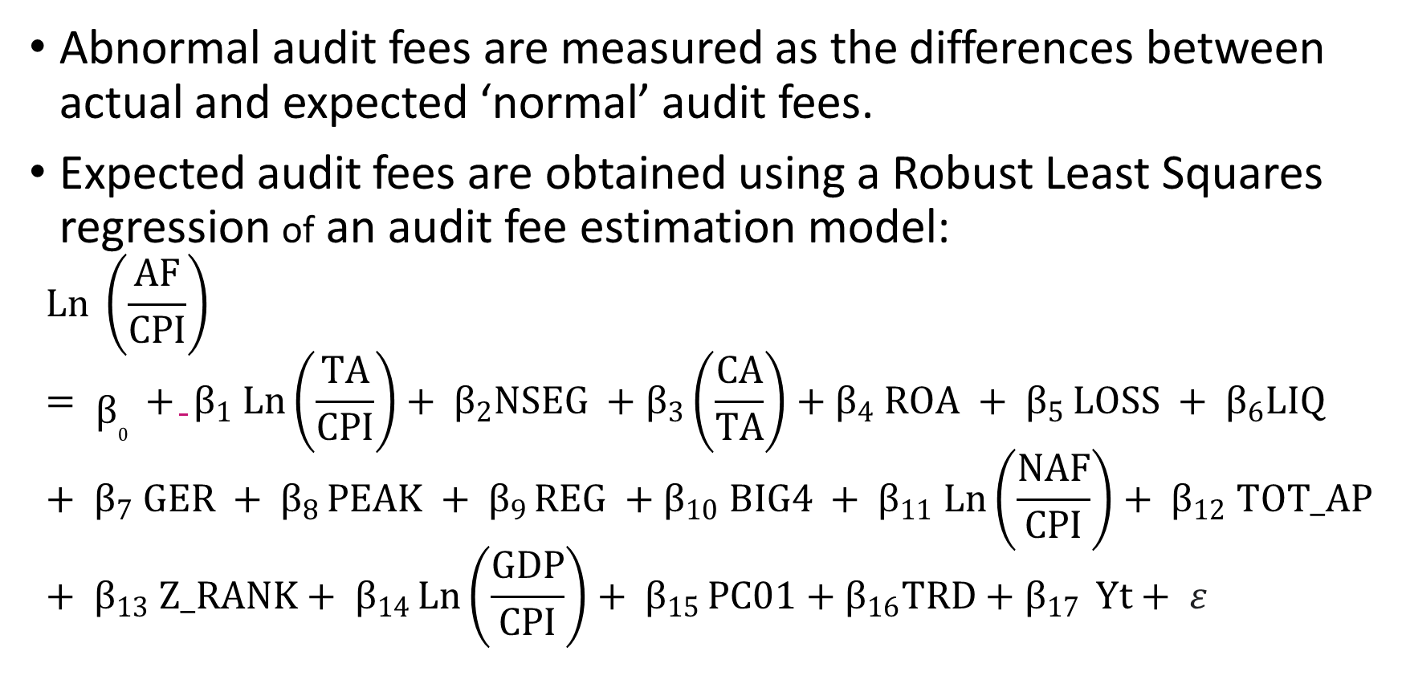
Research design
Abnormal audit fees are measured as the differences between actual and expected ‘normal’ audit fees.
Expected audit fees are obtained using a Robust Least Squares regression of an audit fee estimation model:
$$Ln \left(\frac{AF}{CPI}\right)= β_{0} + β_{1} Ln\left(\frac{TA}{CPI}\right)+ β_{2}NSEG +β_{3}\left(\frac{CA}{TA}\right)+β_{4} ROA + β_{5 }LOSS + β_{6}LIQ + β_{7} GER + β_{8} PEAK + β_{9} REG +β_{10} BIG4 + β_{11} Ln\left(\frac{NAF}{CPI}\right)+ β_{12} TOT_AP+ β_{13} Z_RANK+ β_{14 }Ln\left(\frac{GDP}{CPI}\right)+ β_{15} PC01+β_{16}TRD+β_{17} Yt+ ε$$

Slide 8
Research design- continued
Wilcoxon Signed Ranks Test is used to examine the significance of positive and negative abnormal audit fees in 2020 compared to those of previous years.
For robustness check, we re-measure abnormal audit fees as the residuals from the audit fee estimation model and rerun the analysis.

Slide 9
Research sample and sources for data
This study utilises a sample of domestic listed companies from top largest economies in Europe, namely: France, Germany, Spain, and the United Kingdom, over the period 2014 to 2020. This makes an initial sample of 214 companies with 1,498 firm-year observations.
The final sample comprises 145 companies with 745 firm-year observations. Company-level data are collected from Refinitiv Eikon database. GDP and country-level corporate governance indicators are gathered from the World Bank, while the CPI is obtained from the OECD database.

Slide 10
Descriptive statistics- raw data

Slide 11
Descriptive statistics- raw data

Slide 12
Descriptive statistics- raw data

Slide 13
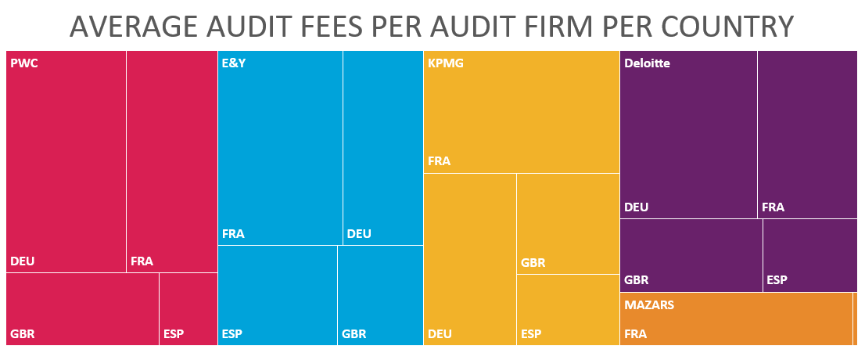
Descriptive statistics- raw data

Slide 14
Measuring benchmark ‘normal’ audit fees
Variable | Coefficient | Std. Error | Prob.
C | -8.144*** | 0.300 | 0.000
Ln (TA/CPI) | 0.560*** | 0.003 | 0.000
NSEG | 0.050*** | 0.001 | 0.000
CA/TA | -0.059*** | 0.018 | 0.001
ROA | 0.003*** | 0.001 | 0.000
LOSS | 0.254*** | 0.022 | 0.000
LIQ | -0.010 | 0.007 | 0.149
GER | -0.073*** | 0.030 | 0.014
PEAK | 0.082*** | 0.008 | 0.000
REG | -0.152*** | 0.011 | 0.000
BIG4 | -0.209*** | 0.025 | 0.000
Ln (NAF/CPI) | 0.275*** | 0.003 | 0.000
TOT_AP | 0.062*** | 0.005 | 0.000
Z_RANK | 0.084*** | 0.006 | 0.000
Ln (GDP/CPI) | 0.546*** | 0.030 | 0.000
PC01 | -0.089*** | 0.005 | 0.000
TRD | 0.014*** | 0.004 | 0.000
Y15 | 0.005 | 0.014 | 0.728
Y16 | -0.008 | 0.016 | 0.618
Y17 | -0.011 | 0.009 | 0.215
Y18 | -0.019** | 0.009 | 0.042

Slide 15
Descriptive statistics of abnormal audit fees

Slide 16
Descriptive statistics for abnormal audit fees

Slide 17
Results of Wilcoxon Signed Ranks Test
Paired samples | Z | Asymp. Sig. (2-tailed)
Panel A: Abnormal audit fees= Actual audit fees- benchmark audit fees
P_AB_AF_19 - P_AB_AF_20 | -1.665b* | 0.096
P_AB_AF_18 - P_AB_AF_20 | -1.512b | 0.131
P_AB_AF_17 - P_AB_AF_20 | -2.908b*** | 0.004
P_AB_AF_16 - P_AB_AF_20 | -2.431b** | 0.015
P_AB_AF_15 - P_AB_AF_20 | -2.201b** | 0.028
N_AB_AF_19 - N_AB_AF_20 | -1.369b | 0.171
N_AB_AF_18 - N_AB_AF_20 | -.656b | 0.512
N_AB_AF_17 - N_AB_AF_20 | -1.785c* | 0.074
N_AB_AF_16 - N_AB_AF_20 | -1.352b | 0.176
N_AB_AF_15 - N_AB_AF_20 | -.081c | 0.935

Slide 18
Independent Samples Median Test
Asymptotic significances are displayed. The significance level is 0.05.
 | Null hypothesis | Test | Seg. | Decision
1 | The medians of P_AB_AF are the same across categories of YEAR. | Independent Samples Median Test | 0.237 | Retain the null hypothesis.
2 | The medians of N_AB_AF are the same across categories of YEAR. | Independent Samples Median Test | 0.456 | Retain the null hypothesis.
3 | The medians of P_RESID are the same across categories of YEAR. | Independent Samples Median Test | 0.129 | Retain the null hypothesis.
4 | The medians of N_RESID are the same across categories of YEAR. | Independent Samples Median Test | 0.801 | Retain the null hypothesis.

Slide 19
Findings
The findings show higher positive and negative abnormal audit fees during the pandemic; however, they are not significantly different from those of 2019.
A robust finding is that negative abnormal audit fees in 2020 are not significantly different from any of those of 2015 to 2019.

Slide 20
Originality
This is the first study to empirically explore what happened to audit fees during the coronavirus pandemic across four major European countries.
It provides robust findings based on alternative measures of abnormal audit fees and alternative estimation methods.

Slide 21
Implications
This result provides some relief regarding concerns that pressure on audit fees during the pandemic could impair audit quality. However, we should be cautious when interpreting these results as we have measured the effect of COVID-19 using the year 2020 only.

