Slide 1
New insights into the associations between financial performance and environmental disclosure and Performance
Omaima Hassan and Peter Romilly
Robert Gordon University, UK and Ecmetrika Consultancy & Research, UK
Presented at the 40th European Accounting Association Annual Congress, May 2017, Valencia, Spain

Slide 2
Purpose
This study examines both the associations and causations between financial performance (FP), environmental performance (EP) and disclosure (ED), utilizing a large, multi-country panel dataset disaggregated between developed and developing countries.

Slide 3
Motivations
There is an extensive empirical literature on the association between EP, ED and FP but with mixed results. Reasons for this impasse include:
methodological and measurement problems in the constructs of interest;
lack of a temporal dimension in the data;
omitted variables bias;
inadequate sampling procedures.
This results in inconsistent results and inability to replicate and generalise findings to different settings

Slide 4
Motivations- Cont.
There is a lack of research on the direction of causation between the variables of interest (Nollet, Filis, & Mitrokostas, 2016). There is, for example, a lack of direct empirical evidence on the impact of prior environmental disclosure on current environmental performance (Luo, Lan, & Tang, 2012; Matisoff, 2013; Lewis et al., 2014).

Slide 5
Related literature
Al-Tuwaijri et al. (2004) investigate the associations among FP, EP and ED, comparing the OLS estimations with 2SLS and 3SLS estimations.
Using a cross-sectional sample of 198 US ‘‘Standard & Poors 500’’ firms.
They use a self-constructed disclosure index to measure the extent of ED.
They measure EP using the ratio of toxic waste recycled to total toxic waste generated. This measure is probably less representative of EP for some firms than industry- specific measures. Additionally, this measure for EP does not consider the relative toxicity of the waste being recycled, and aggregates all waste into one medium.

Slide 6
Contributions
First, this study employs a simultaneous equation system to allow for potential endogeneity between ED, EP and FP, an approach similar to that of Al-Tuwaijri et al. (2004), but utilizing panel rather than cross-section data and a wider range of firm-level and country-level control variables.
Second, our time series data enables an analysis of the direction of causation between the key variables, a response to recent research calls by Walls et al. (2012) and Nollet et al. (2016).

Slide 7
Contributions- Cont.
Third, in contrast, the current study employs a measure of environmental disclosure which is available for a large number of companies and countries over multiple time periods.
Fourth, we use a relatively new proxy for environmental performance, i.e., GHG emissions, which are acknowledged as one of the most important components of corporate environmental performance (Dragomir, 2012, p. 225).
Finally, in contrast to prior studies that focus on one or a few countries, our research model is estimated on a multi-country dataset disaggregated between developed and developing countries.

Slide 8
Research hypotheses
H1: There is no association between environmental disclosure and environmental performance.
H2: There is no association between environmental performance and financial performance.
H3: There is no association between financial performance and environmental disclosure.

Slide 9
Research sample
Our final sample includes a total of 1,607 firms with 9,120 firm-year observations from 45 countries worldwide, comprising 1,392 companies from developed countries (8,121 firm-year observations) and 215 companies from developing countries (999 firm-year observations).
Company-level data for this study are collected from the Bloomberg database, country-level data on GDP and corporate governance are from the World Bank. The date of enforcement of the Kyoto Protocol per country is collected from the United Nations website.

Slide 10
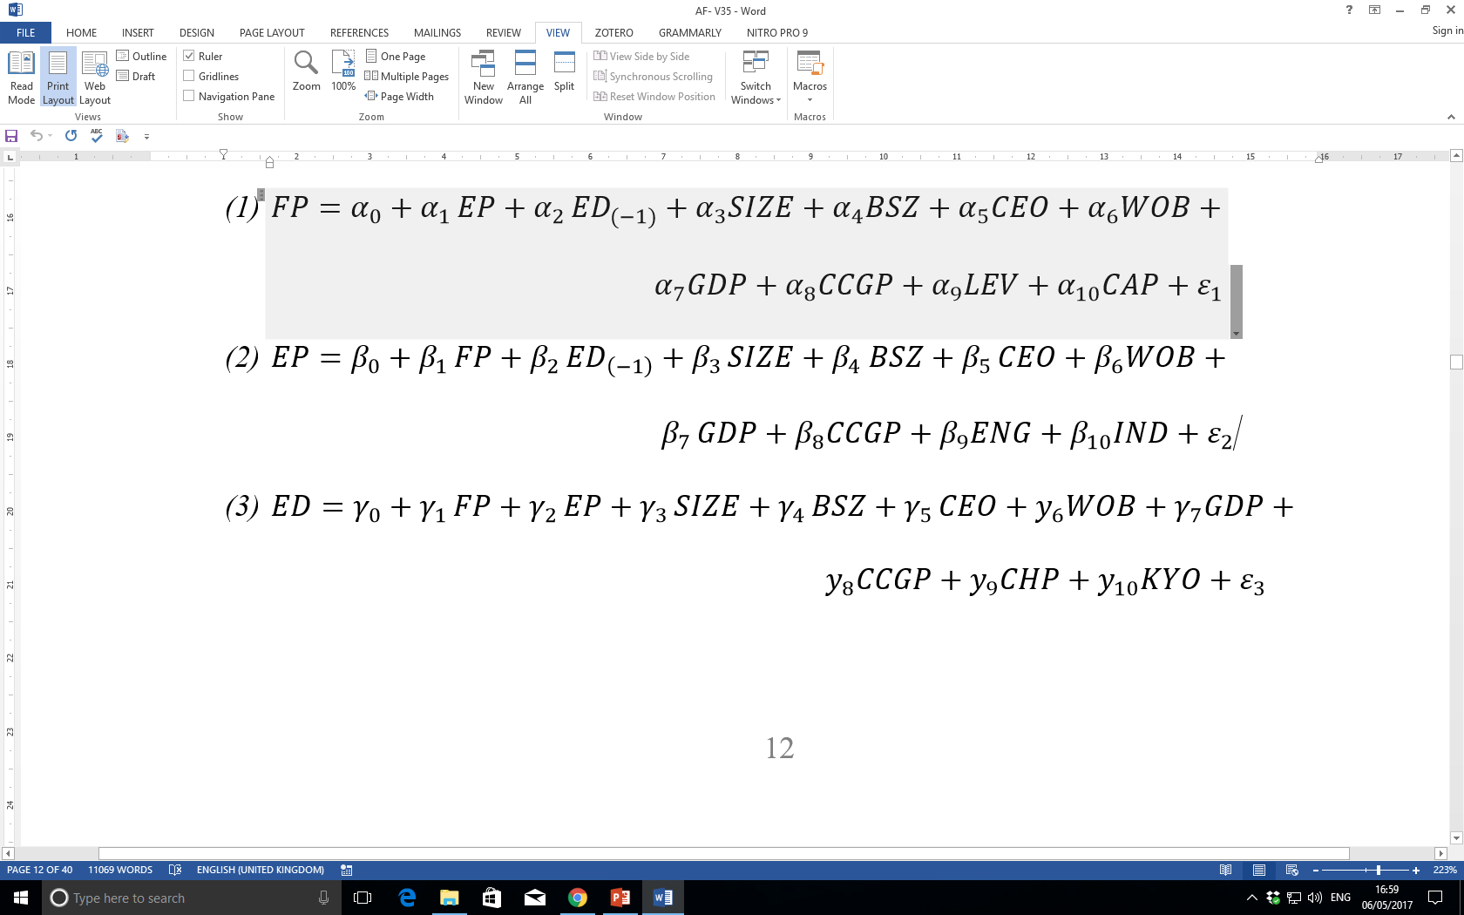
Research Model- test of association

Slide 11
Analysis
The associations between EP, FP and ED are examined by means of structural equations controlling for potential endogeneity and employing a range of control variables.
The pairwise-causations between EP, FP and ED are examined by means of Granger-causality tests in the next section.

Slide 12
Results

Slide 13
Conclusions
A robust result is that good environmental performance is strongly associated with good financial performance.
After pretesting for stationarity we find evidence of one-way causality from environmental performance and disclosure to financial performance, but no evidence of reverse causation.

Slide 14
Conclusions- cont.
We document strong evidence of one-way causation from environmental performance to environmental disclosure, but no evidence of reverse causation.
We also report inconsistent results between developed and developing countries, which indicates that pooling these two types of countries together can mask important discrepancies between them.

Slide 15
Implications
The over-arching policy implication is that corporate environmental performance drives financial performance, with implications for the formulation of management strategy at firm level and government policy at national and international levels.

Slide 16
Thank you!

