Slide 1
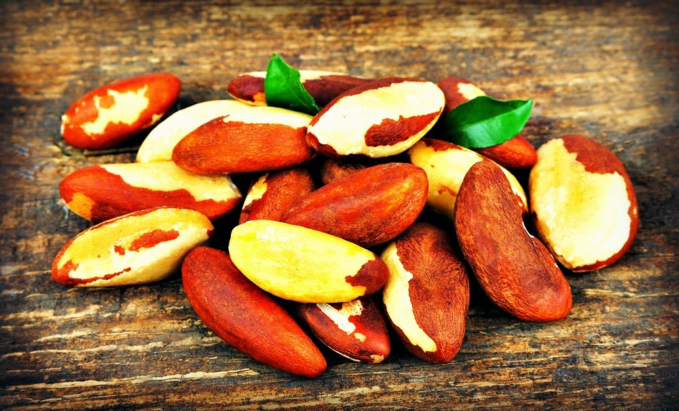


The role of selenium supplementation in cardiovascular disease prevention: an in vitro study to identify the molecular mechanism(s)
Dean Leighton
Ph.D Student
Robert Gordon University
Nutrition Society, March 2015

Slide 2


A role for selenium supplementation to prevent cardiovascular disease in obese individuals : Exercise and Nutrition-based Interventions
Where Are We At?
Exercise
Nutrition
Selenium Supplementation
In-vivo
In-vitro
High Intensity Interval Training

Slide 3
Obesity is characterised by systemic oxidative stress
17%
55%?
7%
23
26%
17%
1980
1995
2013
2050
Normal weight
Obese
ROS
ANTIOXIDANTS
ROS
REDOX HOMEOSTASIS
ANTIOXIDANTS
OXIDATIVE STRESS
High O₂⁻/H₂O₂/OH⁻
Low GPx/SOD

Slide 4
Atherosclerosis is driven by systemic oxidative stress
OBESE ARTERY
LUMEN
MONOCYTES
NADPH Oxidase
ROS
+
LDL
oxLDL
LDL
+
ROS
EXCESSIVE ROS
ELEVATED LDL-C
B1-Integrin
B2-Integrin
MONOCYTE ROLLING + TRANSMIGRATION
VCAM1
ICAM1
ENDOTHELIAL CELLS
INTIMA
MONOCYTE DIFFERENTIATION TO MACROPHAGE
INFLAMMATION
FOAM CELL
PLAQUE FORMATION
VASCULAR SMOOTH MUSCLE

Slide 5
An optimum selenium status for cardiovascular health?
Essential micronutrient incorporated as selenocysteine into selenoproteins
Important selenoproteins (glutathione peroxidase – GPx) have antioxidant capacity
Reference nutrient intake = 55-70ug/day
GPx-1/GPx-4 are ubiquitously expressed and their enzymatic activity is dependent on selenium status.
Sub-optimal selenium intake in UK
Lack of knowledge on monocyte and endothelial cell oxidative stress response to selenium supplementation
Increase CVD
Increase CVD
‘Optimum’ selenium concentration/GPx activity
CVD Risk
Low selenium concentration
High selenium concentration
LOWER CVD RISK
Selenium Status

Slide 6
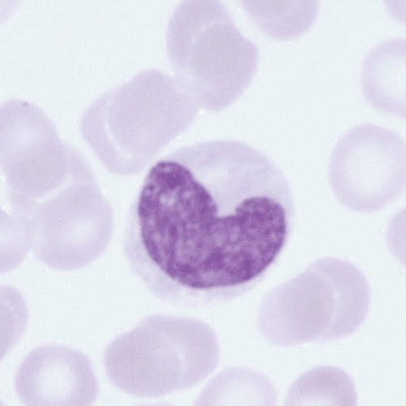
Aims
Aims
To investigate the effect of selenium supplementation to modulate oxidative stress in U937 monocytes (in-vitro) in relation to:
Cell viability (MTS assay)
ROS levels (CM-H₂DC-FDA flow cytometry)
GPx-1/GPx-4 antioxidant enzyme gene expression (RT-PCR)

Slide 7
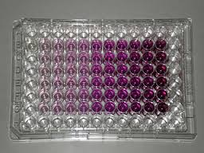
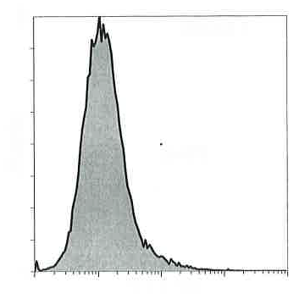
Methods
Protocol
MTS Assay
1. U937 cell seeding
2. Sodium Selenite Supplementation
(100nM or 200nM)
3. PQ (1mM)/SNAP (0.7mM) treatment
CM-H₂DC-FDA Flow Cytometry
48 hours at 37°C
16 hours at 37°C
Reverse Transcription PCR (GPx-1/GPx-4)

Slide 8

100nM selenite ensures greater cellular protection than 200nM selenite under stress conditions
n=10; mean +SEM
UNSTRESSED CELLS
STRESSED CELLS
***
***
***
Selenium supplementation (100nM/200nM Na₂SeO₃) of unstressed cells did not significantly change cell viability compared to control cells (no PQ/SNAP).
Monocytes pre-supplemented with 100nM Na₂SeO₃ before PQ/SNAP treatment, significantly increased cell viability by 33% (p<0.001) compared to PQ/SNAP treated cells.
Monocytes pre-supplemented with 200nM Na₂SeO₃ before PQ/SNAP treatment, did not significantly improve cell viability compared to PQ/SNAP treated cells.

Slide 9

100nM selenite attenuates reactive oxidative species levels under stress conditions
n=3; mean +SEM
STRESSED CELLS
***
Selenium supplementation (100nM Na₂SeO₃) of unstressed cells did not significantly change ROS levels compared to control cells (no PQ/SNAP).
Monocytes pre-supplemented with 100nM Na₂SeO₃ before PQ/SNAP treatment, significantly reduced ROS levels by 32% (p<0.001) compared to PQ/SNAP treated cells.

Slide 10
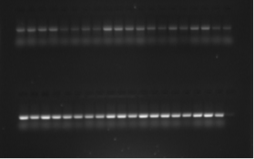
100nM selenite augments both GPx-1 and GPx-4 gene expression under stress conditions
n=3; mean +SEM
GPx-1
GPx-4
UNSTRESSED CELLS
STRESSED CELLS
UNSTRESSED CELLS
STRESSED CELLS
**
**
**
*
*
Monocytes pre-supplemented with 100nM Na₂SeO₃ before PQ/SNAP treatment, significantly increased GPx-1 expression by 146% (p<0.01) compared to PQ/SNAP treated cells.
Monocytes pre-supplemented with 100nM Na₂SeO₃ before PQ/SNAP treatment, significantly increased GPx-4 expression by 77% (p<0.05) compared to PQ/SNAP treated cells.

Slide 11
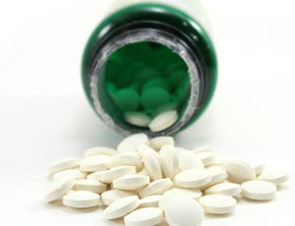
Discussion
Potential beneficial effects of 100nM selenium supplementation:
ROS
Selenium supplementation
ANTIOXIDANTS
ROS
ANTIOXIDANTS
↓ OXIDATIVE STRESS
OXIDATIVE STRESS
Increase GPx-1 + GPx-4
Low GPx
MONOCYTE (OXIDATIVE STRESS)
ROS
ROS
100nM Selenite
ROS
High ROS
Low GPx
GPx-1 ↑
GPx-4 ↑
ROS ↓
ROS
ROS
ROS
ROS
ROS
ENDOTHELIAL CELL
ENDOTHELIAL CELL
ENDOTHELIAL CELL
↓ Foam cell formation/↓ Fatty plaque ?

Slide 12

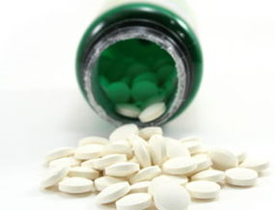
Future Directions
Future Directions
Ability selenium supplementation:
  Modify ROS/GPx-1 + GPx-4 in endothelial cells under OS.
  Modify CAM expression in both monocyte and endothelial cells under OS.
100nM
Selenite
First study to investigate effect selenium supplementation on both ROS/antioxidant enzymes AND CAM expression.
SELENIUM DEFICIENT
SELENIUM SUPPLEMENTED
MONOCYTE
MONOCYTE
ROS
ROS
ROS
NADPH Oxidase
High ROS
Low GPx
GPx-1 ↑
GPx-4 ↑
ROS ↓
ROS
ROS
Synergistic effects of selenium supplementation on monocytes and endothelial cells?
ROS
ROS
ROS
ENDOTHELIAL CELL
ENDOTHELIAL CELL
ENDOTHELIAL CELL

Slide 13





Acknowledgements
Dr Giovanna Bermano
Dr Marie Goua
Dr Katherine Burgess
Dr Eimear Dolan

