Slide 1
Title: “Developing a Capacity Sizing and Energy Management Model for a Hybrid Photovoltaic-Hydrogen Grid-connected Building Scenario”
Presented by: Ayatte I. Atteya
Supervised by: Dr. Dallia Ali - Dr. Mamdud Hossain
School of Engineering, Robert Gordon University (RGU)

Slide 2
Outline
Introduction
Green Hydrogen Energy Storage
Rationale of the proposed Research
The proposed hybrid PV-H2 system for grid-connected buildings
Case Study
Capacity sizing of the proposed system components
Energy Management Model of the proposed system components
Simulation Results
Conclusion

Slide 3
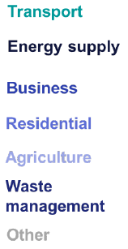
Introduction
In June 2019, the parliament passed a new legislation requiring the UK to bring down all greenhouse gas emissions (GHG) by 100% by 2050, compared to1990 levels.
The energy supply sector has accounted for 70% of the overall reduction in UK GHG emissions since 1990.
1990-2020
%Change
50%

Slide 4
Introduction
Energy Supply Sector has been the second largest contributor to GHG emissions in 2020 after transport sector, constituting 21% of total GHG emissions.
The share of renewable energy mix is required to increase by more than twice its current amount to achieve the Zero-Carbon ambition.

Slide 5
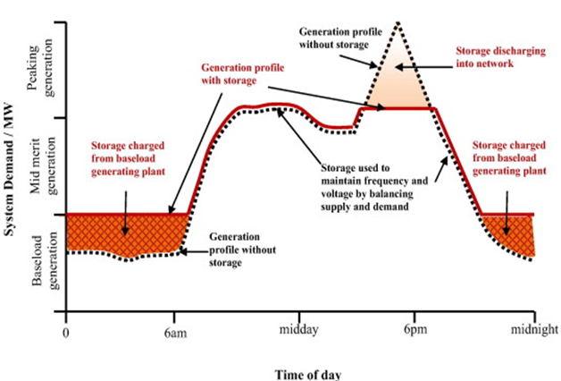
Introduction
The admission of renewable energy systems into the grid is subject to significant variability due to their intermittency, requiring central generations to cover any transient variation between renewable power input and consumer demand.
Fossil-fuel spinning reserves running without energy storage
Improvement of Power Plant Profile with Energy Storage
Integration of Energy Storage Systems
Charging Storage during hours of low demand
Discharging storage during hours of high demand
Suggested Solution
Generation profile without energy storage
Generation profile with energy storage

Slide 6
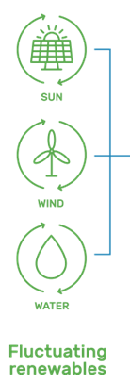
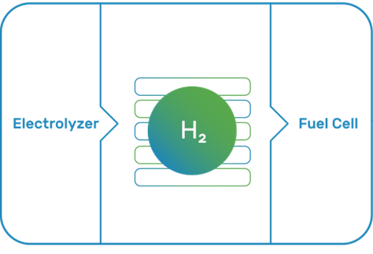
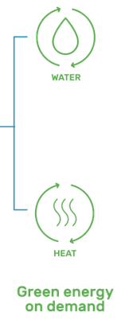
Green Hydrogen Energy Storage Systems
H2 Production
H2 Storage
H2 Implementation
By-Products
H2 Storage System
Electrical Energy Input
H2O
Electrical Energy Output
H2 Gas
H2 Liquid
Solid-state
O2 Output
H2 for other uses

Slide 7
Rationale of the Proposed Research
The integration of Renewables into Electrical Power Systems brings major technical challenges which can be addressed by integrating Green Hydrogen Energy Storage (HES); however, integrating HES requires:
System Sizing
Operation Scheduling
Meeting the energy demands
Mitigating the intermittency of renewable energy
Minimizing the GHG emissions
Scheduling the operation of the hydrogen system components with other parts of the electrical system

Slide 8
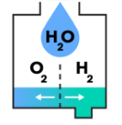
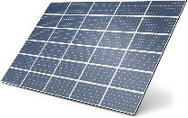
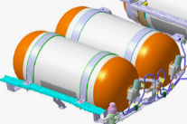
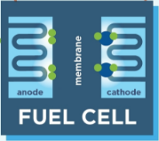
The Proposed Hybrid Photovoltaic-Hydrogen Energy System within a Grid-Connected Building Scenario
Utility Grid
Data of Solar irradiation and temperature
H2 Electrolyzer
Photovoltaic (PV)
Surplus Energy
(Non-utilized solar energy)
Solar energy generation consumed by load demand
Grid import to cover deficit in green energy
The Proposed Hybrid PV-H2 Energy System
(To be sized)
Charging
The stored solar excess energy
Discharging
H2 Storage
Fuel Cell
RGU Campus Load Demands
Notes:
The proposed system will be based on PV and H2 Storage systems. During hours of high PV production, the excess energy from PV will be used to generate Green H2 by electrolyser, then the green H2 generated will be stored and discharged during the hours of off-peak generation and peak-load demand through a FC facility, to cover the shortage in PV production. The grid import will only take place to cover the deficit from both PV and H2 fuel cell.

Slide 9
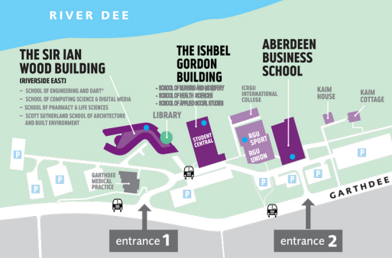
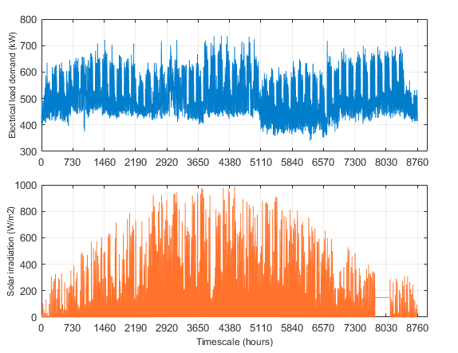
Case Study: Sir Ian Wood Building (SIWB) – RGU Campus
The proposed system sizing and energy management modelling has been developed for SIWB (as case study) based on its actual hourly load demand profile for the year 2020/2021
Parameter | Rating
Average Demand | 515.8 kW
Peak Demand | 738 kW
Minimum Demand | 340 kW
Total Annual Demand | 4.518 GW

Slide 10
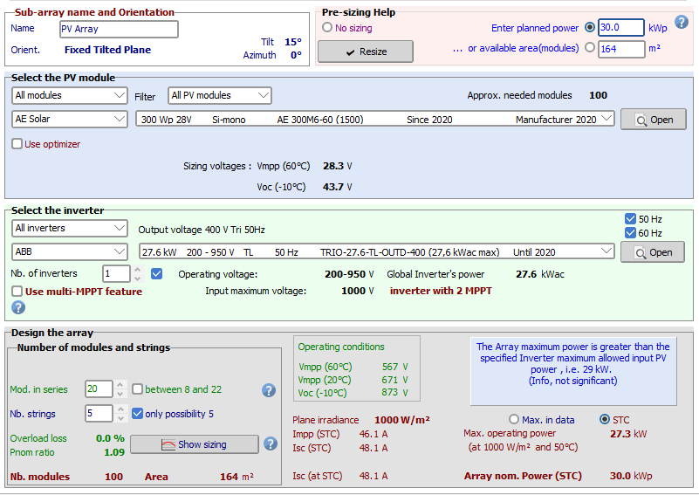
Simulating the Building Currently Installed PV Capacity
Design Specifications of PV Facility currently installed in RGU Campus
Panel Orientation | Facing South (Azimuth: 0°)
Pitch Angle | 15°
Solar PV Module Type | SI-Mono X Neon 300 W PV Panel
Number of PV panels installed | 100
Total PV Installed Capacity | 30 kW
Inverter Type | Power-One TRIO-27.6TL S2X Inverter
Number of installed inverters | 1

Slide 11
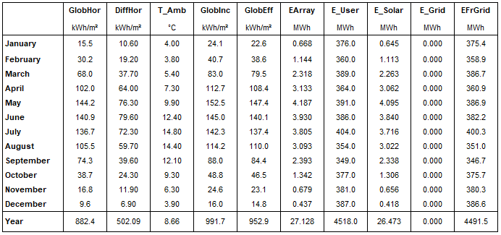
Simulating the Building Currently Installed PV Capacity
Monthly Load Energy consumption
Solar Energy fed to load demand
2.42 kWh/kW/day x 30 kW x 365 days = 26.47 MWh
Total useful Solar Energy Production at the output of PV inverter
Analysis of PV Facility currently installed in RGU
Total Solar Energy Supplied to Load Demand | 26.47 MWh
Total Load Energy Consumption | 4518 MWh
% Solar Energy Supplied to Load Demand | 0.58 %
Notes:
The results of PVSyst simulation has shown that the PV system currently installed is only able to supply 0.6% from total load demands

Slide 12
Sizing of the Proposed PV System Capacity
The size of the proposed PV capacity can be calculated based on the PV capacity factor, defined as the percentage of the average output power from the PV to the rated power of PV module:
$${CF}_{PV}=\frac{P_{PV}}{P_{PV rated}}$$
$P_{PV}=P_{avg load}=515.8$ $kW$
$$G_{avg}=119.66 W/m^{2}$$
The PV capacity factor ${(CF}_{PV})$can be estimated by measuring the ratio of average actual solar irradiation to the solar irradiation at Standard Test Conditions ${(G}_{STC}=1000 W/m^{2})$
$${CF}_{PV}=\frac{G_{avg}}{G_{STC}}= \frac{119.66}{1000}=11.966\%$$
$$Thus;$$
PVGIS Data of Hourly Solar Irradiation over one-year
$$P_{PV rated}=\frac{P_{PV}}{{CF}_{PV}}=\frac{515.8}{0.11966}=4310 kW=4.31 MW$$
$$Proposed PV Installed$$
$$Capacity$$

Slide 13
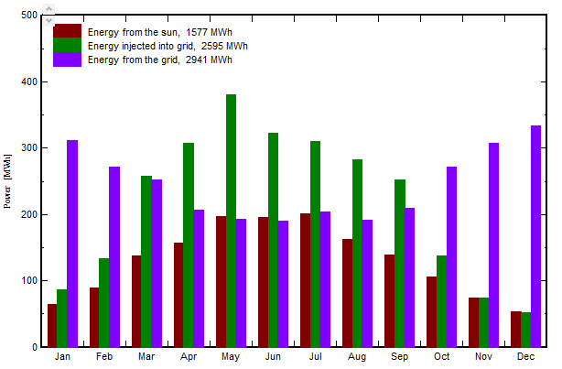
Modelling and Simulation of the Proposed PV System Capacity with no H2 Energy Storage
PVSyst Simulation Results - Monthly Solar energy production by the proposed PV capacity
PVSyst Simulation Results – Performance of the proposed grid-connected PV capacity in feeding load demands with no H2 energy storage
2.652 kWh/kW/day x 4310 kW x 365 days $≈$ 4172 MWh
Total useful PV Production at the output of PV inverter

Slide 14
Analysis Results of the Proposed PV System Capacity with no H2 energy Storage

Slide 15
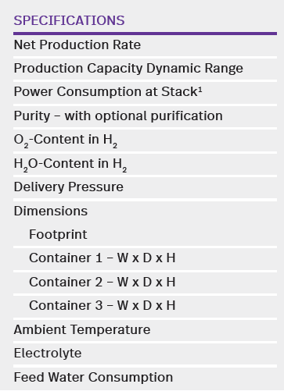
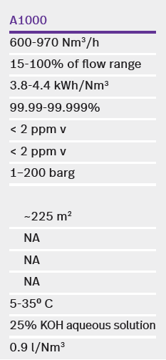
Sizing of the Proposed H2 Electrolyser
The electrolyser can be sized as 50% of the proposed PV capacity to compensate for the level of underutilization during the hours of low availability of solar energy.
$$P_{ele rated}=0.5 × P_{PV rated}$$
$$=0.5 ×4.31 MW=2.155 MW$$
NEL A1000 H2 electrolyser (A-Series stacked together)
$$Electrolyser Capacity Range$$
$$=\left(3.8−4.4\right)\frac{kWh}{{Nm}^{3}}×\left(600−970\right)\frac{{Nm}^{3}}{h}$$
$$=(2.28−4.27) MW$$
Satisfying the proposed Size of H2 Electrolyser
Parameter | Rating
Average H2 Electrolyser Capacity | $$3.275 MW$$
Average H2 Volume Production | $$785 {Nm}^{3}/h$$
Average H2 mass Production | $$70.7 kg/h$$
H2 Mass Flow Rate per unit capacity | $$0.0216 kg/h/kW$$
H2 Electrolyser Target Pressure | $$200 bar$$

Slide 16
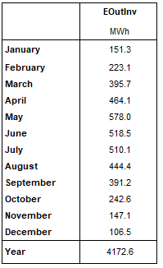
Sizing of the Proposed H2 Fuel Cell
The H2 fuel cell has been sized to cover the maximum power deficit that can occur by the proposed PV capacity during the hours of minimum solar production.
PVSyst Simulation Results of Solar Energy Production at the output of PV Inverter during the month of December
30th December
Comparison of Solar Energy output at PV inverter and Actual Load Demand during 30th December
Day at which occurs minimum PV Production (56 kWh daily production)
A 500-kW closest standard size of fuel cell capacity can be considered, enough to cover the average load demand during the day of min PV production

Slide 17
Sizing of the Proposed H2 Storage Tank
Based on the maximum permissible working pressure of the selected H2 electrolyser (200 bar), a BOC Manifold 15-Cylinder Pallet (MCP) with the following specifications can be selected:
Volume of H2 tank
Target Pressure
Maximum Storage Capacity
The suitability of the selected H2 tank is verified through the thermodynamic model of H2 accumulation inside the tank, considering pressure build-up and pressure decrease during charging and discharging processes of H2 tank over the year.

Slide 18
Sizing Summary of the Proposed Hybrid PV-H2 Energy System
Component |  | Rating
PV System | Proposed Capacity | 4.31 MW
 | PV Modules | 14368 Modules, 300 W each
 | Modules connection | 449 strings x 32 in series
 | PV inverters | 4 units, 1000 kW each
H2 Electrolyser | Rated Capacity | 3.275 MW
 | H2 Mass Flow Rate | 0.0216 kg/h/kW
 | Target Pressure | 1-200 bars
H2 Fuel Cell | Rated capacity | 500 kW
H2 storage tank | Tank Volume | 132 m³
 | Mass Storage Capacity | 1331 kg
 | Target Pressure | 200 bars
Energy Management Model
Running on an hourly-basis
over the year
To schedule the operation of proposed components and the utility grid in feeding the building demands

Slide 19
Energy Management Model – Flowchart
Calculate hourly PV Output Power: $P_{PV}\left(t\right)$
START
Initialization of component sizing developed for the Proposed Hybrid PV-H2 Energy System
$$∆P\left(t\right)=P_{PV}\left(t\right)−P_{load}\left(t\right)$$
$$∆P\left(t\right)>0$$
NO
Apply Scenario of PV Deficit
Data input of hourly load demand profile and hourly solar irradiation
YES
B
Apply Scenario of PV excess
A
t=1
$$t>8760$$
YES
NO
END

Slide 20
Energy Management Model – Scenario of PV Energy Excess
A
Calculate no. of H2 moles present in the tank: $n_{tank }\left(t\right)$
Stop filling H2 tank
NO
$$∆P\left(t\right)≤P_{ele rated}$$
Calculate the Non-utilized PV excess
Set:${ m}_{tank }\left(t\right)$ ${=m}_{tank }(t−1)$
Calculate the operating pressure of H2 tank: $P\left(t\right)$
$$P_{ex }\left(t\right)=∆P\left(t\right)−P_{ele rated}$$
YES
$${Set: P}_{ele}\left(t\right)=∆P\left(t\right)$$
Set:${ P}_{ }\left(t\right)$ ${=P}_{ }(t−1)$
$$P\left(t\right)≤P_{max}$$
NO
$${Set: P}_{ele}\left(t\right)=P_{ele rated}$$
Calculate mass of H2 generated: $m_{g }\left(t\right)$
Evaluate mass of H2 to be sold to grid
YES
Allow charging of H2 tank and update the mass status of H2 tank:${ m}_{tank }\left(t\right)$
Calculate no. of H2 moles generated: $n_{g }\left(t\right)$
$$m_{H2 sale }\left(t\right)=m_{g }\left(t\right)$$
Main Function

Slide 21
Energy Management Model – Scenario of PV Energy Deficit
B
$$m_{c}\left(t\right)≤m_{tank}\left(t−1\right)$$
NO
Set:${ m}_{c }\left(t\right)$ ${=m}_{tank }(t−1)$
$$P_{def}\left(t\right)={P_{load}\left(t\right)−P}_{PV}\left(t\right)$$
YES
Allow discharging of H2 tank and update the mass status of H2 tank:${ m}_{tank }\left(t\right)$
Update $P_{fc}\left(t\right),$based on mass of H2 available in the tank
NO
$$P_{def}\left(t\right)≤P_{fc rated}$$
$${Set: P}_{fc}\left(t\right)=P_{fc rated}$$
YES
Calculate the power that needs to be imported from grid
Calculate no. of H2 moles consumed by fuel cell: $n_{c }\left(t\right)$
Calculate the power that needs to be imported from grid
$${Set: P}_{fc}\left(t\right)=P_{def}\left(t\right)$$
Calculate mass of H2 to be consumed: $m_{c }\left(t\right)$
Update no. of H2 moles present in the tank: $n_{tank }\left(t\right)$
$$P_{grid}\left(t\right)={P_{def}\left(t\right)−P}_{fc}\left(t\right)$$
$$P_{grid}\left(t\right)={P_{def}\left(t\right)−P}_{fc rated}$$
Calculate the operating pressure of H2 tank: $P\left(t\right)$
Main Function

Slide 22
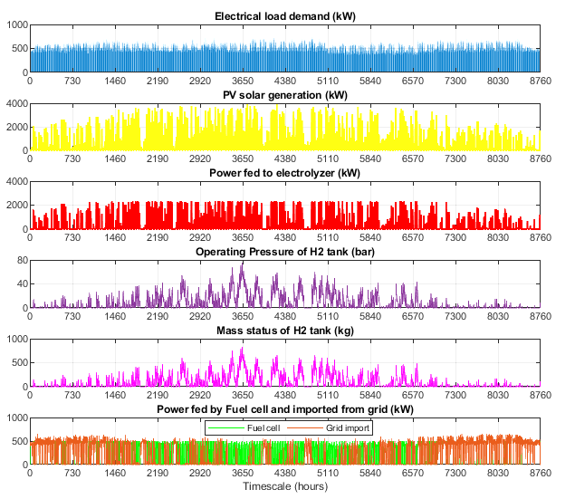
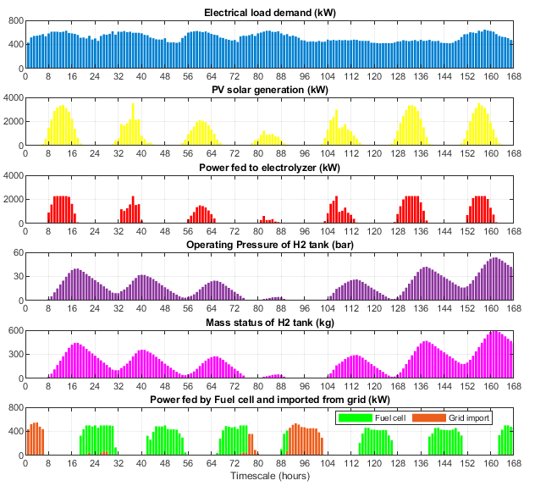
Simulation Results of Hybrid PV-H2 Energy System
Simulation Results over one-year timescale
Simulation Results over one Summer week
Hours of high PV production
Hours of low PV production
Electrolyser “ON”
Pressure rise
Pressure decrease
H2 Charging
H2 discharging
Fuel Cell “ON”

Slide 23
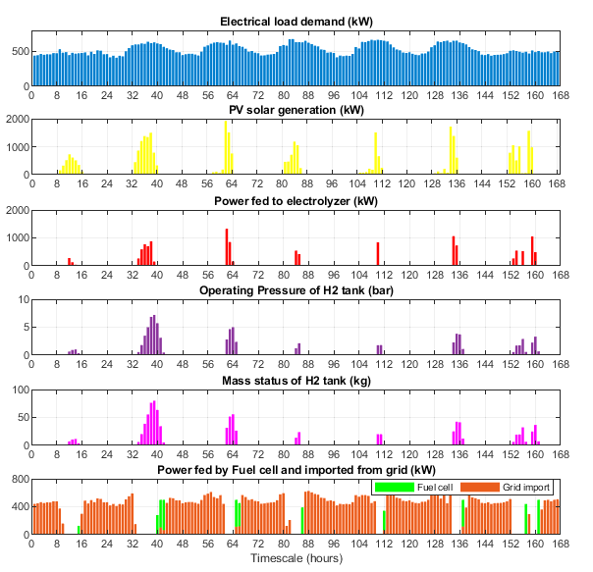
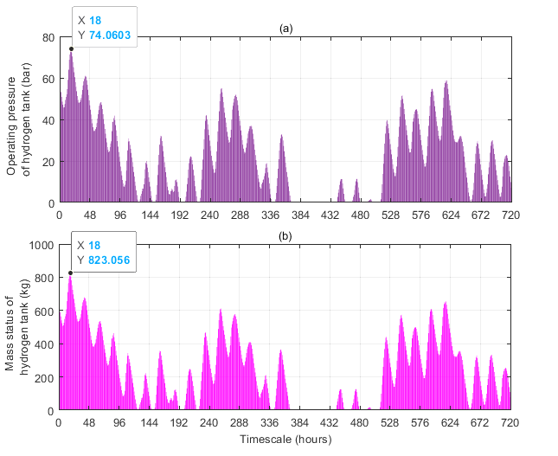
Simulation Results of Hybrid PV-H2 Energy System
Simulation Results over one Winter week
Simulation of Hourly status of H2 tank and the associated operating pressure during the month of June

Slide 24
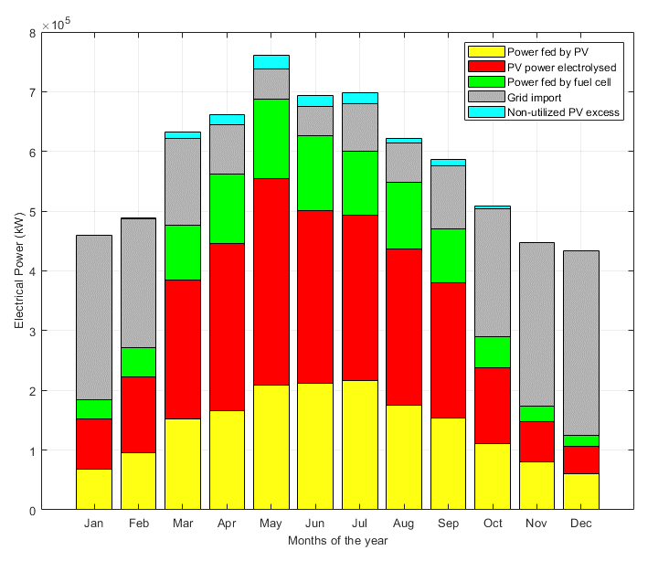
Simulation Results of Hybrid PV-H2 Energy System
Monthly power exchange of the proposed Grid-connected PV-H2 System in supplying the load demands

Slide 25
Conclusion
A Capacity sizing and Energy Management Modelling has been developed for the proposed hybrid Photovoltaic-Hydrogen Energy System for grid-connected building scenario to support the building sector decarbonization while ensuring a reliable system operation
The results have shown a maintained energy balance between the renewable generation, load consumption, green hydrogen production by electrolyser and consumption by fuel cell, with less contribution from the utility grid throughout the year.
The integration of the proposed Hydrogen Energy Storage System has increased the total contribution of green energy in feeding the building load demand by 21%, while improving the utilization of the proposed PV system capacity by 59%.

Slide 26
Any Questions?

