Slide 1
Shifting Stories: provenance and production in Scotland’s fashion and textile SMEs
Dr Karen Cross

Slide 2


Slide 3
Scottish fashion and textiles
Scottish textile jobs support the prosperity of many rural communities (Textiles Scotland 2016), for example the Harris Tweed hand-weavers in the Outer Hebrides. Scotland’s traditional tweeds and tartans, cashmere and woollens continue to survive today, largely through Small to Medium Enterprises (SMEs) producing luxury products with a focus on value rather than volume.

Slide 4
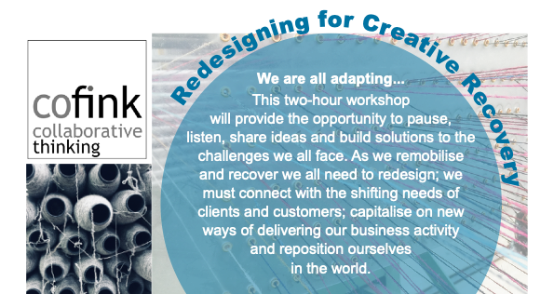
Workshop:
Redesigning for Creative Recovery
Participants:
20 Scottish SMEs (closed session)
Facilitated by:
Tom Inns, Cofink
Designed to:
Support SMEs impacted by Covid-19

Slide 5
Workshop: Sustainable Fashion and Textiles in Scotland
4 presenters:
3 Scottish fashion & textile brands and a circular economy consultant + 55 participants
Session open to the public, facilitating knowledge exchange

Slide 6
Consumption…
Consumption shifts due to lockdown lifestyle changes saw increased interest in colourful, comfortable and cosy products, crafted in local communities; products that epitomise Scottish fashion and textiles.

Slide 7
…consumer awareness and citizen ethos
Participants noted increased consumer awareness of environmental issues and more interest in better-made clothing with greater longevity. It could be that Covid-19 has engendered a more compassionate purchaser, in line with Geiger and Keller’s (2017) study that links compassion to sustainable purchase behaviours.

Slide 8
Production, provenance…
‘Its cheaper to go elsewhere but that’s not the point. We’re committed to authenticity, integrity and provenance around our product.’
The SME participants noted increased interest in provenance from some consumers, with details of material, origin and authenticity being sought, aligning with Strauss and Fuad-Luke’s (2008) reveal slow design principle.

Slide 9
…and change
‘‘I am looking at making different things, working with different materials, offering different products with different price points, marketed in new ways... all this change means my story as a creative practitioner has had to shift.’
‘…your ability and willingness to change and adapt and to really embrace fear and not let that hold you back from what you’re really passionate and committed to do.’
‘It’s been really exciting for us to bring that [Zero Waste Design] to a finished product.’

Slide 10
Innovation… connection…
For the participants, an unintended benefit of the pandemic has been to accelerate digital skills acquisition and close a recognised digital skills gap (Scottish Government 2021). They identified digital upskilling as an important form of innovation.
Participants noted the increased ease of connection with other places and people, through participation in webinars and international trade events, which they normally could not afford to attend in terms of time and cost. This aligns with Strauss and Fuad-Luke’s engage slow design principle, which describes slow design as ‘collaborative, relying on sharing, cooperation and transparency of information’ (2008: 6).
‘Across the sector there are amazing stories of innovation, we need to make sure we connect them.’

Slide 11
…and communication
The opportunity to share their stories was deemed important, not just in terms of supporting each other but also in the construction of stories about themselves as creative practitioners.
There was recognition that consumers were interested in the stories of their products, practices, and brands, and that they should probably pay more attention to how they tell those stories.
‘We have seen how everything is connected in new ways; we need to find new ways to tell these stories.’

Slide 12
Conclusion: communicating with consumers
Digital storytelling negates distance, bringing the consumer closer wherever they are in the world
Storytelling experiences that provide collaborative or shared opportunities can build a sense of community
The combination of education and engagement can engender a citizen ethos

Slide 13
Conclusion: sharing among
SMEs
Digital storytelling negates distance, creating community regardless of rurality
Storytelling experiences that provide collaborative or shared opportunities could accelerate sustainable innovation
A sense of community, collaboration and collective experience creates resilience

Slide 14
Next steps
This research, as part of the Augmented Fashion project, is a work in progress.
The next steps will involve creating fashion/textiles immersive story experiences with a sustainability message, to:

Slide 15

Thank you for listening!
If you are interested in finding out more about
please contact:
Dr Karen Cross: k.a.cross@rgu.ac.uk
Dr Yang Jiang (PI): yang.jiang2@rgu.ac.uk
Josie Steed: j.steed@rgu.ac.uk

