Slide 1
Modelling Real-World Renewable Hydrogen Energy Systems for Enabling Scotland Zero-Carbon Ambition
Presented by: Ayatte I. Atteya
PhD Student, School of Engineering, Robert Gordon University, Aberdeen, UK

Slide 2
UK Energy Outlook 2022
Energy trends in UK electricity generation were dominated by an increased record of offshore wind energy in 2022 compared to 2021.
18.6%
14.4%

Slide 3
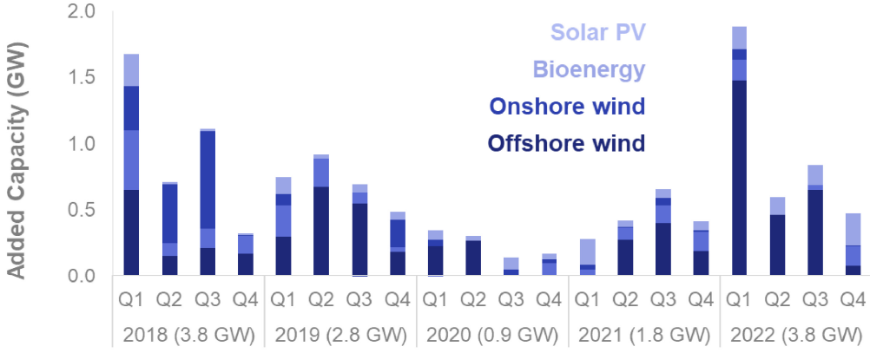
UK Energy Outlook 2022
In the first quarter of 2022, 1.5 GW was installed in offshore wind alone.
In total 2.7 GW in offshore wind was installed in 2022 including key sites at Moray East (1.0 GW) and Seagreen (0.3 GW) in Scotland, as well as Hornsea Two in England (1.4 GW).
2.7 GW offshore wind
1.5 GW Offshore wind

Slide 4
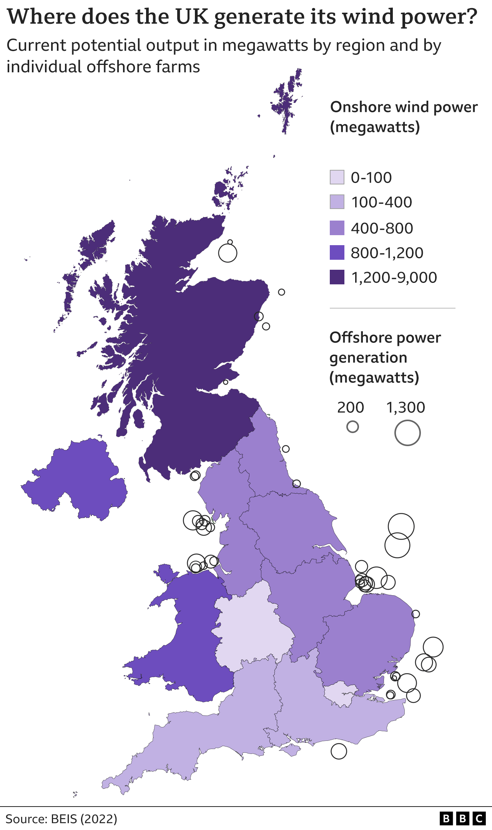
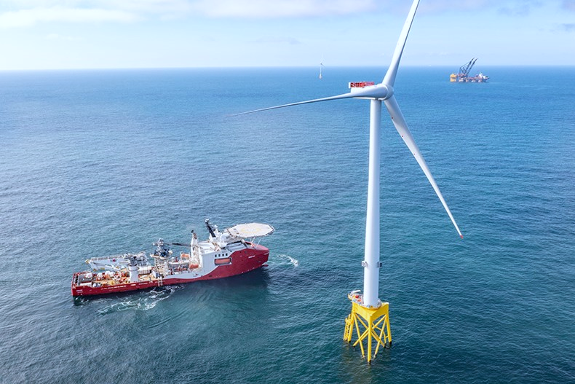
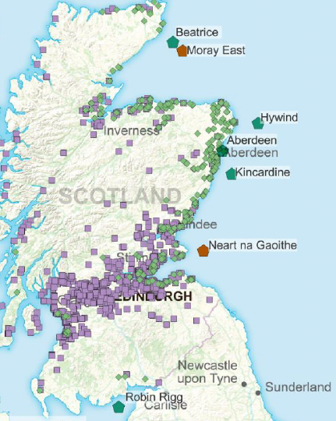
Scotland’s Renewable Potential
Onshore Wind: Currently Scotland has over 20 operational onshore windfarms with a total installed capacity of 7.3 GW.
Offshore Wind: Scotland has six operational offshore windfarms with total installed capacity of around 9.6 GW.
Scotland
Scotland Offshore Wind
Robin Rigg (Solway Firth), Beatrice (Moray Firth),
Levenmouth (Firth of Forth),
Aberdeen Bay,
HyWind (Aberdeenshire), Kincardine (Aberdeenshire)
United Kingdom

Slide 5
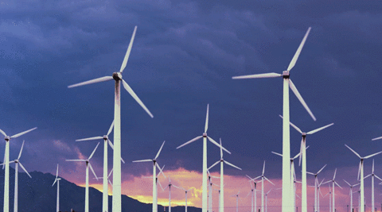
Can we Fully Exploit All Renewable Potential in Scotland??
Weather or not we can exploit full renewable potential in Scotland depends on a number of factors: weather conditions, capacity factors and the usage of adequate energy storage systems to absorb the excess of renewable energy.

Slide 6
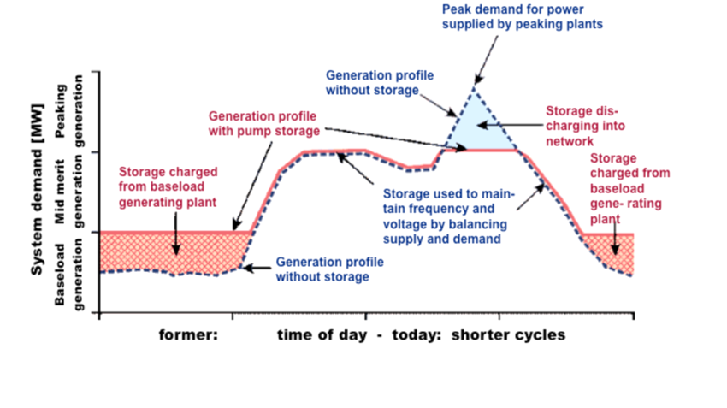
The need for Energy Storage Systems
Renewable energy systems are subject to significant variability due to their intermittent nature.
Integrating energy storage systems is then crucial to balance between generation and consumption and unlock the full renewable potential.

Slide 7
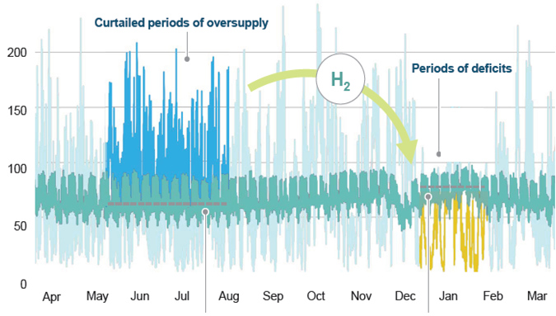
Green Hydrogen Energy Storage Systems
H2 is a free-carbon energy carrier that can be used to store the surplus of renewable power generation, thus allowing the large-scale integration of renewables and realizing Scotland’s decarbonization goals.
The Scottish government has recognized the potential of H2 energy and set out a target of generating 5GW of low-carbon and renewable hydrogen by 2030.
Notes:
Scotland has enough renewable potential to generate generous amount of green H2, thus the Scottish government has recognized this and set a target to generate 5GW of renewable H2 by 2030.

Slide 8
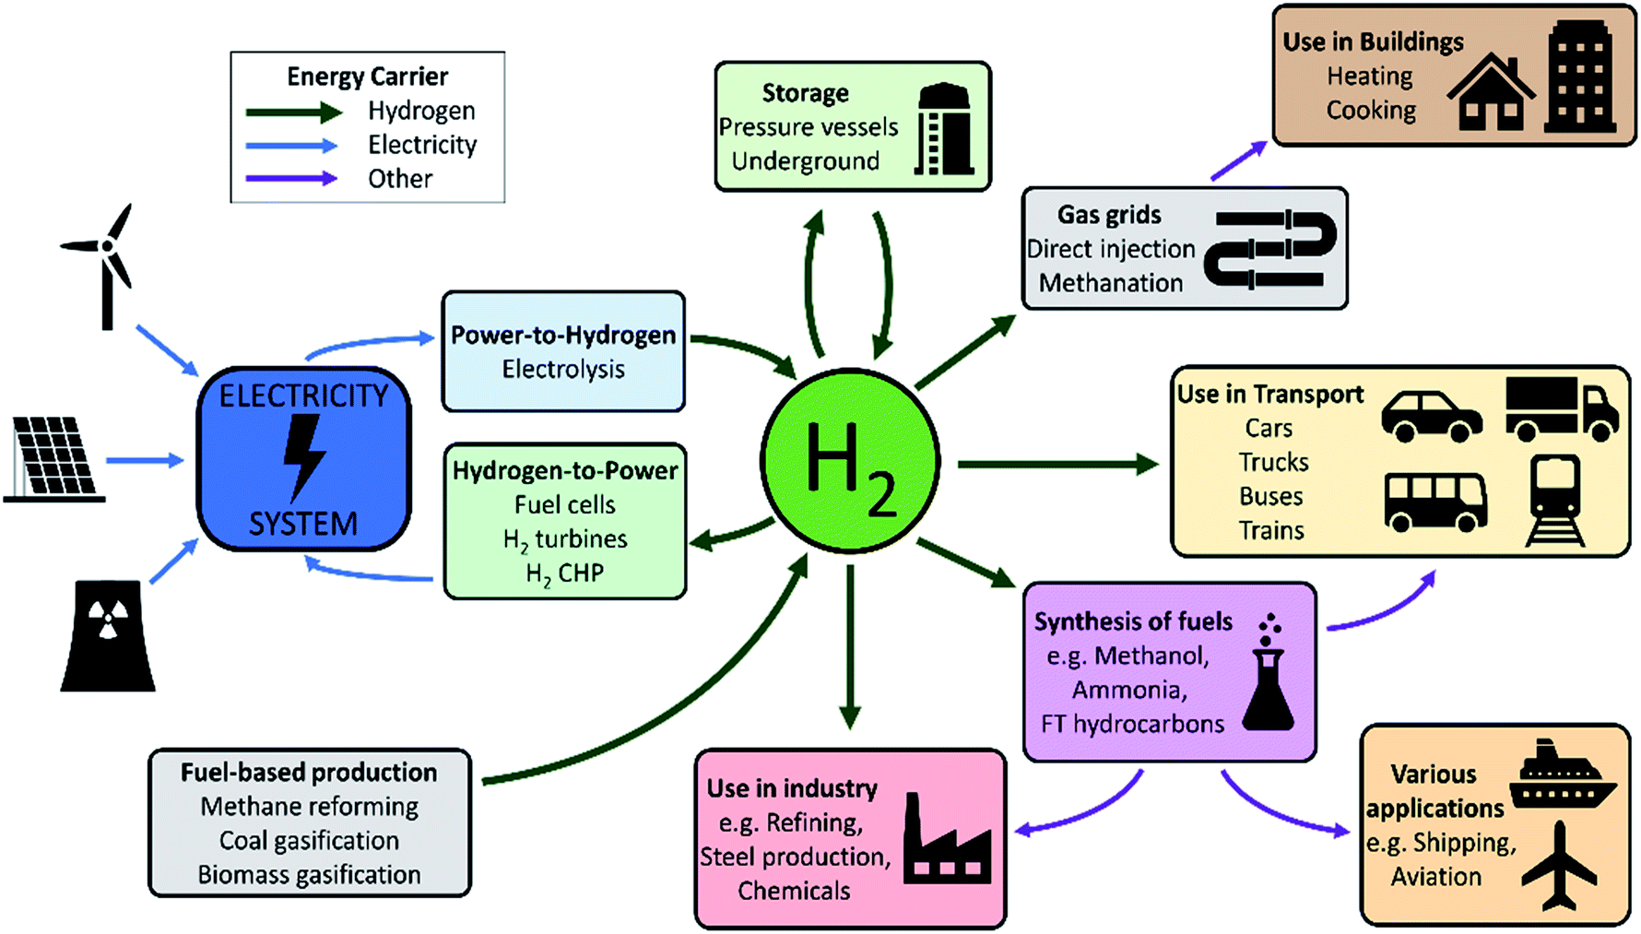
Why Hydrogen?
H2 is versatile and offers greater flexibility in decarbonizing the energy supply chain by providing multiple energy stream revenues: electricity, heat and fuel.
H2 is distinguished from other storage alternatives by its large-scale storage capacity and long-term storage capability, being ideally suitable for seasonal storage of renewables.

Slide 9
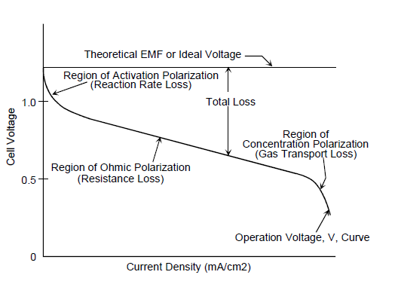
Performance of Renewable Hydrogen Energy Storage Systems
Actual Fuel Cell Voltage/Current Characteristics
Electrolysis Efficiency with increased load operation

Slide 10
Commercially-available Tools for Modelling Renewable Hydrogen Energy Storage Systems
ANSYS simulates and optimizes the internal working of electrolysis and fuel cells
HYDROGEMS as part from TRANSYS performs detailed modelling of Hydrogen Energy Storage systems
HOMER simulates and optimizes the operation of Hybrid Renewable Energy Systems

Slide 11
Developing a Precise Dynamic Model for Sizing and Simulating Hybrid Solar Hydrogen Energy Storage (HSHES) Systems
PV System Model
Electrolyser Model
Hydrogen Storage and Fuel Cell Model

Slide 12
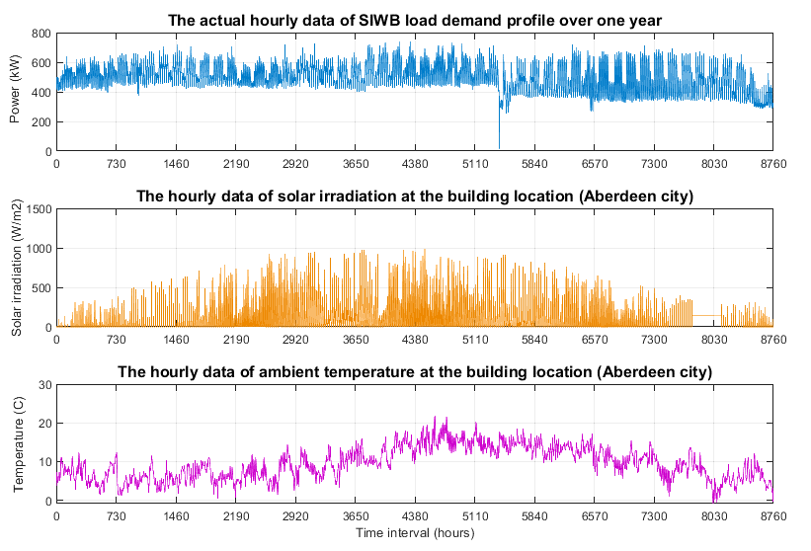
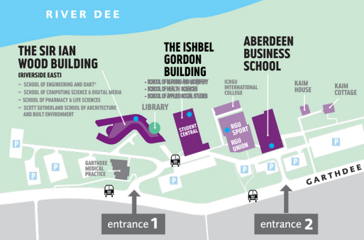
Case Study: The Sir Ian Wood Building (SIWB) – Robert Gordon University (RGU)
Parameter | Rating
Average Demand | 497.2 kW
Peak Demand | 738 kW
Total Annual Demand | 4.36 GW

Slide 13
Results of the Developed Model
Sizing Results of the proposed HSHES System for SIWB
Simulation Results of the hourly PV production, H2 production and H2 consumption by the sized HSHES System over one summer week
Component | Sized Capacity
PV System | 4.15 MW
Electrolyser | 1.5 MW
Pressurized H2 Storage Tank | 106 kg
H2 gas Cylinder Volume | 7.21 m3
H2 Target Pressure | 175 bar
Fuel Cell | 600 kW

Slide 14
Results of the Developed Model
Simulation Results of the hourly power served to the load from the fuel cell and utility grid by the sized HSHES system over one summer week
Simulation Results of the hourly status of Pressurized Hydrogen Storage Tank level over one summer week
Max level attained using generic model =315 kg
Max level attained using proposed model =86.5 kg

Slide 15
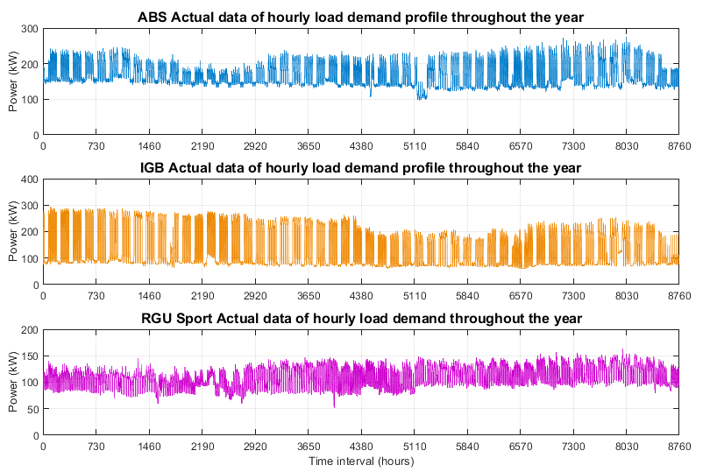
Applying the Developed Model on Other RGU Buildings
ABS
IGB
RGU Sport
Parameter | ABS | IGB | RGU Sport
Average Demand (kW) | 170 | 138.4 | 110.2
Peak Demand (kW) | 273.8 | 293.2 | 162.8
Total Annual Demand (GW) | 1.487 | 1.212 | 0.965

Slide 16
Sizing and Power Flow Results for Other RGU Buildings

Slide 17
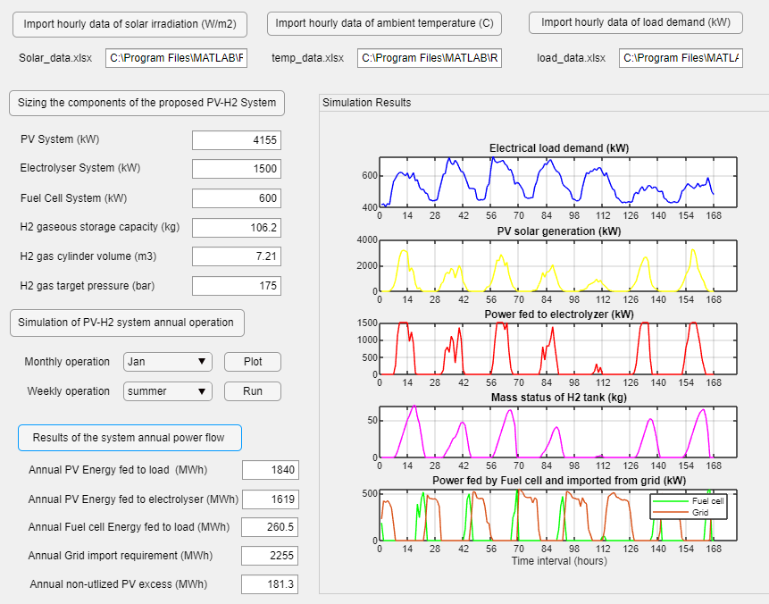
Developing a Graphical User Interface (GUI) Tool for Sizing and Simulating HSHES System for any grid-connected Building
Data input
Sizing Feature
Simulation Feature
Analysis of the System Annual Power Flow

Slide 18
Conclusion
For unlocking the full renewable potential through implementing hydrogen energy storage solutions, we developed a model for sizing and simulating Real-World dynamic operation of Hybrid Solar Hydrogen Energy Storage (HSHES) Systems within grid-connected buildings.
The developed model enables sizing the capacity of HSHES system components and modelling the dynamic behavior of electrolysers running back intermittent solar energy production while emulating the electrochemical behavior of fuel cell systems in response to load demand requirements.
The developed model has been implemented on a group of grid-connected buildings and results have shown around 47-50% of green energy supply has been provided to load demands from the sized HSHES systems.
A novel Graphical User Interface (GUI) is under development to achieve around 50% carbon reduction for any grid-connected building.

Slide 19
Thank You Any Questions?

