Slide 1
Exploring the experiences of people who use and deliver Integrated Health and Social Care in a regional area of Scotland.
Louise Henderson
PhD Student, NHSG/RGU
Lecturer, RGU
T: 01224 263157
E: l.c.henderson2@rgu.ac.uk
: @Lou_Henderson2
Supervisory Team
Prof. Catriona Kennedy, RGU.
Dr Heather Bain, RGU.
Dr Elaine Allan, NHSG & RGU.

Slide 2
My name is…

Slide 3
For today…
Outline some of the key findings from our literature review.
Give you a brief overview of our study.
Highlight opportunities to take part in our research.

Slide 4
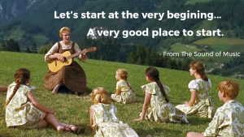
… Literature review

Slide 5
Questions of the literature
What are the experiences of people who access and receive integrated health and social care (IHSC) at home to meet their health & wellbeing needs (HWB)?
How do people access IHSC at home?
What do people, who utilise IHSC at home, perceive as their HWB needs?
How do integrated health and social care meet the HWB needs of those who utilise it?
Scoping review Oct ’17 (Baxter and Jack 2008)
Integrative review
Mar – Apr ’18
Thematic analysis (Braun & Clarke, 2016)
Databases (7)
EBSCOHost:
CINAHL; AMED; SocINDEX; MEDLINE
TRIP
Web of Science
Science Direct
Prospero Protocol Published March 2018 (Henderson et al. 2018)

Slide 6
Findings
Records identified through database searching (n = 435)
Additional records identified through other sources (n = 2)
Records after duplicates removed (n = 430)
Quality appraisal
SIGN grading system
Grading ranged from 2++ to 3
Grading ranged from B to D
Records screened (n = 430)
Records excluded (n = 383)
Full-text articles assessed for eligibility (n = 47)
Exclusions
Not primary research- descriptive
Does not meet criteria
Population; relevance: “integration”
Quality appraisal
Critical Appraisal Skills Programme (CASP)
Overall, quality of papers was poor
Studies included in qualitative synthesis (n =12)
(Mixed method
Studies included in quantitative synthesis (n = 8)

Slide 7
Feeling safe
Maintaining and promoting health and wellbeing through IHSC
Findings
Relationships with staff, carers and family are important
Collaboration
Communication
Relationships & Trust
Community & Social Roles & Contacts
Feeling in control
Inclusion
Feeling able to cope
Clarity of care systems
Functionality
Relationships as a cornerstone of IHSC
Connecting with staff
Understanding and navigating integrated collaborative systems of care

Slide 8
Our study…
People who use IHSC services
A case study of service user, informal carer and staff experiences of IHSC

Slide 9
Aim & objectives of this study
Objectives
To describe the health & wellbeing (HWB) needs of services users and informal carers.
To investigate the relationship between HWB needs and the experiences of key stakeholders who receive IHSC.
To explore the experiences of key stakeholders who access and delivery IHSC services in a regional area of Scotland.
To explore the significance of relationships in experiences of IHSC
Aim
To understand experiences of integrated health and social care, for service users and people that help them at home.

Slide 10
Participants & Methods
IHSC in the region
Data collection & analysis
Semi-structured interviews
1 hour (1:1)
2 hour (Group)
Time/date/location of your choosing
Thematic analysis: Nvivo - Replication logic ↑certainty of results
Summary report available
Context 1: Moray HSCP
Context 2: Aberdeenshire
HSCP
Context 3: Aberdeen City
HSCP
Case
A
Service
User
Informal
Carer
Case
C
Service
User
Informal
Carer
Case
E
Service
User
Informal
Carer
IHSC Staff
IHSC Staff
IHSC Staff
Case
B
Service
User
Informal
Carer
Case
D
Service
User
Informal
Carer
Case
F
Service
User
Informal
Carer
IHSC Staff
IHSC Staff
IHSC Staff
(Yin 2018)

Slide 11
Anticipated Impact & Study Progress
Impact
Improving care for service users and their families.
Could contribute to future development of IHSC in the region.
Potential to feed into Scottish Government.
… if appropriate (bold?)
Progress
2 years into PhD (1/2 way)
Integrative literature review
Exploratory field work
Patient, Public & Staff Involvement
Ethical review: SERP & IRAS
Data collection
Analysis, findings & writing up

Slide 12
How can we become involved in this study?

Slide 13
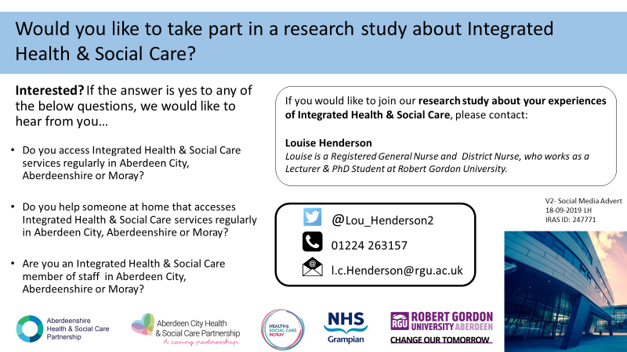
Inclusion criteria
Over 18 years of age.
English speaking.
Using IHSC services regularly.
Currently supporting the person. who is using IHSC (informal carer).
Regularly provide IHSC through a contractual paid IHSC role, to the person that is using IHSC.
Exclusions
People with learning difficulties.
People who do not have capacity to consent.
People who have profound mental health issues.

Slide 14
Closing remarks…
Outlined some of the findings from our literature review & given you an overview of our study. Exciting time of change in IHSC…
Please get in touch if you would like to know more about the study or if you, or someone you know may like to take part.
Many thanks, in anticipation of your help.
Louise Henderson
PhD Student, NHSG/RGU
Lecturer, RGU
T: 01224 263157
E: l.c.henderson2@rgu.ac.uk
: @Lou_Henderson2

Slide 15
References
BAXTER, P. and JACK, S. 2008. Qualitative case study methodology: study design and implementation. The Qualitative Report, 13, 544-599.
HEWITT-TAYLOR, J., 2017. The essential guide to doing a health and social care literature review. Oxon: Routledge.
HENDERSON, L., KENNEDY, C., BAIN, H. and ALLAN, E. 2018. Integrated health and social care; exploring the needs and experiences of service users and their families [Online]. York, UK: National Institute for Health Research. Available: http://www.crd.york.ac.uk/PROSPERO/display_record.php?ID=CRD42018085550 [Accessed 01/09/2018 2018].
YIN, R. K. 2018. Case Study Research and Applications : Design and Methods 6th ed, London, Sage Publications Incorporated

