Slide 1
THANK YOU Any questions?
Taking matters into their own hands: lockdown and the NoFap community
Dr David S. Smith

Slide 2
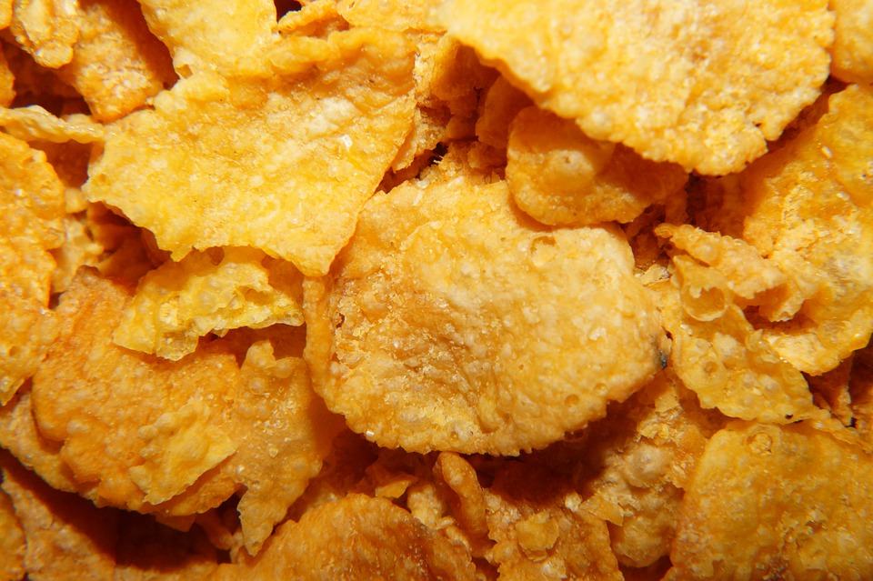
NoFap
Mrabetz (unchanged) https://creativecommons.org/licenses/by-sa/4.0/deed.en
A brief history of NoFap
Tissot (1760) & Kellogg: negative views
91.5% of men/ 60.2% of women each month (Solano et al., 2020): increase
Alexander Rhodes: worried about sexual performance – testosterone link?
4X daily to never (Wilson, 2016): Reddit - 822k+ members/ Fapstronauts
Site/ community help individuals overcome addiction/ problematic use
Pornography addiction – not DSM V, in ICD-11 (Reid & Kafka, 2020)

Slide 3
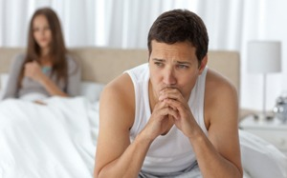
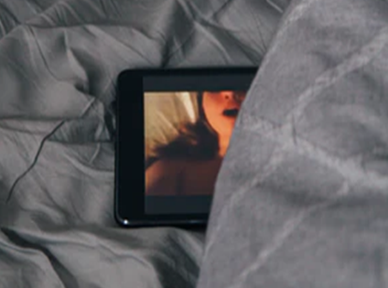
Addiction and pornography
Pornography and addiction
Stimulates dopamine paths in reward system (Gola et al., 2017)
Wired to respond to sexual stimulation to reinforce behaviour?
Reduced with dopamine antagonist (Kraus & Meshberg-Cohen, 2015)
Correlations with problematic pornography use:
Reduced working memory (Calvo et al., 2021)
Marriage dissatisfaction – men only (Perry, 2017)
Reduced commitment to partner (Lambert et al., 2012)
Sexual dissatisfaction – not ED (Dwulit & Rzymski, 2019)
Why it may not be addictive
Perceived addiction/ religiosity – cultural vs clinical (Ley et al., 2014)
Often do not measure personality: sensation seeking? (Brown & Engle, 2014)
Compulsion vs addiction? i.e. reduce anxiety vs reward (Egan & Parmar, 2013)

Slide 4
NoFap for self improvement
‘Semen retention’ gives ‘superpowers’: motivation/ cognition
e.g. strength, deep voice, willpower, mental clarity, focus, mood regulation

Slide 5
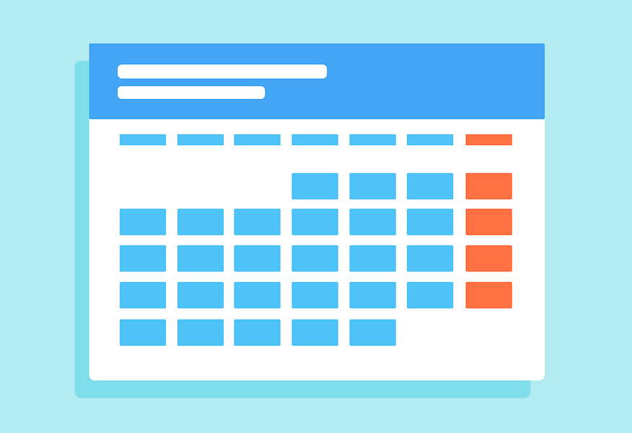
The NoFap challenge
Getting these powers
90 day abstinence from feedback loop of Pornography, Masturbation, Orgasm (PMO)
Meant to result in cognitive reboot
Difficulty levels
Easy mode: Masturbation and sex, but no pornography
Normal mode: Sex, but no masturbation or pornography
Hard mode: No masturbation, pornography or having sex
Monk mode: Hard + no artificial stimulation e.g. web
Who are the Fapstronauts?
95% men (Bishop, 2019)
White students – atheist/ agnostic (Rhodes, 2018)
Why?: motivation, relationships, intimacy (Osadchiy, 2020)
Largely Anglo Northern-American (Taylor and Jackson, 2018)
Part of the Manosphere?

Slide 6
The Manosphere: arguably a part (Hartmann, 2020)
Users: socially inhibited young men across manosphere (Bates, 2020)
Informal coalition of anti-feminist/ male hegemony groups (Ging, 2019)
“Natural” masculinity under attack from feminism (Marwick & Caplan, 2018)
Manosphere
Pick-up artists
Men Going Their Own Way
Men’s Rights Activists
Involuntary celibates

Slide 7
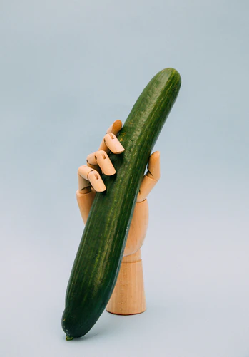
The values of NoFap
The NoFap philosophy (Taylor & Jackson, 2018)
663 posts/10 threads: “masculinity”
Shared meanings of masculinity?
Three key discourses:
1. Realness and realisation – seeking genuine intimacy
Masturbation/non-penetrative sex - not seen as masculine
Contrast: real/ virtual women – ultimate goal vs inhibiting habit
2. Masculinity is innate – a stone age brain in the modern world
Uneven power between genders: reflect differences in physicality
Men = pleasure seekers/ women = pleasure givers: porn steals men’s agency
3. Masculinity is a performance – act naturally
Society vilifies masculinity: reclaim suppressed identity
‘Embrace your masculinity’: who members are and aspire to be

Slide 8
Quotations
The NoFap philosophy (Taylor & Jackson, 2018)
. . . what in the world is masculine about jerking off to porn in front of a screen? ... There’s nothing shameful about fucking a hot young girl, you feel like the king of the jungle afterwards that’s what we are meant to do! ... Not jerk off like lonely losers to pixels on a screen. He makes some good points in the book, doesn’t mean I became a feminist and grew a vagina after reading it. If anything it made me want to fap less and fuck more. Is that not masculine for you?
No Fap is not only about overcoming our addiction over porn and masturbation, it is also about reconnecting with our inner masculinity. So lets come out of our fantasies and begin to connect with real women. Lets love them and have meaningful sex with them and show Philip Zimbardo that it is the beginning of the end of the Demise of guys!!! Can we do it??? Yes we can!!!!
Think about what feminine means to you. Are you doing those things? Are you seeking approval, laughing nervously, and being indecisive? You shouldn’t be. . . And by the way, you can laugh, but laugh only if you want to. Laughing because you are nervous is feminine. Let the girls do that around you…
Who are you to say what Nofap is – really – about? As you should know, most fapstronauts partake for several different reasons. My reason for being a fapstronaut is to increase my masculinity, become stronger as a man, and learn who i really am. If a woman is uncomfortable with masculinity (aka sexist) that is THEIR problem, not mine.

Slide 9
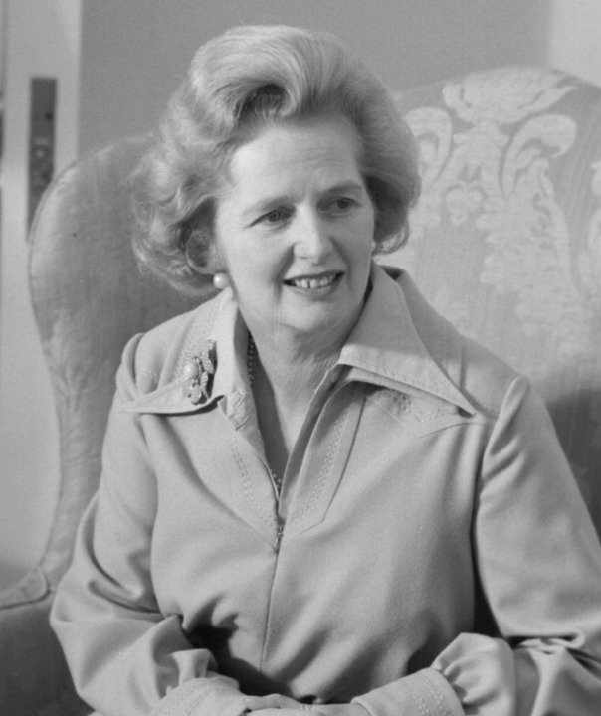
NoFap and neoliberalism
Hartmann (2020) sexual Thatcherism
NoFap videos on YouTube: sexuality and self-governance
Historical discourse: unmanly vice (Stolberg, 2000) – true men yield control
Transgressive: subverts natural economy of sexual exchange (Garlick, 2012)
The journey
The masturbating man
Passive consumer: reward but no effort
Emotionality: effeminate
The post-mastubatory man
Autonomous: sexual agency
Internally vs externally driven
Orgasm = natural reward for effort
Relapsing: betrayal of masculine sovereignty

Slide 10
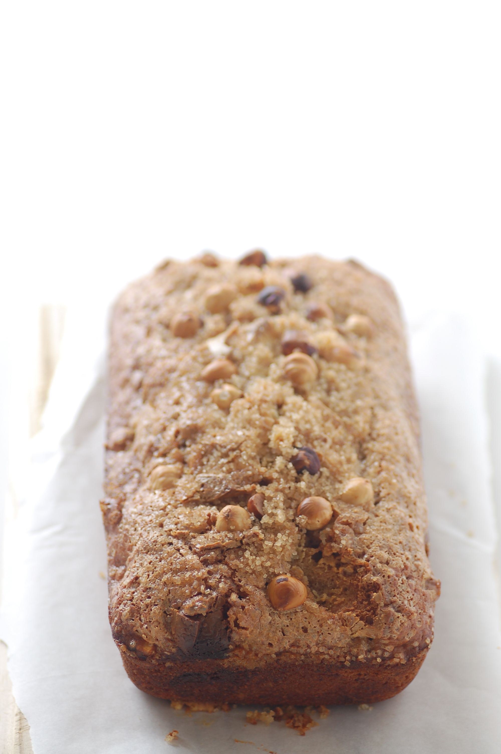
Covid-19
Social distancing and mental health
Negative mental health outcomes anticipated across all locations/ age groups (Banks & Xu, 2020; Holmes et al., 2020; Kumar & Nayar, 2020; Rajkumar, 2020)
Psychological responses
Stress (Horesh et al., 2020)
Loneliness (Brodeur et al, 2020)
Depression (Rehman et al., 2021)
Boredom (Droit-Volet et al., 2020)
Social isolation (Gupta & Dhamija, 2020)
Increases in…
Baking (Selwood, 2020)
Gardening (Marsh, 2021)
Eating (Cherikh et al., 2020)
Drinking (Pollard et al., 2020)
Reading (Boucher et al., 2020)
Smoking (Cransac-Miet et al., 2020)
Playing video games (Sweeney, 2021)
Internet use (Droit-Volet et al., 2020)

Slide 11
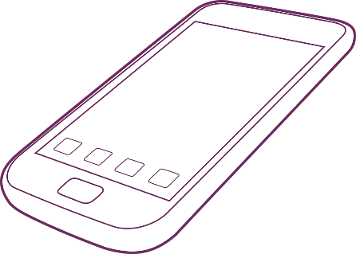
Lockdown and sexual behaviour
Low-risk sexual outlets (Doring, 2020)
Constructive way to ward off mental health issues? Few opportunities
Endorsed: governments in Ireland (Brent, 2020) New York (Valenti, 2020)
Sexual behaviour: increased…
Sex toy sales (Lee, 2020)
Sexting partners (Lehmillera et al., 2020)
Phone sex services (Callander et al., 2020)
Solo masturbation (Cascalheira et al., 2021)
Sexual relationships between habiting couples (Addi et al., 2020)
Pornography and the pandemic
Correlation: loneliness (Butler et al., 2018)
Correlation: low affective states (Boethe et al., 2020)
Problematic use in local lockdown (Marchi et al., 2021)
Pornhub searches up: free premium access (Grubbs, 2020)
General increase in lockdown (Rodrigues & Martins, 2020; Mestre-bach, Blycker & Potenza, 2020; Sharma & Subramanyam, 2020; Zattoni, 2020)

Slide 12
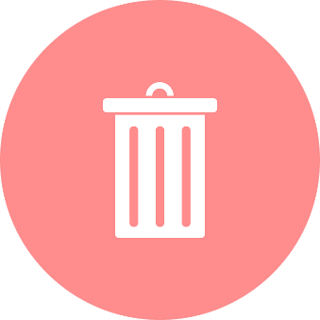
Smith et al., (in submission)
Self-love in the time of Covid
Research questions:
How have NoFappers adapted to lockdown?
Is lockdown associated with relapses or reboots?
How has the online community supports members?
Method
Python: related search term
Team analysed subset of posts: inter coder reliability
Posts split: 3 team members analysed, fourth reviewed coding
Total: 524 posts/ 164 threads March-November 2020 (final, 513/159)
Coded: valence, key themes, gender implications, metaphor, alternatives
Posts removed if…
Threads were irrelevant
Posters stated they were under 18
Note all quotations cited are paraphrased to protect anonymity

Slide 13
Smith et al., (in submission)
Analysis
Discourse analysis: 4 key themes identified, with sub themes
Themes
The difficulty of lockdown
The opportunity of lockdown
Testing the parameters of NoFap
Community cohesion
Not mutually exclusive
e.g. difficulty of lockdown makes it a positive catalyst for change

Slide 14
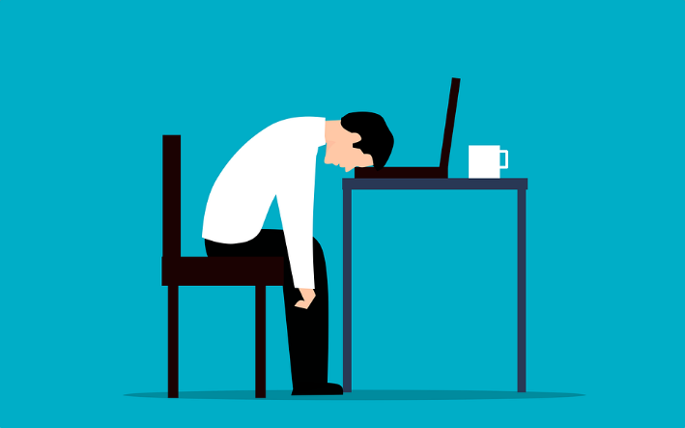
1. The difficulty of lockdown
Lockdown as a challenge
Most posts: social distancing measures have been difficult for users
Metaphors: armed conflict/ war, lockdown as blackhole, finishing “alive”
Subthemes
1. Boredom
Easy thrills of online pornography – single men
Time alone in room: laptop/ mobile – increase urge
Highest: members with active social lives prior to lockdown
PMO: time goes faster – “only” way of reward without effort
Lockdown is crucial, but I’m in a bad place. I’m streaming all day, eating too much and staring at the ceiling. I feel shit. I'm alone with zero stimulation. Sports has saved my life, but there are only so many sit ups I can do in my room.
The last few months I am my old PMO self again – the pandemic has made this worse. Being at home all day means I relapse almost daily...

Slide 15
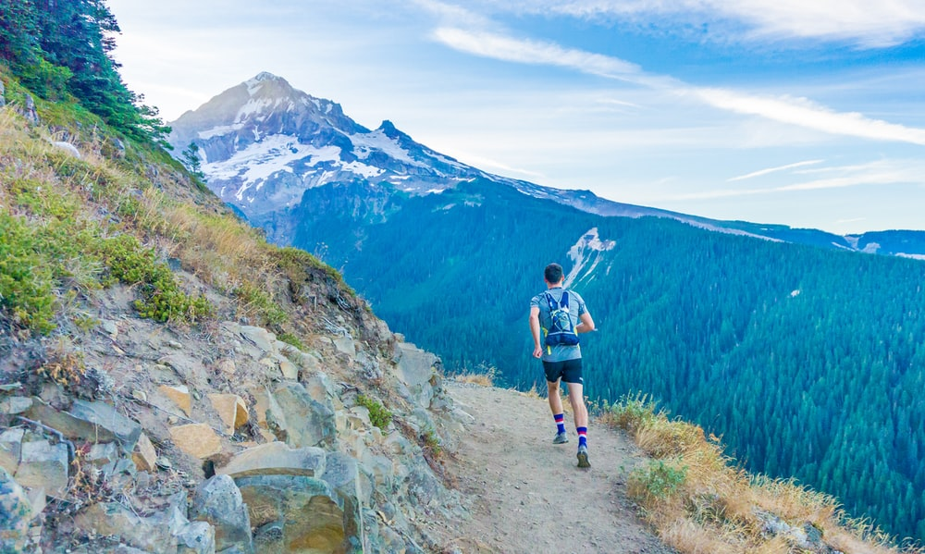
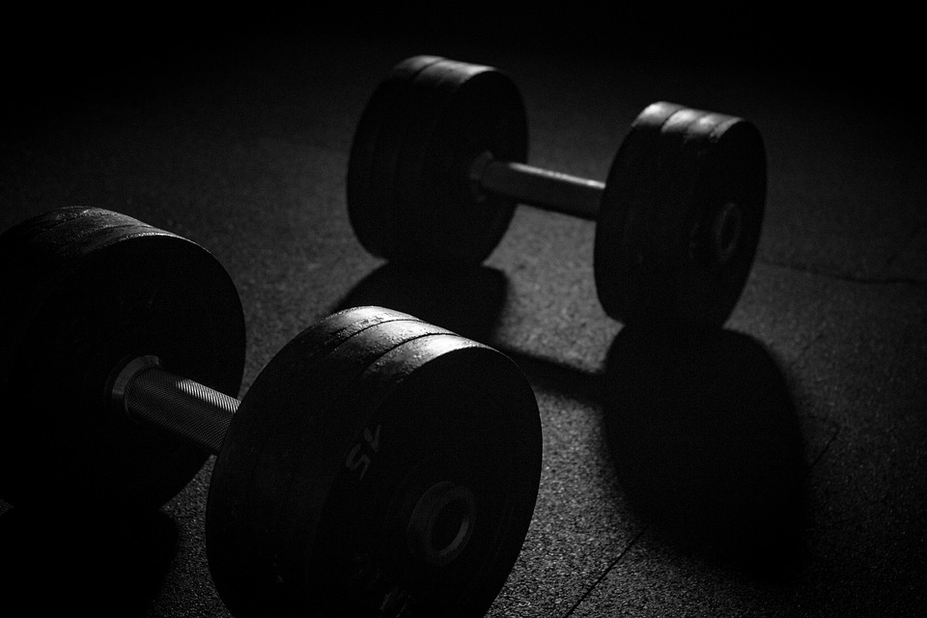
Alternatives to “fapping”
Performative masculinity: strength/ discipline (Taylor and Jackson, 2018)
Endurance/resistance training increase testosterone (Grandys et al., 2009)

Slide 16
1. The difficulty of lockdown
Lockdown as a challenge
2. Loneliness
Escaping, negative states - “sole companion”
Regress: unproductive/ unmotivated/ “pitiful”
Fantasies: self-harm/ breaking things
“Lately the toll of social isolation has been hard. I feel down, bored and aimless most of the time, which takes the form of very strong urges.”
3. Technology = temptation
Pornography easy to access – Pornhub: free access
Smart phones, laptops/ TV: paths to sexual thought
Social media e.g. Instagram/ Facebook – Monk mode?
“Everything is on computer: work, studies. It’s just a click away. How do you stop?”
Struggles/ habits = reflect general population

Slide 17
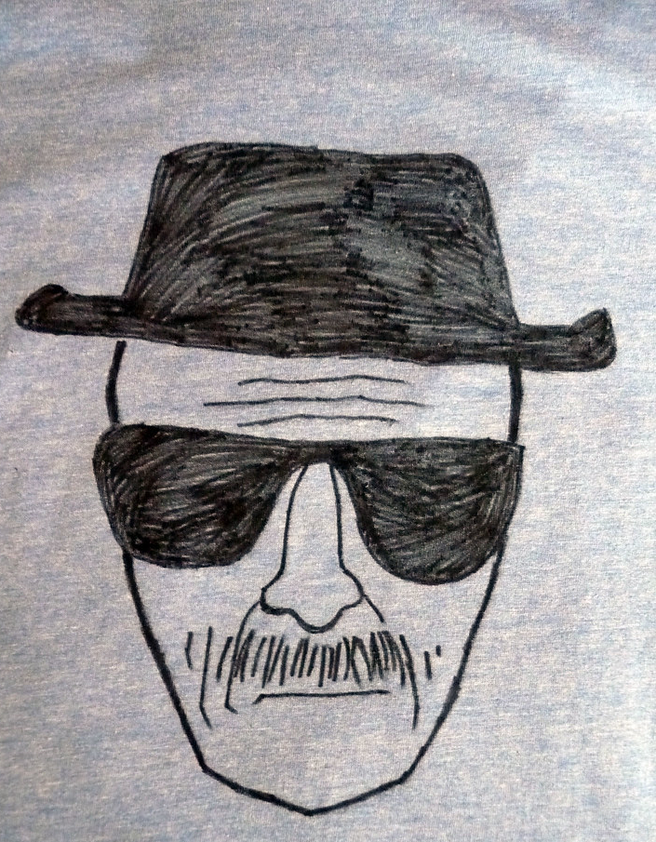
2. The opportunity of lockdown
Lockdown as a good thing
Approx 25% of posts
Collective identity: strength vs incels
Measures = opportunity to test their grit
“Smooth seas do not make skillful sailors”
Subthemes
1. Personal growth
Extra time to pursue their goals
Gift: focus without daily pressures
Breaking Bad transformation: to Heisenberg
“To create Heaven, one needs to live in Hell”
Only ‘easy mode’ after
2. Separating the men from the boys
Exposes casually dedicated members
Chiasm: NoFap and general pop. ‘zombies’
Elite 1% vs 99% who cannot yield self control
Fapstronauts’ kids will tell stories about lockdown powers: mythical

Slide 18
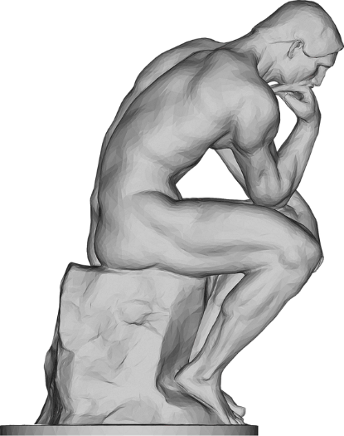
3. Testing the parameters of NoFap
Desperate times/ desperate measures
Lockdown measures reflected exceptional circumstance: the same rules? Why continue with NoFap when they cannot get sexual partners?
Existential questions
Why NoFap now?
What qualifies as cheating?
Could they masturbate less?
But
Complete lifestyle change
“Real sex” not only goal
Subthemes
2. Digital intimacy
Absent partners
Is phone sex acceptable?
Masturbation without porn?
But
Undermines meritocracy
Phone with no touching ok
3. No free pass
Near-unanimous: lockdown counts
NoFap = pledge: regardless of circumstances

Slide 19
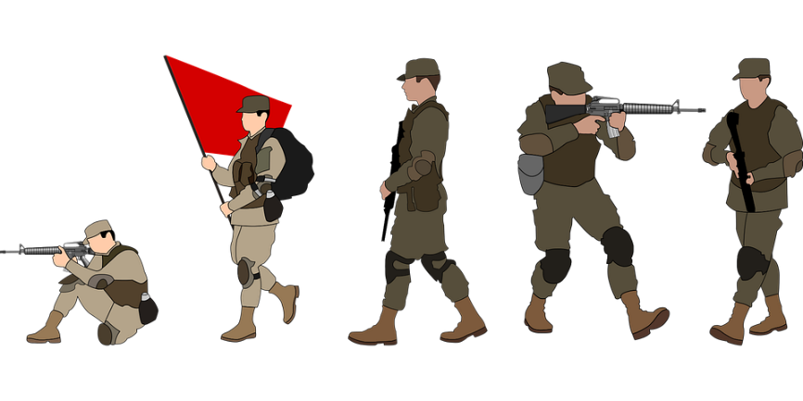
4. Community cohesion
Importance of digital community
Share vulnerability: NoFap = journey vs destination
Antithetical to masculine scripts (Hartmann, 2020; Taylor and Jackson, 2018)
Subthemes
1. Bromance
Emotionally intimate/ expressive
Safe space: disclose personal info without judgement/ rejection
Relapses: encouragement/ upvotes/ advice/ support
Motifs: ‘Bro’ terminology and military units
2. Solidarity
Commitment to each other and solo achievement
Reinforcement/ mentorship: members show streak in flares
Neoliberal but equality of opportunity: share tips/ strategies
‘You have a 300-day streak, I so admire you. I want you to teach me!’

Slide 20
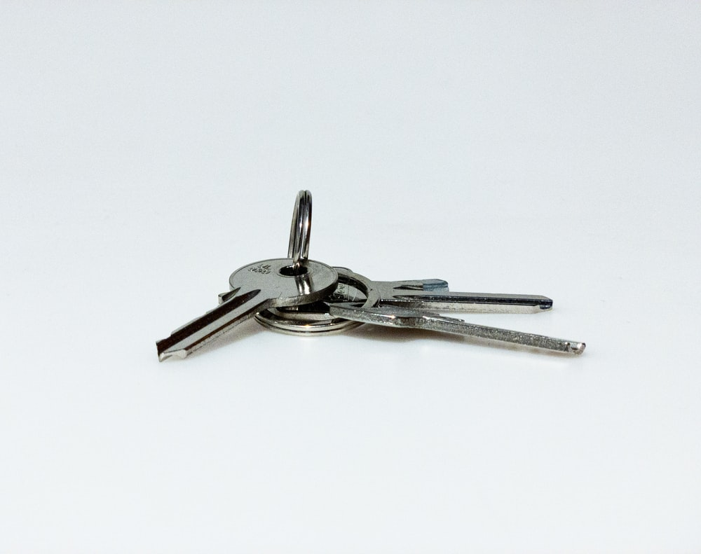
Conclusions
Themes
Difficulty of lockdown
Opportunity of lockdown
3. Testing the parameters of NoFap
4. Community cohesion
Key points
Challenge: overwhelming or empowering?
Fluid: some changed their mind throughout
Broad patterns in the data: November vs March?
Gender implications of movement – women as members?
Control for location, rates and longitudinal changes?
Acknowledgements:
Dr. Alice Butler-Warke, Ms. Emma-Lee Davidson, Dr. Gemma Stevens, Miss Caroline Hood, Mr. Connor Keegan

Slide 21
Any questions?

