Slide 1
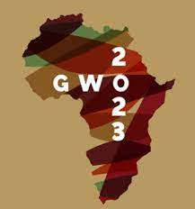
A Multination Study on Women Entrepreneurs response To Covid-19 In Crisis in the Global South: A feminist Perspective
Bridget Irene, Joan Lockyer, Charlotte Felix-Faure,
Dina Nziku, Chioma Onoshakpor, James Okrah

Slide 2
Literature Review
No global crisis has shocked the world economy in terms of supply and demand, as COVID-19 as, in terms of its intensity and impact.
Businesses must adapt their business models during crises and shocks.
This is particularly challenging for women entrepreneurs whose businesses are vulnerable to economic meltdowns and shutdowns, such as the COVID-19 global pandemic necessitated.

Slide 3
Aim/Objectives/research questions
The objective of this study is to explore the gendered approach to crisis management by investigating women entrepreneurs' crisis responses across seven SSA.
How gendered is crisis in Sub-Saharan African countries and what impact does it have on women entrepreneurs.

Slide 4
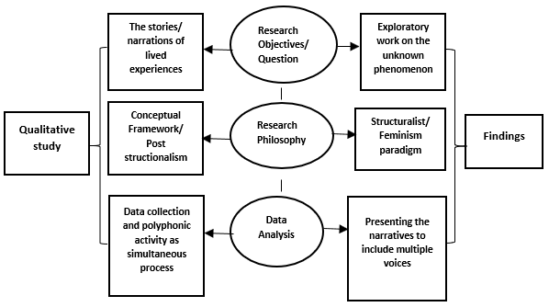
The methodological framework for this study
​Figure 1: The Methodological Framework for this study

Slide 5
Key results and findings
The findings from suggests that depending on the nature of the crisis, it can present both an opportunity and a risk for women entrepreneurs.
The Intersection of Crisis Type and Gender: Communal Traits versus Agentic Traits in Crisis Response. See figure 2
Think Manager -Think Male versus the Think Crisis Think Female Stereotypes. See figure 3

Slide 6
Figure 2: Intersecting factors that impact Women’s Response to Crisis

Slide 7
Figure 3: Effects of socially Constructed Gender Traits/Behaviours on Crisis Typology

Slide 8
Contribution to research and practice
Theoretical contribution: resilience of women in relation to the type of entrepreneurship crisis e.g COVID health pandemic
Policy may be adapted to support appropriate crisis response in relation to the nature of crisis
Providers of training on women’s empowerment could introduce an adapted model of STEM education that is gender-sensitive.
Policy may be amended to provide specific support for women entrepreneurship within the African context during crisis

