Slide 1
Culture vs Commerce?
Indies in Scotland: Exploring the role of independent bookshops in Scotland’s towns and villages
Dr Audrey Laing

Slide 2
Research Context
Current project builds on previous work exploring:
consumer behaviour in bookshops
bookshop as ‘third place’
browsing in bookshops
Current bookselling environment is one of digital disruption and economic challenge.
However, numbers of independent bookshops in the UK has risen for 5th year in a row (Comerford 2022)

Slide 3
Research Context
Previous research suggests bookshops can be ‘Social and cultural hubs’ (SCB 2012)
CEBR Report highlights ‘creative spillover impact’ (2017)
Are booksellers ‘reluctant capitalists’? (Miller 2006)
Or have they become ‘skilled capitalists’ (O’Brien 2017)
Backdrop of dying high street
Methodology: publishing contact, then snowball sampling of village and town bookshops

Slide 4
Research Questions
What is your role in the local community?
What support/policy change would help your business?
What challenges do you face?
What relationship do you have with local stakeholders?
What do you do to survive and prosper?

Slide 5
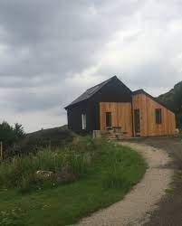
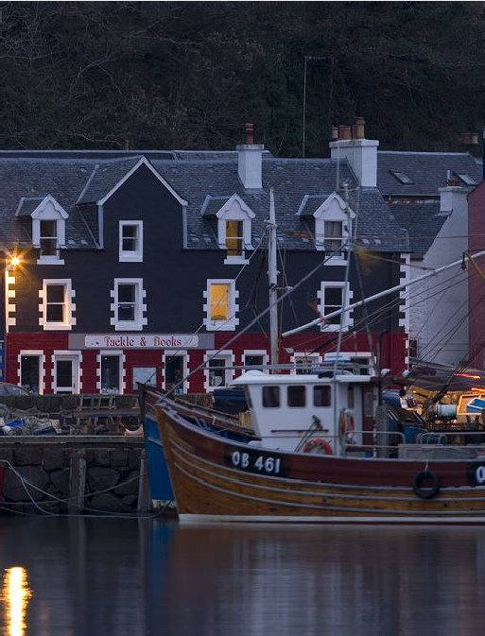
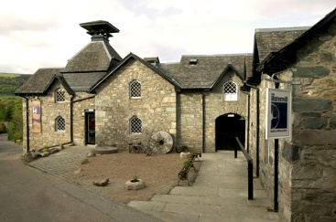

Slide 6
Findings – the challenges
Digital disruption - plateau and acceptance, but frustration re Amazon tax breaks
‘we pay our taxes and we pay a living wage’
‘Amazon cannibalises and destroys’
Business rates are inconsistent and council policies are centralised
Q: How do local councils support you?
A:‘Crap. I would say they actually have a negative effect on the local area.’
‘they have no understanding of issues in rural areas’

Slide 7
Findings – more challenges
Breaking of connections with libraries and schools
‘I’m not saying [the policy is] deliberate,
but no-one’s ever thought it through…’
Fallout from demise of the NBA
‘If it’s cheaper in Tesco than from a distributor or publisher, something is wrong. It’s not a viable business model. I can’t think of another industry where a brand new product, what should be one of your best sellers, is so vastly discounted’
‘we are on the cusp of vulnerability’

Slide 8
Findings – the strength of indies
Community hub ‘socially connective retail’, supporting wellbeing (O’Brien 2017)
Enhance and support cultural activities (CEBR 2017)
Proactive, community drivers, cross pollination with the local community
Current growth in book festivals – worth over £11M to Scottish economy – often driven by indies
Intrinsic motivation and dedication of bookshop owners
‘You wouldn’t be running a bookshop if you were only interested in the bottom line’
‘Did I have a customer yesterday…?’

Slide 9
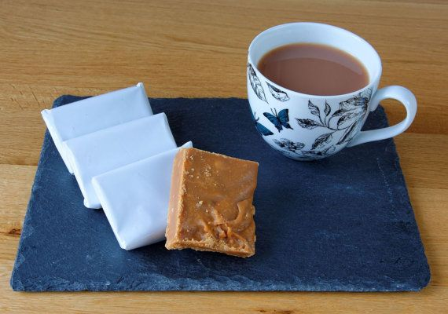
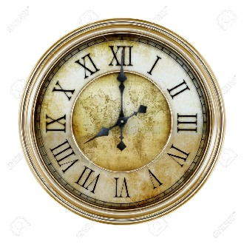
Findings – more indie strengths
Geographically remote bookshops are often destination stores
Central part of local and visitor mix
‘some people come in every day’
‘it’s a safe space’
Often very seasonal
May need other products such as café for financial survival
Serendipity is important…

Slide 10
Culture vs Commerce in summary:
Widespread governmental and local council failure to recognise cultural and community value of bookshops in towns and villages
Independent bookshops demonstrate considerable dedication, fortitude and imagination overcoming the challenges of location, tax, large powerful competitors and economic difficulties
Independent bookshops often play a central networking role in high street/ local village, identity and survival
Independent bookshops are hubs of activity, proactivity and philanthropy; safe spaces for communities, protectors and promoters of literacy and lovers of books.

Slide 11
The Future High Street
There are many imaginative suggestions to deal with the ‘high street problem’ (Hospers 2017; Parker et al 2020)
Focus on the social, cultural, experiential
A perfect fit for bookshops
Alongside cafes, artisan stores and other destination venues, independent bookshops can be the serendipitous heart of the community
‘a bookshop gives identity to a high street’

Slide 12
References
Centre for Economics and Business Research (CEBR) (2017). Bookselling Britain: the economic contribution to – and impacts on – the economy of the UK’s bookselling sector. CEBR: London.
Comerford, R., (2022). Indie bookshop numbers rise for fifth consecutive year, BA figures show. The Bookseller. [online]. Available from: https://www.thebookseller.com/news/ba-bookshop-membership-grows-fifth-year-survey-finds-1298190 [Accessed 21 April 2022]
De Lisle, R., (2014). Let’s reinvent the bookshop. 1843. [online]. May/June. Available from: https://www.1843magazine.com/content/lifestyle/rosanna-de-lisle/bookshop-design [Accessed 29 November 2018].
Gregory, C., Sonderland Saga, R. and Parker, C. (2022). Booksellers as Placemakers: The contribution of booksellers to the vitality and viability of high streets Available from: https://www.booksellers.org.uk/BookSellers/media/Booksellers/Booksellers-as-Placemakers-for-website_1.pdf [Accessed 5 May 2022]
Frank J. (2018) Regenerating Regional Culture: A study of the International Book Town Movement. Sociology of the Arts. Palgrave Macmillan, Cham
Hendricks, J., (2016). Curating Value in Changing Markets: Independent Record Stores and the Vinyl Record Revival. Sociological Perspectives, 59(2), pp.479–497.
Hracs, B. and Jansson, J., (2018). Conceptualizing curation in the age of abundance: The case of recorded music. Environment and Planning A: Economy and Space, 50(8), pp.1602-1625.
Laing, A., (2020). Indies in Scotland: Exploring the Unique Role of independent Bookshops in Scotland’s Towns and Villages. Publishing Research Quarterly, 36(4), pages 585-600. Available from: https://doi.org/10.1007/s12109-020-09759-5
Miller, L. (2006). Reluctant Capitalists. University of Chicago Press: Chicago.
O’Brien, G. (2017) Small and slow is beautiful: well-being, ‘socially connective retail’ and the independent bookshop, Social & Cultural Geography, 18:4, 573-595, DOI: 10.1080/14649365.2016.1199814
Scottish Centre for the Book (2012). Books in Scotland. Edinburgh Napier University: Edinburgh.

Slide 13
Captioning Statement
Video and audio content at the University uses closed captions generated by automatic speech recognition (ASR). The ASR process is based on machine learning algorithms which automatically transcribe voice to text. According to our technology providers this process is approximately 70-90% accurate depending on the quality of the audio, and consequently video and audio closed captions may include some transcription errors. It is therefore important to recognise that the original recording is the most accurate reflection of the content, and not the captions.
If you require accurate captions as part of your reasonable adjustments, please contact the Inclusion Centre to discuss your requirements.

