Slide 1

Enhancing our knowledge of students’ independent learning techniques via a qualitative approach
Enhancing our knowledge of students independent learning techniques via qualitative techniques
Dr Pauline A M Bremner, Dr Kate Goodhand, Tracy Pirie, and Dr Katrina Forbes-McKay

Slide 2



Enhancing our knowledge of students’ independent learning techniques via a qualitative approach
The Aim

Slide 3
Key Learning Points:
To define what independent learning is
To outline the ways in which students use strategies for enhancing their independent learning
To highlight staff perceptions of what students, need to be independent learners
To recommend the best way forward given the findings of research, considering the SDG’s, in particular, goal 4 focusing on lifelong learning

Slide 4
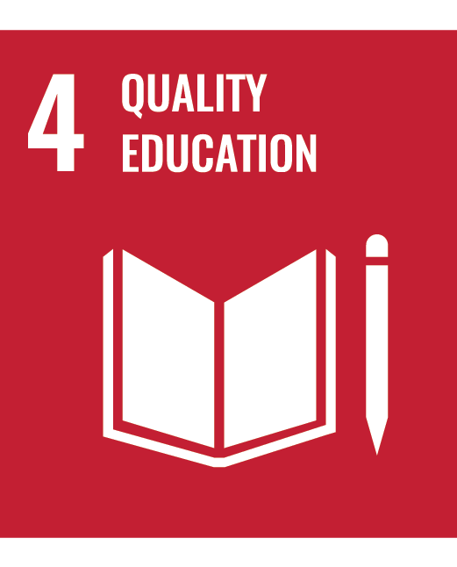

Independent Learning:
Independent learning is a method or learning process where learners have ownership, control, and a desire to develop their own learning. They learn by their own actions and direct, regulate, and assess their own learning.

Slide 5
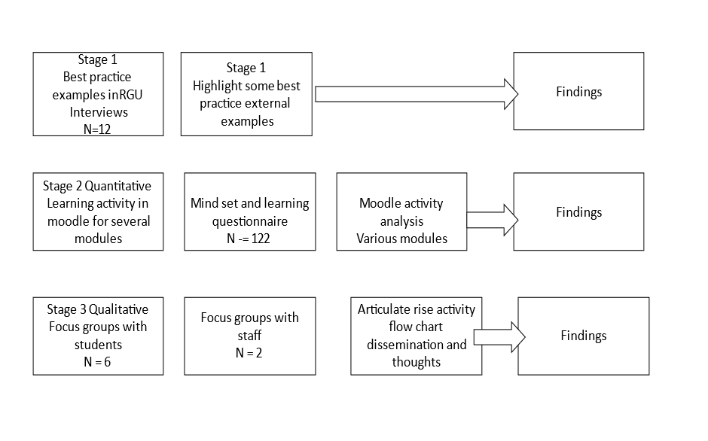
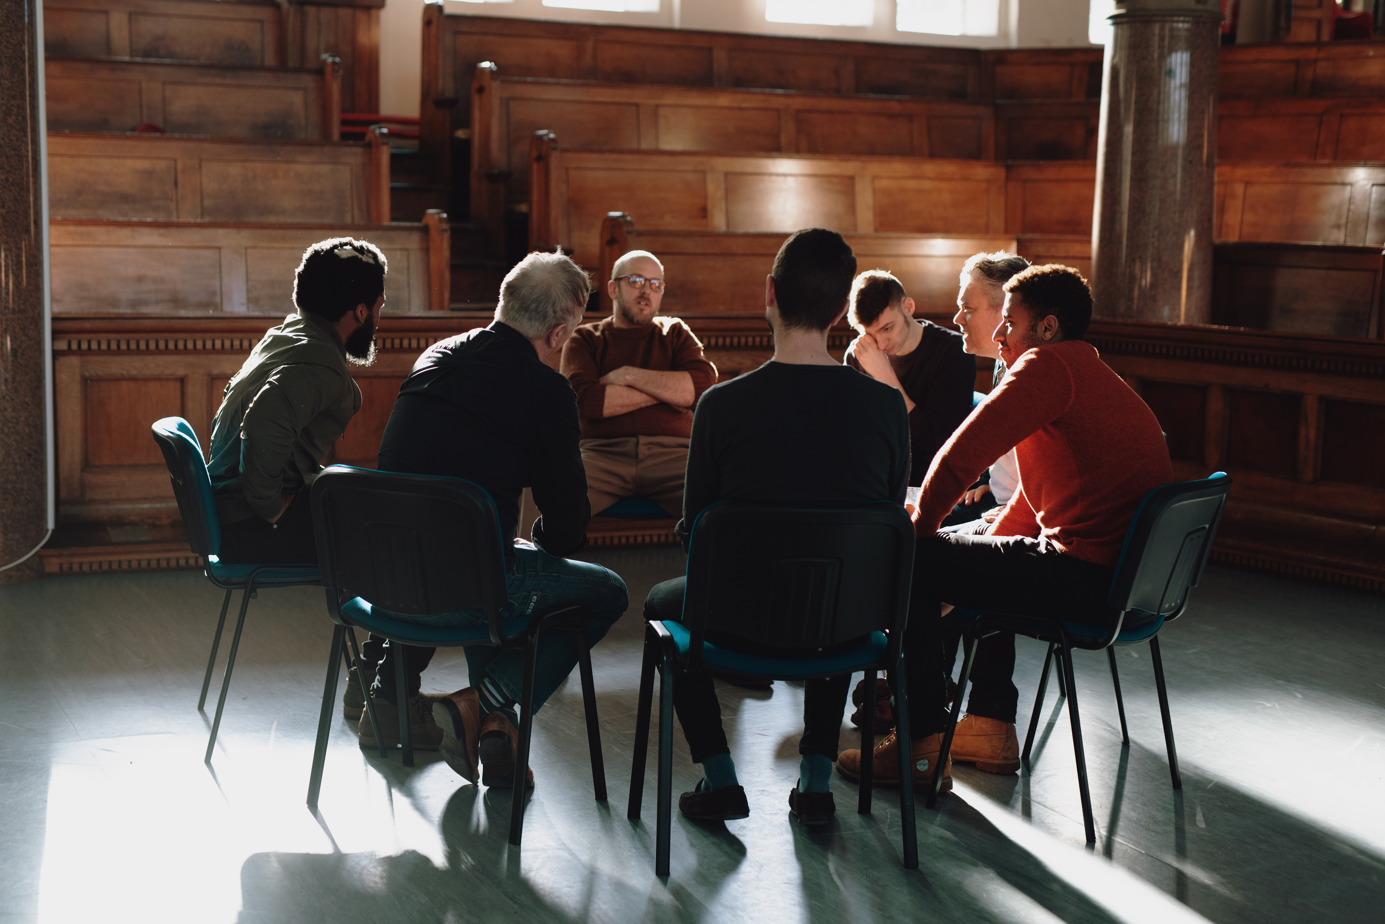

Methods

Slide 6
Methods
Themes
Settling questions
General Independent Learning questions
Resources for Independent Learning questions

Slide 7
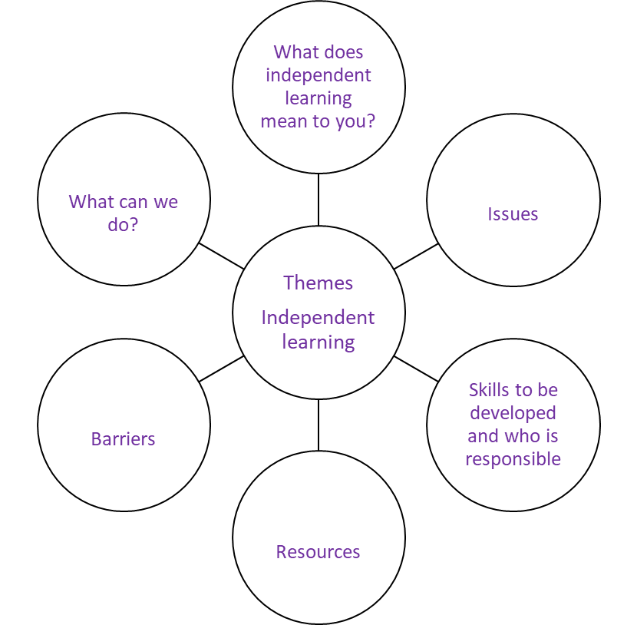
Findings: Staff
The composition included
The disciplines covered
The focus groups were (Braun and Clark 2006)

Slide 8

Findings: Staff
Students need to be able to work on their own
‘spectrum, I think that takes place where you've got different levels of independent learning for some people’.
‘I think they need a foundation. They need a knowledge foundation that will help them do that’.
There are a number of resources to help with IL maybe too many which is the main issue information overload
skills sets ‘change year on year’ and that for supporting ‘direct entrants we put in extra things, and we try to sort of share resources so that they're not, we're not duplicating’.

Slide 9
Findings: Staff
Barriers to IL are many: physical and technical
Enabling tools suggested were:
  Assessment
  Module
  Explain what IL is
  Ethos
  End of year feedback and not SEQs
  Measurement tools
‘I want this student who comes in and who's going to make a great contribution to whatever profession’ as it is a bit sad ‘that we're doing a kind of remedial’.

Slide 10
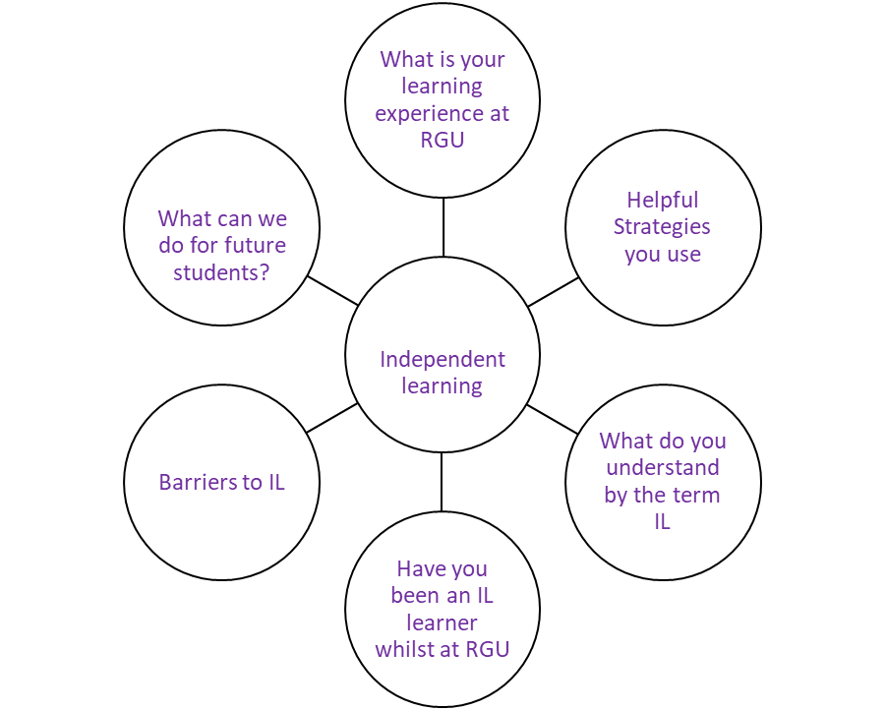
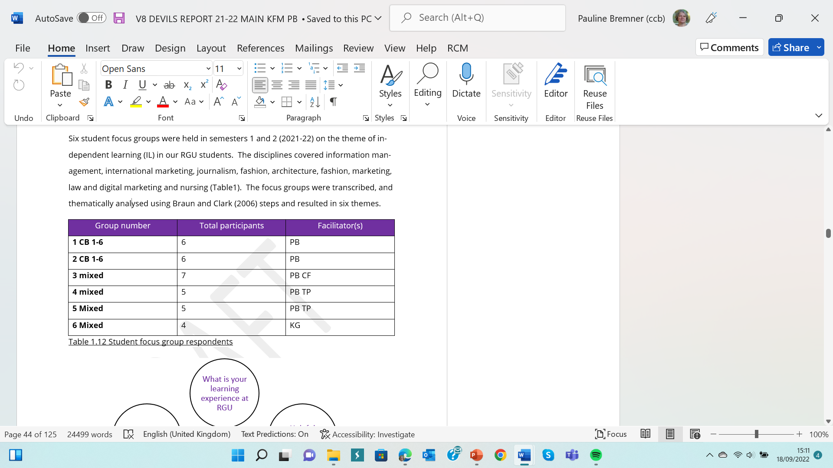
Findings: Students
The disciplines covered

Slide 11
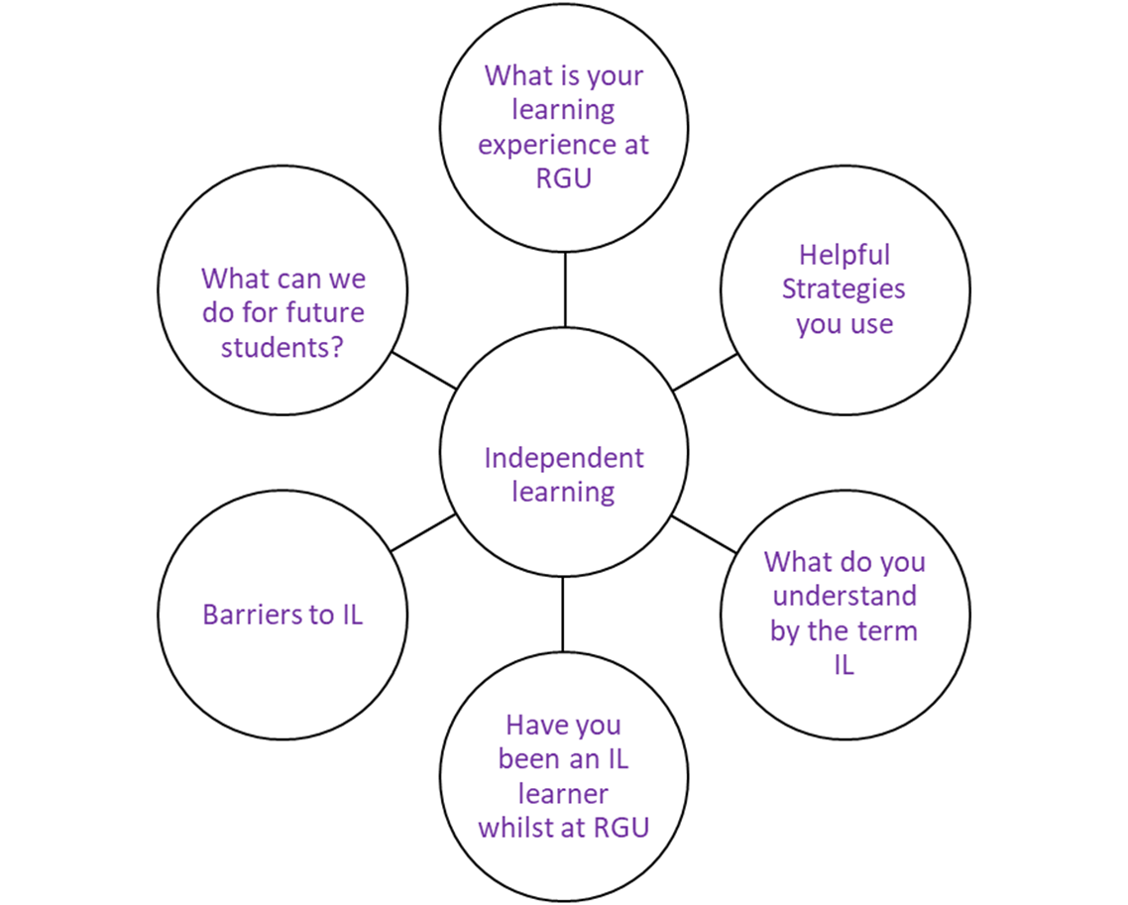
Findings: Students
The majority of the students identified RGU as having a supportive learning environment, many resources available
Students use a number of strategies, professional services, specialist to their course and ad hoc
Students did not really recognise the meaning behind IL. The students highlighted more functional activities rather than IL definitions as such, with time taken over stipulated hours being mentioned, and taking control being highlighted
‘We learn as we do, and I think that's really good to be able, to just sit in the class and listen passively’.

Slide 12
Findings: Students
Have you been an IL whilst at RGU - some noted the changes in technology have enhanced the speed at which they can do things with a love hate relationship
‘I loved and hated the online teaching’
Barriers to IL - As one noted ‘it makes it a bit tricky for me to be an IL if I don’t know the expectations’.
Students noted for the topic of IL to move forward it is about motivating students to work in that way, developing creativity and curiosity and having resources at their fingertips helps

Slide 13
Recommendations
A university wide definition of independent learning
A module/micro credential examining independent learning could be added to all degree programmes
A bringing together of information sources into one articulate rise programme or APP
A handout showing the correlation between moodle use and results

Slide 14
Conclusions
The definition of IL is not clear to all
  There are many varied responses to what it is and how it can be developed
BUT
If we wish our students to be more independent, we need to let them know what this is and how the responsibility lies with them
  Resources need to be streamlined, more accessible and become a toolkit as a ‘go to’ when students require to. Maybe in the form of an APP

Slide 15
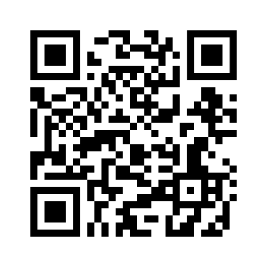
What approaches can independent learning take in educational settings to stimulate lifelong learning ?

Slide 16
References
DIFRANCESCA, D., NIETFELD, J.L., & CAO, L. (2016). A comparison of high and low achieving students on self-regulated learning variables. Learning and Individual Differences, 45, 228-236.
KERSTEN, D. (1975) Predictability and redundancy of natural images, Optical Society of America A, Vol. 4, page 2395
KNOWLES, M. (1975). Self-Directed Learning: A Guide for Learners and Teachers. Chicago, IL: Follett Publishing Company.
MILLARD, L. (2022) Being Successful at Abertay: First Year belonging through personalised micro credentials. Presentation to RGU.
PINTRINCH, R. R., & DeGROOT, E. V. (1990). Motivational and Self-Regulated Learning Components of Classroom Academic Performance. Journal of Educational Psychology, 82, 33-40.
ZIMMERMAN, B. J. (1986). Development of self-regulated learning: Which are the key subprocesses7 Contemporary Educational Psychology, 16, 307-3 13.
ZIMMERMAN, B. J. (1990) Self-Regulated Learning and Academic Achievement: An Overview, Educational Psychologist, 25:1, 3-17

Slide 17

This Photo by Unknown Author is licensed under CC BY-SA-NC

