Slide 1
Changing news values?
An integrated approach to examining meaning co-creation
in digital journalism
Bissie Anderson
University of Stirling, Scotland
bissie.anderson@stir.ac.uk

Slide 2
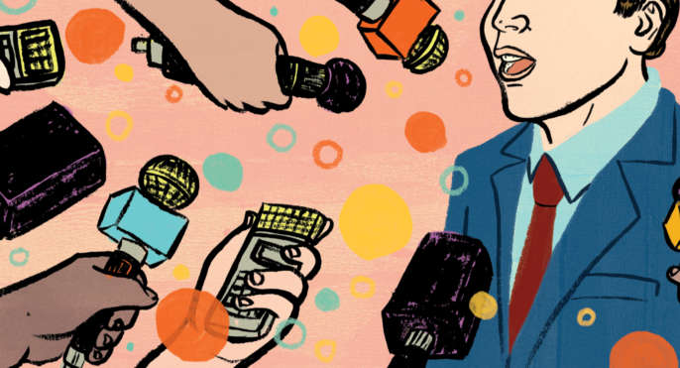
What does opera have in common with journalism?

Slide 3
Journalism’s narrative turn
Digital media affordances make a “more immersive, interactive, multimodal and participatory storytelling” possible (Bounegru et al, 2017)
Digital longform storytelling has “forged a space for linear narrative on the fragmented, de-centred, hypertextual Web”, and “furthers the field’s understandings of the Web’s potential for dramatic and immersive journalism” (Jacobson et al, 2016)
“Combining text, photographs, looping videos, dynamic maps and data visualizations into a unified whole” (Hiippala, 2016)

Slide 4
How do these developments change news values, traditionally regarded as ‘maps of meaning’?
Understanding journalism as a performative process with a clear communicative purpose
How is the audience experience ”constructed”?
Need to explore the concept as a process of negotiation between producer and audience

Slide 5
An integrated methodological framework for the study of news values
Combined producer, artefact and audience perspectives
Three analytical concepts: text-as-intended, text-as-realised, text-as-experienced
Three stages of empirical analysis: triangulation of 1) interviews with digital journalism producers, 2) multimodal + HCI artefact analysis, and 3) audience reception studies

Slide 6
Why combine multimodality and HCI approaches to analyse artefacts?
No mechanism for exploring interactivity in multimodal discourse analysis
Interactivity as 1) an aesthetic feature and 2) a functionality (Adami, 2015)
Should we consider the qualities of afforded interactivity and the role of reader/audience by studying the interaction effects of visual and verbal modes with the functions of interactivity?

Slide 7
Putting the framework into practice
Interviews with 12 data journalism producers in the UK
Interaction design analysis of interface
Multimodal discourse analysis drawing on Jancsary, Höllerer and Meyer’s (2015) five-step framework
Anderson, B, and Borges-Rey, E. (2019). “Encoding the UX”. Digital Journalism.
[in print].

Slide 8
Author-driven/reader-driven UX design, function and semantic operations of data journalism stories

Slide 9
UX design comparative analysis

Slide 10
Multimodal analysis of “Day Zero: how is Cape Town running out of water?” by the Guardian
Notes:
https://www.theguardian.com/cities/ng-interactive/2018/feb/03/day-zero-how-cape-town-running-out-water
Drawing on Jancsary, Höllerer and Meyer (2015) proposed five-step multimodal analytical approach, I 1) characterise the format, 2) capture the manifest content (including stylistic devices, design and layout), and 3) analyse the dominant features, syntagmatic structure of the artefacts and composition, with an emphasis on how the semiotic modes within cohere. 4) I then try to reconstruct latent meanings transcending the interface, and 5) critically evaluate the findings in relation to digital journalism’s practices of meaning construction and wider social implications. Drawing on Adami (2015), I also weave in an analysis of interactivity as both an aesthetic feature and a functionality. Combined with producers’ interview data, I argue, we thus get an in-depth picture of the strategies of meaning-making employed in the encoding process

Slide 11
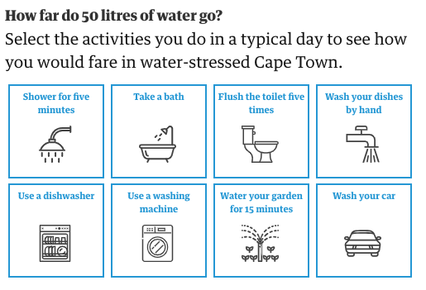
Multimodal analysis of “Day Zero: how is Cape Town running out of water?” by the Guardian
Notes:
https://www.theguardian.com/cities/ng-interactive/2018/feb/03/day-zero-how-cape-town-running-out-water
“The rhetorical strategies manifest in the analysed artefact – typographic emphasis through stark colour contrast, short sentences, dramatic writing, use of expert quotes, reveal-as-you-scroll, visual salience, congruence between text and visualisations, metonymy, and personalisation – inhere discourses of personal relevance, impact and empathy, thus supporting interview data observations. The sought effect is achieved through a blend of verbal and visual semiotic modes, with interactivity acting as an extra layer of augmentation operating above and beyond the two, giving the reader the freedom to either dip or dive into the created space. Balancing the explanatory and exploratory function, and direction and discovery, the interface thus anticipates that the reader actively co-constructs the story narrative both cognitively and haptically, while preserving the coherence and integrity of the storyline by leaving the interactive element optional.”

Slide 12
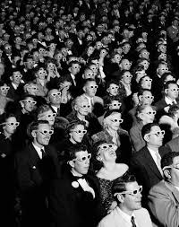
Interactivity, immersion and impact as news values?
Need for audience reception studies:
How do people co-construct digital journalism messages?
“The so-called denotative level of the [televisual] sign is fixed by certain, very complex (but limited or closed) codes. But its connotative level, though also bounded, is more open, subject to more active transformations, which exploit its ‘polysemic’ values.
(Hall, 1980)
Notes:
In another study, I have analysed the Uber Game by FT and the Born Equal, Treated Unequally, by the Telegraph.
“In those stories, making choices as an Uber driver and scrolling, respectively, have a narrativising effect – i.e. some stories’ coherence and therefore, overall message, depends on reader interactions. Hence, I would argue in conclusion, interactivity is still a useful analytical concept for unpacking how meaning is encoded.”

