Slide 1
Women Entrepreneurship, Intersectionality, and Networks on Firm Performance.
Imaobong James and Tolulope Ibukun

Slide 2
Research Aim and Questions
Research Aim:
To examine how women entrepreneurs construct multiple identities and how network resources mediate entrepreneurial performance through digital engagement.
Research Questions:
- How was social capital affected and maintained by women entrepreneurs during and after COVID crisis?
- How does digital engagement impact woman-owned business performance?
- How do networks influence enable women entrepreneurs to overcome intersectionality?

Slide 3
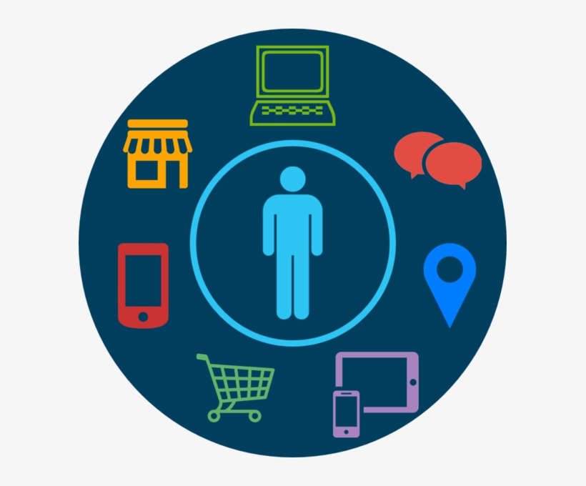
Theories and Concepts
Networks
Process theory - the process of network formation and utilisation of network resources (Anderson et al., 2010; Hakimpoor et al., 2011)
Digital connectedness
Social Capital
The role of social capital - social resource enables connections in the entrepreneurial context (Hardwick and Anderson, 2013; Anderson and Obeng, 2017).
Intersectionality
The overlap of multiple social identities, including race, gender, ethnicity, social class and religion (Abbas et al., 2019). Overlapping forms of marginalisation.
Discrimination and exclusion in a variety of contexts. Socially excluded, is "a feeling of not belonging and not having been given a chance to be included in the society" (Mulunga and Yazdanifard, 2014)
Positionality
The social and political context that creates one’s identity
Awareness of your personal identities and how they shape your worldview.
Understanding the complexity of individuals’ experiences (Crenshaw, 2013).
Digital Engagement
Commitment – Trust Theory.
Virtual connectivity (Drummond et al., 2020)

Slide 4
Research Approach
Data Type
Sampling/research context
Motive
Data Collection
Data Analysis
Purposive sampling
South-south Geopolitical Region of Nigeria
5 years in business
Minimum of HND
Longitudinal Qualitative Data.
Understand the experience of women entrepreneur’s discrimination in Nigeria and how they overcome these challenges
Interviews (F2F and online)
20 research participants
Theoretical Sampling
Grounded theory
The use of Nvivo

Slide 5
Research Timeline
Pre-COVI D - 2018
During COVID - 2020
Post COVID - 2022
Mostly F2F communication
Network: Social networks
High level of marginalisation
20 participants
Seven businesses could not operate
The era of online communication and transactions
Adoption of digital platforms
13 participants
High level of digital platform adoption
Higher connectivity/inclusion
Wider horizons
Bridging Social Capital
High firm performance (Marketing, NPD)
20 participants

Slide 6
Study Focus
Intersectionality
Positionality
Effect of Covid
Digital Engagement
We examined women entrepreneurs' discriminatory experiences (multidimensionality of marginalised subjects (Crenshaw, 1989) in the Global South.
Investigating women entrepreneurs’ awareness of “their stigma and identity ” and how they utilized social resources to overcome marginalisation.
The impact of covid crisis on the firm performances of our respondents
How digital engagement ameliorate the effect of inequalities
Understand the impact of digital resources on firm performance.

Slide 7
Concepts and categories
Open Coding Concepts | Axial Coding Categories
Impact of Covid 19
Digital skill development | Access to digital resources/ visibility
Establishment of online presence
Establishment of bridging social capital | Access to diverse resources / inclusive community
Frequent and real-time network interaction
Impact of Intersectionality
Discrimination and exclusion | Awareness of identity
Marginalization
Impact of positionality
Awareness of personal identities | Credibility, communication privileges Developing coping mechanism
Turning disadvantages into advantages
Identifying network actors
Impact of digital Engagement
Removal of communication barriers | Overcoming intersectionality/social inequality
Access to the wider community
Improved business visibility | Improved firm performance
Reviews/suggestions/referrals

Slide 8
Research Findings/Implications
Digital Engagement
Covid as a stress test
Positionality
The use of digital platforms to overcome intersectionality
Access to the wider community for social integration
Interconnections and interdependence
Development of digital skills
Better communication
Better product advertisement.
Self-awareness
Coping strategies
Developing networks
Establishing connections
Empowerment
.
High firm performance
Research Implications
Improved marketing
New product and service development.
Business Visibility
Product reviews and suggestions
Recommendations and referrals
Developing theory, explanations, and accounts of effective practices to facilitate social inclusion through digital engagement

Slide 9
References
Hardwick, J., Anderson, A. R., & Cruickshank, D. (2013). Trust formation processes in innovative collaborations: Networking as knowledge building practices. European Journal of Innovation Management.
James, I., Xiong, L., & Anderson, A. R. (2021). Mobilising Identity; Entrepreneurial Practice of a 'Disadvantaged' Identity. European Management Review. https://doi.org/10.1111/emre.12451
Crenshaw, K. W. (2013). Mapping the margins: Intersectionality, identity politics, and violence against women of color. In The public nature of private violence (pp. 93-118). Routledge.
Anderson, A. R., & Obeng, B. A. (2017). Enterprise as socially situated in a rural poor fishing community. Journal of rural studies, 49, 23-31.
Abbas, A., Byrne, J., Galloway, L., & Jackman, L. (2019). Gender, intersecting identities, and entrepreneurship research: an introduction to a special section on intersectionality. International Journal of Entrepreneurial Behavior & Research, 25(8), 1703-1705.
Dy, A. M., Marlow, S., & Martin, L. (2017). A Web of opportunity or the same old story? Women digital entrepreneurs and intersectionality theory. Human Relations, 70(3), 286-311.
Drummond, C., O'Toole, T., & McGrath, H. (2020). Digital engagement strategies and tactics in social media marketing. European Journal of Marketing.

Slide 10
Thank you and Questions

