Slide 1
“Join the coalition”:
Pioneer journalism and the reimagining of journalistic epistemology
Dr Bissie Anderson
Robert Gordon University
@bissieanderson
b.anderson4@rgu.ac.uk
Presented at FoJ 2023, Cardiff
15 September 2023

Slide 2
About the project
Aim: Examine how transformation-focused journalism communities produce knowledge vis-à-vis their audiences, publics and wider world
Research design and scope: Multiple case study, transnational (global) pioneer communities
Methodology: Metajournalistic discourse analysis, 30 semi-structured interviews, multimodal discourse analysis of pioneer journalism stories

Slide 3
The research problem
Journalism’s epistemic crisis and loss of epistemic authority (Carlson, 2017, Steensen, 2019)
Converged media, dislocation to non-proprietary platforms, broken monopoly of legacy media, (inter-)active and fragmented audiences, and public realisations that news is a construct challenge the validation of news-as-knowledge (Ekström & Westlund, 2019)
Callison and Young (2019) locate the epistemic crisis of journalism in its traditional view from nowhere (the neutral, distanced regime of reporting), rooted in “sedimented power relations”. They see the possible solution in a “relational” epistemology: “relating oneself and one’s knowledge in systems and social order within which knowledge is produced, valued and mobilised” (p. 13)
Soul-searching in newsrooms old and new to reconnect with audiences/publics: new styles and strategic rituals emerging (e.g., emotionality), challenging journalism’s traditional norms and practices (Wahl-Jorgensen, 2019, Steinke & Belair-Gagnon, 2020)
New conceptualisations of journalism: as “a dynamic and dispersed practice” in constant process of “becoming” (Deuze & Witschge, 2020, p. 32)

Slide 4
‘Pioneer journalism’: A definition
“Pioneer journalism” (Hepp & Loosen, 2021): transformation-focused actors/collectives who experiment with journalistic practice and who, through their imaginations and shared visions of journalism’s “possible futures”, can ultimately effect “the re-figuration of [its] foundations” (p. 15)
“Peripheral actors” (Deuze & Witschge, 2020, Schapals, 2022) YET they serve as “models or imaginaries of new possibilities”, gesturing towards what journalism “could be” (Zelizer, 2017).
Pioneer communities are “imagined collectives” (Hepp, 2016) in deep mediatization, a hybrid figuration between a social movement and a think tank, united by a mission to “bring about media-related change” (p. 927)
Knowledge production: integral to pioneer communities’ identity and goals. Studying pioneer journalism epistemic praxis can sensitise us to shifts in journalistic epistemology and its possible futures.

Slide 5
Research Questions
RQ1: What is pioneer journalists’ vision about the epistemic role of journalism?
RQ2: How do pioneer journalism communities enact their epistemic values in their epistemic practice?
RQ3: How do pioneer journalists, through their epistemic praxis, reimagine journalistic epistemology?

Slide 6
Fieldwork and Data Collection
Initial sampling stage: 20 pioneer journalism organisations
1. Field-mapping (2018-2020): Seven journalism events in Central/Eastern Europe, South America, Southeast Asia (most online) organised by Hacks/Hackers, European Journalism Centre, Splice Media, Association of European Journalists.
2. Initial sampling (2020): 20 pioneer journalism organisations, metajournalistic discourse analysis as “traces of what matters” to explicate shared “matters of concern” (De Maeyer, 2016) and epistemic values.
3. Focused sampling (2020-2021): four cases – Bureau Local (UK), The Current (Pakistan), New Naratif (Malaysia/Southeast Asia), DoR (Romania). Interviews with 30 pioneer journalism producers.
Journalism startup/collective | Country
Bureau Local | UK
Coda Story | US, Georgia and Russia
The Correspondent | Netherlands, Global
The Current | Pakistan
Daily Maverick | South Africa
Decât o Revistă (DoR) | Romania
El Surtidor | Paraguay
The Ferret | Scotland
Frontier Magazine | Myanmar
IndigiNews | Canada
Inkyfada | Tunisia
Krautreporter | Germany
New Naratif | Southeast Asia
Outriders | Poland
R.AGE | Malaysia
Rappler | Philippines
Scalawag | US South
Splice Media | South-East Asia
Toest | Bulgaria
Wapatoa | Myanmar

Slide 7
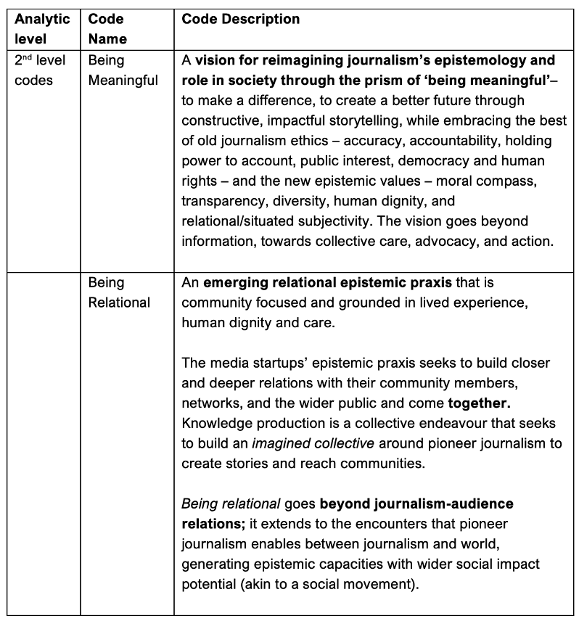
Data Analysis
Phronetic approach to analysing
qualitative research data (Tracy, 2018):
Inductive <-> deductive iterative approach (tagging between theory/literature and emergent themes)
Open (primary) and focused (secondary) coding cycles
Codebooks crafted from emergent research data and ‘road-tested’ on rest of data
15 first-level codes, synthesised into two higher-level conceptual categories, and iteratively refined at every stage of data analysis

Slide 8
Metajournalistic discourse analysis: Pioneer journalists’ shared epistemic values
Being meaningful:
Making a difference
A hybrid vision of journalism ethics: mixing the old (accuracy, accountability, public interest, holding power to account, democracy and human rights) and the new (moral compass, transparency, diversity, human dignity, and relational/situated subjectivity)
Some in-vivo codes:
“A better future” (Rappler manifesto)
“Meaningful lives, meaningful knowledge” (Wapatoa manifesto)
“Meaningful journalism” (Coda Story manifesto)

Slide 9
Metajournalistic discourse analysis: Pioneer journalists’ shared epistemic values
The meanings of ‘being meaningful’
Being useful, simplifying information for audiences (“simple content for a more informed life”, The Current)
Empowering Southeast Asians to take action and build democracy through bridging information and action (New Naratif)
Bettering the lives of citizens, bridging the divide between rural and city communities (DoR)
Empowering underrepresented communities and giving them agency through co-producing “stories that matter” (Bureau Local)

Slide 10
‘Pioneer journalism’ communities as part-social movements (Hepp, 2016)
“New Naratif is a movement for democracy, freedom of information, and freedom of expression in Southeast Asia. We aim to make Southeast Asians proud of our region, our shared culture, and our shared history. We fight for the dignity and freedom of the Southeast Asian people by building a community of people across the region to imagine and articulate a better Southeast Asia.”

Slide 11
“Relational journalism” (IndigiNews manifesto)
“IndigiNews cares about people. We understand the importance of developing strong relationships within communities and hearing a range of perspectives. We are trained in anti-oppressive and trauma-informed reporting, and understand that there are often historical and political undercurrents that impact communities today.”

Slide 12
‘Being relational’: Pioneer journalism’s epistemic praxis
Mutual learning: Dialogic knowledge production (coming together, building closer relationships, grounding knowledge production in lived experience and community agency, non-extractive, inclusive editorial approaches, soliciting ideas from audiences)
"It's just so that people can share and often what you can generate through doing that is, I guess, relationships of trust between people, people sharing information at a much deeper, more complex level than they would normally in a conversation with a journalist… and also creating those conversations between different members of the community.” (Bureau Local journalist and community organiser)
Community service and collective care (people-powered epistemic approach, careful and thoughtful UX design, stories seen as actants-of-change generating capacities for action)
“We strive to be a source of balance and compassion…” (DoR Editor-in-chief)

Slide 13
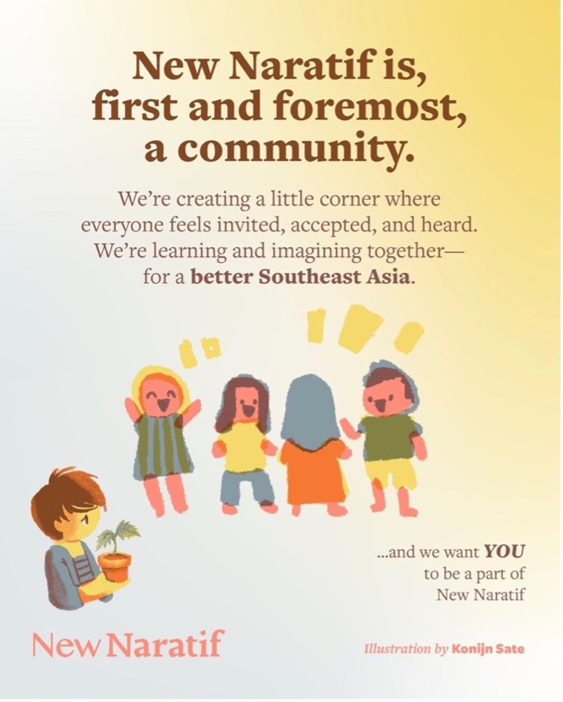
‘Being relational’: Pioneer journalism’s epistemic praxis
Together in the imagined collective: Mobilising in collective action (recruiting like-minded people to their cause, using activist discourse, impact-focused reporting - e.g., Bureau Local’s “Decolonise the news” and “News you can use” campaigns)
Towards knowledge-based advocacy (moving beyond journalism’s traditional purely informative function, and extending to capacities to spark change - e.g., New Naratif’s Baca ‘democracy classrooms’)

Slide 14
“Politically, we don't have an editorial line. But morally, we have an editorial line. For example, we are very pro-women, because we're a woman-led startup, we are pro-minorities, which is difficult in Pakistan to a large extent, because you get a lot of hate if you are pro certain minorities. We are pro-, you know, democracy… we take the democratic line; that's something we don't draw lines on.” (The Current Editor-in-chief)
“Journalism has a responsibility to educate and empower, not just report” (New Naratif CEO)
Journalism as a means to an end: the problem should not be simply about about saving journalism but “thinking deeply about what journalism is for. What’s the point of journalism and what it can and should do.” (Wales-based community organiser, Bureau Local)
“For me, building a more inclusive, understanding, and accepting society is really the bottom line of journalism.” (New Naratif freelance reporter)

Slide 15
Reimagining journalistic epistemology from the ground up
Pioneer journalism producers go beyond their purely epistemic role as facilitators of knowledge and adopt, and indeed embrace, a semi-political role akin to grassroots activism. In so doing, they act as agents of change, slowly shifting journalistic epistemology beyond its traditional mission to inform towards social action and collective care, abandoning the view from nowhere and actively embedding themselves in the world.
Pioneer journalists adopt a more engaged role in society – “towards questioning, negotiating, and even reimagining reality” (Medeiros & Badr, 2022, p. 1356), thus moving beyond information and closer to something akin to knowledge-based advocacy.
Through their epistemic vision and values and their experimental epistemic praxis, pioneer journalists push the boundaries of journalism, gesturing towards some possible futures and towards not only “what journalism could be” (Zelizer, 2017), but more importantly, what it could do.

Slide 16
Five ways pioneer journalists reimagine journalistic epistemology
1. Challenging journalism’s traditionally neutral and detached epistemic praxis by abandoning journalists’ position as disinterested observers and openly taking a stand on issues that matter.
2. Engaging in knowledge-based advocacy – seeking to mobilise, empower, and create impact and democracy-building capacities.
3. Creating a circle of collective care – connecting and building bridges between people, stories and realities, and offering solutions and constructive approaches to issues.
4. Deep engagement and relationality – publics and journalists embedded in the knowledge production process, non-extractive approaches, mutual listening and learning.
5. Redressing epistemic injustice by giving people and communities agency and power to co-produce narratives.

