Slide 1
The Impact of Blockchain and Smart Contracts on Dispute Settlement: A Case for Mediation
Charles Ho Wang Mak
Lecturer in Law, Robert Gordon University |
Research Associate, University of Oxford |
Fellow, Transatlantic Technology Law Forum at the Stanford Law School |
Fellow, Centre for Chinese and Comparative Law at the City University of Hong Kong |
Honorary Fellow, Asian Institute of International Financial Law, University of Hong Kong |
Research Affiliate, SovereigNet at The Fletcher School of Law and Diplomacy, Tufts University
Dr Joseph Mante
Principal Lecturer in Law, Robert Gordon University
Senior Fellow of the Higher Education Academy
Member, Society of Legal Scholars, UK

Slide 2
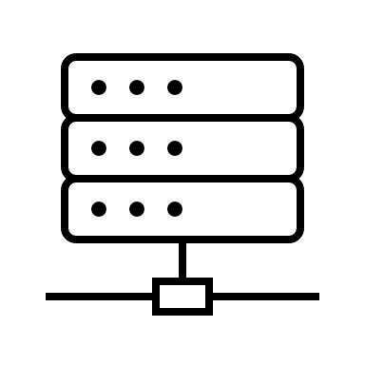
Blockchain Technology and Smart Contracts in Law
What is Blockchain?
Types of Blockchains
Centralised: Single trusted entity, cheaper, flexible, high privacy.
Decentralised: Data stored in a P2P network, secure but costly.
A 'structured collection of information' used for tracking transactions.
Ensures data integrity and identity authentication through encryption.
A 'foundational technology' with applications in various industries.
Smart Contracts
Self-executing computer programmes that execute contractual terms automatically.
Debate persists on whether they are legally binding contracts or merely computer codes.

Slide 3
Disputes No More? The Role of Smart Contracts in Dispute Avoidance
Formulation and Types of Smart Contracts
Advantages and Limitations
Initial Agreement: Parties agree on terms in natural language.
Translation to Code: A trusted third party translates the terms into a programming language.
Coding Languages: Source code, machine code, object code, assembly code, etc.
Types of Transactions: Simple binary transactions benefit most.
Deterministic Nature: Reduces the scope for disputes.
Decentralisation: Leaves little room for interference and ambiguity.
Conditions-Based: Executes only when specific conditions are met.
Limitations: Unforeseen occurrences, Coding errors, and Exploitation by malignant actors.
Notes:
f

Slide 4
Emerging Legal Framework for Resolving Smart Contract Disputes
JAMS Smart Contract Protocol
The Digital Dispute Resolution Rules
Developed by JAMS, an institutional ADR provider.
Aimed at facilitating the use of ADR in blockchain-related disputes.
Adaptation of existing commercial arbitration and mediation rules.
Recognises the increasing frequency of smart contracts.
Introduced by the UK Jurisdiction Taskforce in April 2021.
Provides a framework for swift and efficient resolution of blockchain-related disputes.
Adapts traditional dispute resolution rules for on-chain transactions.
Utilises technology to foster the resolution process.
Notes:
f

Slide 5
Integration of Blockchain and Smart Contracts in Mediation
Advantages of Integration
Facilitative and Evaluative Mediation
Transparency: Decentralised ledger technology ensures an immutable record of transactions.
Efficiency: Smart contracts automate contractual obligations, minimising potential for dispute.
Security: Immutable records eliminate the possibility of tampering.
Facilitative Mediation: Mediator guides the process, parties retain control over the outcome.
Evaluative Mediation: Mediator offers opinions on strengths and weaknesses of each party's case.
Application: Both styles can be enhanced by blockchain and smart contracts.
Notes:
f

Slide 6
Blockchain in Mediation Process
Mediator Selection and Process
Future Directions and Challenges
Mediator Database: Blockchain maintains a decentralised database of certified mediators.
Smart Contracts: Automate the agreement signing stage, coding rights and obligations.
Timestamping: Secure and transparent recording and tracking of all proceedings.
Multi-Step Resolution: Blockchain adaptable to multi-step processes like arbitration.
Decentralised Systems: Set for expansion but pose challenges in communal deliberation.
Regulatory Complexities: Need for global coordination across jurisdictions.
Notes:
f

Slide 7
Possible Solutions to Challenges in Smart Contracts and Blockchain Technology
Legal and Educational Solutions
Technical and Regulatory Solutions
Legal Standing of Smart Contracts
Legislation or regulation should define the legal standing.
Education on Technology
Alleviate concerns through education.
Digital Literacy
Role of government and educational institutions.
Data Privacy
Implement robust data privacy measures.
Scalability
Improve efficiency of blockchain networks.
Continuous R&D
Exploration of efficient consensus algorithms.
Notes:
f

Slide 8
Thank you!

