Slide 1
Foreign parties and the tort jurisdiction gateway under the English CPR
Joseph Mante
Principal Lecturer
RGU

Slide 2
Outline of presentation
Context
The Tort Gateway Rules
Recent judicial Interpretations
Implications for foreign parties

Slide 3
Context
State of human interactions -more civil claims involving foreign parties.
Service out of England and Wales - current rules :
CPR Part 6, Rules 6.36, 6.37 and Practice Direction (PD) 6B, para 3.1.
Three conditions to be met:
Claim must fall under one of the Gateways under CPR PD 6B paragraph 3.1.
There must be a serious issue to be tried on the merits.
England must be the appropriate forum for trial
(FS Cairo (Nile Plaza) LLC v, Lady Brownlie)

Slide 4
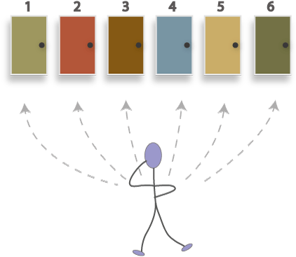
The Tort Gateway Rules
CPR Part 6, PD 6B, Paragraph 3.1(9):
A claim is made in tort where –
damage was sustained, or will be sustained, within the jurisdiction;
(b) damage which has been or will be sustained results from an act committed, or likely to be committed, within the jurisdiction; or
(c) the claim is governed by the law of England and Wales.
Notes:
Service of process out of the jurisdiction is an unusual assertion by this Court of an extraterritorial jurisdiction which could have international repercussions, and so is carefully controlled by the Rules of Court. Camera Care Ltd v Victor Hasselblad AB, [1986] E.C.C. 373 Star pages *382 Sir Roger Ormrod
Lloyd LJ in Golden Ocean Assurance Ltd v Martin (The Goldean Mariner) 1990 –Caution must always be exercised in bringing foreign defendants within our jurisdiction… It must never become the practice to bring foreign defendants here as a matter of course

Slide 5
The Tort Gateway Rules -History
RSC 1965 Ord.11 r.1(1)
action “founded on a tort committed within the jurisdiction”.
SI 1983/1181 (1987)–
claim in tort where “the damage was sustained, or resulted from an act committed, within the jurisdiction”
CPR Part 6 (SI 2000/221) r6.20 (8)
(a) damage sustained within the jurisdiction; or
(b) damage sustained resulting from an act committed within the jurisdiction.
CPR Update 81 2015) – added “or will be sustained” in subparagraph(a) and of the words “or likely tobe committed” in subpara.(b).
CPR PD Update 149 (July 2022) added subparagraph C – claims
‘governed by the law of England and Wales’
Notes:
OBSERVATION – with each change, the scope of the rule is broadened significantly.

Slide 6
Judicial Interpretation–CPR Pt6,PD6B,Para 3.1(9)(a)
Metall und Rohstoff AG v Donaldson Lufkin & Jenrette Inc (1989) AC –
Where the claim was founded on a tort and either the damage was sustained within the jurisdiction, or the damage resulted from an act committed within the jurisdiction.
Where damage had occurred in more than one jurisdiction -significant damage in England is required to ground jurisdiction.
Where the tort consisted of acts done in more than one jurisdiction, and substantial acts had been committed within the court's jurisdiction
Notes:
Aluminium - trading with a broker in London
Acts causing damage were committed in London and New York (conspiracy)
Damage occured both in Switzerland and England
Order for service out of the jurisdiction challenged under Ord. 11, r. 1(1)(f).
Held:

Slide 7
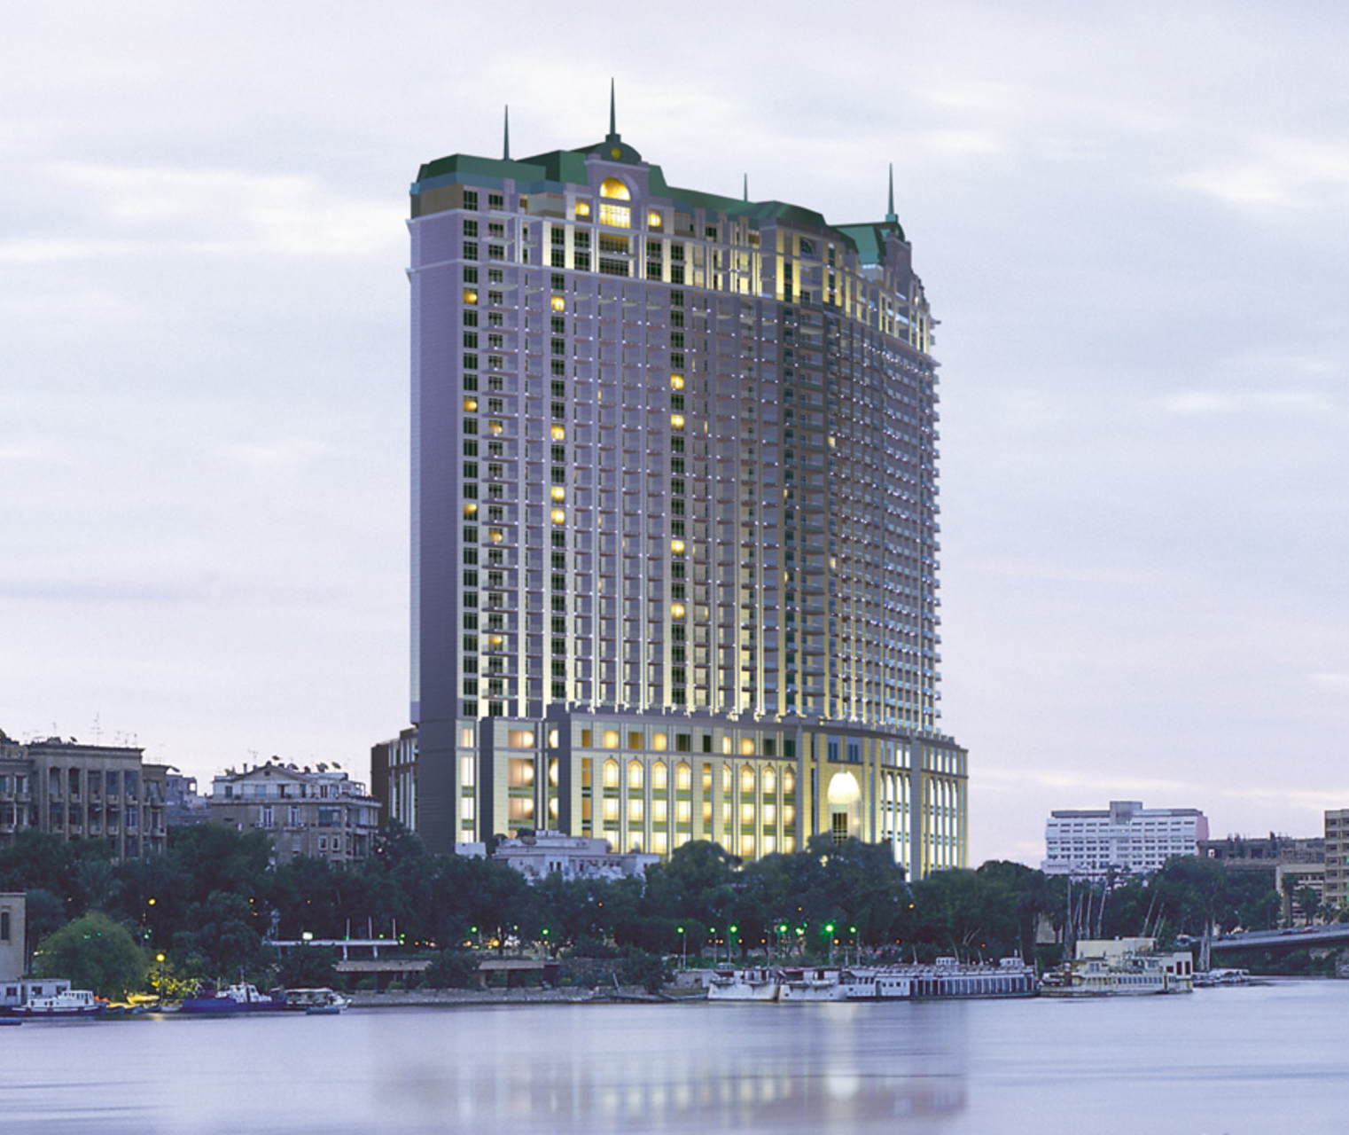
Judicial Interpretation–CPR Pt6,PD6B,Para 3.1(9)(a)
Meaning of ‘Damage’
Two important decisions from the Supreme Court:
Four Seasons Holdings Inc v Brownlie (2017)
FS Cairo (Nile Plaza) LLC v Lady Brownlie (2021)
Notes:
Book holiday – arranged a chauffeur –driven car through the hotel for excursion to Fayoum in 2010
Car involved in a fatal crush – Claimant injured, her husband and daughter died, two grandchildren survived
Claimant sued - Four Seasons Holding co in Canada – for her injuries and on behalf of Husband’s Estate
Evidence that the Holding company did not run the Hotel
Supreme Court , however, was drawn into a discussion of whether meaning of ‘damage’ under CPR Part 6 PD6B Para 3.1.(9) (a) sustained by the Claimant
Court was split on the meaning of the word Damage.

Slide 8
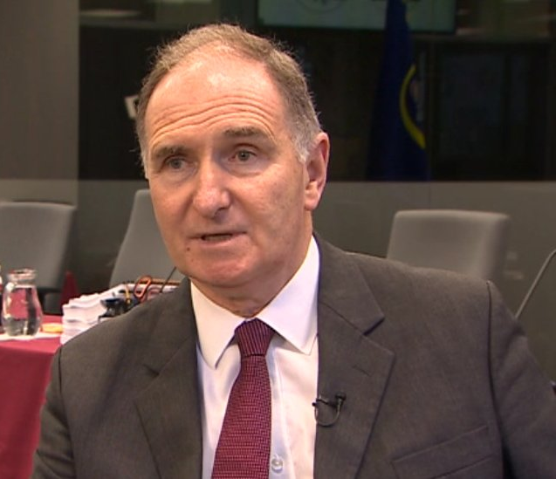
Judicial Interpretation–CPR Pt6,PD6B,Para 3.1(9)(a) Meaning of ‘Damage’
Majority:
‘Damage’ must be given its literal meaning
The word "damage" in para.3.1(9)(a) simply referred to actionable harm, direct or indirect, flowing from the alleged wrongful act.
Interpretation based on the EU system (interpretation of Article 7(2) of the Brussels I Recast) not applicable.
Damage could be sustained in more than one place - see Metall und Rohstoff ( CA decision)
This definition has the support of a string of first instance decisions and decisions from Canada and Australia – see e.g., Wink v Croatia Osiguranje DD (2013), Qatar Airways Group Q.C.S.C. v Middle East News FZ LLC (2020) etc.
Notes:
Main argument of the majority view (Lords Clarke and Wilson, Lord Reed, Lord Briggs, Lord Burrows, Lady Hale)
Ordinary meaning of the word damage – all detriment flowing from the tort – physical, financial, social
This definition has the support of a string of first instance decisions and decisions from Canada and Australia
This approach is to be distinguished from damage required to complete a cause action.
Concerns that applying ordinary meaning of the word damage will result in the English courts assuming universal jurisdiction over personal injury claims suffered by English claimants – courts still have discretion to prevent that (para 54)
Wrong to state that the jurisdictional gateway for claims in tort had been deliberately drafted to assimilate domestic rules with rules of EU law. The distinction between direct and consequential damage developed under the EU system not applicable – FS Cairo.
amendment in 2000 broaden rule by changing " the damage " to " damage “. Free standing rule now - Qatar Airways Group Q.C.S.C. v Middle East News FZ LLC
The word "damage" in para.3.1(9)(a) simply referred to actionable harm, direct or indirect, caused by the wrongful act alleged.
The Court of Appeal in Metall und Rohstoff [1990] 1 QB 391 was clearly correct in holding that a claimant may suffer damage
within the meaning of the domestic tort gateway in more than one place.A claimant might suffer damage in more than one place.

Slide 9
Judicial Interpretation–CPR Pt6,PD6B,Para 3.1(9)(a) Meaning of ‘Damage’
Minority :
‘Damage’ if interpreted in context and with the purpose of the gateways in mind, should have a narrow meaning.
The word "damage" in para.3.1(9)(a) should refer to direct damage, the harm which constitutes the basis of the tort (which completes the cause of action) not ‘facts which are merely evidence of the financial value of that damage’.
Dissenting voices!
Notes:
Four Seasons Holdings Inc v Brownlie – para 25 – Lord Sumption: the damage to the interest protected is sustained in country A where the claimant has been injured or killed. The pecuniary measure of that damage may depend on things that happened elsewhere. For example, medical or care costs may be incurred in country B, or earnings may be lost which would have been earned in country C or paid in country D, but the damage has not been sustained in these places.
FS Cairo (Nile Plaza)LLC - Para 171 – Lord Leggatt : It would mean that ground (9)(a) applies where anyone who lives in England is injured when travelling abroad provided only that the injury sustained is sufficiently serious to cause pain or disability which continues, or financial loss (such as loss of earnings or the cost of medical treatment) which is incurred, after the claimant returns home to England. (para171, FS Cairo)
damage had to be assessed by reference to the relevant claim and the damage sustained within the jurisdiction had to be significant relative to that sustained outside the jurisdiction. 18:58, 24 June 2023 Microsoft Mobile Oy (Ltd) v Sony Europe Ltd, 2017 WL 00737389

Slide 10
Illustration: Stylianou v Toyoshima [2013]
Accident occurred in Australia
Injuries were sustained in Australia
Applicable law - Western Australian
Active proceedings in Australia – 2+ years
Considerations of the judge:-
Only issue in dispute was quantum of the claim
Claimant was English, lived in England and could not travel to Australia
Injuries will make it hard for her to give instructions during the hearing
Large number of expert witnesses would have to travel to Australia
The fact that the defendant had no connection with England
Only connection: - he was involved in a collision with a British holidaymaker in Australia
Notes:
FC Cairo (Nile Plaza)LLC : Para 204 per Leggatt JSC

Slide 11
Implications of the majority view
It confers on the English courts what amounts to a universal jurisdiction to entertain claims by English residents for more serious personal injuries suffered anywhere in the world.
The ‘forum non conveniens’ guardrail has not achieved much so far – see FC Cairo – dissenting decision of Leggatt JSC at para 203
Current approach does not sufficiently take account of foreign parties’ connection with England and Wales - Stylianou v Toyoshima; economic and other implications
Lloyd LJ in Golden Ocean Assurance Ltd v Martin (The Goldean Mariner)… It must never become the practice to bring foreign defendants here as a matter of course…
Notes:
: Typical of the reasoning in these cases is Stylianou v Toyoshima [2013] EWHC 2188 (QB) at [111]–[112] , where the judge decided that England was the forum conveniens “in spite of the fact that the accident occurred in Australia, the injuries were sustained there, the applicable law is, as I have found, Western Australian, and that proceedings in Australia were actively continued for nearly two and a half years”. What weighed most heavily in the balance for him was that the only issue in dispute was the quantum of the claim and the claimant was English, lived in England and could not travel to Australia because of her injuries which would make it hard for her to give instructions during the hearing. The fact that a large number of expert witnesses would have to travel to Australia in order to give evidence was also seen as an important factor. The fact that the defendant had no connection with England apart from having had the misfortune to be involved in a collision with a British holidaymaker while driving in Western Australia does not seem to have been given any weight at all.

Slide 12
CPR Part 6 – Practice Direction 6B
Para 3.1(9)(b)

Slide 13
Judicial Interpretation–
A claim is made in tort where –
(b) damage which has been or will be sustained results from an act committed, or likely to be committed, within the jurisdiction
Literal Interpretation of rule
Expansive approach adopted in Metall und Rohstoff AG v Donaldson Lufkin & Jenrette Inc (1989) AC –
‘what if damage has resulted from acts committed partly within and partly without the jurisdiction?’ –p437
Notes:
Increased business interactions mean

Slide 14
Judicial Interpretation–CPR Pt6,PD6B,Para 3.1(9)(b)
Metall und Rohstoff AG Approach:
ask whether ‘damage has resulted from substantial and efficacious acts committed within the jurisdiction (whether or not other substantial and efficacious acts have been committed elsewhere): if the answer is yes, leave may…be given…’
Other cases : -
Newsat Holdings Ltd v Zani - negligent misstatement – where statement was made not where it was received
Manek v IIFL Wealth (UK) Ltd - Negligent misrepresentation - decisions taken at various meetings in London
Notes:
Where the entirety of the acts in question occur in England, this head applies without question 19:06, 24 June 2023 Qatar Airways Group QCSC v Middle East News FZ LLC, 2020 WL 06567056
But in cases where acts have occurred both in England abroad, head (a) can still apply where "damage has resulted from substantial and efficacious acts committed within the jurisdiction [by the relevant defendants] whether or not substantial and efficacious acts have been committed elsewhere" ( Metall & Rohstoff , 437E-F).

Slide 15
Implications of expansive interpretation of Para 3.1(9)
When decisions made in England and implemented out of the jurisdiction results in or contributes to injury to foreign claimants or damage to their properties?
Parent company deemed to be managing/joint managing a subsidiary which commit tort outside England?
Parent company providing defective advice in England?
Parent company promulgates defective group-wide safety/environmental policies, which are then implemented by the subsidiary?
Parent company holds itself out as exercising a particular degree of supervision and control over the subsidiary in England?
Should ‘an act committed’ in paragraph 3.1.(9)(b) also be given an expansive interpretation to include ‘direct and indirect acts’?
Notes:
Vedanta Resources v Lungowe (Vedanta) [2019] UKSC 20
Okpabi v Royal Dutch Shell Plc. (Okpabi). [2021] UKSC 3 –
AAA v Unilever plc [2018] BCC 959

Slide 16
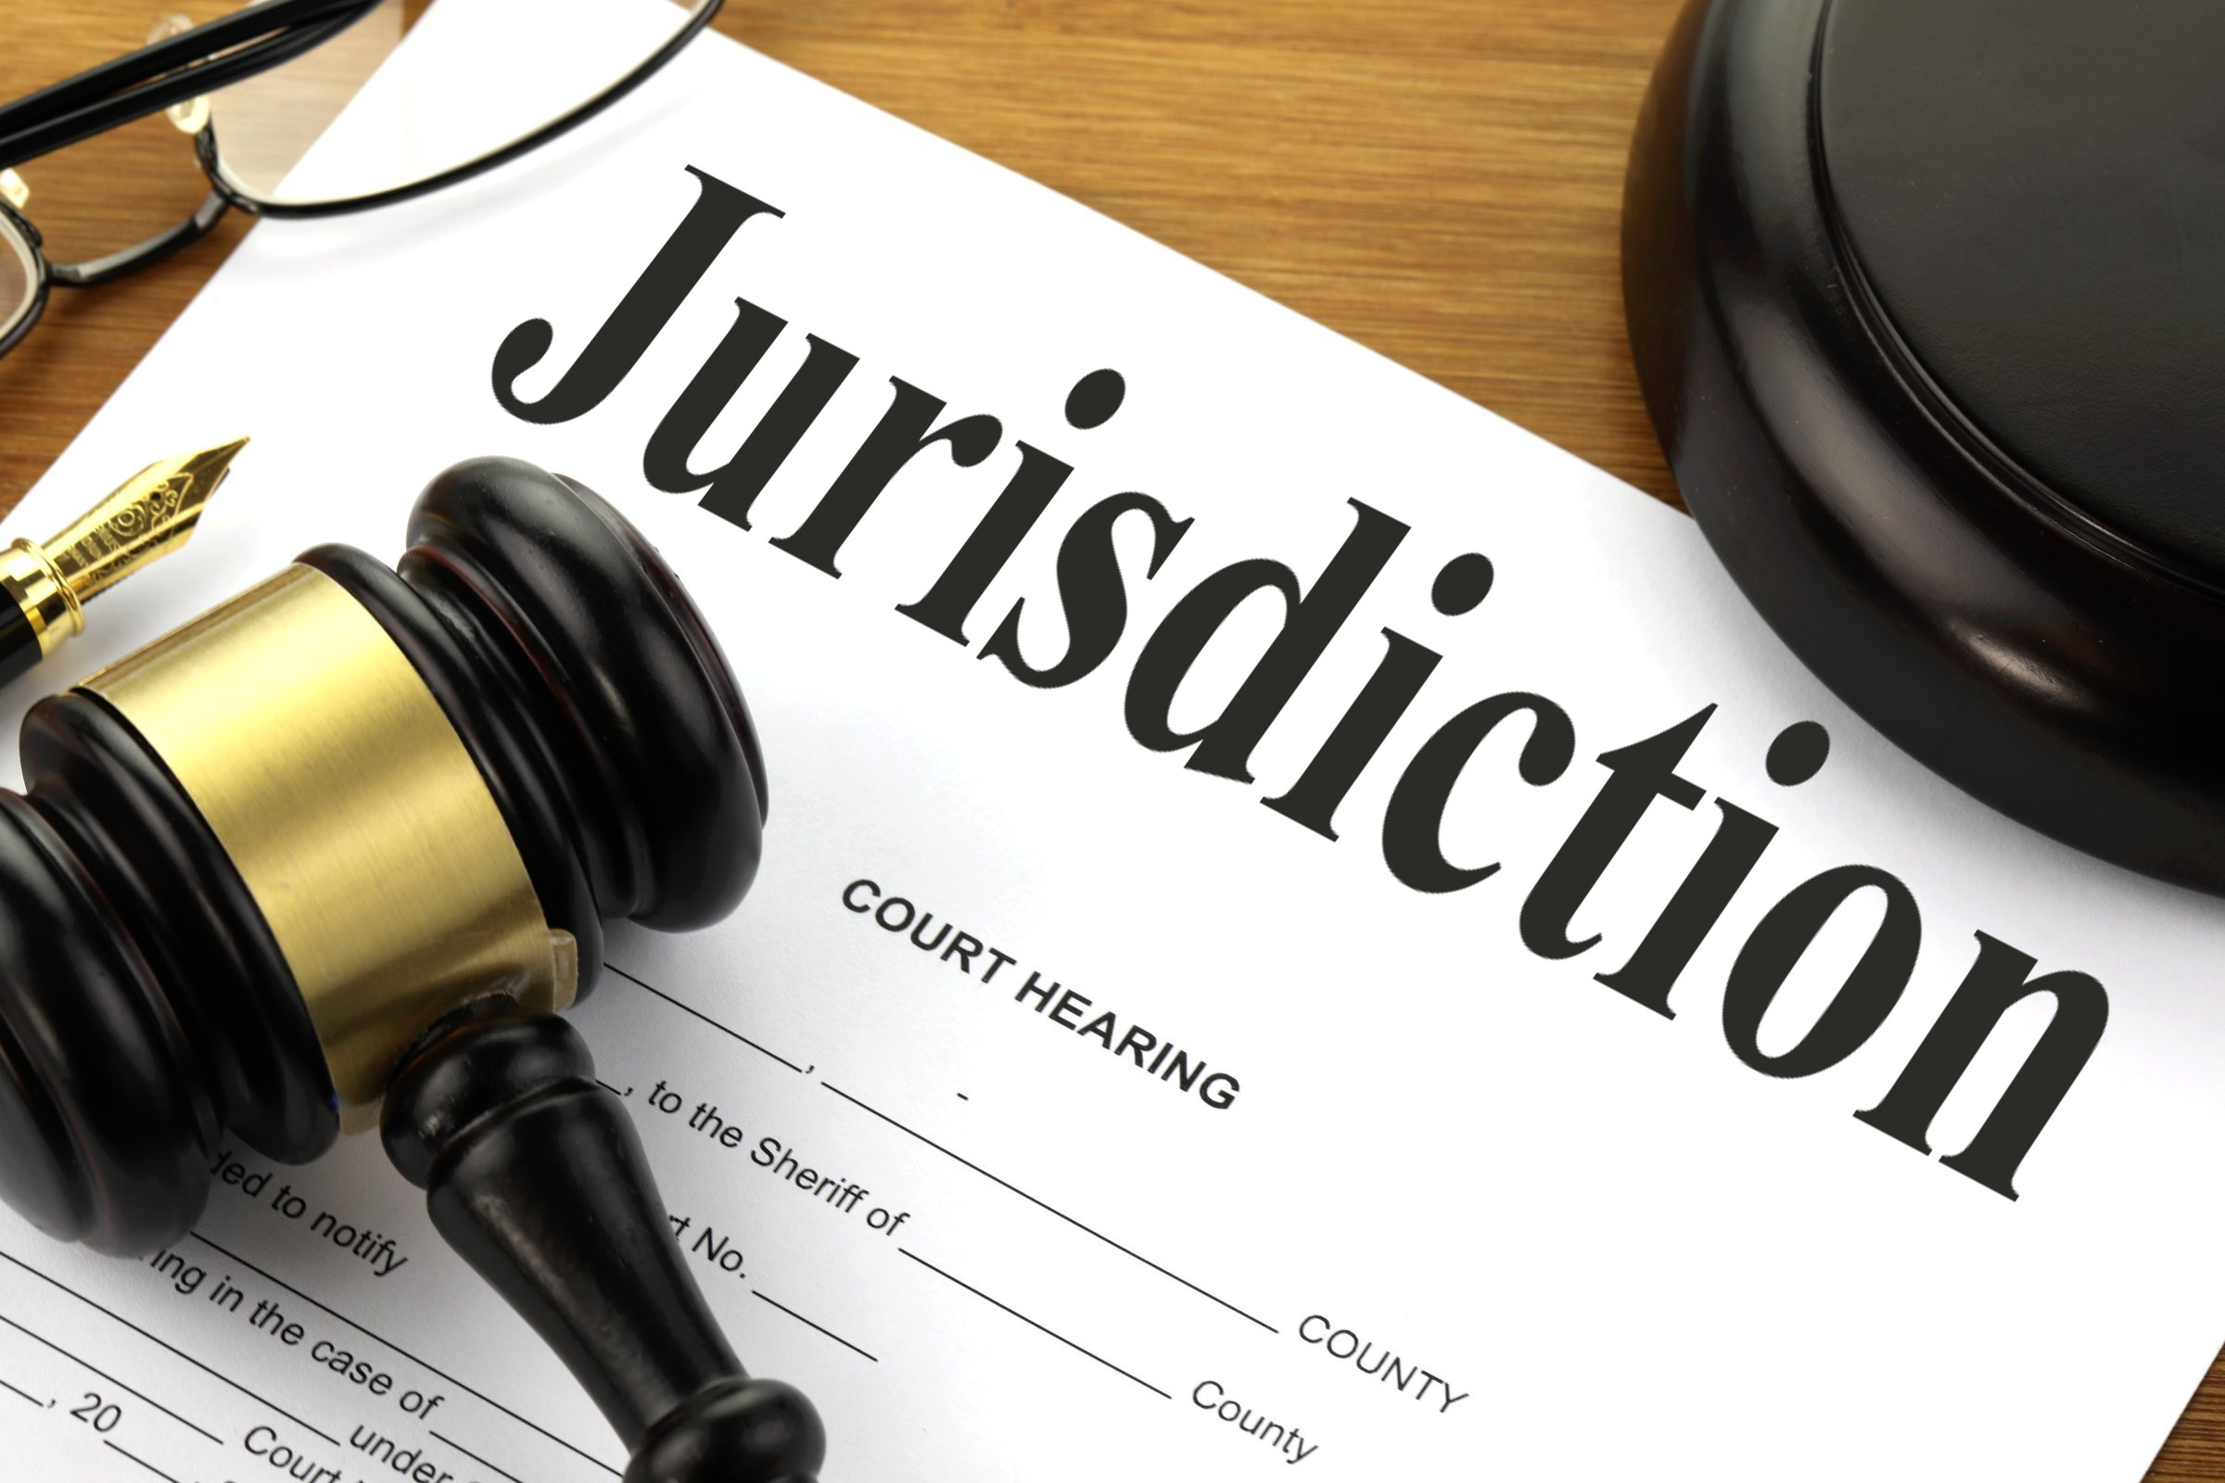
Conclusions
Extra-territorial nature of service out of the jurisdiction – possible international repercussions
Rules meant to ensure:
that there is real and substantial connection with England
that there is a ‘stable and legitimate basis for assumption of jurisdiction over a foreign defendant’.
Changes to rules on tort gateway since mid-60 have progressively broaden scope of gateway…
Current interpretation of paragraph 3.1.(9a) - English courts assuming universal jurisdiction over English residence in serious physical injury cases
Further expansion of paragraph 3.1.(9b) possible/likely?
Implications for foreign parties – mixed but overall negative…
Notes:
Service of process out of the jurisdiction is an unusual assertion by this Court of an extraterritorial jurisdiction which could have international repercussions, and so is carefully controlled by the Rules of Court. Camera Care Ltd v Victor Hasselblad AB, [1986] E.C.C. 373 Star pages *382 Sir Roger Omrod
Policy underpinning changes has not always demonstrated how the changes further the above goals
Current expansive interpretation of paragraph 3.1.(9a) closest we have come to the courts assuming universal jurisdiction over English residence in serious physical injury cases
Does the recent Supreme Court decisions make it likely that we’ll see further expansion of paragraph 3.1.(9b)

