Slide 1
The English Civil Procedure Gate-Keeping Rules, Foreign Claimants and Access to Justice
Dr Joseph Mante
The Law School, Robert Gordon University
Aberdeen

Slide 2
Outline
Context
Gatekeeping Rules and Evidential standards
Three major problems with current system
Time
Cost
Outcome
What do we do about them?

Slide 3
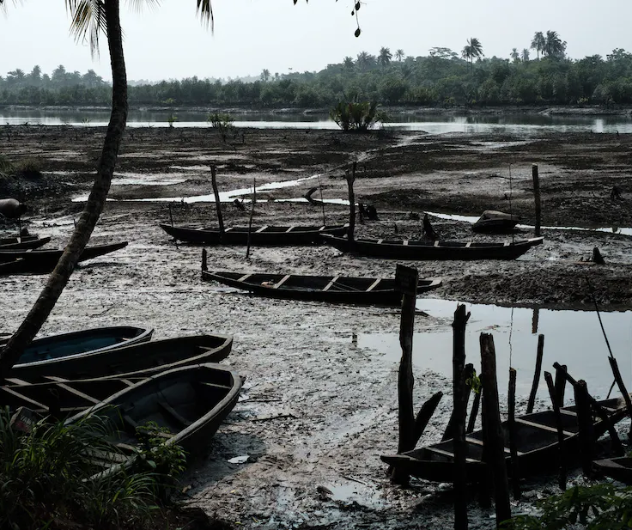
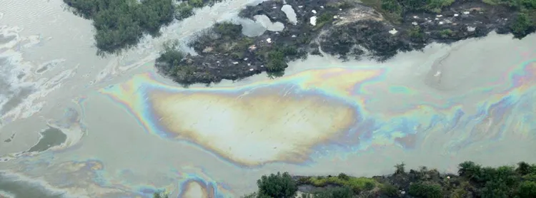
Context – Foreign parties
Involvement of foreign parties in English litigation – a common feature.
Recent/growing trend – foreign victims of mass wrongs suing in England.
Claims relate to wrongs sustained outside England
Actions are often brought against entities domiciled in England (parent companies) and foreign subsidiaries.
Cases raise issues of health and safety violations, human right abuses and environmental pollution
Notes:
Health and Safety cases - Ngcobo v Thor Chemicals Holdings Ltd, [1995] 10 WLUK 81 (exposed to hazardous and unsafe quantities of mercury vapour sued three defendants domiciled in the UK) ; Connelly v RTZ Corpn plc (No 3), [1999] CLC 533 and Lubbe v Cape plc. [2000] 1 WLR 1545 (asbestos-related case)
Human Rights abuses - AAA v Unilever plc., 218 Kenyan employees [2018] EWCA Civ 1532 – 218 Kenyan Employees of Unilever’s subsidiary UKTL ( human right abuses - Kenyan presidential elections in 2007)
Environmental Pollution – [2019] Vedanta Resources Plc v Lungowe -1825 Zambians -Case: claim for personal injury, damage to property and loss of income, amenity and enjoyment of land due to pollution and environmental damage caused by discharges from a Zambian copper mine
Environmental pollution - [2020] HRH Emere Godwin Bebe Okpabi v Royal Dutch Shell - Claimants – residence of the Niger Delta region - Defendants - UK-domiciled parent company and subsidiary company in Nigeria - Case : Oil operations conducted by Nigerian subsidiary company - Persistent oil leaks from the pipelines caused serious water and ground contamination allegedly causing environmental damage in Nigeria
Municipio de Mariana and others v BHP Group plc (2021) – collapse of Fundao Dam in Brazil

Slide 4
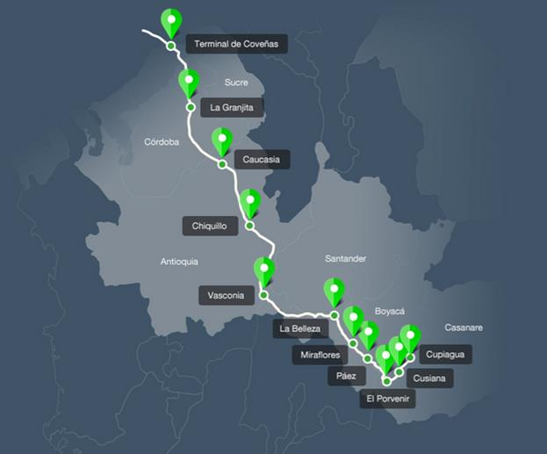
Context - Examples
Environmental Pollution –
Municipio de Mariana and others v BHP Group plc (2021) – collapse of Fundao Dam in Brazil -200,000 individuals, 530 businesses, 25 municipalities etc.
Okpabi v Royal Dutch Shell (2020) - 40,000 Nigerian claimants
Vedanta Resources Plc v Lungowe (2019) -1825 Zambian claimants
Motto v Trafigura Ltd - 30,000 Ivorian claimants
Ocensa Pipeline Group Litigation involving 109 Columbian claimants
Bodo Community v Shell involving 15,000 claimants.
Human Rights abuses
AAA v Unilever plc., 218 Kenyan employees
Health and Safety cases
Ngcobo v Thor Chemicals Holdings Ltd ; Lubbe v Cape plc.
Notes:
Health and Safety cases - Ngcobo v Thor Chemicals Holdings Ltd, [1995] 10 WLUK 81 (exposed to hazardous and unsafe quantities of mercury vapour sued three defendants domiciled in the UK) ; Connelly v RTZ Corpn plc (No 3), [1999] CLC 533 and Lubbe v Cape plc. [2000] 1 WLR 1545 (asbestos-related case)
Human Rights abuses - AAA v Unilever plc., 218 Kenyan employees [2018] EWCA Civ 1532 – 218 Kenyan Employees of Unilever’s subsidiary UKTL ( human right abuses - Kenyan presidential elections in 2007)
Environmental Pollution – [2019] Vedanta Resources Plc v Lungowe -1825 Zambians -Case: claim for personal injury, damage to property and loss of income, amenity and enjoyment of land due to pollution and environmental damage caused by discharges from a Zambian copper mine
Environmental pollution - [2020] HRH Emere Godwin Bebe Okpabi v Royal Dutch Shell - Claimants – residence of the Niger Delta region - 40,000 people of the Ogale community in Nigeria - Defendants - UK-domiciled parent company and subsidiary company in Nigeria - Case : Oil operations conducted by Nigerian subsidiary company - Persistent oil leaks from the pipelines caused serious water and ground contamination allegedly causing environmental damage in Nigeria
Municipio de Mariana and others v BHP Group plc (2021) – collapse of Fundao Dam in Brazil

Slide 5
Gatekeeping Rules and Evidential Standards
Current Rules : CPR Part 6, Rules 6.36, 6.37 and Practice Direction (PD) 6B, para 3.1.
Three conditions to be met - Four Seasons v. Brownlie SC (2017), para 3):
Jurisdictional gateways - claim must fall under one of the gateways under CPR PD 6B paragraph 3.1.
There are serious issues to be tried.
England is the appropriate forum for trial (Spiliada)
Most real and substantive connection
Case can be suitably/appropriately tried
Interests of all parties
Ends of Justice

Slide 6
Three problems with current system
Time : The length of time these applications (in their various guises) take to resolve.
Cost : The level of investment parties pour into these applications – justifiable?
Outcome/Consequences of current process?
Notes:
The wheels of justice grinds slowly but grinds exceedingly fine…

Slide 7
Time
Emerging trend: these jurisdiction applications take long time to resolve
Examples: -
Vedanta Resources Plc v Lungowe - challenge July 2015 resolved four year later by the Supreme Court
Okpabi v Royal Dutch Shell – action commenced 2015 – application resolved in 2019
FS Cairo (Nile Plaza) LLC v Lady Brownlie – Accident in 2010. Claim issued December 2012; challenge –May 2013 – Finally resolved by the SC in 2021
Jurisdiction disputes - preliminary…
Notes:
Dedicated courts? Streamlining rules? Time limits?

Slide 8
Cost
HRH Okpabi v Royal Dutch Shell Plc (CA) para17:
At the hearing before the judge the parties’ “skeleton arguments” ran to 259 pages, plus 17 additional pages of detailed criticism of the other side's case and 61 pages of post-hearing notes. RDS deployed 13 lengthy witness statements and three expert reports; and the claimants served 15 witness statements and two expert reports. The total length of the witness statements ran to over 2,000 pages of material, quite apart from the eight files of exhibits…”
Vedanta Resources Plc v Lungowe S.C, para 10:
The extent to which these well-known warnings have been ignored in this litigation can be measured by the following statistics about the materials placed before this court. The parties’ two written cases (ignoring annexes) ran to 294 pages. The electronic bundles included 8,945 pages. No less than 142 authorities were deployed, spread over 13 bundles, in relation to an appeal which, on final analysis, involved only one difficult point of law.

Slide 9
Consequences of Current process
VTB Capital plc v Nutritek International Corpn (per Lord Neuberger)
Self-defeating – doing as much as will be done in the actual hearing…
Disproportionate – incurring enormous cost on a simple and uncontroversial issue
Unnecessary exertion for a relatively straightforward issue
Access to justice concerns:
“There is also a real danger that, if the hearing is an expensive and time- consuming exercise, it will be used by a richer party to wear down a poorer party, or by a party with a weak case to prevent, or at least to discourage, a party with a strong case from enforcing its rights.” (Para 82)
Evidence of judicial frustration with the process…Judicial admonition on ‘proportionality’ has largely not been followed.

Slide 10
Why parties do what they do?
The process: three major issues rolled into a single application!
Potential outcomes – serious implications for parties:
A leap forward!
A taste of judicial perspective on case
End of the road?
Parties seek to put their ‘best case’ forward… just in case…

Slide 11
Proposed solutions
Okpabi v Royal Dutch Shell Plc (H.C), para 10:
It would be regrettable if the only way that compliance could be ensured were to be by the court imposing a strict limit on the number of witness statements that could be lodged, and also restricting their length. Experienced legal advisers ought not to need such strictures in order to concentrate their minds. However, a fundamental change of approach is required by the parties in cases such as these for applications of this nature.
Notes:
Judicial restraint –
Proportionality – Vedanta, paras 6-14; Okpabi, paras 20-23
Imposing strict limits on what could be filed – Okpabi v RDS (first instance)
Administrative solution –
Using the courts’ case management power to rein in ‘out of hand’ practices- VTB Capital plc v Nutritek International Corpn [2013] 2 AC 337 at paras 89

Slide 12
Proposed solutions
Vedanta Resources Plc v Lungowe, (SC) para 14:
The fact that it has been necessary, despite frequent judicial pronouncements to the same effect, yet again to emphasise the requirements of proportionality in relation to jurisdiction appeals, suggests that, unless condign costs consequences are made to fall upon litigants, and even their professional advisors, who ignore these requirements, this court will find itself in the unenviable position of beating its head against a brick wall.
Notes:
Judicial restraint –
Proportionality – Vedanta, paras 6-14; Okpabi, paras 20-23
Imposing strict limits on what could be filed – Okpabi v RDS (first instance)
Administrative solution –
Using the courts’ case management power to rein in ‘out of hand’ practices- VTB Capital plc v Nutritek International Corpn [2013] 2 AC 337 at paras 89

Slide 13
Rule change?
Regulatory changes -
A rethink of what the rules are meant to achieve - a purposive approach?
Review of the requirements – too much too early?
Review of the evidentiary standards?
Operational changes –
Proportionality
Imposing time limit
Cost implications
Role of Parties?

Slide 14
Impact on Access to justice
Gate-keeping rules burdensome?
Implications of cost and time concerns for foreign parties.
The Spiliada test (second part – substantial justice)
Should the key question not be whether there is a real risk that substantial justice would not be obtainable in the foreign jurisdiction?
The cogent evidence standard

Slide 15
Conclusion
Whilst there is merit in ensuring that foreign parties are brought before English courts for good cause and on the basis of a substantive connection with England, the means by which that process is achieved need not be burdensome, costly or time consuming.

