Slide 1
WORLD SUSTAINABILITY CONFERENCE NOVEMBER 22, 2023
Harnessing the Intersection of Food, Water, and Energy for a Sustainable Future
Hybrid I University of Birmingham, UK

Slide 2
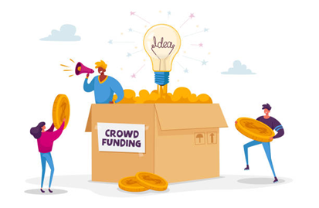
Bridget Menyeh and Theo Acheampong 22nd November 2023
Crowdfunding for Renewable Energy in Emerging markets: An Exploratory Study

Slide 3
Presentation Outline
BACKGROUND
01
RESEARCH GAP
02
AIM AND METHODOLOGY
03
FINDINGS, IMPLICATIONS AND CONCLUSIONS
04

Slide 4
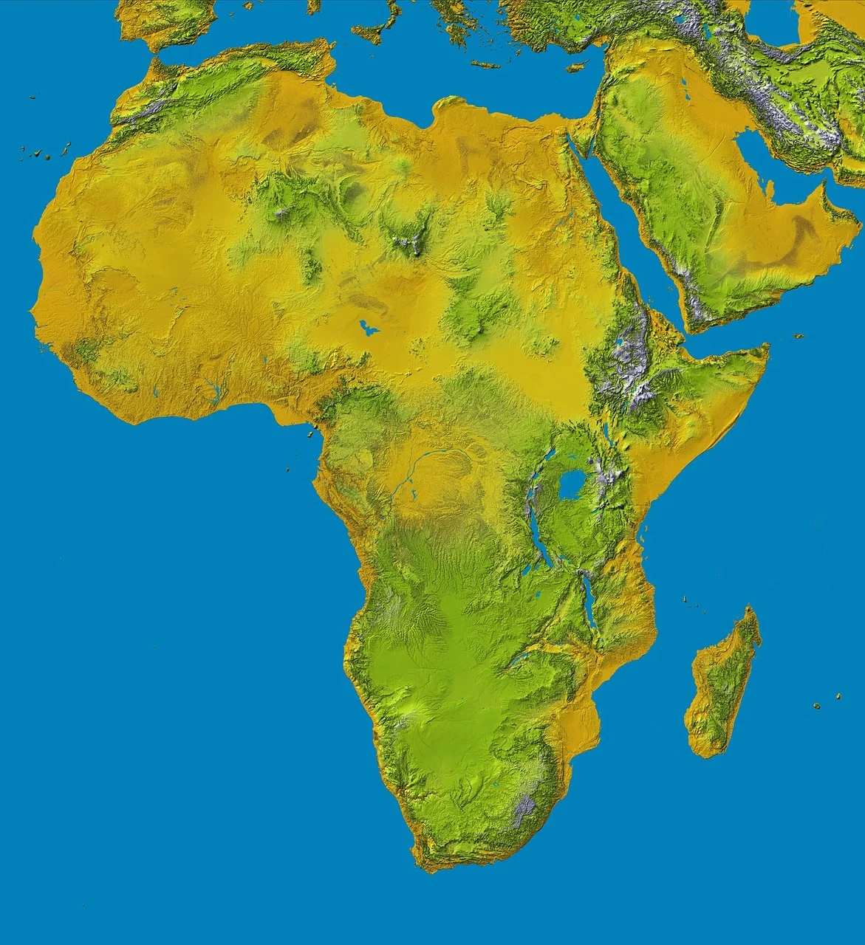
Background
For a sustainable energy future, there is no doubt the renewable energy will be a crucial part of the world’s future energy mix.
In Sub- Saharan Africa, about 600 million people lack access to electricity and other modern energy services such as clean cooking solutions.
Financing remains a challenge to achieve Universal access by 2030. Estimates of US25 billion annually but significant shortfalls exist.
How can we mobilise additional sources of finance? This is both a research and developmental concern

Slide 5
Background Cont’d
Over the last decade, crowdfunding has emerged as a viable tool in the alternative finance industry to complement financing of projects from government and banks
Associated increase in crowdfunding literature (also on renewable energy) but skewed towards developed economies
Scanty literature on crowdfunding for renewable energy in developing countries Africa – especially from a crowdlending or investment perspective rather than philanthropic purposes

Slide 6
State of Literature and Gap
The extant literature has laid a solid foundation by establishing the nature and types of crowdfunding and outcomes from the platform and project developer perspectives (Bergmann et al., 2021).
However, research focussed on the mechanics and dynamics of crowdfunding by investigating the perceptions of the crowd, especially in a developing countries is lacking.
Thus, this study sought to close the gap by investigating perceptions of the “crowd”/funders on investing in renewable energy and what attributes mattered in the decision-making.

Slide 7
Aim and Methodology
Aim : To provide an in-depth knowledge about household investor perspectives regarding in crowdlending for renewable energy. In particular, what attributes would influence their decision to invest in crowdfunded renewable energy project.
Methodology: Integrative literature review to understand key theories shaping crowdfunding success and three focus groups (20 household investors).

Slide 8
Review Findings
Key Theories | Description | Associated Works
Collective Action Theory | Provides a framework to explain why and how individuals come together to pursue common goals and interests. This can include the conditions and motivations that lead people to achieve outcomes which can be more difficult to pursue or achieve solely. | Doan and Toledano, 2018 Gleasure and Feller, 2018 Toxopeus and Maas, 2018 Gonzalez-Cacheda and Outeda, 2021; Monik and Parzuchowski, 2023
Social Proof Theory | This theory explains how individuals look to others for guidance especially in uncertain situations as they are unsure as to how to behave. This could manifest as observing other’s behaviour, reading reviews or testimonials, and referring to data that show preferences or actions. | Stevenson et al., 2022; Anglin et al., 2022; Wesse; et al., 2019; Roethke et al., 2020; Gerber et al., 2012
Network Theory/ Social Capital theory | Provides a framework for studying and examining social relationships and the patterns of connections among individuals, groups, or organizations and how that influences the success of funding campaigns. | Vismara, 2016; Nitani and Riding, 2019 ; Dejean, 2020; Triose, 2020; Lynn et al., 2020; Groza et al., 2020; Cai et al., 2021; Shneor et al., 2023
Signalling Theory | This theory explains how fundraisers/ entrepreneurs can use signals or cue to communicate their credibility to the crowd/backers. This is often a way to overcome information asymmetry and signal project quality. | Wu et al., 2015; Kromidha and Robson, 2016; Wehnert et al.,2019; Li et al., 2022 ; Davies and Giovannetti, 2018; Gama et al., 2023

Slide 9
FOCUS GROUP FINDINGS
TYPE OF RE TECHNOLOGY
(SOLAR WAS PREFERRED)
PROJECT VIABILITY
01
06
02
RATE OF RETURN
PRICE OF INVESTMENT
PLATFORM SECURITY
AND USER FRIENDLINESS
05
03
DEVELOPER REPUTATION
04
GOVERNMENT POLICY
PAYBACK TIME

Slide 10
Findings/ Implications
Our findings demonstrate that an unfair playing field exists on financial returns between renewable energy and investment alternatives available to the crowd.
Hence, the crowdfunding landscape will require deliberate design to improve attractiveness around non-financial attributes such as developer/fundraiser reputation and project viability to further strengthen project economics.
Additionally, perceptions around security and ease of use of crowdfunding platforms are highlighted with the former being situated in the challenges of the broader banking or financial system
Need for social proof and quality signalling to attract household investors. Further research around motivations for collective action in such developing markets is also recommended

Slide 11
CONCLUSION
Need for social proof and quality signalling to attract household investors.
Further research around motivations for collective action in such developing markets is also recommended

