Slide 1
Formation Integrity Evaluation for Geosequestration of CO₂ in Depleted Petroleum Reservoirs Under Cyclic Stress Conditions
Sand Management Network Student Competition
29th November 2023
Presented by: Efenwengbe Aminaho (PhD Candidate)

Slide 2
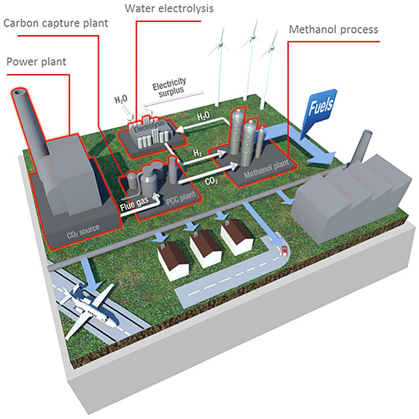
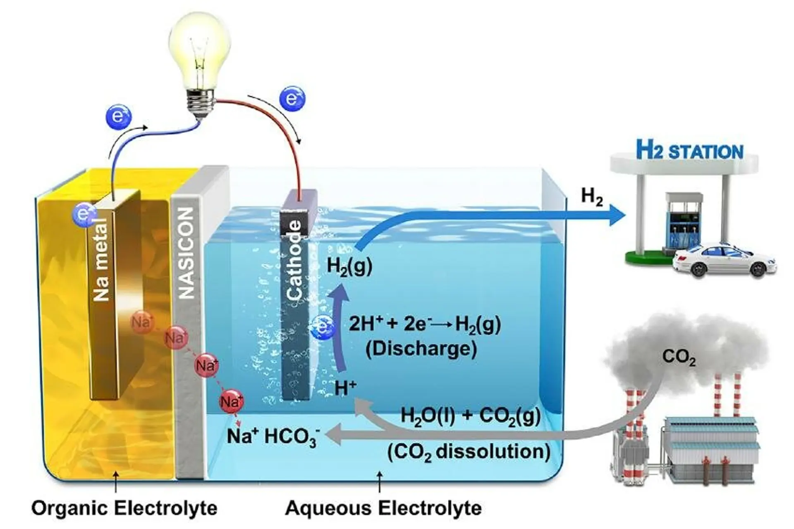
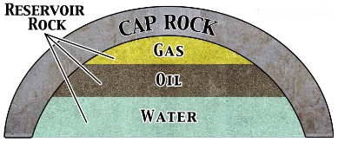
Carbon dioxide (CO₂) geosequestration. CO₂ stored in aquifers/depleted reservoirs. Geosequestration: cyclic and non-cyclic. CO₂ conversion to Methanol or Hydrogen. Cyclic process: sand management issues. Formation integrity: Petrophysics & Brittleness.
Low BI: < 0.1
Medium BI: 0.1 to 0.5
High BI: > 0.5
Introduction
(a)
(b)
Figure 1: CO₂ conversion to (a) Methanol (Sánchez-Díaz, 2017) (b) Hydrogen (Kim et al., 2018).
Figure 2: Petroleum reservoir-caprock structure.

Slide 3
Aim & Objectives
To evaluate formation integrity during cyclic injection and withdrawal of CO₂ gas stream.
Evaluate the impact of impurities in the CO₂ gas stream on the petrophysics and brittleness of reservoir and caprock.
Identify possible sand management and wellbore instability issues during cyclic withdrawal of CO₂.

Slide 4
Methodology
Mathematical model and numerical simulations
Mathematical model developed:
${BI}_{bm}=\frac{\frac{v_{Q}{\overline{M}}_{Q}}{{\overline{V}}_{Q}}+\frac{{0.49v}_{F}{\overline{M}}_{F}}{{\overline{V}}_{F}}+\frac{0.51v_{C}{\overline{M}}_{C}}{{\overline{V}}_{C}}+\frac{{0.44v}_{D}{\overline{M}}_{D}}{{\overline{V}}_{D}}}{\sum_{i=1}^{nm}{\frac{v_{i}{\overline{M}}_{i}}{{\overline{V}}_{i}}}}$
$\overline{M}$ - Molecular weight [g/mol]
$\overline{V}$ - Molar volume [m³/mol]
$v$ - Volume fraction
BI - Brittleness index
Fluid ratio: 97.5 mol% CO₂ : 2.5 mol% impurity.
Impurities: H₂S and SO₂.
Figure 3: A 2-D radial flow model for cyclic injection and withdrawal of CO₂.

Slide 5
Results & Discussion
Figure 4: Porosity change and permeability ratio in the sandstone reservoir and shale caprock.
Notable increase in porosity and permeability at the production interval close to the wellbore.

Slide 6
Results & Discussion
Table 1: Percentage change in porosity and permeability of the reservoir and caprock.
Formation type | Petrophysics | After cycle 7
 |  | CO₂ | CO₂-H₂S | CO₂-SO₂
Shale caprock | Change in porosity (%) | -0.03 to 0.19 | -0.03 to 0.21 | -0.30 to 0.13
 | Change in permeability (%) | -0.10 to 0.59 | -0.10 to 0.66 | -0.92 to 0.40
Sandstone reservoir | Change in porosity (%) | -1.56 to 5.98 | -1.54 to 5.97 | -4.42 to 7.86
 | Change in permeability (%) | -6.12 to 26.70 | -6.06 to 26.68 | -16.54 to 36.29
Slight decrease in porosity and permeability below the production perforation interval – deposition of fines.
Decrease in porosity and permeability for the CO₂-SO₂ case mainly due to the precipitation of anhydrite.

Slide 7
Results & Discussion
Table 2: Brittleness index of the formation before and after CO₂ geosequestration.
Formation type | Brittleness index | Before sequestration, t=0 |  |  | After cycle 7
 |  | CO₂ | CO₂-H₂S | CO₂-SO₂ | CO₂ | CO₂-H₂S | CO₂-SO₂
Shale caprock | BI_{bm} | 0.0377 |  | 0.0377 | 0.0375 to 0.0377 |  | 0.0373 to 0.0377
Sandstone reservoir | BI_{bm} | 0.4593 |  | 0.4593 | 0.4582 to 0.4594 |  | 0.4433 to 0.4593
Change in brittleness index (BI) in the reservoir is negligible, except for the CO₂-SO₂ case.
In the reservoir, close to the production perforation interval, BI decreases slightly.
Slight increase in BI (to 0.4594) below the production perforation interval – confirms the deposition of brittle minerals.

Slide 8
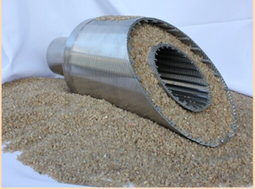
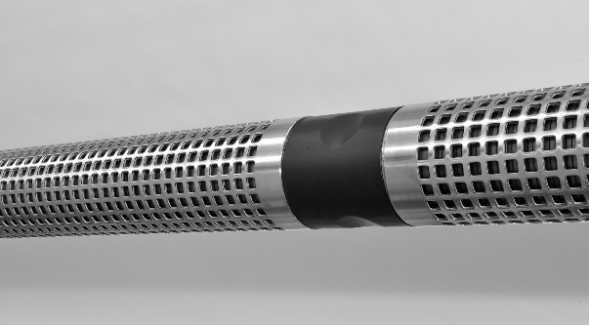
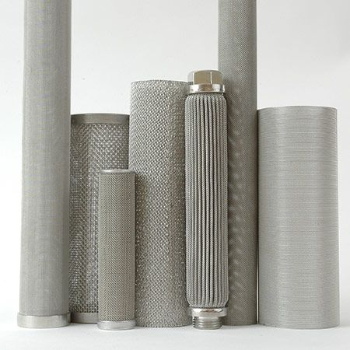
Conclusions & Recommendations
More dissolution of minerals at the interval open to production in the reservoir.
The BI of sandstone reservoir and shale caprock decreases during CO₂ geosequestration.
Sand management practices (e.g., sand screens) are required to minimise fines migration.
Optimum CO₂ withdrawal rate/bottom hole pressure to minimise wellbore instability issues.
Figure 5: Sand screens

Slide 9
References
Aminaho, E.N. and Hossain, M. (2023). Caprock integrity evaluation for geosequestration of CO₂ in low-temperature reservoirs. Aberdeen: Robert Gordon University. https://rgu-repository.worktribe.com/output/2072081
Kim, C., Kim, J., Joo, S., Bu, Y., Liu, M., Cho, J. and Kim, G. (2018). Efficient CO₂ utilization via a hybrid Na-CO₂ system based on CO₂ dissolution. iScience, 9, pp. 278 – 285.
Ma, X., Yang, G., Li, X., Yu, Y. and Dong, J. (2019). Geochemical modeling of changes in caprock permeability caused by CO₂–brine–rock interactions under the diffusion mechanism. Oil & Gas Science and Technology - Rev. IFP Energies Nouvelles, 74 (83), pp. 1-13.
Mahmud, H.B., Leong, V.H. and Lestariono, Y. (2020). Sand production: A smart control framework for risk mitigation. Petroleum, 6, pp. 1-13.
Sánchez-Díaz, Á (2017). MefCO₂ – Synthesis of methanol from captured carbon dioxide using surplus electricity (EU-H2020). Impact, 2017 (5), pp. 6-8.
Zhang, W., Xu, T. and Li, Y. (2010). Modeling of fate and transport of co-injection of H₂S with CO₂ in deep saline formations. United States. https://www.osti.gov/servlets/purl/1007193

Slide 10
THANK YOU!
Any Questions?

