Slide 2

Applying competency-based teaching and assessments with a focus on pharmacy education
Dr Antonella Tonna
Senior Lecturer
School of Pharmacy and Life Sciences,
Robert Gordon University, Aberdeen, Scotland, UK

Slide 3

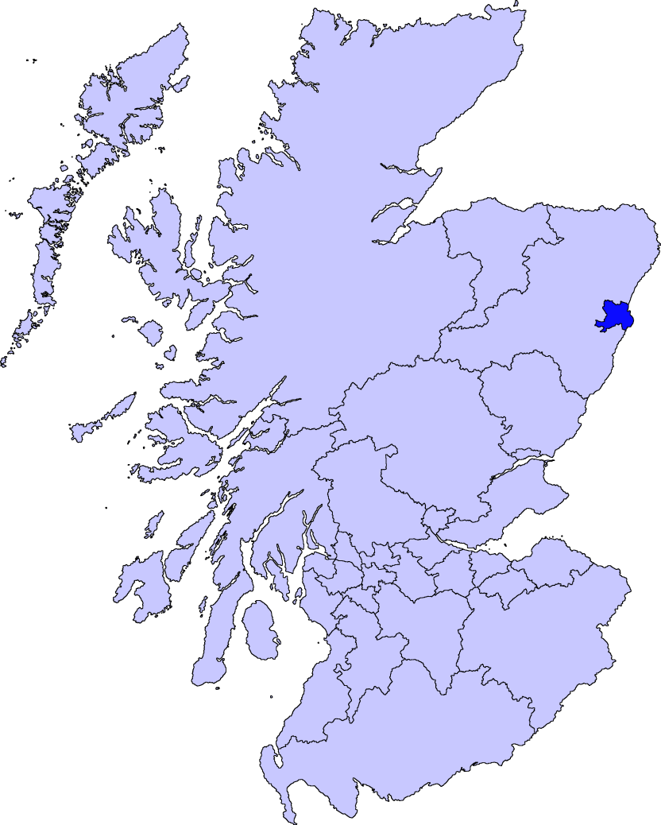

Thank you for inviting me to present at the 1st ICAHS 2023

Slide 4


From this ….
To this …

Slide 5




Aberdeen in the sunshine
Aberdeen in the sunshine

Slide 6



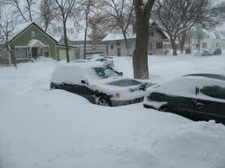
Aberdeen in winter
Aberdeen in the winter

Slide 7



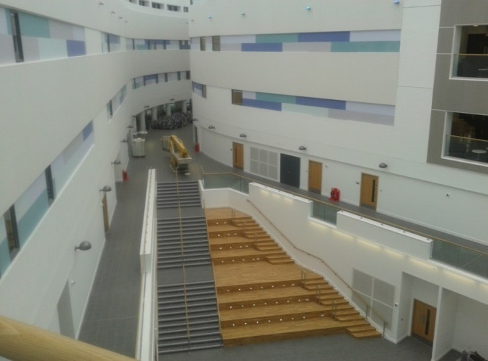
Our Campus
Our new campus … maybe not so new now!

Slide 8

Session outline
An introduction to competency-based learning (CBE) and assessment
An understanding of why there has been a shift to CBE
Models of competency assessment that may be used
Examples of competency frameworks as part of the pharmacy undergraduate and postgraduate curricula
Discussion – learning from each other’s experiences

Slide 9


CBE is a way for students to acquire skills required for their future profession
Only CBE should be included in future healthcare professional curricula
It is not possible to robustly assess competency based learning
Let’s start with some thoughts and opinions

Slide 10
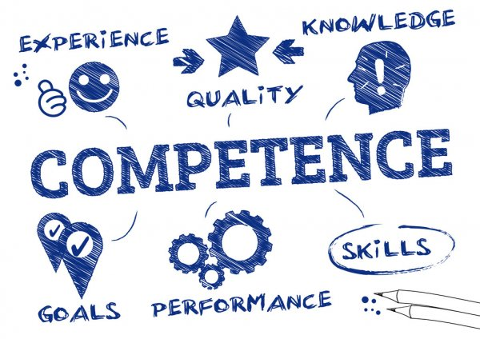
What is competency?
Knowledge, behaviours, attitudes and skills that lead to the ability to do something successfully or efficiently.

Slide 11


What is competency-based education (CBE)?
It is based on students achieving competencies – skills, attitudes, behaviours and knowledge that are set prior. Individuals move on to apply their knowledge to performance.
Students have clear outcomes they need to achieve – some students may achieve this before others; there is greater focus on the learner
The learner needs to be involved in their own education and embrace their own development
Example of UG competency:
Safety netting is effectively provided to patient as part of counselling process of dispensing

Slide 12

Why has there been a shift towards CBE and assessment in healthcare?
To ensure healthcare professionals’ education
Meets the needs of society: patients living longer with more complex treatment needing collaboration, communication, patient education, person centred
Meets the evolution in practice – for example embedding pharmacist prescribing

Slide 13

A drive to develop a Global Competency Framework for the Pharmacy Profession
FIP embarked on the task to develop a competency framework to support the educational development of pharmacy practitioners worldwide
It aims to combine the underlying scientific principles with practice supporting the development of highly competent pharmacists
Overarching aim is to ensure the current and future needs of the society and workforce are met around the world
This framework is based mainly on pharmacy education in Western countries.

Slide 14
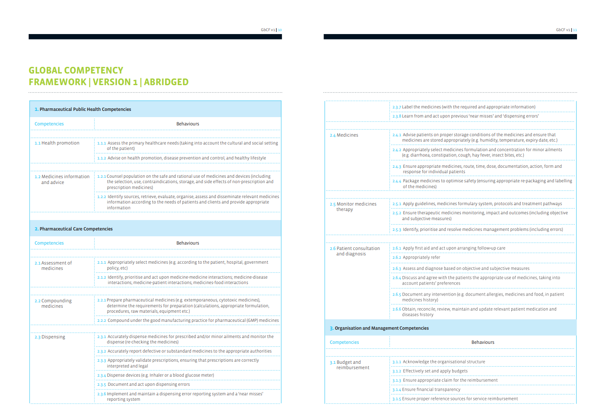
Population Focus
Patient Focus
System Focus

Slide 15
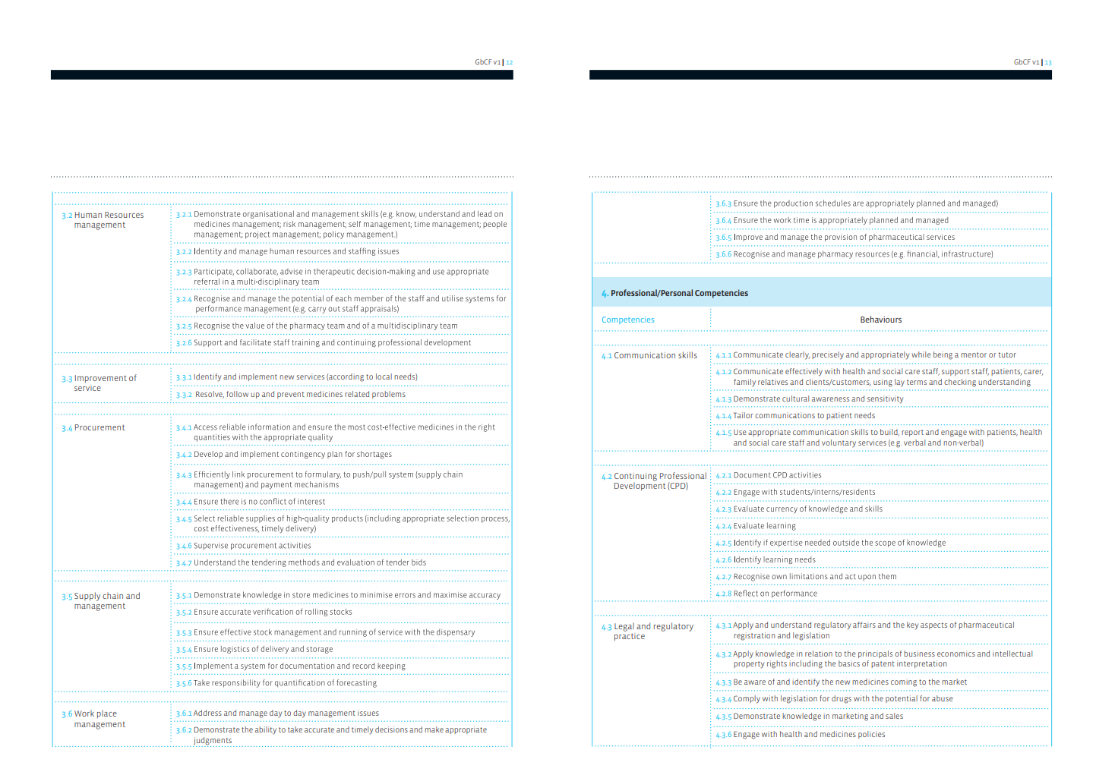
Practice Focus

Slide 16
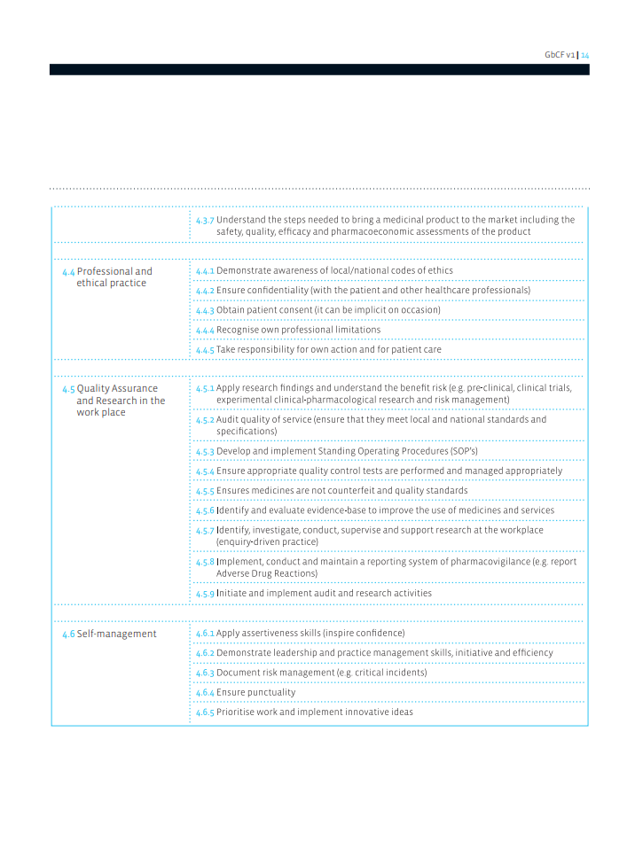

Slide 17
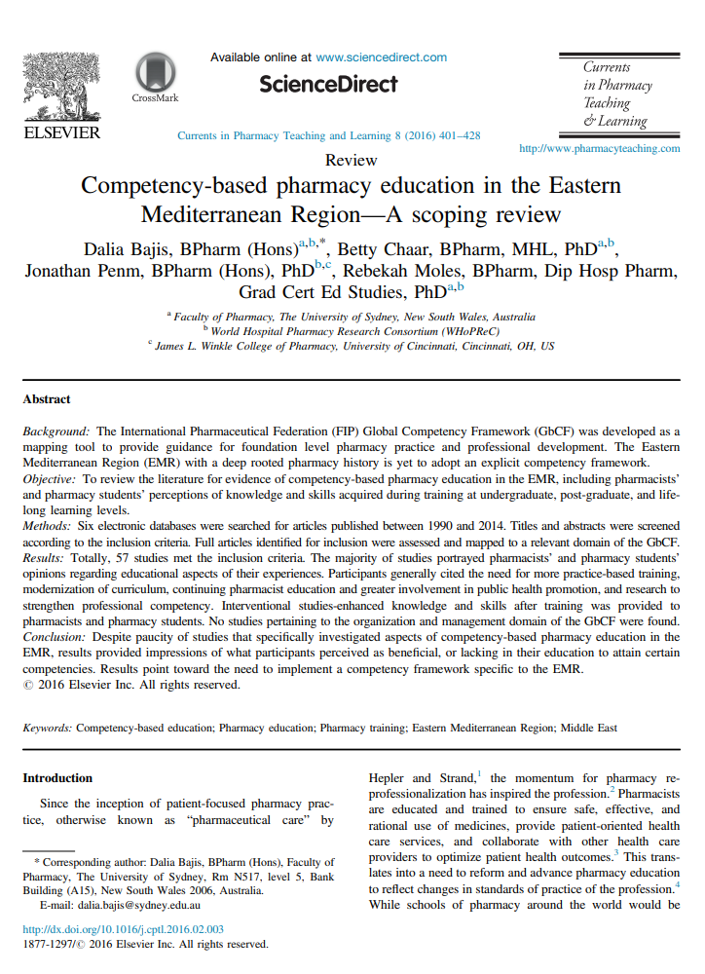
Of particular relevance to this region
10 from UAE

Slide 18
Of these 10 studies ….
Domain 1
Pharmaceutical Public Health Competencies including medicines information and advice and health promotion
Community pharmacists
Questionnaire assessing degree of participation in breast cancer health promotion
Most never provided patients with advice or counselling BUT were interested in breast cancer CPD
Community pharmacists
Questionnaire assessing knowledge and need for adding herbal medicines as part of UG education
Most felt training did not provide necessary skills and knowledge
Also interested in attending CPD on herbal medicines

Slide 19
Domain 2 Pharmaceutical care competencies
Assessment, Dispensing, Counselling etc..
4th year UG students
Knowledge, attitudes and proficiency in practice of EBM before and after a PBL series
Skills and attitudes towards EBM changed after the PBL series
However, students commented on lack of role models in practice who implemented EBM
Pharmacists
Assessed communication on dispensing based on USP Medication Counselling Behaviour Guidelines
>1% of interactions reached Stage 4 which includes aspects such as ensuring patient understands instructions given
Community pharmacists
Exploring role of pharmacists in counselling
Mainly agreed that this is a pharmacist role but many identified further training required

Slide 20
Domain 4 Professional/Personal Competencies including communication, CPD, legal and ethical aspects
3rd year UG students
Use of TBL in teaching ethics in pharmacy practice
Students showed better group performance and teamwork BUT conducted in English with a number of students struggling
2nd year UG students
Teaching communication to physicians to enhance student persuasive ability
Students own rating – rated course highlight BUT skills not observed
Community pharmacists
Knowledge, attitudes and beliefs of ADRs
Community pharmacists
Characteristics and workforce issues in UAE
Lack of training evident
A number considered their lack of knowledge and skills prevented them from delivering a professional service
Pharmacists
Insight into CPD
In favour of CPD and thought it would enhance knowledge and the way they practiced

Slide 21
In conclusion a requirement for more education and training of current workforce on aspects such as counselling
A need to ensure that future pharmacists are “fit for purpose” and are patient focused
Need to shift focus to the ability of pharmacists to use and apply skills to meet demands of population
Can changes in curriculum bridge the gap?
Will give some examples on how we are attempting to implement this in our pharmacy courses
Pharmacists have the knowledge but there is a need to apply this to performance e.g. lifelong learning, public health promotion

Slide 22
Development of clinical competence
Number of educational theories that are used to rank clinical competence – from knowledge at lower levels to action with application of knowledge at expert level
Assessment of practice may take place in a real-world environment or in a simulated environment where the latter is not practical
Entrustable Professional Activities (EPA) – what the student or pharmacist should be able to do without supervision
Assessment may be formative – assessment FOR learning; or summative – assessment OF learning

Slide 23
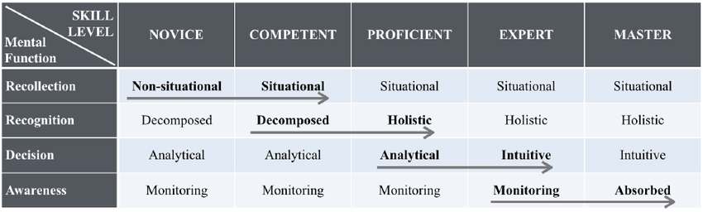
Dreyfus model of skills acquisition
Individuals progress through various levels of skills acquisition

Slide 24
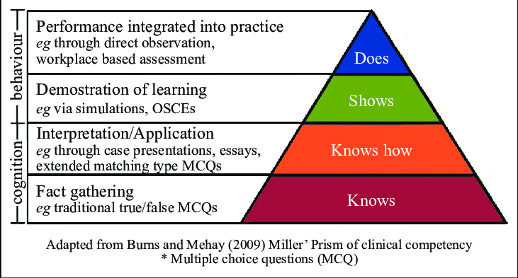
Miller’s Pyramid of Competency Evaluation through Performance

Slide 25
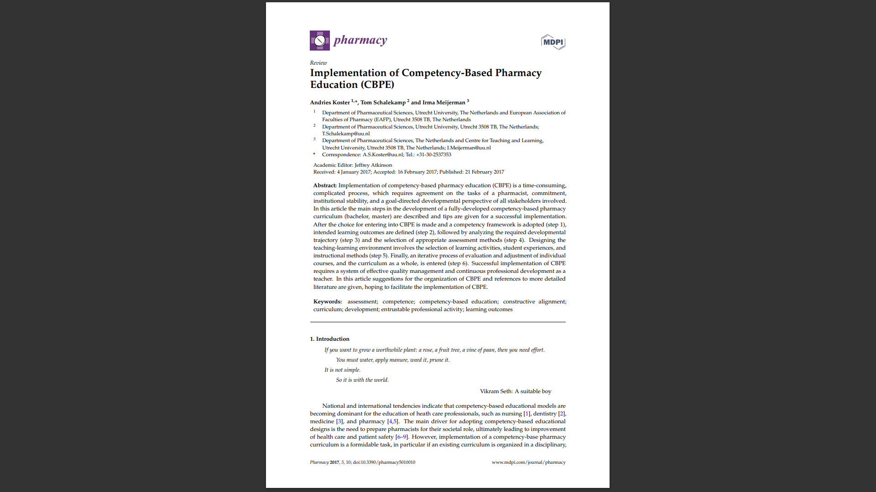
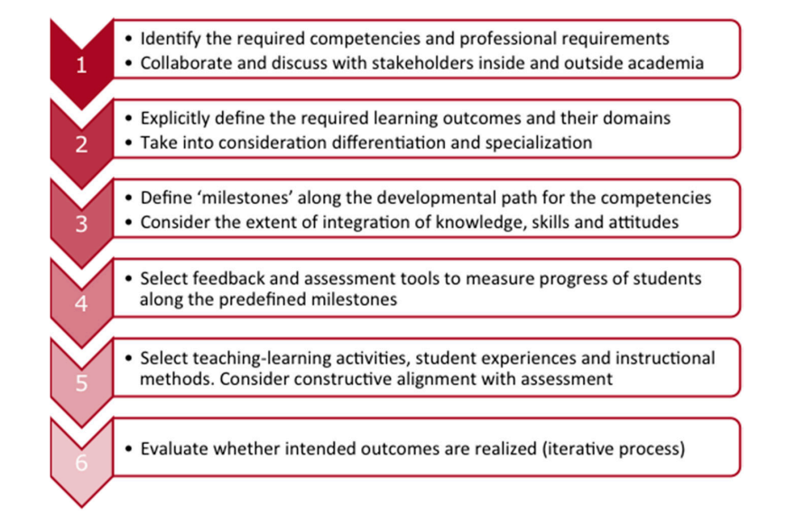
The curriculum design process to embed CBE

Slide 26
An example of progression within a competency framework aimed at setting standards and outcomes for the initial education and training of pharmacists in the UK – focusing on skills and attitudes

Slide 27
General Pharmaceutical Council
Domain
Patient centred care and collaboration
Outcome
Demonstrate effective communication at all times and adapt their approach and communication style to meet the needs of the patient
DOES at undergraduate level

Slide 28
How can this be embedded into the curriculum?
Increased complexity from counselling on dispensing, provision of lifestyle advice, taking of medication history, providing prescribing recommendations
Taught throughout the four years at different levels
Vertical application in curriculum
Assessment
Higher stages
OSCEs – also in a simulated environment
Work place during experiential learning – observation and feedback in practice
Assessment
Lower stages
Observed assessments in simulated practice environment with emphasis on performing repeatedly and reliably

Slide 29
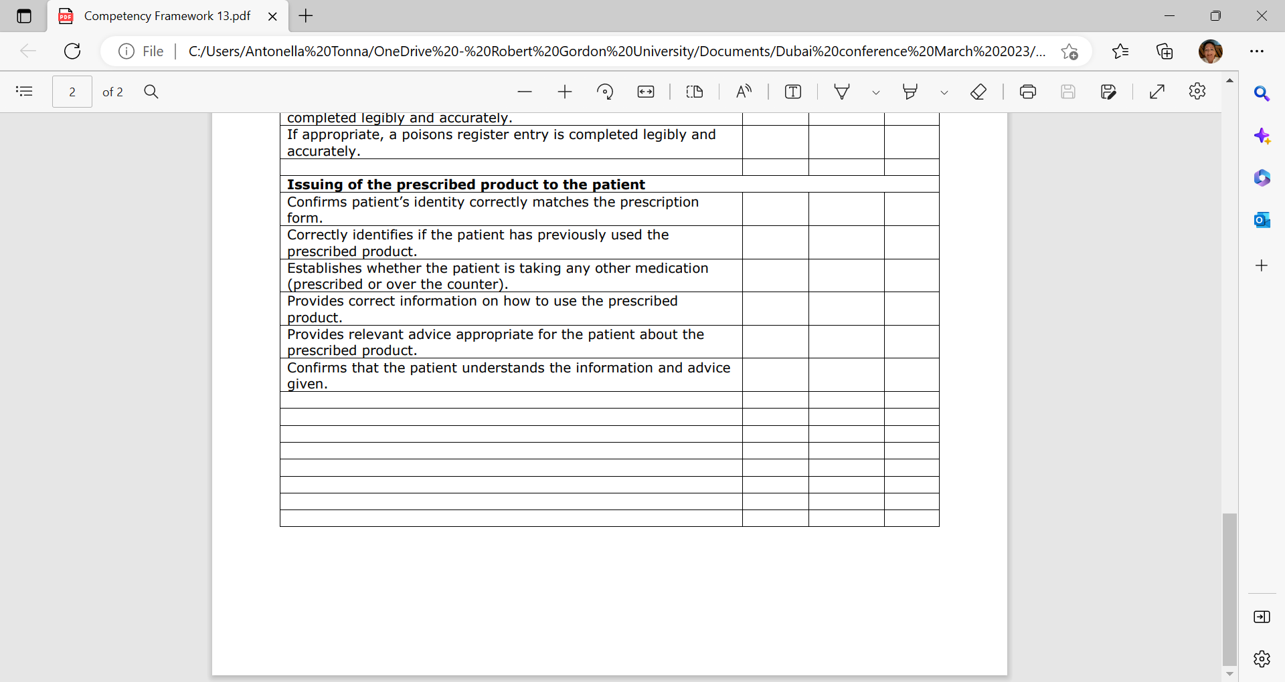
Stage 2 – Assessment of dispensing process
Learning outcome: Effectively communicate with patients, the public and the wider healthcare team

Slide 30
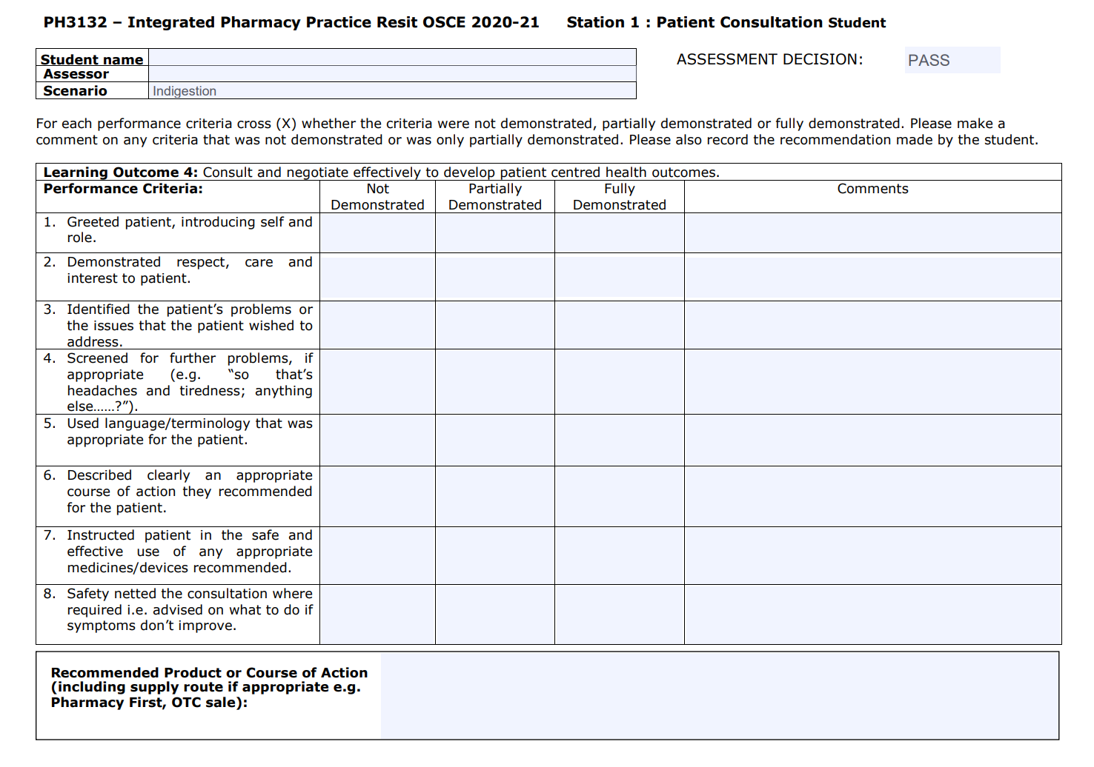
Stage 3 – assessment of response to patient symptom or request for a product

Slide 31
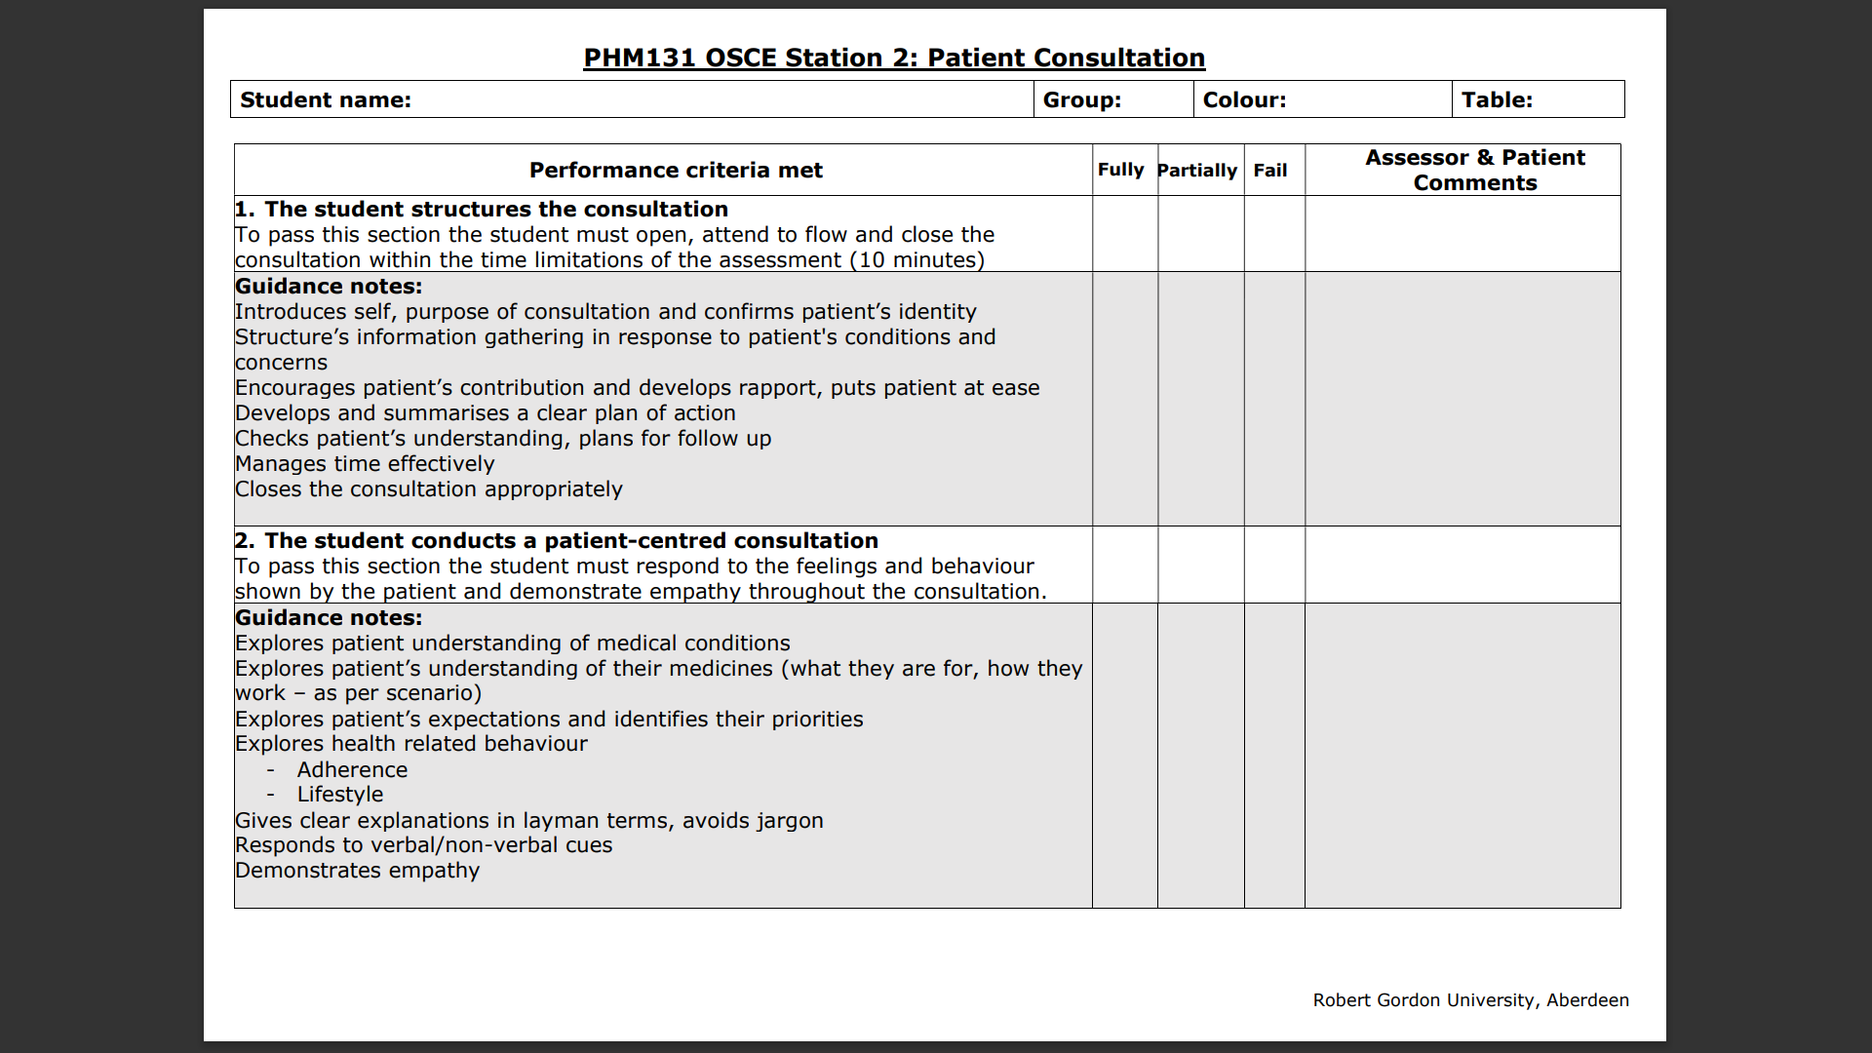
Stage 4 – assessment of consultation
Learning outcome: Demonstrate attainment of relevant professional interpersonal communication skills

Slide 32
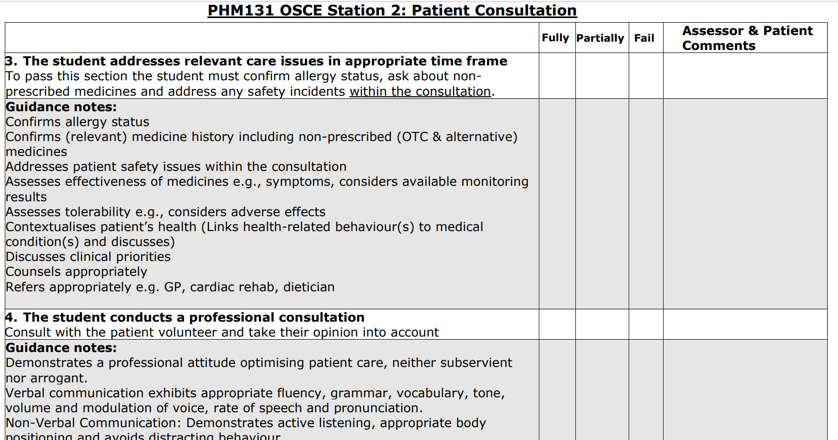

Slide 33
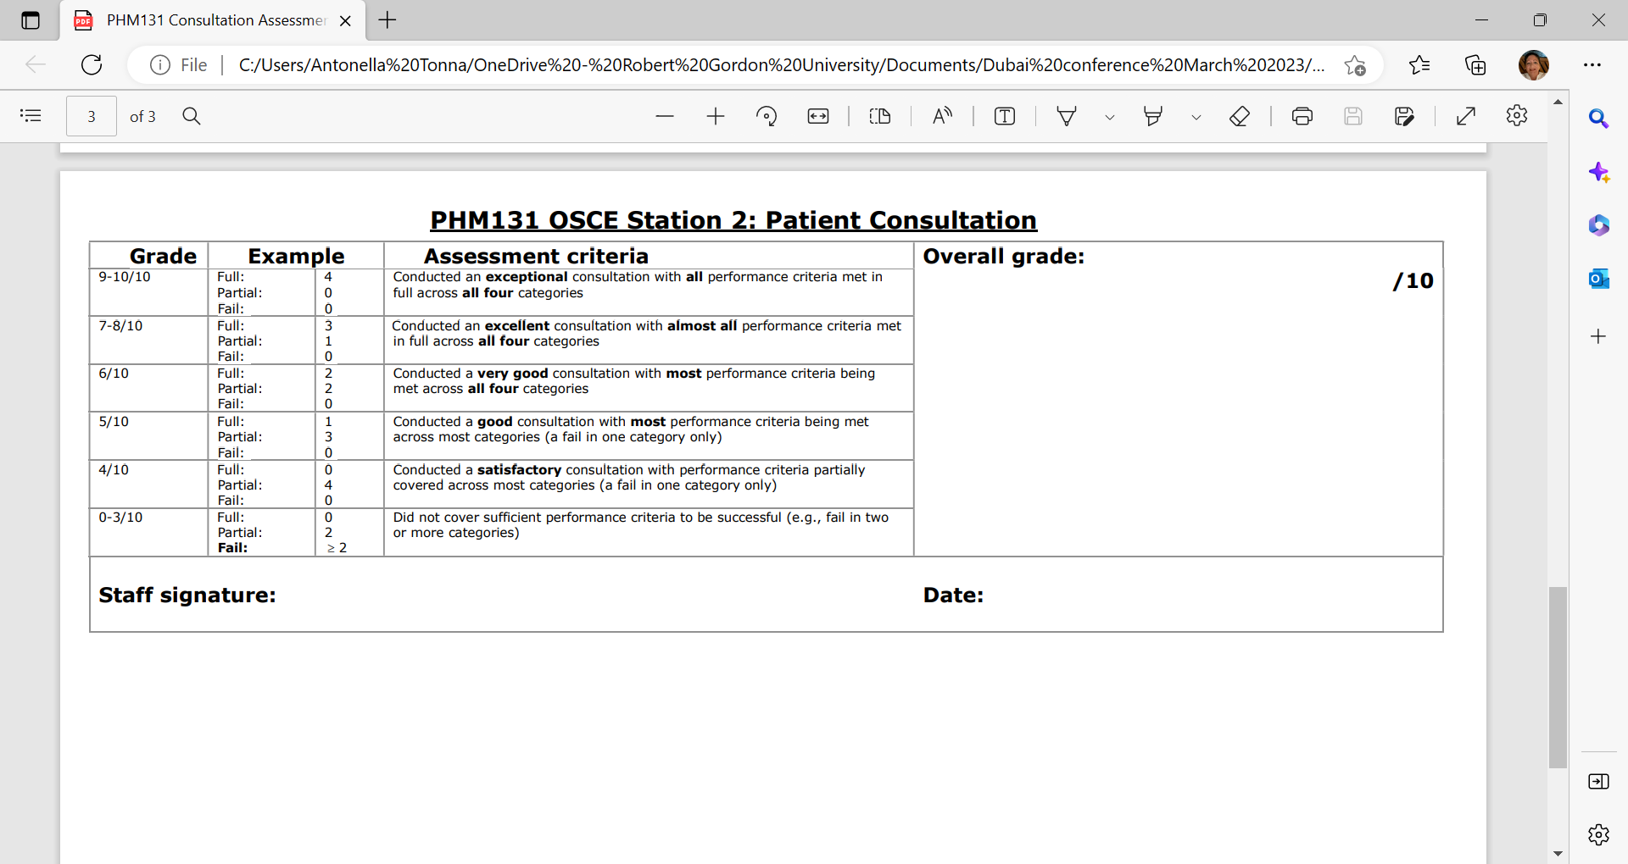

Slide 34
An example of progression within a competency framework aimed at setting standards and outcomes for the initial education and training of pharmacists in the UK – focus on a specific subject area

Slide 35
Infection
Incorporation to combine in more complex case-based discussion linking all facts provided to a specific patient – e.g. infection recurring after few weeks with link to resistance
Assessment is by responding to set cases given
SHOWS HOW
Case based discussion with more interpretation of facts e.g. C &S reports, Lab parameters; starts to focus on the application of knowledge
KNOWS HOW
Didatic teaching and self –directed learning to learn facts
Assessment is by recall of facts: MCQs, short/long questions
KNOWS
Can make own prescribing decisions independently
Assessment is by assessing the action when showing ability: OSCE and responding to a case being provided independently, workplace assessment
Maybe in combination with a portfolio
DOES

Slide 36
An example of competency-based assessment in postgraduate education as part of the pharmacist independent prescribing course
Students are assessed on their professional approach, patient safety, clinical judgement and a person centred care approach during a consultation with a simulated patient

Slide 37
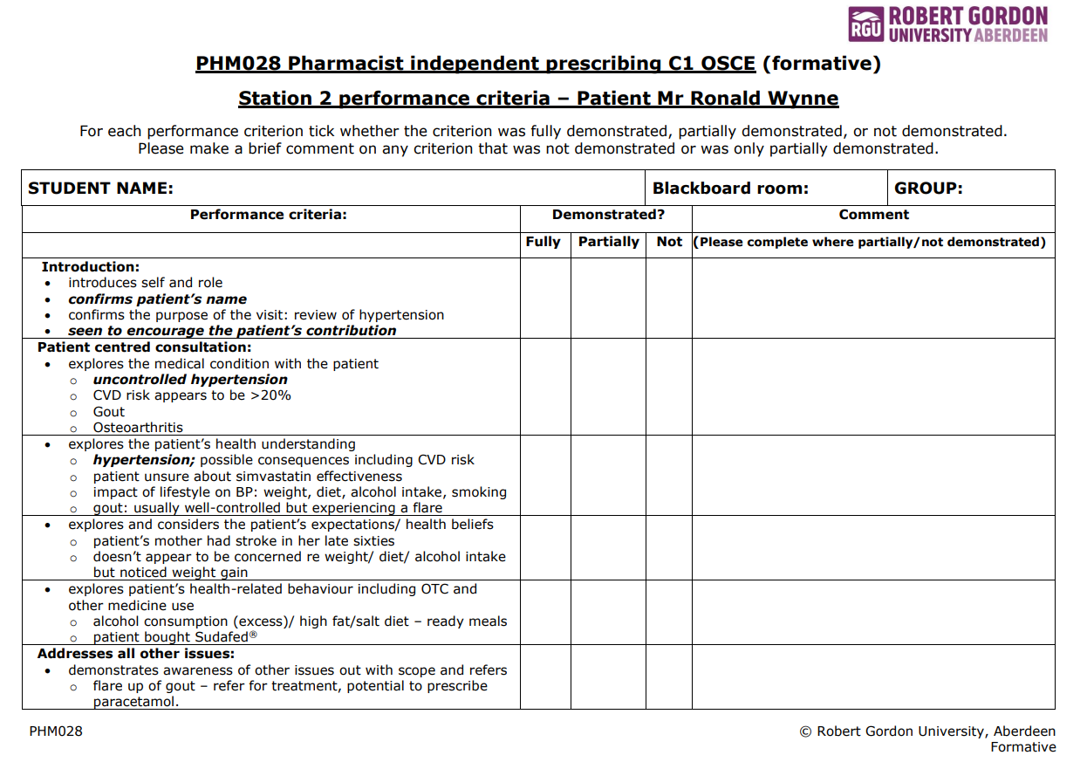
General competency of "patient centred consultation" being tailored to the case students are being assessed on
Guidance for assessors

Slide 38
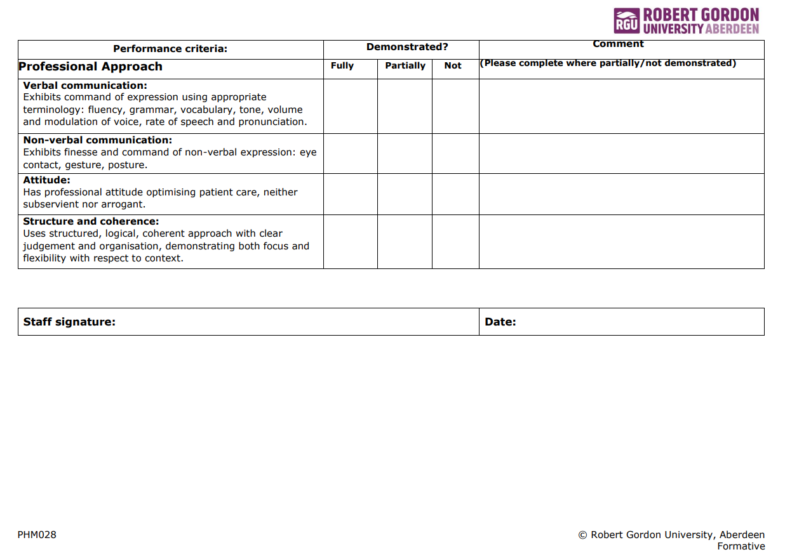
Professional approach ‘Not demonstrated’ in 2 or more of the performance criteria constitutes a FAIL

Slide 39

What are the challenges that we are now facing?
Student pharmacists currently in Year 1 will be prescribers when they graduate
How do we ensure they are competent?
Experiential learning is becoming a more prominent feature of pharmacy UG teaching in Scotland
How do we ensure that workplace-based competency assessments are fit for purpose?
How do we ensure that workplace-based facilitators and practitioners can carry out these assessments?
How do we ensure that the students achieve the necessary learning irrespective of their placement sites?

Slide 40
CBE is a way for students to acquire skills required for their future profession
Only CBE should be included in future healthcare professional curricula
It is not possible to robustly assess competency based learning
Let’s go back to initial thoughts and opinions

Slide 41
Resources
Bajis D et al. Competency-based pharmacy education in the Eastern Mediterranean Region – A scoping review. Current in Pharmacy Teaching and Learning. 2016;8:401-428
General Pharmaceutical Council. Future pharmacists: standards for the initial education and training of pharmacists; 2021. Available from: https://www.pharmacyregulation.org/sites/default/files/document/standards-for-the-initial-education-and-training-of-pharmacists-january-2021_final-v1.3.pdf
International Pharmaceutical Federation. Pharmacy Education Taskforce: a global competency framework:2012. Available from: https://www.fip.org/file/1412
Jacob SA et al. Competency-based assessment in experiential learning in undergraduate pharmacy programmes: Qualitative exploration of facilitators’ views and needs (ACTp Study) Pharmacy 2022, 10, 90
Katoue MG, Schwinghammer TL. Competency-based education in pharmacy: A review of its development, applications, and challenges. Journal of Evaluation in Clinical Practice. 2000;26:1114-1123
Koster A, Schalekamp T, Meijerman I. Implementation of Competency-Based Pharmacy Education (CBPE). Pharmacy. 2017, 5, 10

Slide 42


