Slide 1
The impact of COVID-19 on Antimicrobial Stewardship implementation in United Arab Emirates hospitals – an exploration informed by the Consolidated Framework for Implementation Research
Presented by
Nortan Hashad
Lecturer, Pharmacy, Higher colleges of Technology, Dubai, UAE
PhD researcher, Pharmacy and Life Sciences, Robert Gordon University, Aberdeen, UK.

Slide 2
Authors
Nortan Hashad^{1, 2}, Derek Stewart³, Dhayaneethie Perumal⁴, Najiba Abdulrazzaq⁵, Antonella Pia Tonna²
¹Pharmacy, Higher Colleges of Technology, Dubai, United Arab Emirates
²Pharmacy and Life Sciences, Robert Gordon University, Aberdeen, United Kingdom
³College of Pharmacy, Qatar University, Doha, Qatar
⁴Commission of Academic Accreditation, Ministry of Education, Abu Dhabi, United Arab Emirates
⁵Al Kuwait hospital, Emirates Health Services, Dubai, United Arab Emirates

Slide 3
Conflict of interest
Nothing to disclose
This research did not receive any specific grant from funding agencies in the public, commercial, or not-for-profit sectors.

Slide 4
Background and aim
Antimicrobial stewardship programme (ASP) has been defined by WHO as ‘An organizational or system-wide health-care strategy to promote appropriate use of antimicrobials through the implementation of evidence-based interventions’
The disruption caused by Coronavirus disease 2019 (COVID-19) on antimicrobial stewardship programmes (ASP) has been acknowledged but not explored in-depth.
Aim
This study uses a theoretical qualitative approach to understand the impact of COVID-19 on ASP implementation in United Arab Emirates (UAE) hospitals as well as identify facilitators and barriers to ASP implementation.

Slide 5
Formation
A panel of 39 constructs arranged across five domains.
1
Application
Increasingly used in healthcare-related implementation research.
2
Consolidated Framework for Implementation Research (CFIR)
Purpose
Help to gather data about contextual factors that can impact implementation of a service as facilitator or barrier for implementation.
3
Development
Developed based on a constellation of 19 implementation theories, models or frameworks that are published in peer-reviewed journals.
4
Use in this research
CFIR was used to guide: data collection tool development, coding and analysis as well as final reporting of results.
5

Slide 6
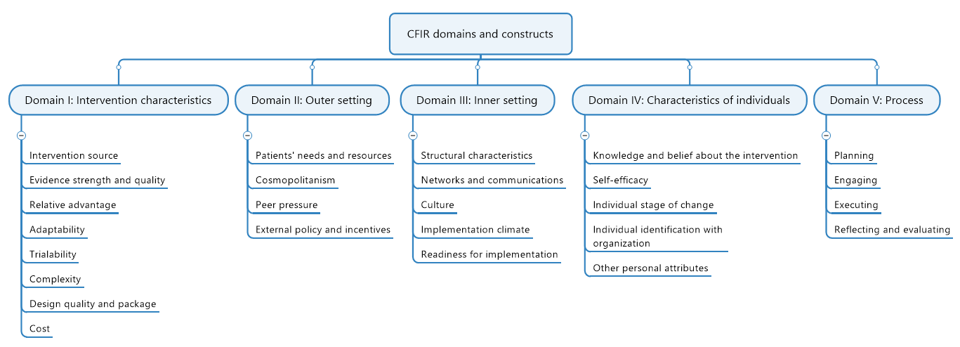
Map produced by Mind Manager from Coral Corporate

Slide 7
Methods
Research tool
Semi-structured online interviews, Conducted through Zoom, Microsoft teams, Blackboard collaborate ultra. July 2020 – December 2020. Approximately 45 – 60 minutes
Interview schedule
Methods
informed by Consolidated framework for Implementation research (CFIR) and literature review.
Participants
ASP team members and other healthcare practitioners dealing with antimicrobials in UAE hospitals

Slide 8
Methods
Recruitment
Purposeful followed by snowball sampling.
Maximum variation of participants representing different governing health authorities, bed size, background training and specialities.
Data management
Methods
Audio recorded, transcribed verbatim and anonymised.
Transferred to NVIVO software – facilitate data management and visualisation.
Data analysis
Independently analysed by two researchers both:
Deductively (based on CFIR) and Inductively (based on emerging themes).

Slide 9
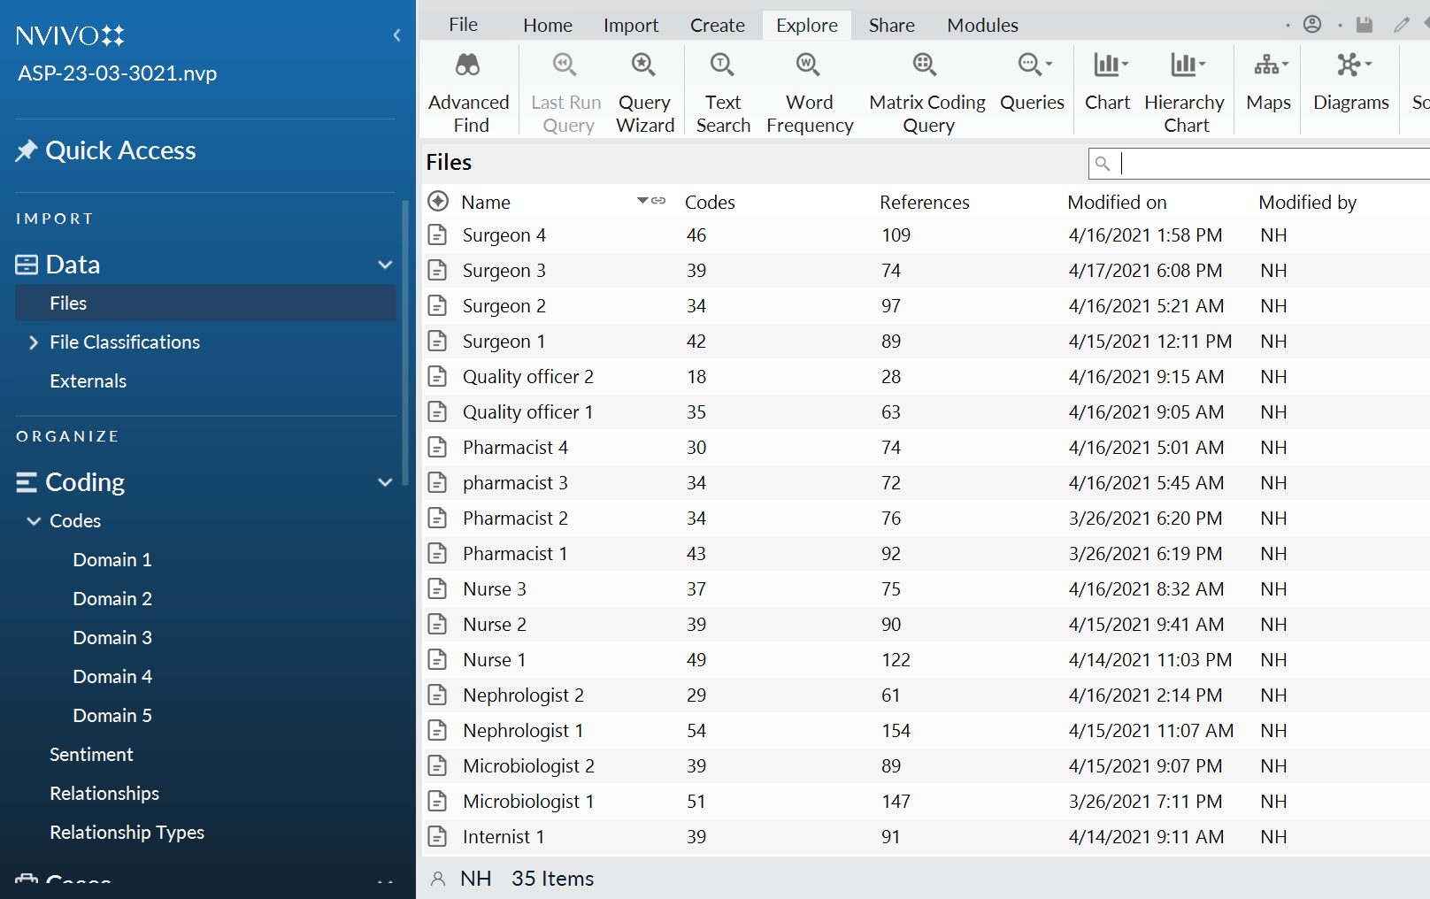
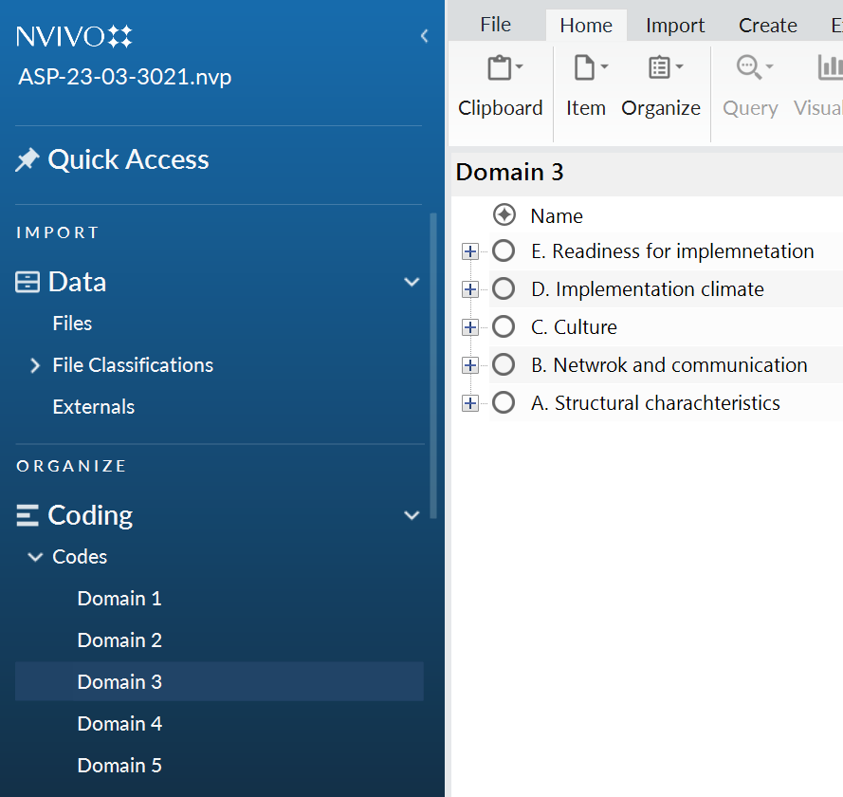
NVIVO software
Coding framework by NVivo 12 Pro

Slide 10
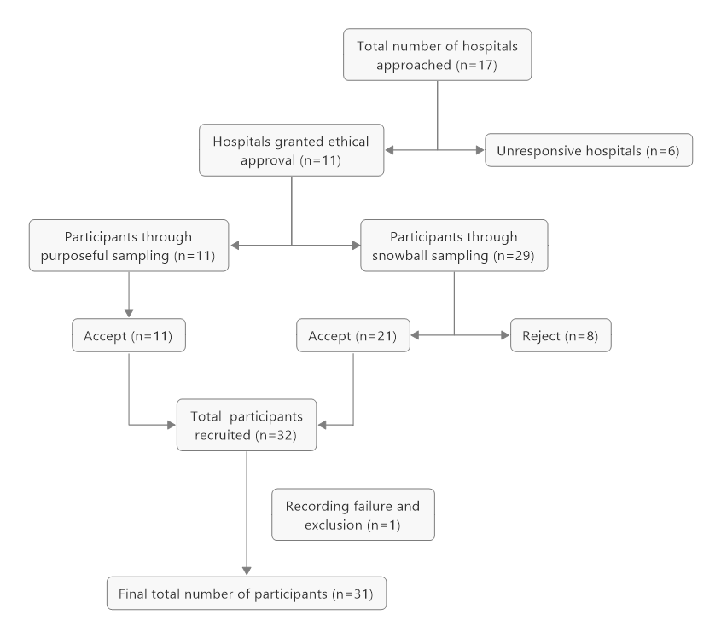
Results A. Population demographics
Sampling strategy for data generation
Maximum variation sampling

Slide 11
Results B. Hospital demographics
Total 11 hospitals granted ethical approval
(8 governmental and 3 private), across the seven Emirates
Sharjah
n = 2
Fujairah
n = 1
Dubai
n = 3
Ras al Khaimah
n = 1
Abu Dhabi
n = 4

Slide 12
Results C. Main themes identified
Theme one
Increased complexity of ASP implementation and resulting changes in prescribing behaviour influenced by COVID-19
Theme two
Adaptations, networking and cosmopolitanism (external networking) to enhance integration of COVID-19 management in ASP services
Theme three
Adaptations and networking to support continuity of ASP implementation process

Slide 13
Theme one: Increased complexity of ASP implementation and resulting changes in prescribing behaviour influenced by COVID-19
Disruption of ASP implementation as a result of COVID-19
Change in priority under the impact of COVID-19
Changes in antimicrobial resistance pattern
Delay in ASP plans under the impact of COVID-19
Change in antimicrobial prescribing behaviour
“It halted everything, because we had to be pulled to cover the covid wards. ” [ID physician 1]
“People [prescribers] did not even care about the comments of ASP. So they started all the broad spectrum antibiotics you can imagine, although in many cases it was clear, clear viral infection.” [ICU consultant 3]
“We saw a lot of misuse of antibiotics. We saw a lot of doctors who were just if a patient comes with COVID-19 they would start a lot of empirical antibiotics.” [Clinical pharmacist 5]

Slide 14
Theme two Adaptations, networking and cosmopolitanism (external networking) to enhance integration of COVID-19 management in ASP services
Cosmopolitanism and networking to support building national COVID-19 management guidelines
Adaptations for ASP activities to include management of COVID-19 patients
“Experience with ASP and having structure and having consultations and having meetings with different stakeholders really allowed us [to help in building national guidelines for COVID], a lot of the infectious disease people are clinical pharmacist and are actually quite solid.” [Clinical pharmacist 2]

Slide 15
Theme three Adaptations and networking to support continuity of ASP implementation process
Adaptation on networking to facilitate continuity of ASP implementation during the pandemic
Adaptation of pre-authorization forms to facilitate continuity of ASP implementation during the pandemic
Restrictions on broad spectrum antimicrobials
Desire to re-establish ASP implementation
Gradual decline in antimicrobial prescribing
“Everybody trying to work virtually to reduce contact with others, even our rounds, we used to do rounds, it's virtual rounds, we will do it through WhatsApp” [Clinical pharmacist 1]
“For us as an ASP member in our facility, we provide a daily feedback for the doctor, especially in the Critical care area regarding the treatment plan of covid patients, so it was a huge challenge at the initial phase of covid, but now start to be stabilized and improved.” [Clinical pharmacist 6]

Slide 16
CFIR constructs identified as barriers mapped to corresponding themes
Impact on ASP practice | CFIR Domain | CFIR Construct | Corresponding overarching theme | Corresponding subtheme
Barriers | Intervention characteristics | Complexity | Theme (1) | Disruption of ASP implementation
 |  |  | Theme (1) | Delay in ASP plans under the impact of COVID-19
 |  |  | Theme (1) | Changes in antimicrobial resistance patterns
 | Outer setting | Patient needs and resources | Theme (1) | Seriousness of illness of COVID-19 patients
 | Inner setting | Implementation climate | Theme (1) | Changes in antimicrobial prescribing behaviour
 |  | Relative priority | Theme (1) | Change in priority under the impact of COVID-19 pandemic

Slide 17
CFIR constructs identified as facilitators mapped to corresponding themes
Impact on ASP practice | CFIR Domain | CFIR Construct | Corresponding overarching theme | Corresponding subtheme
Facilitators | Intervention characteristics | Adaptability | Theme (2) | Adaptations for ASP activities to include management of COVID-19 patients
 |  |  | Theme (3) | Adaptation of networking to facilitate continuity of ASP implementation during the pandemic
 |  |  | Theme (3) | Adaptation of pre-authorisation forms to facilitate continuity of ASP implementation during the pandemic
 | Outer setting | Cosmopolitanism | Theme (3) | Cosmopolitanism and networking to support building national COVID-19 management guidelines
 | Inner setting | Network and communication | Theme (3) | Cosmopolitanism and networking to support building national COVID-19 management guidelines
 |  | Access to knowledge and information | Theme (3) | Gradual decline in antimicrobial prescribing
 | Characteristics of individuals | Knowledge and belief about the intervention | Theme (3) | Desire to re-establish ASP implementation

Slide 18
Conclusion
Despite the initial disruption of ASP implementation given the complexity of the intervention, due to the pandemic, successful restoration and evolvement of ASP services reflects the high value and adaptability of ASP implementation in UAE hospitals.
This value further motivates for investment in such programmes to ensure readiness for future pandemics and to keep pace with global accelerated developments in healthcare systems.

Slide 19
References
Pierce J, Stevens MP. COVID-19 and antimicrobial stewardship: lessons learned, best practices, and future implications. International journal of infectious diseases: IJI: official publication of the International Society for Infectious Diseases. 2021; 113:103-108.
Damschroder LJ, Aron DC, Keith RE, Kirsh SR, Alexander JA, Lowery JC. Fostering implementation of health services research findings into practice: a consolidated framework for advancing implementation science. Implementation Science: IS. 2009; 4:50-50.
Hashad N, Perumal D, Stewart D, Tonna AP. Mapping hospital antimicrobial stewardship programmes in the Gulf Cooperation Council states against international standards: a systematic review. The Journal of hospital infection. 2020; 106(3):404-418.

Slide 20
Thank You Any questions

