Slide 1
An application of theoretically informed implementation research in pharmacy
Facilitated by
Dr Antonella Tonna
Senior Lecturer in clinical pharmacy, School of Pharmacy and Life Sciences, Robert Gordon University, Aberdeen, Scotland, UK.
Nortan Hashad
PhD researcher, Robert Gordon University, Aberdeen, Scotland, UK; Lecturer, Pharmacy, Higher Colleges Of Technology, Dubai, UAE.

Slide 2
By the end of this workshop, attendees will be able to:
Understand the meaning of and need for implementation research.
Recognise the classification of implementation theories, models and frameworks.
Apply different implementation theories, models and frameworks to varied research studies.

Slide 3
Workshop outline
40 minutes: Introduction to theoretically informed implementation research
60 minutes: Application of knowledge by trying out some case scenarios
15 minutes: Putting learning into practice – a worked example
5 minutes: Any last minute comments

Slide 4
Introduction
30 minutes

Slide 5
Implementation - historical insights
Published in a commentary Forbes.com, 2004
“Organizations are successful because of good implementation, not good business plans.”
On of the original Apple employees responsible for marketing Macintosh computer line
The concept of implementation was developed in the 1970s.
It was taken to new levels when it was linked to evidence-based practice (EBP).

Slide 6
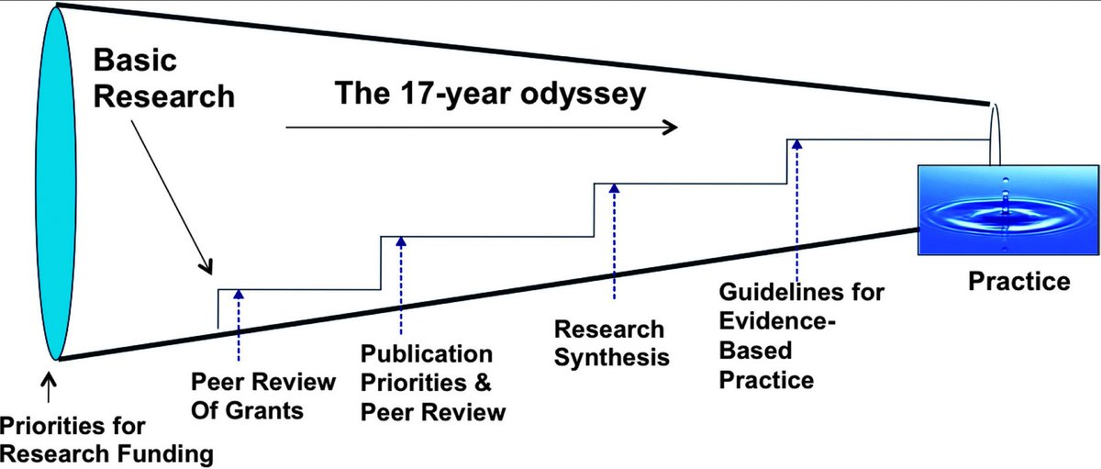
Bridging the Gap Between Research and Practice: Implementation Science
Implementation research: what is known to be efficacious i.e. EBM vs what is the uptake of this evidence in the real world
Influenced by many factors in the specific context including population needs, funding, professional discretion, fit of evidence into the practice
Translational research: applying knowledge from clinical trials to tools addressing clinical needs

Slide 7
Closing the research – practice gap
Scholars were increasingly interested in closing research-practice gap through the identification and examination of activities and processes that effectively support the dissemination, uptake, and implementation of evidence in real-world practice and policy settings.
Initially elements of interest were factors (setting or individuals related) influencing implementation and activities supporting implementation.
Constructs were grouped into implementation frameworks, aiming to identify overarching determinants of implementation success or failure.
What should be happening based on evidence generated by the research
[Best Practice]
What is happening
[Current Practice]
What is the difference between the two
[Practice Gap]

Slide 8
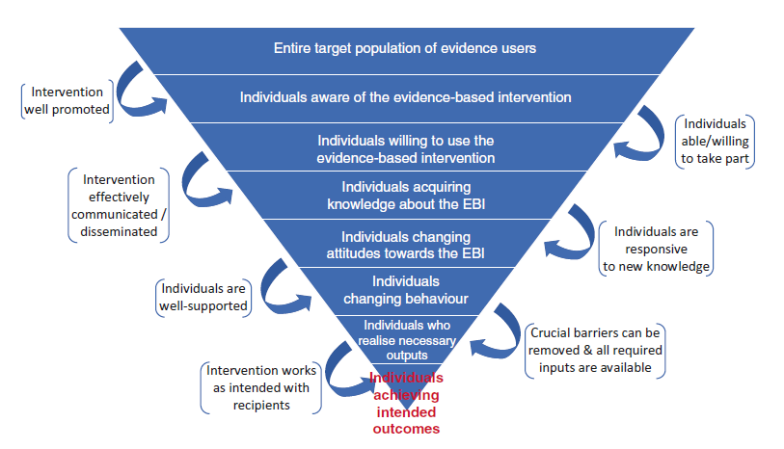
Funnel of attrition
Multiple steps are required to achieve outcomes in real-world practice using evidence.
This can potentially lead to a loss of impact – because of presence of a broad range of barriers hampering each stage.
Eventually leading to a small number of individuals benefiting from the effective intervention.
Reference: ALBERS, B., SHLONSKY, A. and MILDON, R., 2020. Implementation science 3.0. Cham, Switzerland: Springer

Slide 9
Villages in Africa assigned to receive a nutrition package for children; package developed based on nutritional EB guidelines for malnutrition
Villagers traditionally refuse any help
Some individuals within the village are aware of this help
Intervention works as intended BUT a change in malnutrition status observed only in a handful of children
Less individuals are willing to be weighed to qualify for this intervention
A few mothers attend nutritional counselling
These mothers change their behaviours allowing children to access food

Slide 10
“The scientific study of methods to promote the systematic uptake of research findings and other Evidence-Based Practices (EBP) into routine practice, and hence, to improve the quality and effectiveness of health services and care”
In simple language
……. Implementation research takes what we know and turns it into what we do.
Implementation research, definition
Reference: ALBERS, B., SHLONSKY, A. and MILDON, R., 2020. Implementation science 3.0. Cham, Switzerland: Springer

Slide 11
According to World Health Organization practical guide for implementation research:
There is little understanding of how to deliver interventions effectively in diverse settings and within the wide range of existing health systems.
Implementation issues often arise as a result of contextual factors that policy-makers and health system managers may not even have considered.
Reference: PETERS, D. et al., 2013. Implementation research in health: a practical guide. Geneva: World Health Organization.
Why do we need implementation research?

Slide 12
University of Washington implementation science research hub
Source: https://impsciuw.org/

Slide 13
Planning an implementation research study
Frame/Identify your research question
Create an implementation logic model
Pick an implementation science theory, model, or framework
Identify implementation strategies
Select research method
Select study design
Choose measures and evaluation approach
Secure Funding
Conduct Study
Disseminate Results
Source: https://impsciuw.org/

Slide 14
Why should we use implementation frameworks to support implementation research?
They are useful at multiple levels:
Guide the design and conduct of studies
Inform the theoretical and empirical thinking of research teams
Aid interpretation of findings
Reference: Moullin, J.C. et al., 2020. Ten recommendations for using implementation frameworks in research and practice. Implementation science communications, 1, pp. 42

Slide 15
Wasted resources, erroneous conclusions, specification errors in implementation methods and data analyses, and attenuated reviews of funding applications.
Lead stakeholders to misjudge their implementation context or develop inappropriate implementation strategies.
Poor use of frameworks can slow the translation of research evidence into practice, and thereby limit public health impact.
Lack of employing implementation Frameworks in implementation research can lead to:
Reference: Moullin, J.C. et al., 2020. Ten recommendations for using implementation frameworks in research and practice. Implementation science communications, 1, pp. 42

Slide 16
Implementation frameworks can provide a structure for the following:
Describing and/or guiding the process of translating effective interventions and research evidence into practice - process frameworks
Analysing what influences implementation outcomes - determinant frameworks
Evaluating implementation efforts - outcome frameworks
Reference; Nilsen, P. Making sense of implementation theories, models and frameworks. Implementation Sci 10, 53 (2015). https://doi.org/10.1186/s13012-015-0242-0

Slide 17
Selecting a suitable implementation framework
The process for selecting implementation framework(s) for a particular implementation effort should consider the following:
The purpose of the framework (describing/ guiding the implementation process, analysing what influences outcomes [barriers and facilitators], or evaluating the implementation effort)
The level(s) included within the framework (e.g., provider, organization, system)
The degree of inclusion and depth of analysis or operationalisation of implementation concepts (process, determinants [barriers and facilitators], strategies, evaluation)
The framework’s orientation, which includes the setting and type of intervention (i.e., EBP generally, a specific intervention, a guideline, a public health program being implemented) for which the framework was originally designed
Reference: Moullin, J.C. et al., 2020. Ten recommendations for using implementation frameworks in research and practice. Implementation science communications, 1, pp. 42

Slide 18
Per Nilsen's schema sorts implementation science theories, models, and frameworks into five categories:
1. Process models
2. Determinants frameworks
3. Classic theories
4. Implementation theories
5. Evaluation frameworks
Per Nilson’s classification
Reference: Nilsen, P., 2015. Making sense of implementation theories, models and frameworks. Implementation science : IS, 10, pp. 53

Slide 19
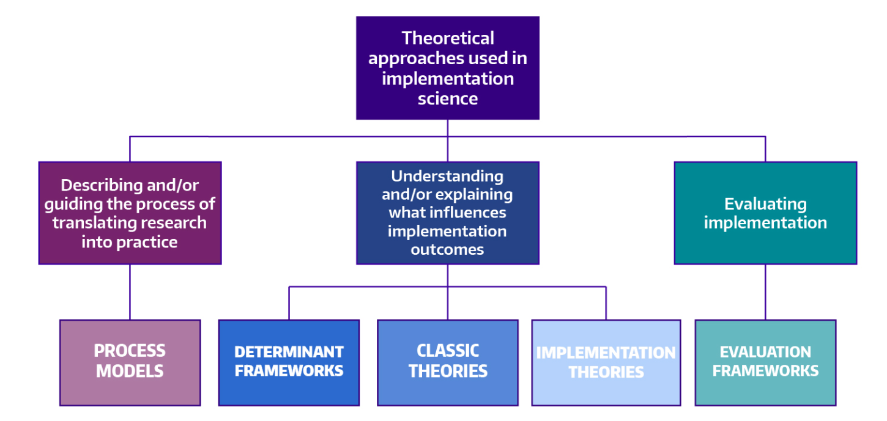
Source: https://impsciuw.org/implementation-science/research/frameworks/
Adapted from: Nilsen, P. Making sense of implementation theories, models and frameworks. Implementation Sci 10, 53 (2015). https://doi.org/10.1186/s13012-015-0242-0
Per Nilson’s classification

Slide 20
Per Nilson’s classification
1. Process models
Describe and/or guide the process of translating research into practice.
2. Determinant frameworks
Specify types (also known as classes or domains) of determinants and individual determinants, which act as barriers and enablers (independent variables) that influence implementation outcomes (dependent variables).
3.Classic theories
Theories that originate from fields external to implementation science, e.g. psychology, sociology and organizational theory, which can be applied to provide understanding and/or explanation of aspects of implementation
Consolidated Framework for Implementation Research – organization
Theoretical domains framework - individual
Diffusion of innovation
Reference: NILSEN, P., 2015. Making sense of implementation theories, models and frameworks. Implementation science : IS, 10, pp. 53

Slide 21
Some examples from our practice

Slide 23
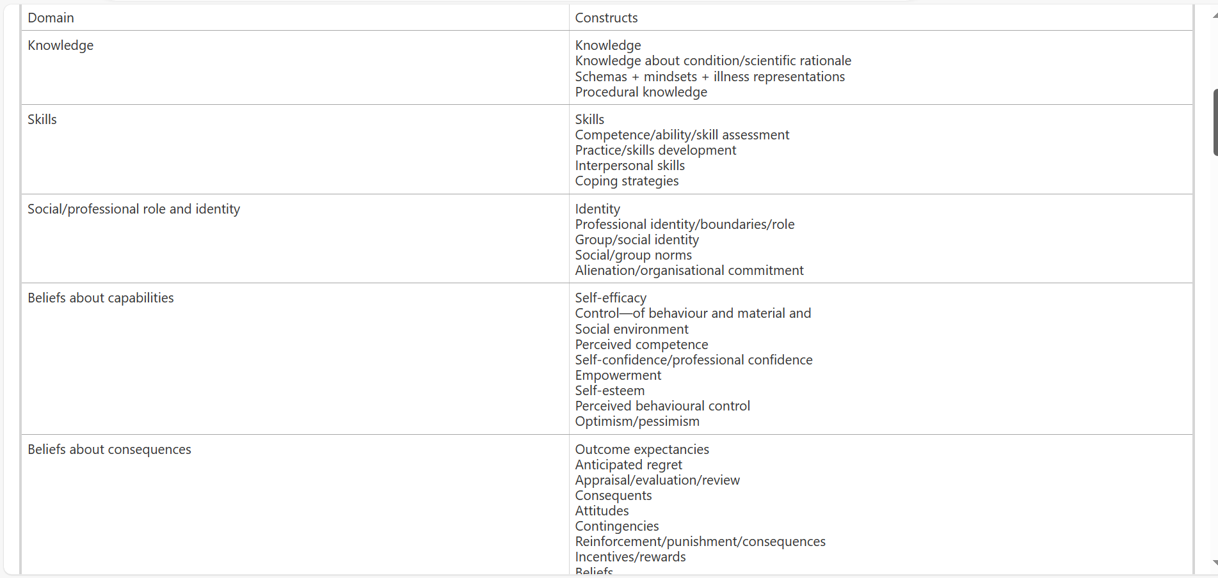

Slide 25
Ongoing research culture survey being conducted internally at RGU
Online questionnaire with use of multiple frameworks
Diffusion of innovation theory to help us understand the respondent’s approach to change
Use of theoretical domains framework to help us understand how the participants approach research – this question exploring Domain – “Belief about capabilities”
Determinants of behaviour on an individual level

Slide 28
Per Nilson’s classification
4. Implementation theories
Theories that have been developed by implementation researchers (from scratch or by adapting existing theories and concepts) to provide understanding and/or explanation of aspects of implementation
5. Evaluation frameworks
Specify aspects of implementation that could be evaluated to determine implementation success
Normalization Process Theory
Reference: Nilsen, P., 2015. Making sense of implementation theories, models and frameworks. Implementation science : IS, 10, pp. 53

Slide 29
Using an implementation theory to explore factors influencing implementation within an organization

Slide 30
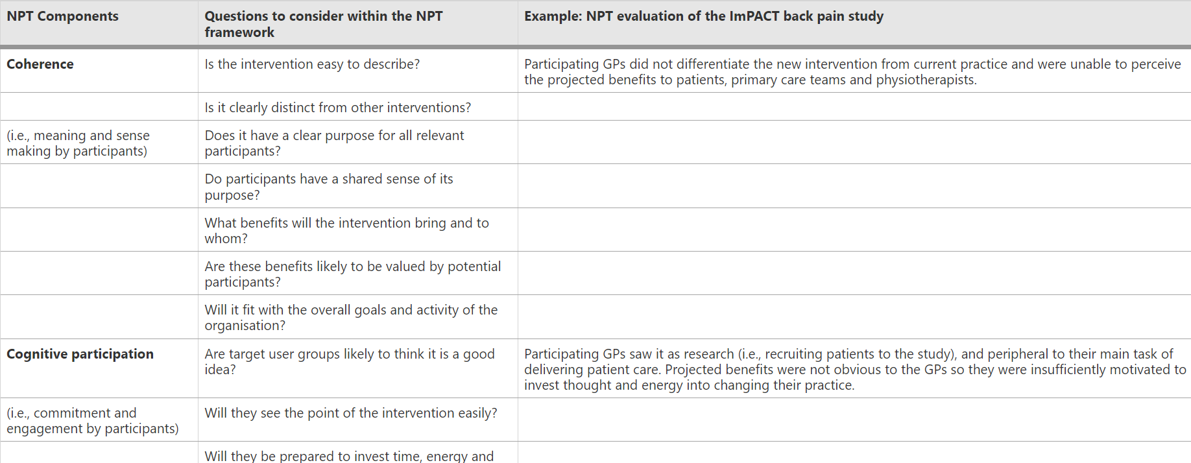
https://bmcmedicine.biomedcentral.com/articles/10.1186/1741-7015-8-63/tables/1
NPT [19, 20] identifies factors that promote and inhibit the routine incorporation of complex interventions into everyday practice. It also explains how these interventions work, looking not only at early implementation, but beyond this to the point where an intervention becomes so embedded into routine practice that it 'disappears' from view (i.e., it is normalised).

Slide 32
References
Albers, B., Shlonsky, A. and Mildon, R., 2020. Implementation science 3.0. Cham, Switzerland: Springer.
Moullin, J.C. et al., 2020. Ten recommendations for using implementation frameworks in research and practice. Implementation science communications, 1, pp. 42
Nilsen, P., 2015. Making sense of implementation theories, models and frameworks. Implementation science : IS, 10, pp. 53
Peters, D. et al., 2013. Implementation research in health: a practical guide. Geneva: World Health Organization.

Slide 33
Any questions
10 minutes

Slide 34
Application to different case scenarios Handing over to you
60 minutes

Slide 35
Application of knowledge gained to case scenarios
Now we will be looking into few case scenarios and attempt to identify a suitable implementation theory/model/framework according to Per Nilson classification.
We will need the following:
Per Nilson classification article (See printed simplified guide)
University of Washington implementation research Hub:QR code provided (https://impsciuw.org/implementation-science/research/frameworks/)
Dissemination and implementation models in health (interactive web-based tool)QR code provided (https://dissemination-implementation.org/tool/explore-di-models/)

Slide 36
University of Washington implementation research Hub
Dissemination and implementation models in health
(interactive web-based tool)

Slide 37
Application of knowledge gained to case scenarios
First: What is the aim of the implementation research project?
Second: Select one of the theories/models/frameworks most appropriate to underpin the research as per the recommendation of Per Nilson
Third: Use Dissemination and Implementation resource to check the included constructs, examples of publications and figure if available.

Slide 38
Case scenario one
A pharmacist working in an ambulatory health care clinic, is about to start using automated (robotic) dispensers.
These are machines which employ artificial intelligence to prepare prescriptions according to system entry by physicians.
The pharmacist is interested in examining which contextual factors will support the implementation process so that they can consider in their plan.
What would be the most appropriate theoretical tool to underpin this study?

Slide 39
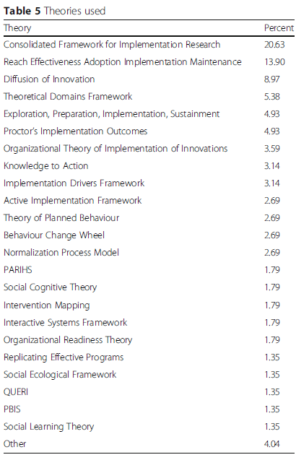
How do we go about selecting a tool?
Criteria for selecting implementation science theories and frameworks: results from an international survey
Most commonly used implementation theories and frameworks used based on this study
Reference: Birken, S.A. et al., 2017. Criteria for selecting implementation science theories and frameworks: results from an international survey. Implementation science : IS, 12(1), pp. 124

Slide 40
Intervention is at the early stage of implementing the research into practice
Proctor’s Implementation Outcomes Framework
RE-AIM
(Reach, Efficacy, Adoption, Implementation, Maintenance)
EPIS: Exploration, Adoption/Preparation, Implementation, Sustainment
Diffusion of Innovation theory
HBM: Health Belief Model
Organizational theory for dissemination and implementation research
CFIR: Consolidated Framework for Implementation Research
TDF: Theoretical Domains framework

Slide 41
Case scenario one
https://episframework.com/

Slide 42
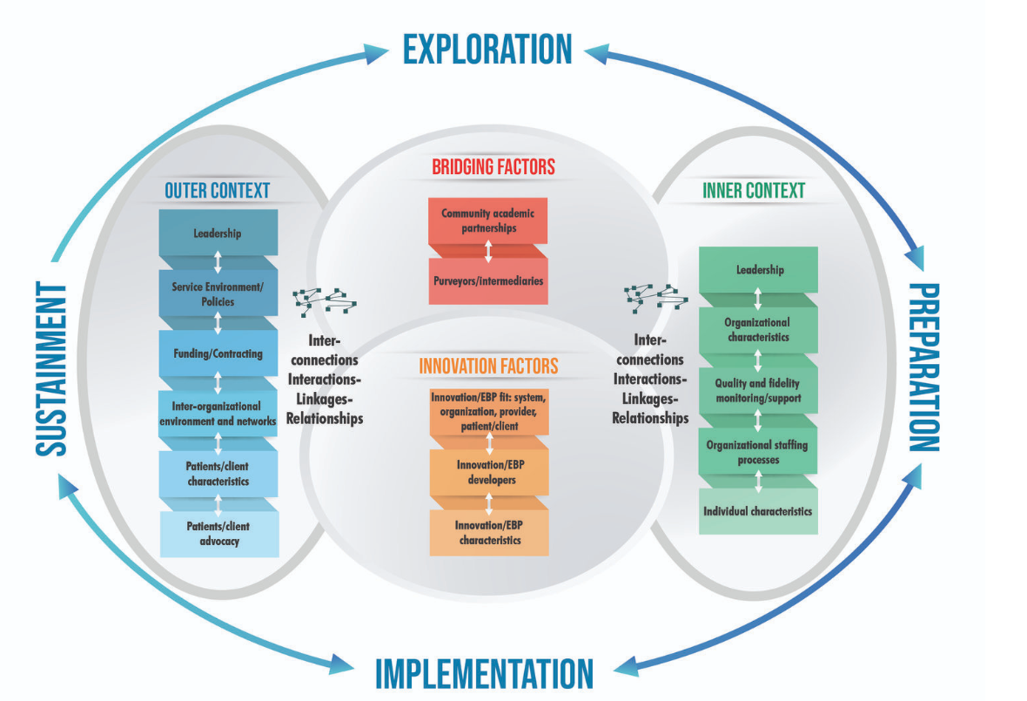
Case scenario one
EPIS: Exploration, Adoption/Preparation, Implementation, Sustainment
Include the four phases of implementation process:
Exploration
Preparation
Implementation
Sustainment
Also include:
Outer system
Inner organizational context
Characteristics of innovation
Bridging factors
https://episframework.com/

Slide 43
Case scenario two – one year on
The ambulatory health care clinic has been using automated dispensers (robotics) throughout the past year.
These are machines which employ artificial intelligence to prepare prescriptions according to system entry by physicians.
The pharmacist is interested in evaluating outcomes of implementation over this past year.
What would be the most appropriate theoretical tool to underpin this study?

Slide 44
One year on – aim of research is to evaluate the outcomes of implementation
Proctor’s Implementation Outcomes Framework
RE-AIM
(Reach, Efficacy, Adoption, Implementation, Maintenance)
EPIS: Exploration, Adoption/Preparation, Implementation, Sustainment
Diffusion of Innovation theory
HBM: Health Belief Model
Organizational theory for dissemination and implementation research
CFIR: Consolidated Framework for Implementation Research
TDF: Theoretical Domains framework

Slide 45
Case scenario two
Proctor’s Implementation Outcomes Framework

Slide 46
Case scenario three
The medical use of cannabis has been approved and regulated by health authorities.
Your hospital has been implementing the service for a few years now.
You would like patients in need to get the maximum possible benefit from this service.
You decided to design a study to explore different factors (determinants) related to the context of your practice that are acting as facilitators or barriers for successful implementation.
What would be the most appropriate theoretical tool to underpin this study?

Slide 47
Case scenario three
To explore factors that act as barriers and facilitators to implementation of intervention within an organization
Proctor’s Implementation Outcomes Framework
RE-AIM
(Reach, Efficacy, Adoption, Implementation, Maintenance)
EPIS: Exploration, Adoption/Preparation, Implementation, Sustainment
Diffusion of Innovation theory
HBM: Health Belief Model
Organizational theory for dissemination and implementation research
CFIR: Consolidated Framework for Implementation Research
TDF: Theoretical Domains framework

Slide 48
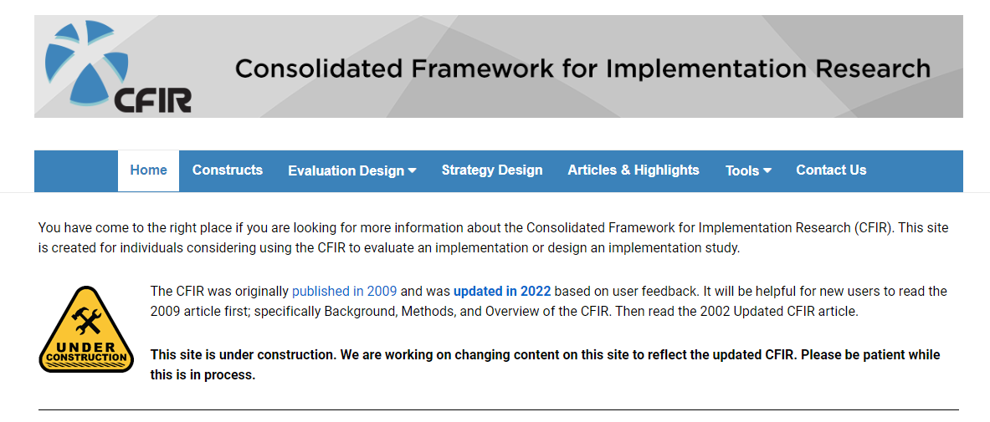
Case scenario three
Consolidated Framework for Implementation Research
Source: https://cfirguide.org/

Slide 49
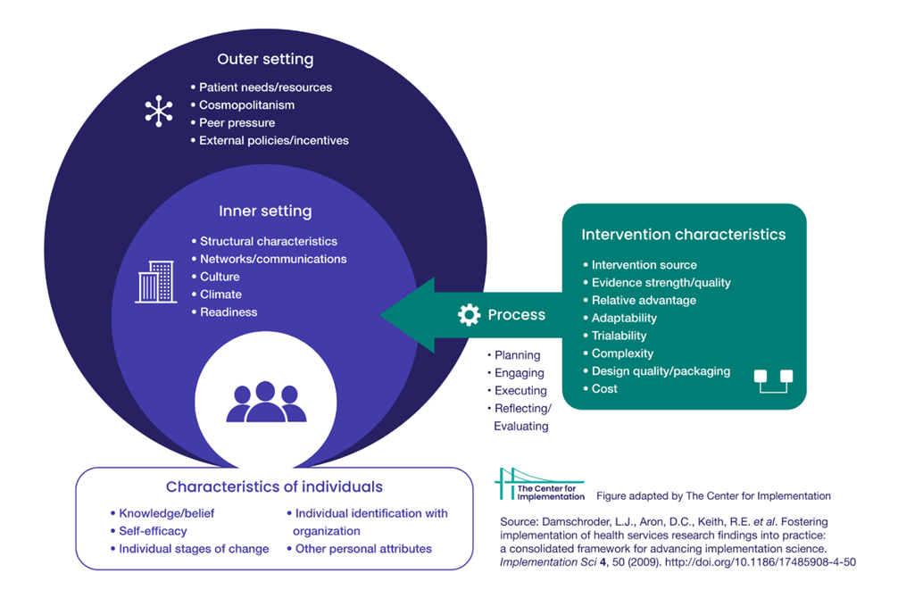

Slide 50
Case scenario four
You observed that your patients are increasingly asking for different categories of OTC pain medications. You are not sure what exactly are the factors which have led to this surge in OTC demand.
You decide to design a study to explore various aspects that impact patients’ behaviour and their attitude towards self-care with OTC pain medications.
What would be the most appropriate theoretical tool to underpin this study?

Slide 51
Case scenario four
To explore various aspects that impact patients’ behaviour and their attitude towards self-care with OTC pain medications.
Proctor’s Implementation Outcomes Framework
RE-AIM
(Reach, Efficacy, Adoption, Implementation, Maintenance)
EPIS: Exploration, Adoption/Preparation, Implementation, Sustainment
Diffusion of Innovation theory
HBM: Health Belief Model
Organizational theory for dissemination and implementation research
CFIR: Consolidated Framework for Implementation Research
TDF: Theoretical Domains framework

Slide 52
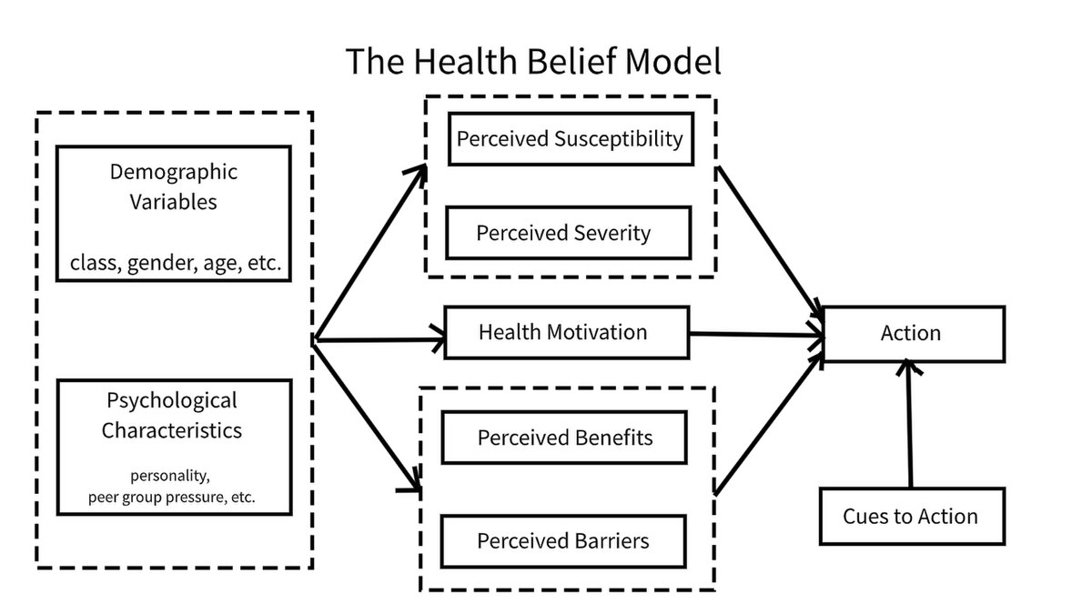
Case scenario four
Health Belief Model

Slide 53
An in-depth example of the process to design, conduct and publish and implementation research studies Putting learning into practice
15 minutes

Slide 54
A theoretical exploration of the implementation of Antimicrobial Stewardship Programmes Perspectives of key stakeholders underpinned by the Consolidated Framework for Implementation Research

Slide 55
Consolidated Framework for Implementation Research (CFIR)
The study aim was to explore key stakeholders’ perspectives of ASP implementation in United Arab Emirates (UAE) hospitals, with a focus on facilitators and barriers.
Therefore, a determinant comprehensive framework was deemed most suitable.
Specify types of determinants which act as barriers and enablers that influence implementation outcomes
Source: https://impsciuw.org/implementation-science/research/frameworks/
Adapted from: Nilsen, P. Making sense of implementation theories, models and frameworks. Implementation Sci 10, 53 (2015). https://doi.org/10.1186/s13012-015-0242-0

Slide 56
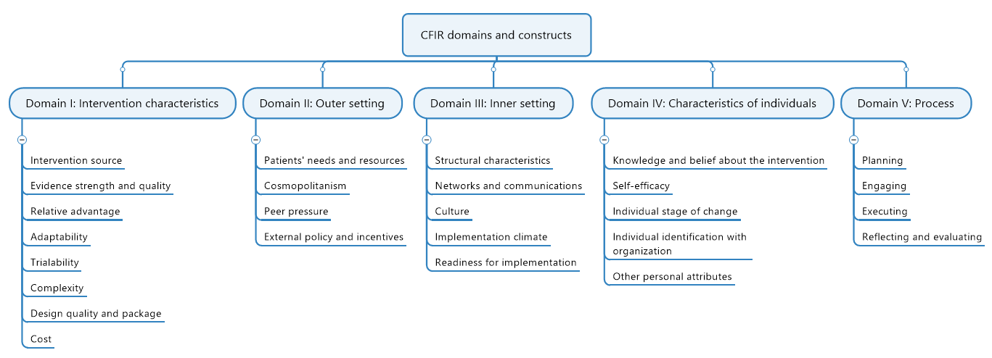
Map produced by Mind Manager from Coral Corporate

Slide 57
Formation
A panel of 39 constructs arranged across five domains.
1
Consolidated Framework for Implementation Research (CFIR)
Application
Increasingly used in healthcare-related implementation research.
2
Purpose
Help to gather data about contextual factors that can impact implementation of a service as facilitator or barrier for implementation.
3
Development
Developed based on a constellation of 19 implementation theories, models or frameworks that are published in peer-reviewed journals.
4
Use in this research
CFIR was used to guide data collection tool development, coding and analysis as well as final reporting of results.
5

Slide 58
How CFIR was integrated throughout the research process
Reporting
Data collection tool
Results
Reporting of facilitators and barriers
Data analysis
Interview questions
were based on CFIR domains and constructs
Themes were presented based on CFIR domains and constructs
Deductive coding based on CFIR for aggregation of data

Slide 59
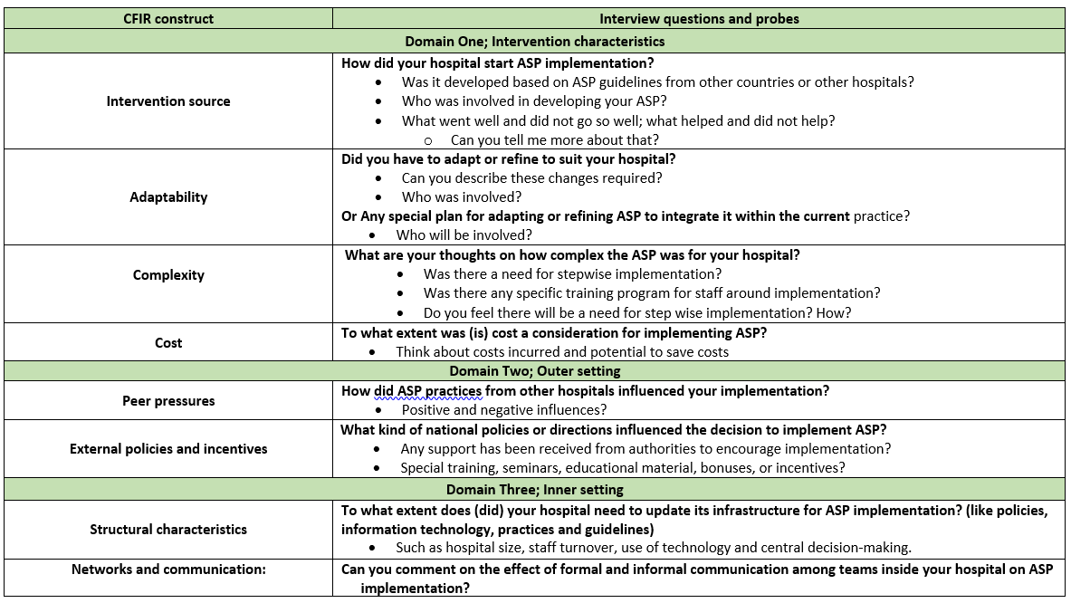
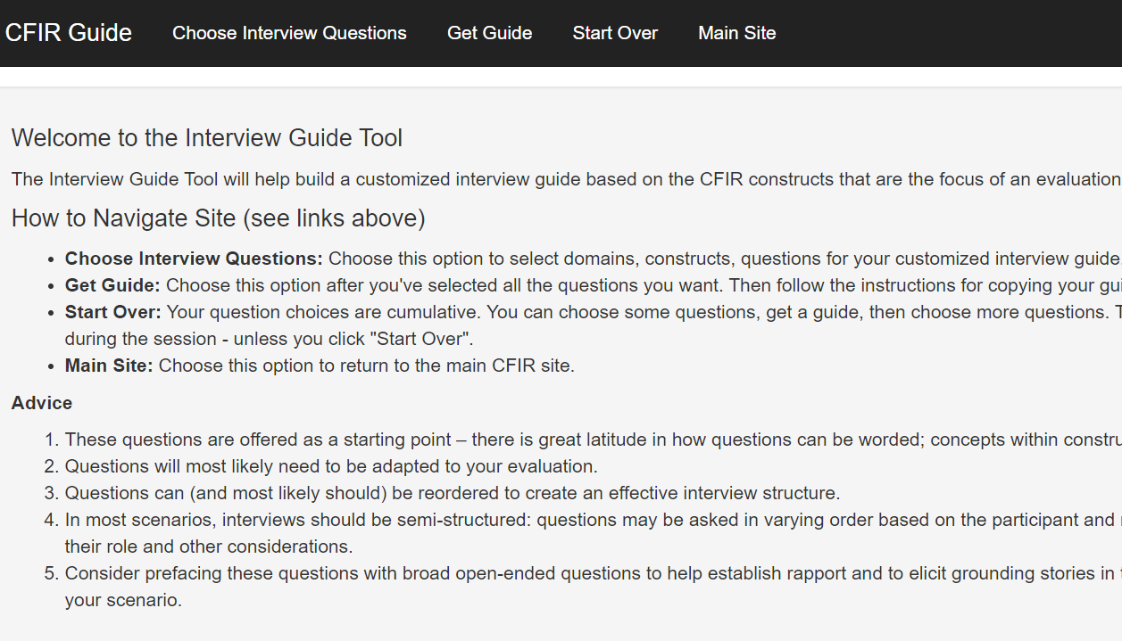
How CFIR was integrated throughout the research process
First step was operationalising CFIR interview guide tool to suit ASP implementation

Slide 60
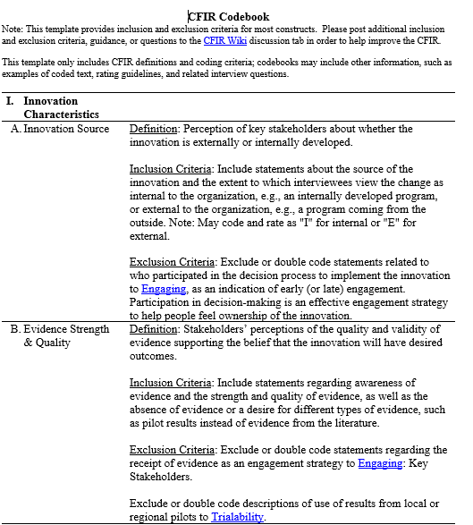
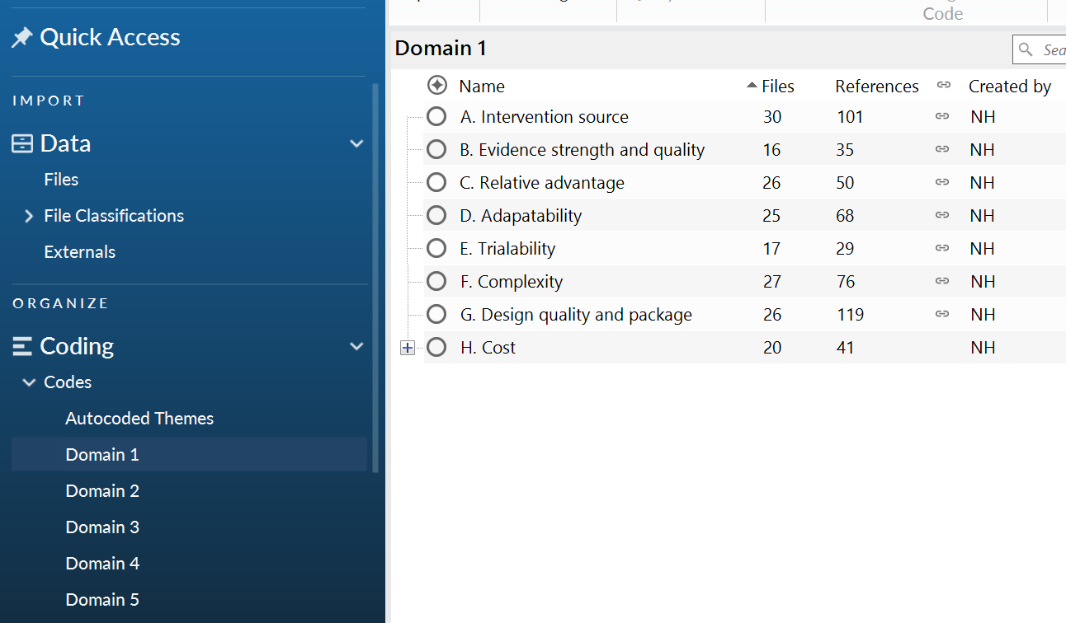
How CFIR was integrated throughout the research process
Then used the CFIR code book as a guide for inductively coding data during analysis

Slide 61
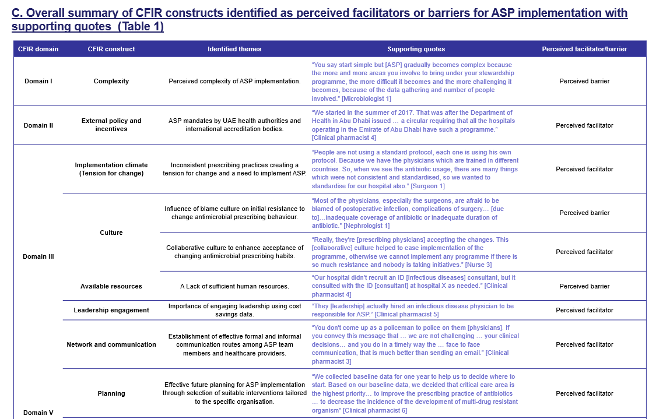
Results were presented based on the most dominant CFIR domains and constructs
How CFIR was integrated throughout the research process

Slide 62
A final message
The use of theories, models or frameworks can provide researchers with a better understanding of how and why implementation is successful.
Each tool has a distinct purpose.
After identifying the correct tool:
Explore constructs covered by the tool
Explore published research that has used the tool
Optimize the tool through defining terminologies to suit your research topic

