Slide 1
Making sense of Literature and AI
Prof. Anita Weidmann
Dr. Antonella Tonna

Slide 2
Welcome
Prof. Anita Elaine Weidmann
MRPharmS, MFRPSII, SFHEA, PhD
Head of Clinical Pharmacy
Faculty for Chemistry and Pharmacy
Innsbruck University, AT
Dr. Antonella Tonna
BPharm (Hons), MFRPSII, FHEA, MSc, PhD
Senior Lecturer (Clinical Pharmacy)
School of Pharmacy & Life Sciences
Robert Gordon University, UK

Slide 3
Aim of the Masterclass
To take you through the stepwise approach of conducting a thorough literature review, enabling you to:
decide on the most appropriate type of literature review for your own setting and research interest
develop your own review question and protocol
with and without the help of AI.

Slide 4
Your expectations?

Slide 5
Our expectations!
Keep an open mind
Don’t be shy
Keep asking “Why?”
Be respectful towards each other
Be creative and critical in your thoughts
Reflect and dare to dream
Talk ?Discuss as much as possible
Use your mobile phone

Slide 6
Getting to know each other
If you could meet any living person for dinner, who would you pick and why?
Notes:
09.00-09.25

Slide 7
Task 1
Your Experience
Briefly explain your experience with literature reviews and research topic of interest to each other.
Notes:
09.25-09.30

Slide 8
Literature review development (Part 1)
Choosing an appropriate review methodology and writing a research question
Notes:
09.30 – 10.15

Slide 9
What’s your research question?
Notes:
Before you make any decisions about the methodology to use you MUST sit down and write a specific research question. What is it you wish to research.
All too often do pharmacy students decide on the method they want to use and only then decide on the research question.
Irrespective of what you do or don’t have experience with NOTHING is more important than a specific research question.
It is not only a “nice to have” it is imperative to a successful research project.
The more specific your research question the easier it will be to determine the methodology to use and the higher the quality of yoru research.

Slide 10
How to write a research question
Notes:
Normally the topic you are interested in, stems from your daily practice. A question you have come across, or maybe one have been asked but that you couldn’t find the answer to no matter how hard you’ve tried. Or maybe you have identififed a pattern in practice you have started to question. E.g. Like so many elderly patients endning up with a delirium or confusion. Maybe colleagues keep asking you the same questions over and over e.g. do you need to leave a gap betweeen Levothyroxine and PPIs?
So the first step and you could argue is also the most important step is to develop your research question. Make sure you take your time with this, it takes much longer than you think. The danger is that the question is too big, too vague or too complex.
To write a good research question you need to clearly define the what, who where and how of your project. Think carefully about what you are interested in. Is it the views and experiences of colleagues, is it to grasp what guidelines exist on a certain topic or are you more interested in the number and type of care issues?
Once that is done write down WHO your sample target is e.g. patients with 5 or more medicines or geriatric patients with a specific diagnosis.
Then write down where the study will take place e.g. ward 2A of Prague Royal Infirmary.
Lastly state how your study is carried out i.e. in our case a scoping review

Slide 11
How to write a research question
The aim of this systematic scoping review was to summarize the available evidence on frailty assessment during the COVID-19 pandemic, in an attempt to identify knowledge gaps to be bridged and possibly to draw future perspectives in this field.
No WHO & WHERE
doi:10.3390/jcm9072106
The objective of this review was to identify and summarise the most recent research literature related to Post-stroke fatigue in order to update the evidence base.
No WHO, WHERE & HOW (?)
https://doi.org/10.12688/f1000research.22880.2
The aim of this scoping review is to map the characteristics of medication use for older people in residential facilities in the last year of life. We aim to identify potential variables associated with these patterns of medication use, and how medication use changes as death approaches.
Nothing missing
https://doi.org/10.1177/0269216320911596
Notes:
Lets look at some examples from practice….

Slide 12
How to write a research question
Question: Which medications carry a risk of causing a delirium particularly in patients diagnosed with dementia?
Aim: To identify medications that have the risk of inducing delirium, particularly in patients diagnosed with dementia.
Title: ?A review of Medication-induced Delirium in dementia patients.
Notes:
Once your have written your specific Research Question you should use this to write the AIM & TITLE of your study as these should be consistent.
For more information especially around writing research objectives pleas etake a look at this video

Slide 13
Additional materials 1.0
Notes:
For more information especially around writing research objectives pleas etake a look at this video
Once you are clear about your research question and aim you will have to decide which Literature review type is most appropriate to answer your research question.

Slide 14
What types of Literature Review are there?
Notes:
So what types of literature reviews are there?
In General

Slide 15
Types of Literature Reviews
Unstructured = Narrative Review
No set method
Broad but not conclusive overview
Depends on the researchers skills
Subjective / Biased
Structured = Systematic OR
Scoping Review
Set method
Specific overview of existing lit.
Quality Assured process independent of the researchers' skills
Objective
Higher level of evidence / Meta-analysis
Unstructured / Narrative Review
Structured / Systematic OR
Scoping Review
Notes:
In general there are two types of Literature Review
Unstructured & structured
Unstructured is also called a narrative review and it is the type most of us are familiar with from Univeristy, writing essays, Introduction and Background sections for Bachelor, Masters or PhD thesis. It is generally the style we are best at because we have the most amount of experience with it.
Narrative Literature Reviews don’t have a specific methodology to follow and they depend very much on the skills of the researcher.
How good are you at googling information ☺ Most of us will also know to inlcude pubmed or google scholar. – Q: What other databases would you check?
An additional limitation is that the results of a narrative review are usually very subjecive and can’t claim to have looked at the majority of published literature to any given topic.
In contrast there is a structured approach to reviews, which have a very specific method to follow, have clear quality assurance steps and result in a higher level in evidence. These are calles Systematic OR Scoping Reviews.

Slide 16
What is the difference?
Scoping Review
Systematic Review
It has a clearly formulated
question
Carries the highest level of evidence
It is a structured robust
method
Protocol must be
registered officially
Not dependent on access to patient data
Quality assessment of papers
No ethics required
ALL steps quality assured
Determines the gap in lit. and whether a systematic review is needed
Synthesizes the evidence / Meta-analysis
Notes:
What is a scoping review?
A structured method to find out what scientific literature is already available on a given topic (synthesize evidence and). It provides a way to get an overview of the scientific evidence already out there on any topic you may be interested in.
It is a lot more robust in it’s approach than ‘show me with you’ve got google” and less involved than a full blown Systematic literature review.
It has a systematic structure (which allows you to carry out the ScR even if you have little or no experience with research but are interested in a particular polypharmacy topic.
You are not dependent on access to patient data. All you need is a computer. It is also means that you can squeeze the work around a busy work schedule as you can use a quiet hour during the day or the evening to conduct this.
As it doesn’t involve patient data, ou don’t need lengthy ethics applications.
Aside from synthesising the evidence on a topic it also serves to determine whether a systematic review of the literature is warranted.
What are the differences to a SR?
A systematic review is a clearly formulated question that uses systematic and explicit methods to identify, select and critically appraise relevant primary research, and to extract and analyze data from the studies that are included in the review.” The methods used must be reproducible and transparent.
It carry’s the highest level of evidence esp. if it includes Meta-analysis for clinical questions (even above RCTs)
Protocol must be registered with an official Systematic review database such as Cochrane and PROSPERO [publication; no duplication]
Additional quality assurance steps to ensure robustness and appraisal of relevant primary research by assessing the quality of studies using a validated tool dependent on study design e.g. CASP, STROBE, AGREE etc.
In short, a scoping review is the little brother of the Scoping Review.
[Ed: Different icons please and centre icon]

Slide 17
What is the difference?
Scoping Review
Systematic Review
Determines the gap in lit. and whether a systematic review is needed
Synthesises the evidence / Meta-analysis
Identifies and maps full body of literature.
Identifies key characteristics or factors related to a concept.
Does not provide info on quality of papers or summary answer.
Does not produce statements to guide decision-making.
Precursor to Systemtic Review.
Provides highest level of summary evidence / analysis.
Assesses the quality of evidence and its level of bias.
Produces statements that guide clinical decision making.
Notes:
Simply speaking the main difference is that a Scoping review, while determining the Gap in the literature does NOT produce any statements that help to guide decision making.
Whle a SR provides the highest level of clinical evidence.

Slide 18
Advantages & Disadvantages of a scoping review
Simple to follow scientific method
It helps you to identify the gaps
It is cheap to run
It doesn’t need complicated permissions
It is still publishable
BUT it is time consuming!!!
Notes:
Ok so why bother with a scoping review. What are it’s advantages & disadvantages?
The advantage ist that it provides you with a simple to follow scientific method of synthesising whats out there in the literature. So you can be sure you haven’t missed large, important pieces of work.
If you are not sure what’s out there in the literature and whether your idea has already been “taken” it helps you to identify the gaps in the literature
It is cheap to run (all it costs is time! – which is a steal in the world of research)
It doesn’t need ethics and complicated permissions

Slide 19
Steps of a ScR
Scoping Review
Systematic Review
= SUMMARIZE FINDINGS
< QUALITY ASSESSMENT
< REGISTER PROTOCOL
Notes:
On this slide you see a detailed breakdown of the systematic method used. This is virtually identical for both review styles with the exception that:
You will need to officially register your Protocol for a SR - This is normally done using The International Prospective Register of Systematic Reviews (PROSPERO)
b) ALL papers included in a SR are assessed for Research Quality and Bias using validated and internationally available tools.

Slide 20
Additional materials 2.0
Notes:
For more information especially around writing research objectives pleas etake a look at this video’s about ScRs
And a paper on the difference between ScR & SR: https://bmcmedresmethodol.biomedcentral.com/articles/10.1186/s12874-018-0611-x

Slide 21
Are there any Ai tools
that can help?
Notes:
Ok let’s talk about Ai and modern day literature research
Yes AND No
By now there are several dozens of LLM or Ai’s specifically designed for research and literature interrogation and I have tried to summarise these for you (see materials attached)
ELICIT in particular is a programme that can help you brainstorm Research questions; Suggests papers in response to your research question, suggests search terms, helps you to rephrase your question or be more specific. The software can also find relevant papers without perfect keyword matches, summarise them and extract key information.

Slide 22
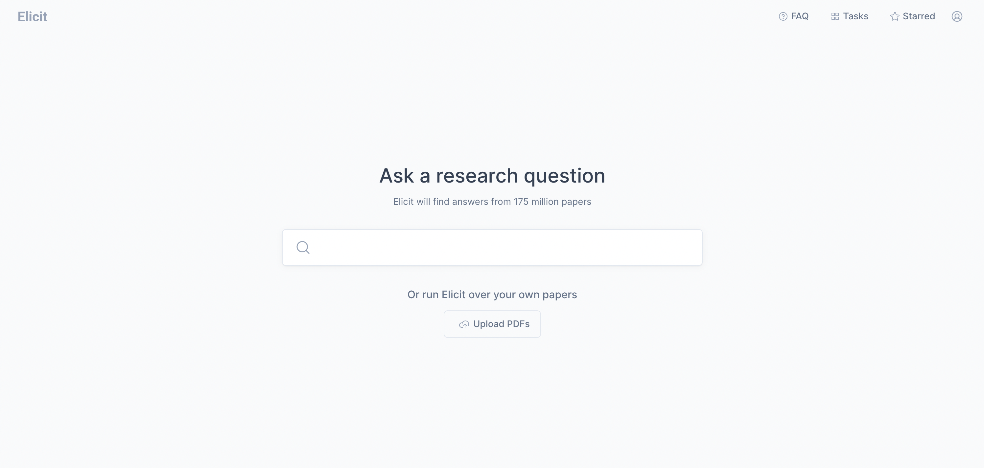
ELICIT
Notes:
Ok lets try this: https://elicit.org/
In Elicit you have to register for a free account.
When it comes to searching you have two options – you can ask a research question or upload your own PDFs
Ask a research question: What guidelines allow the prevention and management of medication induced delirium with a particular focus on patients with dementia.
- suggests papers, gives you a summary and key analysis points. You can read the Abstract, download the PDF or click on the link, so very useful!!!
Let’s take the first PDF paper it suggests SIGN – delirium guidelines and see what happens when we upload that instead.
- at first it only provides the summary of this paper but you can ask it to see more
- and you get more papers which are different to the search above using the research question.
However it doesn’t really tell you how it has come about these papers, where it has looked and what keywords it has used. Therefore you don’t know what it has missed (much like a narrative review).
BUT it is a useful sense check AFTER you have completed your own search to see if anything else of interest comes up (i.e. use it like a search engine)
AND the quick summary/ overview function is useful for getting a quick grasp of the papers and selecting the ones that, at a surface level fit the bill.
However NONE will help you with writing your research QUESTION & AIM. I am relieved by that because that requires a higher level of cognition to identify questions that need answered and thankfully Ai is not there yet.
Equally no Ai will help you to decide which type of Lit. Review to use as this is directly linked to your research question and your comprehension.
So enough from us. It’s now over to you….

Slide 23
Group exercise (45mins)
Decide on a research topic in your group.
Write a specific research question and have a go at the objectives.
Decide which of the main literature research methods is the most appropriate to answer your research question and why.
Notes:
10:15 0 11:00

Slide 24
Coffee Break
Notes:
11:00 – 11:15

Slide 25
Literature review development (Part 2)
Writing a detailed literature review protocol
Notes:
11:15 – 12:00

Slide 26
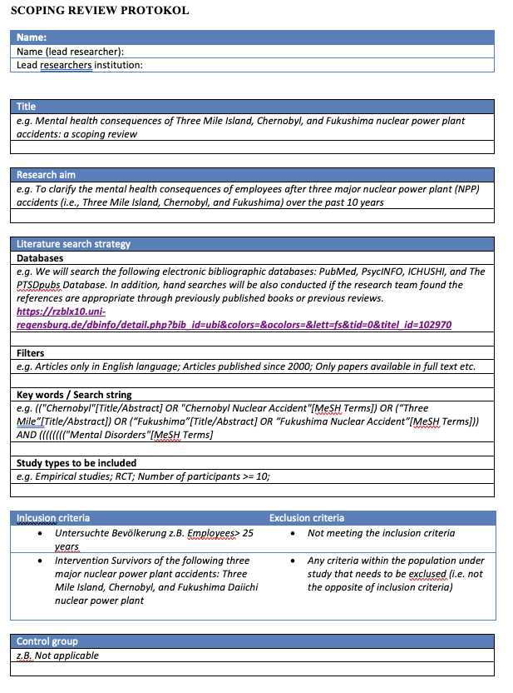
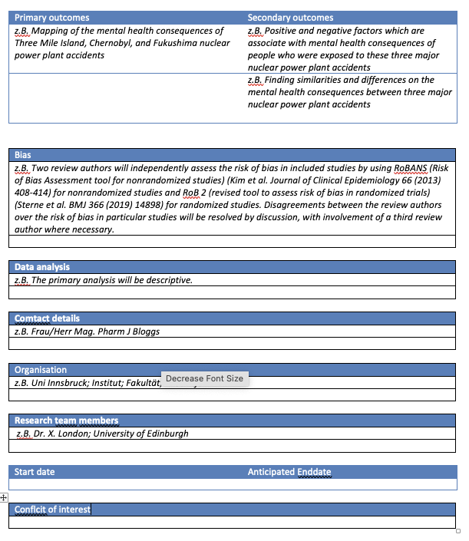
Developing a research protocol
Inclusion and exclusion criteria [NB: Exclusion is not the opposite of inclusion]
Primary and Secondary outcomes [planned and unplanned but predicted info]
Bias
Data analysis
Which databases will you include
Article filters
Types of studies to include
Search terms/ Keywords/ MESH terms
How you will put them together to form a search string
REGISTER
Notes:
Now that you have written a research question there is one more thing you need to do before you can start and that is writing your research protocol.
One the one hand a research protocol is essential to ensure that you will conduct the most robust research possible,
BUT on the other hand it feels a little counterintiutive. How are you supposed to know how you will do things in the future?
The protocol forces you to really think through ALL the steps of your research BEFORE you start so that there are no surprises. Quality and robustness are guaranteed and you have a guidline to work to, This ensures you don’t change your mind half way through or get influences/ sidetracked by other things. It allows you to minimise bias in yoru study AND KEEP IT OUT.
Besides you will be mighty glad when months down the line you can refer to yoru own protocol to remind yourself how you need to do sth.
One of the key things the protocoll asks you to consider are
Inlcusion and exclusion criteria (watch out exclusion NOT the opposite of inclusion)

Slide 27
Inclusion criteria
WHO? Patients with osteoarthritis of the knee.
WHAT? What specific diagnoses should your participants have?
CONFOUNDERS? Do your patients have any co-morbidities that can affect your results?
Any specific classes of medication you need to consider?
Any specific age groups?
WHERE? Where exactly are you recruiting your participants from?
WHEN? How long ago was this diagnosis made?
This allows you to generate a set of specific inclusion criteria
Notes:
Inclusion criteria do require quite a bit of thought.
Get it right and it will make your life very easy when you select papers for inclusion, get it wrong and it quickly becomes a limitation to your study, making the literature selection too non-specific and in some cases resulting in you struggling to cope.
The key to setting good inclusion criteria is to be as specific as possible.
Start by considering your research question as you will have already defined the WHO of your study (e.g. patients with osteoarthritis of the knee)
However this is very vague, try and ask specific questions to narrow it down. E.g. WHERE exactly are you recruiting your participants from (e.g. outpatient clinic at Clachansands hospital Inverness)?
WHAT specific diagnosis should your participants have (e.g. Patients who have had a confirmed diagnosis of osteoarthritis of the knee
HOW long ago was this diagnosis made (5 years ago)
Lastly consider any confounding factors that could introduce bias into your study e.g. co-morbidities that can affect your results; any specific age group you need to include; any other interventions you wish to control for (e.g. Patients who have not yet had a Physiotherapie intervention; Adult patients > 18 years and over)
This helps to turn your very vague WHO into a set of very specific inclusion criteria
In ADDITION you have the Literature specific INCLUSION criteria
Types of studies
Language
Dates of publication

Slide 28
Exclusion criteria
Exclusion criteria are NOT the opposite of inclusion criteria
Exclusion criteria capture any subjects/ papers that would normally fall within your inclusion criteria but are not eligible for inclusion because of certain confounding factors. e.g. Patients> 18 years and over but unable to consent.
Notes:
Identifying the Exclusion criteria from here on in seems very easy.
Q – Can you name an exclusion criteria or two – (ask Audience)
This is the bit that a lot of people get wrong– Exclusion criteria ARE NOT the opposite of inclusion criteria
Exclusion criteria capture any subjects/ papers that would normally fall within your inclusion criteria but ar enot eligible for inclusion because of certain confounding factors.
e.g. Patients> 18 years and over but unable to consent.
e.g. All publications looking at the long term prescribing (>30days) of antibiotics for respiratory infections in patients 18 years and older (exclusion criteria COVID)

Slide 29
Additional materials 3.0
Notes:
3. Slide; Video – Inclusion Criteria

Slide 30
Search strategy
Consider all search terms before you start your research.
Research Question or Aim:
To review published guidelines that allow the prevention and management of medication induced delirium in patients with dementia.
Notes:
Ok on to the the next key aspect of the protocol – your search strategy
I know what you are going to say – How am I supposed to know how my search is going to pan out?
Well that is reflective of the way you probably used to work to write a background, essay or introduction. And therefore a hallmark of a narrative review (e.g. ok let’s start somewhere and see where we end up). Whence the biased, non-transparent nature of narrative reviews.
For a ScR / SR you need to have a clear strategy and consider all search terms before you start your research. (I know – a crystal ball moment)
Ok lets break it down.:
Use your research question to identify any key words (you notice we keep going back to your research question)
Do the same for your inclusion criteria (not the literature specific ones, only the population/patient/ topic specific ones)
Let’s take an example:
To review the published guidelines that allow the prevention and management of medication induced delirium with a particular focus on patients with dementia.
Inclusion:
Adults with a medication induced delirium with or without the diagnosis of dementia
All documents detailing the prevention and management of medication induced delirium with a particular focus on dementia
All clinical settings will be included
For each of those key terms consider any relevant synonyms:
Then consider any relevant MeSH terms (Medical Subject headings)
Consider any relevant truncations
Consider relevant Wild cards

Slide 31
Search strategy
Consider your Key terms and synonyms
Consider Medical Subject headings (MeSH)
Consider truncations (pharm = pharmacy, pharmacist, pharmaceutics etc.)
Consider wildcards (* = multiple character searching; ? = single character searching)
Notes:
Ok on to the the next key aspect of the protocol – your search strategy
I know what you are going to say – How am I supposed to know how my search is going to pan out?
Well that is reflective of the way you probably used to work to write a background, essay or introduction. And therefore a hallmark of a narrative review (e.g. ok let’s start somewhere and see where we end up). Whence the biased, non-transparent nature of narrative reviews.
For a ScR / SR you need to have a clear strategy and consider all search terms before you start your research. (I know – a crystal ball moment)
Ok lets break it down.:
Use your research question to identify any key words (you notice we keep going back to your research question)
Do the same for your inclusion criteria (not the literature specific ones, only the population/patient/ topic specific ones)
Let’s take an example:
To review the published guidelines that allow the prevention and management of medication induced delirium with a particular focus on patients with dementia.
Inclusion:
Adults with a medication induced delirium with or without the diagnosis of dementia
All documents detailing the prevention and management of medication induced delirium with a particular focus on dementia
All clinical settings will be included
For each of those key terms consider any relevant synonyms:
Then consider any relevant MeSH terms (Medical Subject headings)
Consider any relevant truncations
Consider relevant Wild cards

Slide 32
Search strategy
Search Terms | Synonyms
Medication induced | Drug induced
Medication | Medication Therapy Management [MeSH]; Pharmaceutical Preparations [MeSH]; Drug-Related Side Effects and Adverse Reactions [MeSH]
delirium | altered mental status [AMS]; delirium [MeSH] [Deliri*]; DSM-5; encephalopathy (encephalopathy*); acute confusional state; acute brain dysfunction; brain disease [MeSH] acute brain failure, and altered mental status; lack uniform definitions; Hallucination (Hallucin*); Confusion (Confus*); Reorient* [disoriented]; uospatial ability
dementia | cognitive impairment, Alzheimer's disease [MeSH]; delirium superimposed on dementia
prevention
guidelines | Pocket guide; Framework;
Notes:
To review the published guidelines that allow the prevention and management of medication induced delirium with a particular focus on patients with dementia.
Inclusion:
Adults with a medication induced delirium with or without the diagnosis of dementia
All documents detailing the prevention and management of medication induced delirium with a particular focus on dementia
All clinical settings will be included
For each of those key terms consider any relevant synonyms:
Then consider any relevant MeSH terms (Medical Subject headings)

Slide 33
Search strategy
Search Terms | Synonyms
Medication induced | Drug induced
Medication | Medication Therapy Management [MeSH]; Pharmaceutical Preparations [MeSH]; Drug-Related Side Effects and Adverse Reactions [MeSH]
delirium | altered mental status [AMS]; delirium [MeSH] [Deliri*]; DSM-5; encephalopathy (encephalopathy*); acute confusional state; acute brain dysfunction; brain disease [MeSH] acute brain failure, and altered mental status; lack uniform definitions; Hallucination (Hallucin*); Confusion (Confus*); Reorient* [disoriented]; uospatial ability
dementia | cognitive impairment, Alzheimer's disease [MeSH]; delirium superimposed on dementia
prevention
guidelines | Pocket guide; Framework;
Notes:
Then consider any relevant MeSH terms (Medical Subject headings)
Consider any relevant truncations
Consider relevant Wild cards

Slide 34
Search strategy
Search Terms | Synonyms
Medication induced | Drug induced
Medication | Medication Therapy Management [MeSH]; Pharmaceutical Preparations [MeSH]; Drug-Related Side Effects and Adverse Reactions [MeSH]
delirium | altered mental status [AMS]; delirium [MeSH] [Deliri*]; DSM-5; encephalopathy (encephalopathy*); acute confusional state; acute brain dysfunction; brain disease [MeSH] acute brain failure, and altered mental status; lack uniform definitions; Hallucination (Hallucin*); Confusion (Confus*); Reorient* [disoriented]; visuospatial ability
dementia | cognitive impairment, Alzheimer's disease [MeSH]; delirium superimposed on dementia
prevention
guidelines | Pocket guide; Framework;

Slide 35
Search string
Combine using BOOLEAN LOGIC - AND / OR / NOT.
((((((Delirium) OR (Hallucin*)) OR (altered mental status)) OR (Confusion)) OR (Encephalopathy*)) OR (Cognitive*)) AND (Drug induced) AND (Guideline)
Find that sweet spot of quantity & quality.
Notes:
Now the most challenging step is to combine these using the words AND/ OR/ NOT (Boolean logic) in such as way that it provides the most meaningful and list of search results.
The important thing is that you must use trial and error for each data base as each data base is indexed and catalogued differently with a differently written search script behind it.
Ideally you identify key papers that fit you search and you ensure that they appear in your search.
Sometimes if your search string is too short or too long the specificity of your search declines. It is your job to identify that sweet spot of quantity vs quality of papers.
It is not unusual and good practice to recruit the help of a research librarian who will help to ensure your search string is as refined as possible.

Slide 36
Select database
Databases | Info Link
Cochrane Library Cochrane Central Registry of controlled Trials (CENTRAL) CINAHL ClinicalTrials.gov International Pharmaceutical Abstracts (IPA) Medline and Embase PubPharm PSychINFO SAGE Education Science Direct Scopus Springer Link Web of Science (Core Collection) | https://training.cochrane.org/handbook/current/chapter-04#section-4-3
National Grey Literature Collection; Open Access thesis and Dissertations | https://libguides.kcl.ac.uk/systematicreview/greylit
Notes:
Now that you have the correct search string that gives you the highest chance of accuracy you need to decide on the most important databases you want to search.
Most databases have some overlap and you have to decide between general (Metadatabase) or a specific one e.g. Pubmed contains publication from many medical and healthcare related journals; whereas Pubpharm focuses on Pharmacy publications. Springer Link and Cochrane Library focus solely on their publishing house publications.
Grey Literature may also be something you wish to include depending on the type and amount of data available.
A word on google scholar – not great!!

Slide 37
Additional materials 4.0
Notes:
4. Slide; Video – Inclusion Criteria

Slide 38
Are there any Ai tools
that can help?
Notes:
There are no Ai tools that will help you with the
Writing of the protocol
Writing of inclusion and exclusion criteria OR
To develop your search strategy However there are several tools that will help you identify linked refernces (IrisAi; LitMaps; Inciteful; SystemPro; Connected Papers, Elicit) determine how often a paper has been cited and the context of this citation (Scite) These are particularly helpful when trying to identify all relevant literature for your research question. Results from PubMed might require more time to sort through, he says, but it ultimately finds higher-quality papers. AI tools “tend to lose some info that may be pivotal to one’s literature search”, he says.
I have added a List of all Ai tools to your additional materials

Slide 39
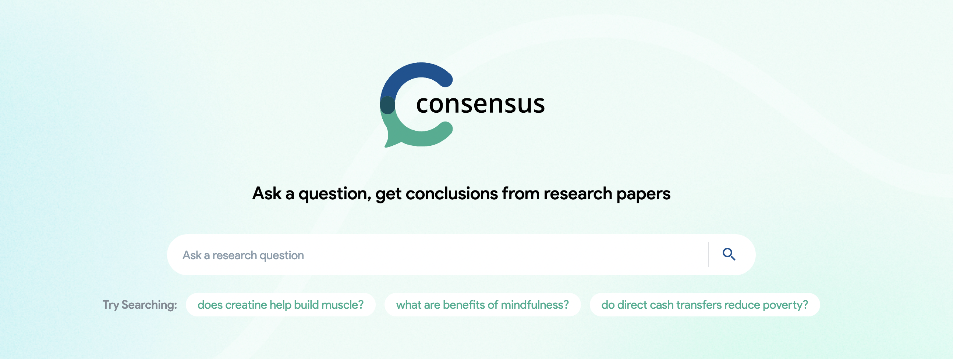
CONSENSUS
Notes:
A good place to start your search:
Consensus AI is a powerful tool that can help you find evidence-based answers from scientific research in a fast and easy way.
It uses artificial intelligence to extract and distill findings directly from peer-reviewed studies published on Semantic Scholar. A good starting point to identify relevant papers in relation to your research question.
Consensus looks like most search engines but what sets it apart is that you ask Yes/No questions, to which it provides answers with the consensus of the academic community.

Slide 40
LITMAPS
Notes:
Ok let’s look at another AI tool – Lit maps
https://www.litmaps.com/
It has a cool function called a seed paper. You can search using yoru normal key words e.g. “Language of dleirium”, it will search the web, make a suggestion and once you have selected the paper of interest this becomes the so called “seed paper”
The seed paper will show you a cool map with all linked papers and provides a degree of importance by making the dots bigger or smaller depending on the number of citations.
It has other cool functions but it works best if you invest the time to develop your own subject specific linbrary within Litmaps.
Many other sites use this visual connectivity function which is very helpful.

Slide 41
CONNECTED PAPERS
Notes:
Using connected papers gives you similar information than LitMaps but it’s presented much more powerful as a one-shot visualization
“Language of delirium”
As for which tool is better, it depends on your needs. Connected Papers is easy to use and can quickly identify similar papers with just one seed paper. Litmaps can make suggestions to help you find papers without you coming up with a keyword for searching. Both tools have their own unique features and it's up to you to decide which one suits your needs better.
Aside from showing you citationsa and paper there is one cool software that helps you to keep track of, manage and distill your literature search.
Jenni. Ai

Slide 42
SEARCH SMART
Notes:
Now, search smart will help you identify the databases to search for:
Search Smart suggests the best databases for your purpose based on a comprehensive comparison of most of the popular English academic databases.
Search Smart tests the critical functionalities databases offer.
Thereby, we uncover the capabilities and limitations of search systems that are not reported anywhere else.
Search Smart aims to provide the best – i.e., most accurate, up-to-date, and comprehensive – information possible on search systems’ functionalities.
Researchers use Search Smart as a decision tool to select the system/database that fits best.

Slide 43
RESEARCH Rabbit
Notes:
A little bit of magic!
AI-powered app that helps researchers: find,
organize, a
and analyze research papers.
It uses AI to scan the web for relevant scholarly articles.
In addition to that the AI-based tool allows you to save and organize articles in your own personal library.
An incredible tool that FAST-TRACKS your research.
Research Rabbit allows adding academic papers to "collections". These collections allow the software to learn about the user’s interests, prompting new relevant recommendations.
Research Rabbit also allows visualising the scholarly network of papers and co-authorships in graphs, so that users can follow the work of a single topic or author and dive deeper into their research.
It integrated with your own reference system (Mendeley, Endnote, Zotero) or you can upload PDFs
Howevere it has very limited use for systematic and scoping reviews BUT is useful to keep track of research, get an overview of related themes, identify the most cited work and use that information for future research ideas or to write introduction and conlcusion.

Slide 44
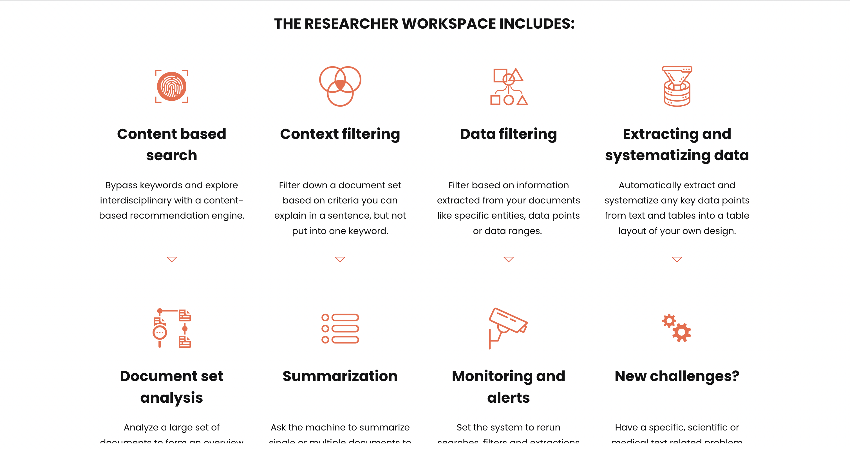
Iris.ai
Notes:
And if you are looking for a sophisticates tool that is the perfect research assistant over time – Jenni Ai would probably be it.
Aside from showing you citationsa and paper there is one cool software that helps you to keep track of, manage and distill your literature search.
Jenni. Ai – it is by far the most advanced and complex tool that supports your literature search.

Slide 45
Group exercise (60mins)
For your chosen group research topic:
Set specific inclusion and exclusion criteria for your literature.
Develop a specific search strategy (keywords, strings, databases).
Search across three databases/ collate 15 suitable titles.
Check if any of the free AI tools can add anything useful after your search is complete.
Notes:
12:00 – 13:00
Quick overall discussion – pro’s & con’s of database searching.

Slide 46
Lunch Break
Notes:
13:00 – 14:00

Slide 47
Literature review development (Part 3)
Study selection, quality assessment and data extraction/ analysis
Notes:
14:00 – 14:45

Slide 48
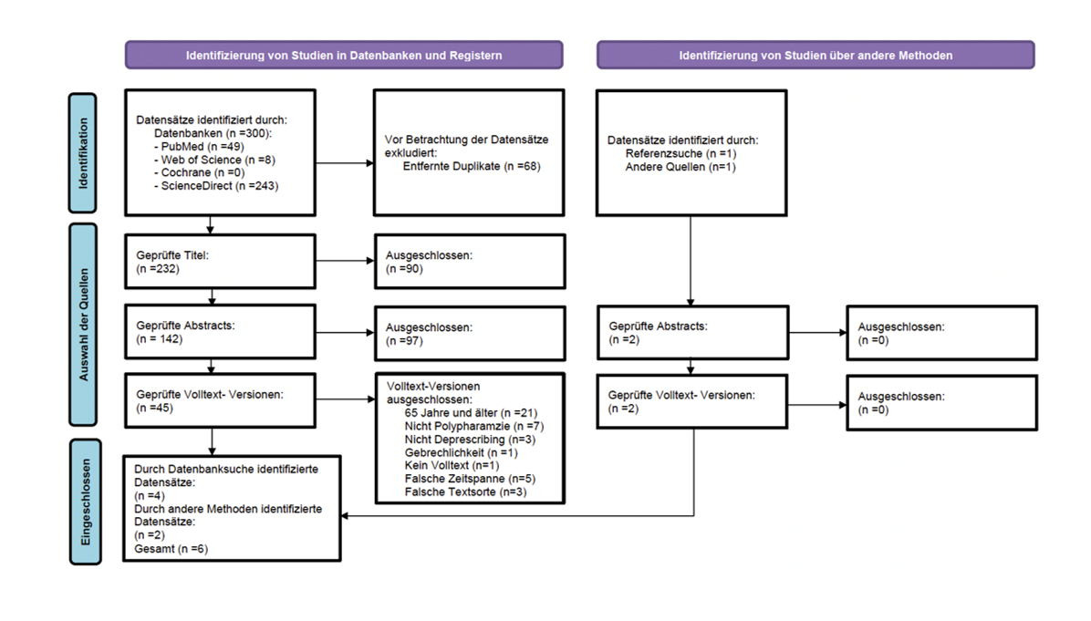
Screening your papers
Database searches and identification of papers
Titles, Abstract and Full text consideration for inclusion (by two researchers)
PRISMA Flowchart
Notes:
Screening your papers is the step that allows you to select ALL papers that fit the inclusion and exclusion criteria within ALL those papers that you have identified in your search.
It is a often time consuming multi-step process by two independent researchers
And has one output in the form of a PRISMA Flowchart.
Titles, Abstracts and full papers can be double considered against your inclusion and exclusion criteria (imperative if you want it published; not if you don’t)
You should then illustrate your search results in a PRISMA chart. This allows all external readers of your work to better understand the scope of your search and steps you conducted. (Handout of PRISMA-ScR template)

Slide 49
Screening
Screening
Title only
Abstract only
Full Text
Vs.
INCLUSION & EXCLUSION CRITERIA
Discrepancies
Notes:
To ensure the maximum reliability of your selected papers
This screening process is completed by two researchers independently.
First Titles, then Abstractsand then the Full texts are screened against the inclusion and exclusion criteria you set ealrier. Any discrepancies get discussed (if twodon’t agree a 3rd researcher will be asked).
At each stage the number of papers will get whittled down further.
Depending on the amount of papers this process is time consumuning but the reliability is very high. It is very important that you don’t rush or skimp over this step. This process is key to your entire SR.
It is impoortant that you take a not of the reason for rejection of every paper as you will need to inlcude this information in your results graph. The results of this process are presented in a so called PRISMA Flow chart.

Slide 50
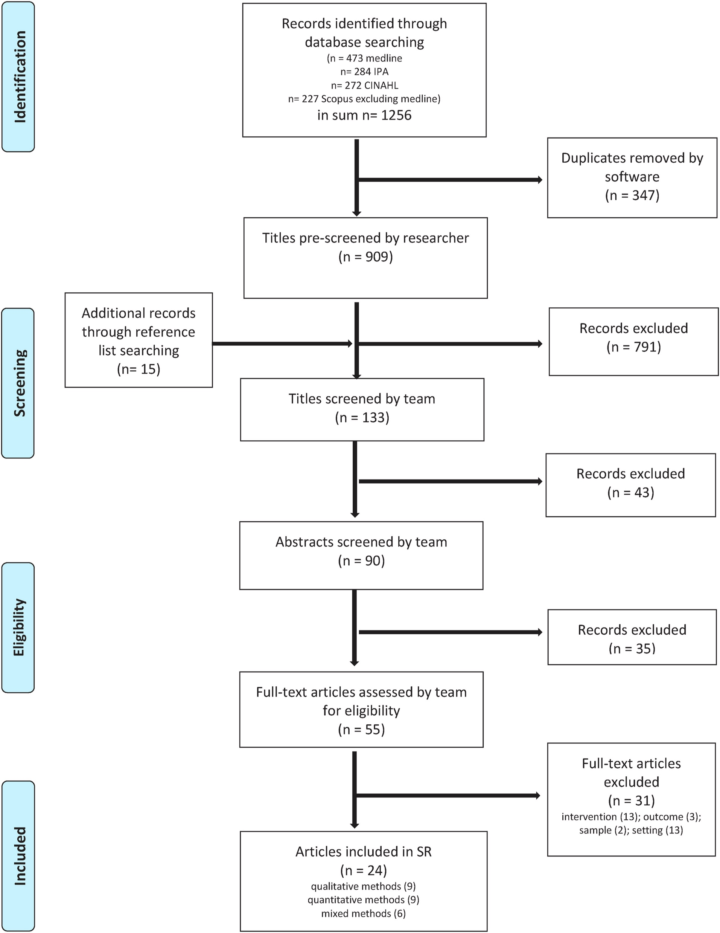
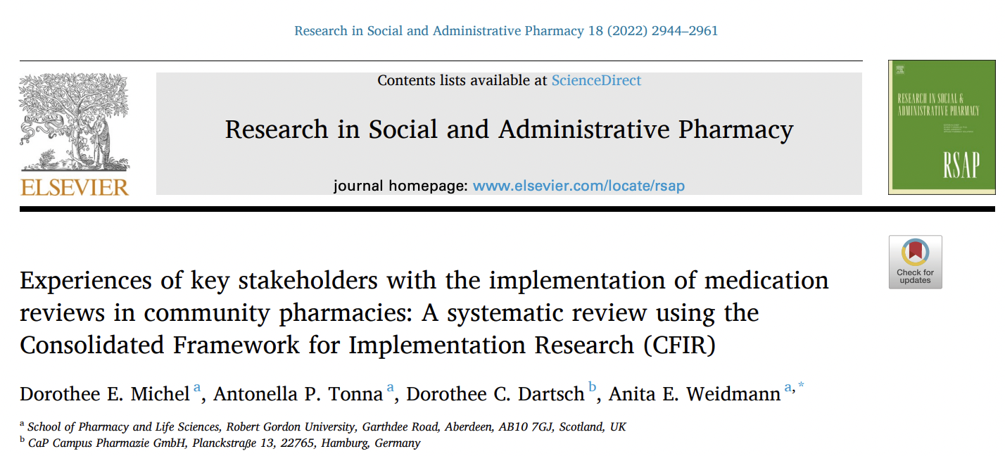
PRISMA chart
http://www.prisma-statement.org/
Notes:
PRISMA stands for: TRANSPARENT REPORTING of SYSTEMATIC REVIEWS and META-ANALYSES. It was developed for SRs but there is also a ScR extension.
You will find all the necessary information on how to conduct a SR and all necessary templates on the PRISMA site.

Slide 51
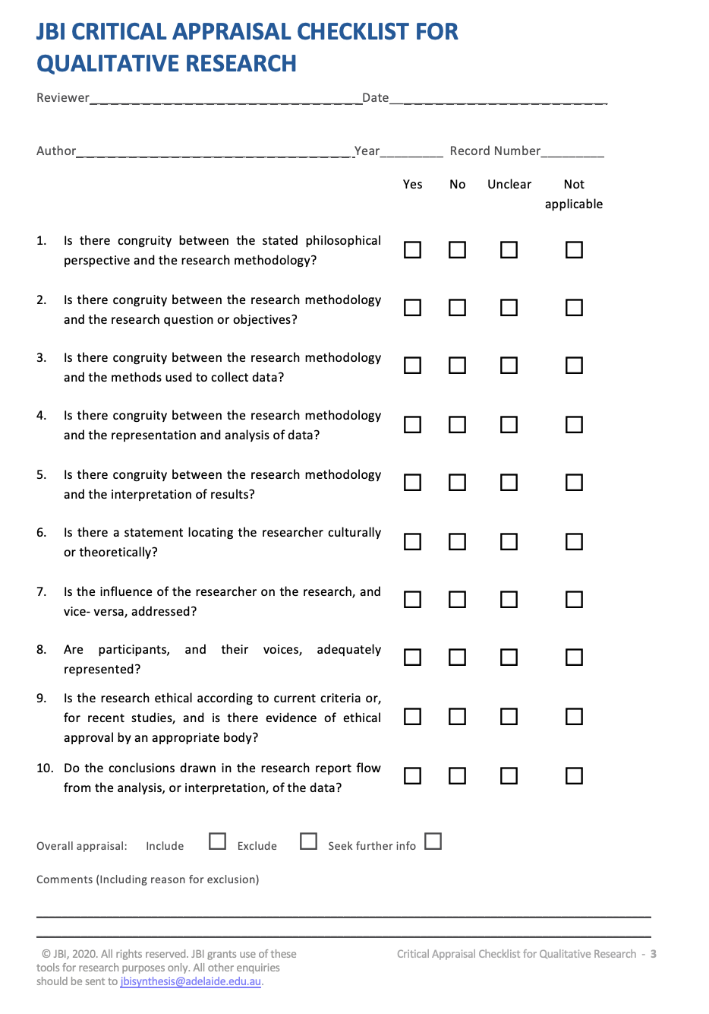
Quality assessment
Notes:
Now that you have selected your final set of papers that fit your inclusion and exclusion criteria. You need to assess the quality of these papers.
The good news is that you can skip this step if you decide on completing a Scoping review but it is an essential step for all systematic reviews.
Again this is done indpendently by at least two researchers
But instead of using criteria you have come up with, you will have to use from a set of already validated and published tools.
The type of tool you use is specific to the methiod used in the paper. That means you will need to select a different tool for each paper you have included in your final selection.
But there is a snag. There is not just one list of tools but there are many organisations who provide these tools an you will have to decide which ones you will use and why.

Slide 52
Critical Appraisal Tookits
Source of Critical Appraisal Toolkits | Links
Joanna Briggs Institute (JBI) | https://jbi.global/critical-appraisal-tools
Critical Skills programme (CASP) | https://casp-uk.net/casp-tools-checklists/
British Medical Journal (BMJ) | https://bestpractice.bmj.com/info/toolkit/ebm-toolbox/critical-appraisal-checklists/
Strengthening the reporting of observational studies in epidemiology (STROBE) | https://www.strobe-statement.org/checklists/
Advancing the science of practice guidelines (AGREE) | https://www.agreetrust.org/resource-centre/agree-ii/
National Heart, Lung & Blood institute (NIH) | https://www.nhlbi.nih.gov/health-topics/study-quality-assessment-tools
Cardiff University | https://www.cardiff.ac.uk/specialist-unit-for-review-evidence/resources/critical-appraisal-checklists
McGill Univeristy (MMAT) | http://mixedmethodsappraisaltoolpublic.pbworks.com/w/file/fetch/127916259/MMAT_2018_criteria-manual_2018-08-01_ENG.pdf
Notes:
This is not an exclusive list but one to get you started.

Slide 53
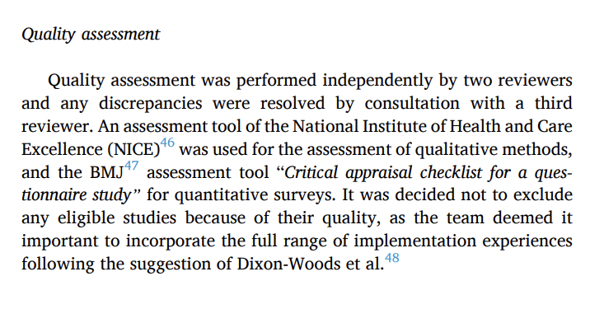
Quality assessment presentation
Proppé G.B, Jónsdóttir F., Gunnarsson P.S., Weidmann AE. Medication-induced delirium in patients with and without dementia: A systemtic review of international guidelines. Paper in preparation
Michel DE, Tonna AP, Dartsch DC, Weidmann AE. Experiences of key stakeholders with the implementation of medication reviews in community pharmacies: A systematic review using the Consolidated Framework for Implementation Research (CFIR). Res Social Adm Pharm. 2022 Jun;18(6):2944-2961. doi: 10.1016/j.sapharm.2021.07.017. Epub 2021 Jul 21. PMID: 34420864.
Notes:
The results are either displayed as a summarising narrative or as a table which provides more detail.

Slide 54
Data Extraction
Publication details
Where, When, Who etc.
Basic information
population included; aim of study; methodology used etc.
Should link directly to your inclusion criteria
Essential information
key results; conclusion; types of medication used etc.
Should link directly to your research question
Notes:
This step is relevant for both ScR & SR
Effectively it is the generation of your results. Most of us are familiar with quantitative research such as Lab work and statitsics. You always end up with nice histograms, pie charts and line graphs. This step is equivalent only with literature results.
So first you need to decide what data in those papers you are interested in.
There is the obvious data - where published, when, who by etc. – this would be akin to your “demographic background information”
Then there is basic infromation - population included; aim of study; methodology used etc. – this should link directly to your inlcusion criteria
Then there is essential information – key results; conclusion; types of medication used etc. – this should lik directly to your research question (and be data that helps you answer your research question directly)
While you will find a template on the PRISMA website you and your team will ALWAYS have to adapt it to your specific study. Make sure you run this through the process of validation and piloting to make sure you haven’t missed any vital information.

Slide 55
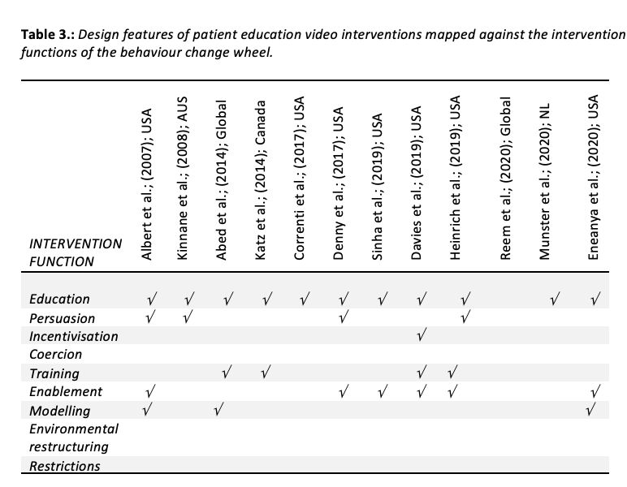
Presentation of data
https://www.equator-network.org/reporting-guidelines/
Weidmann A.E., Sonnleitner-Heglmeier A., Dartsch D. Effect of patient education videos on modifying medication related health behaviours: a systemtic review using the behaviour intervention functions. Patient Education and Counselling, 2023. Accepted for publication.
Notes:
As said before you won’t end up with pie charts & histograms but with a lot of written information.
This is usually displayed in table format.
However make sure that only information is displayed that is directly relevant to your research question. Even when summarising the key findings, make sure this is directly relevant to your research question..
You can also include tables that show clear aspects of your research questions such as barriers and facilitators OR the use of certain concepts/ frameworks.
Lastly when writing up any type of literature review you should follow the good practice reporting guidelines for your type of study. These detailed checklists of what to include can be found on the EQUATOR webpage.
EQUATOR is a central place for research information aimed at Enhancing the QUAlity and Transparency Of health Research

Slide 56
Additional materials 5.0
Notes:
http://www.prisma-statement.org/ (PRISMA transparent reporting of SR and MA)
PRISMA Flowdiagram document.
Data extraction tool example
EQUATOR link
PRISMA checklist

Slide 57
Are there any Ai tools
that can help?
Notes:
As we have seen earlier, some of the Ai tools we have already looked can help with extracting some of the important data which can make data extraction a little easier. However I am not very trusting of this information and I think you ALWAYS have to extract this information yourself, as only you can make the informed decision what information is relevant to your research question and what isn’t.
Iin addition to the ones we looked at earlier there is also CHATPDF which is quite useful for looking at individual papers and helping to identify information.
The tools can maybe save a little bit of time but it still requires a human.
Besides if you are doing a SR then the data extraction MUST be completed independently by two researchers with all discrepancies discussed.
HOWEVER there is one Ai programme that is a huge help when conducting SRs & ScR – Rayyan.
Rayyan is the only tool available that allows us to complete the paper selection process of Titles, Abstracts and Full texts against your set inclusion and inclusion criteria more quickly and easily. It is fully transparent and even facilitates the discussion when discrepancies are shwon. Let’s tale a look:

Slide 58
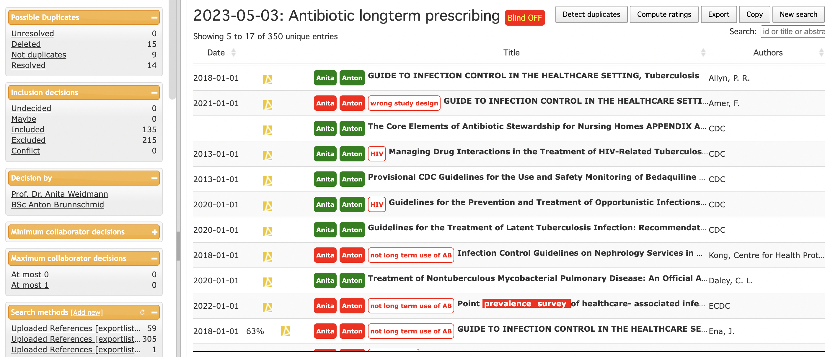
RAYYAN
Notes:
This is what Rayyan looks like.
A list of inlcuded titles is uploaded (these also link to the main PDF and display the Abstract).
Using simple yes no and maybe buttons you can cast your verdict turing the light either green or red
This makes it really easy to see any discrepancies once the blinding is off (as it is demonstrated here)
Further for any paper you reject you can add a comment, helping you to keep track of the exclusion criteria.
This tool has been such a time saving compared to the manual screening using excel and internet searches.
When it comes to the quality assessment of your papers you are back to “good old critical apraisal tools”
Displaying the information is also still a task for the researcher and so is writing the results section.
So over to you!

Slide 59
Lateral
Notes:
Once you have selected your paper for inclusion you can use Lateral to help with the data extraction.
Allows you to extract key information and organise it, comment on it and export all similar information as e.g. word, excel etc.

Slide 60
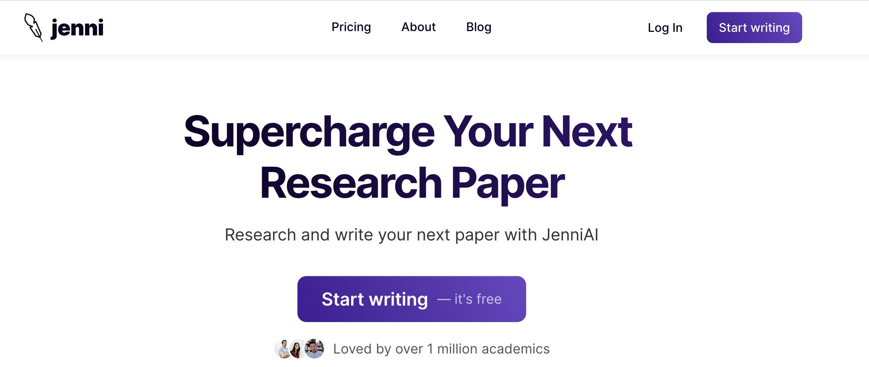
Jenni Ai
Notes:
Finally you can use the paid for AI to supercharge your writing.
Jenni can suggest sentences to get you going or when you are stuck, it can include citations.
It can help you to write in more depth,
present the opposing argument,
write an introduction and a conclusion.
In addition there are a lot of additional tools that do similar things, all of which I have tried to list in the attached PDF material.

Slide 61
Group exercise (60mins)
Complete a Title, Abstract & Full-text screening using the 15 titles.
Identify and decide on the best critical appraisal tools to use.
Develop a data extraction tool specific to the chosen research question.
Notes:
14:45 – 15:45

Slide 62
Coffee Break
Notes:
15:45 – 16:00

Slide 63
Literature review development (Part 4)
The use of AI as novel writing tool: opportunities and challenges
Notes:
16:00 -16:30
Ok so you now hopefully have a better understanding of the types of literature reviews there are, how to chose them and what they involve.
We also looked at Ai tools that can or as it turns out can’t help us with this process.
You have been given a long list of Ai tools you can try out yourself and they are generally very useful as they help us “get there faster”. However they can not:
Come up with the research question
Make decisions about how to carry out the research and where to place the emphasis
They can’t conduct the search for us but point us in the right direction or help us check that we haven’t missed anything important.
They can’t make sense of our results for us.
So if they are really only a supportive technology that is massively limited by its lack of comprehension and higher level thinking What is ALL the hype about?
The hype is about the fact that we now have LLM that can do the scientific writing for us.
Namely GTP4.
Currently there is no other Ai that allows you generate such complex scientific texts and since LLMs are trained on the entire information available online they are way more efficeint than we will ever be.
So before we discuss the pro’s and con’s I want you to try it.

Slide 64
Group exercise (30mins)
Use ChatGPT and/or GTP4 to generate a 300 Word Background for your chosen research topic (fully sceintifically referenced)
Critically appraise the text.
What do you think?
Notes:
16:00 – 16:45

Slide 65
Useful prompts for ChatGPT/ GPT3,5
Always provide
Topic:; Context:; Requirement:; Language:
Get CHatGPT to provide you with feedback on your draft:
“Please critique the following passage and let me know if my argument is clear or not.”
Ask for clarification:
“Please explain the following passage in simple words. I am having difficulty understanding [a particular point].”
Get ChatGPT to discuss things with you: “Can you engage with me in a Socratic dialog on [topic]? Then start asking questions.”
Help with writing Introduction / Conclusion: “Please rewrite this paragraph as a Introduction.” [or conclusion]
Write a “zero draft” – 20mins non-stop about your topic, whatever comes to mind, don’t worry about grammar, language, spelling or structure.
Open up ChatGPT
Use the following prompt:
Please remove redundant words and phrases from the following passage and make it coherent and cohesive.
Chat GPT will give you a coherent paragraph

Slide 66
What do you think?
Notes:
16:45 – 17:20
Open discussion on opportunities and threats AI poses to scientific writing and reflections on how this can help to support the researcher.
Hallucination
Depth of information
Responsibility
Should we have to disclose the use of LLMs in our publications?
Research intergrity
Innovation & Creativity (will it be stifled?)
What about paper mills (trustworthiness)
Publishing houses
However while it is not helpful, sensible and ethical to use something like ChatGTP to write your papers for you there is an Ai that can already help us become a better and more efficient academic writer. Jenni.ai.
Jenni is used by many renowned univeristies around the globe.

Slide 67
Take home messages
Outsource your labour to AI not your thinking.
Use AI as your research assistant not your supervisor.
Use AI to create structure (e.g., outline of a paper) not content.
Don’t over-rely on AI and don’t not forget to use your common sense.
Ai can NOT take responsibility YOU are ultimately repsonsible for the work you produce.
Ai is “artificial” NOT “intelligent” (yet!)
Ai can NOT take responsibility YOU are ultimately repsonsible for the work you produce.
Ai IS “artificial” but it’s NOT “intelligent” (yet!)

Slide 68
Your expectations?
Notes:
17:20 – 17:30
Summing up

Slide 69
Thank you

