Slide 1
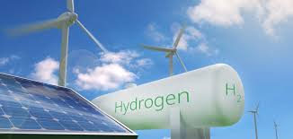

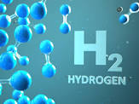
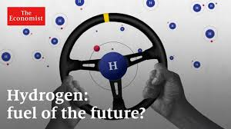
Hybrid Renewable-Hydrogen Energy Systems and their Role in the Energy Transition
Dr. Dallia Ali 1, Ayatte I. Atteya 2
1 PhD, MSc, BSc (Honors), FHEA, CEng, MIET, MIEEE, MPES and MIEEE Smart Grid Community
Expert for European Commission Innovation and Networks Executive Agency (INEA)
Technical Executive Advisor for Pier Solutions
Member of All Party Parliamentary Group on Hydrogen
Member of the ETP Hydrogen Theme Steering committee
Listed in ETP Scotland's HEI Hydrogen Capability Document to support Scottish Government's Hydrogen Policy
Guest Editor for Green Energy & Environmental Technology Journal issue “Renewable-H2 Green Energy Systems”
Senior Lecturer and Course Leader for MSc Renewable Energy Engineering Course, and Upskilling in Renewables and Hydrogen Energy Systems Short Courses
2 PhD student in Electrical and Electronic Engineering, School of Engineering, Robert Gordon University

Slide 2
Outline
Why Hydrogen ?
Hydrogen Production and Color Code Nomenclature
Hydrogen Potential in Supporting the Scottish Net Zero Energy Transition
Renewable-Hydrogen Energy Storage Systems
Hybrid Renewable-Hydrogen Energy Systems – Case Studies
Conclusion

Slide 3
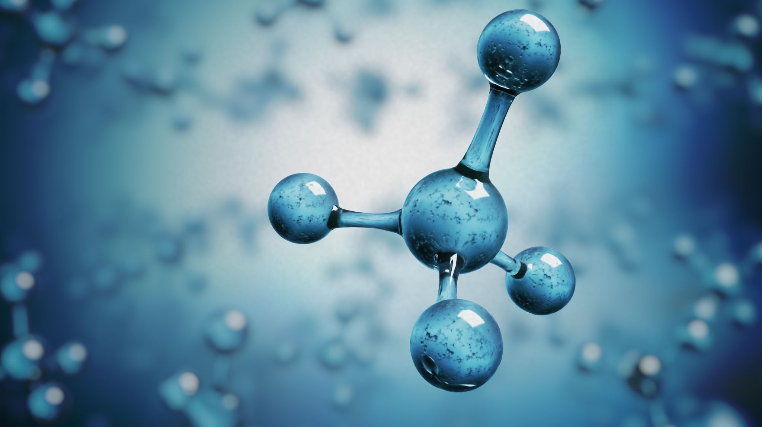
Why Hydrogen?

Slide 4
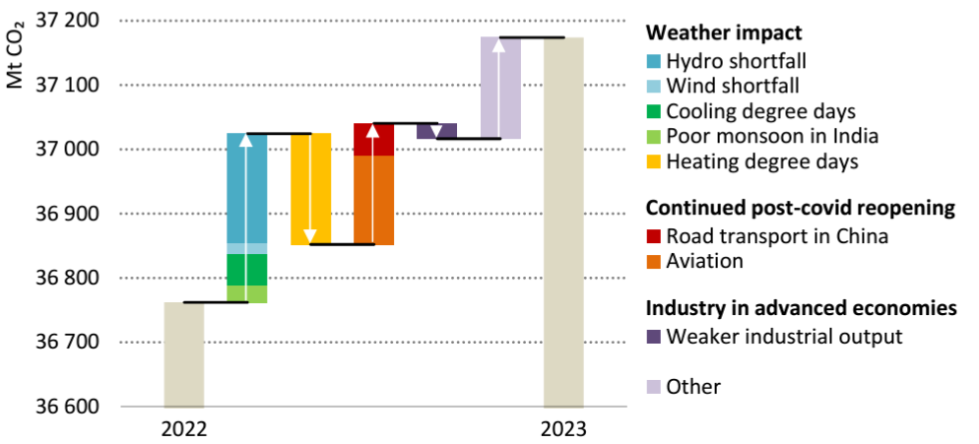
Emissions Brief (IEA CO2 Emissions Analysis 2023)
Global energy-related CO2 emissions grew by 1.1% in 2023, increasing 410 Mt to reach a new record of 37.4 Gt. Emissions from coal accounted for more than 65% of the increase in 2023.
The global shortfall in hydropower generation due to droughts drove up emissions by around 170 Mt. Between 2019 and 2023, total energy-related emissions increased around 900 Mt.
Notes:
To justify the use of H2 we are looking first for emissions brief. So, this is the brief of 2023. Looking at this brief, we find global energy related emissions increased by 1.1% from 2022 to 2023 to reach around 37 Gt of CO2 emissions. The main reason behind this increase have been the shortfall in hydropower generation together with the reopening of road transport and aviation post COVID. Between 2019 and 2023, total CO2 emissions increased by 900 Mt.

Slide 5
Environmental Concerns
Air Pollution (causing health issues)
Water Contamination (affecting humans, animals & plants using it)
Land Degradation or destruction from human activities. (this lessens the quality and/or productivity of the land for agriculture, forestation, construction, etc.)
    Note that the air, water and soil pollution raise public health issues and require many years to recover.
Climate Change (destructive impacts include, but are not limited to, melting of polar ice, change in seasons, new illnesses, and change in the general climate situation).
Global Warming (this results from the fossil fuel GHG emissions)
Effect on Marine Life (affecting shellfish and microscopic fish)
Ozone layer Depletion (loss of earth protection from the sun unsafe beams)

Slide 7
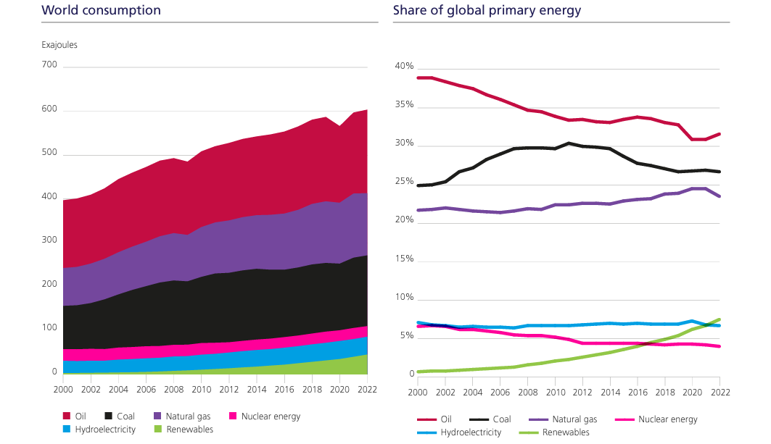
Global Energy Consumption
Notes:
The second challenge that the globe is facing is the increase in energy needs. Every year, we need more energy, and we can see here how global energy consumption is increasing between 2000 and 2022 from all types of fuels, so we are using more oil, more coal and natural gas, nuclear energy consumption is increasing as well, hydroelectricity consumption is increasing and renewables energy consumption is increasing.

Slide 8
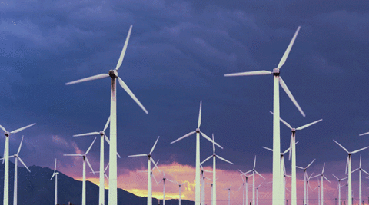
Exploiting the Renewables Potential
Exploiting the full renewable potential depends on several factors including the usage of adequate energy storage systems that can absorb the excess of renewable energy and address their intermittency.

Slide 9
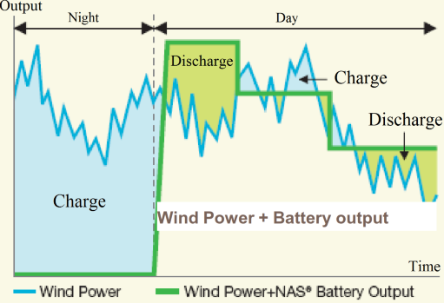
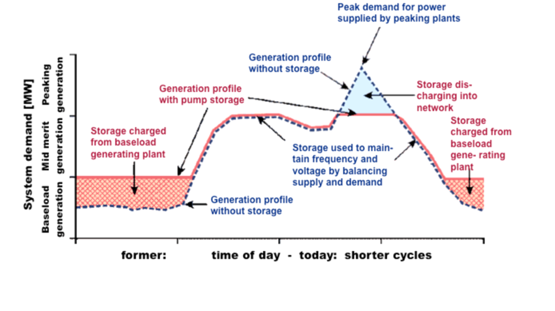
The need for Energy Storage Systems
Implementing Energy Storage with Renewables to address their intermittency and facilitate their High Penetration into grid
Implementing Energy Storage with Power plants for balancing the generation profile and avoid running peaking plants

Slide 10
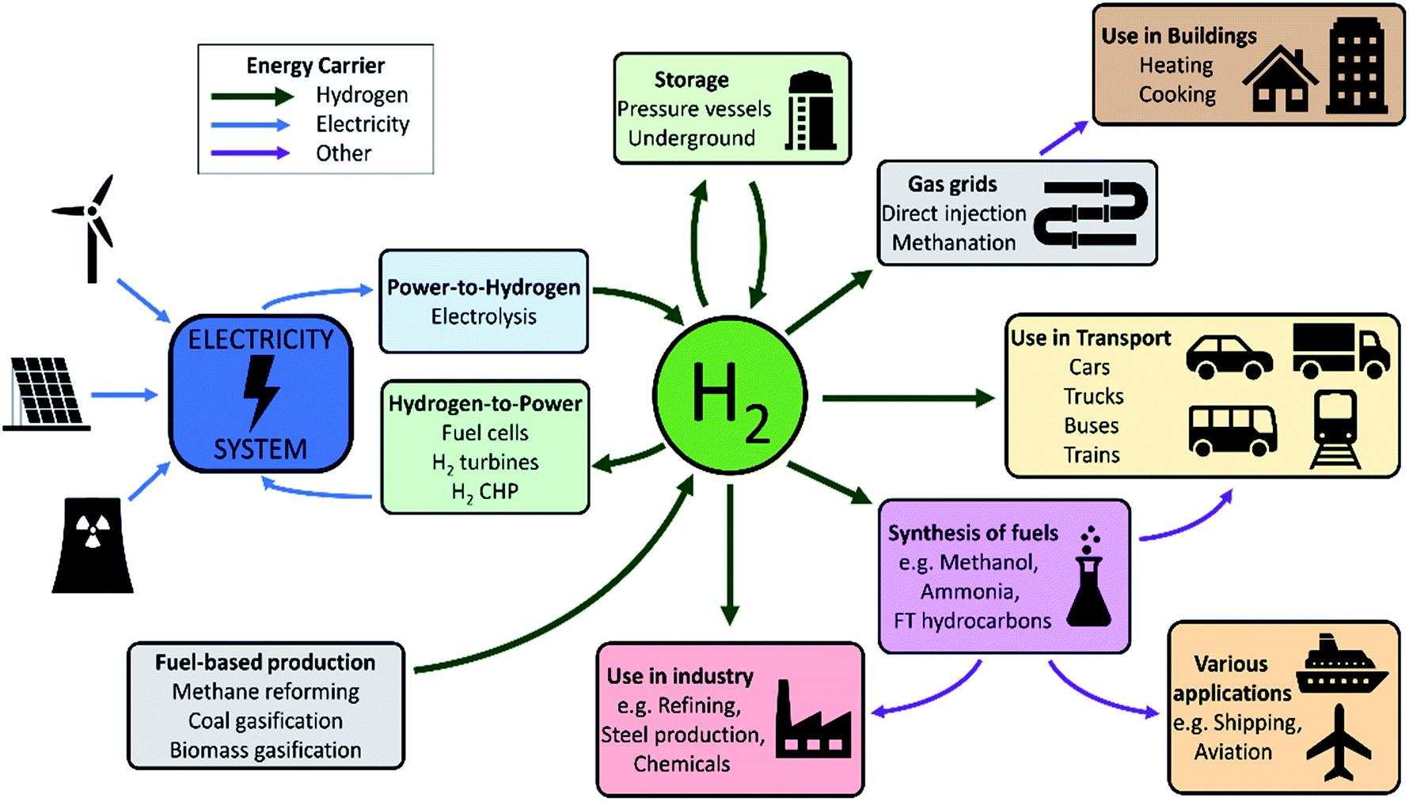

Slide 11
Hydrogen Production and Colour Code Nomenclature

Slide 12
H2 Production
H2 gas is currently produced from a variety of primary fossil energy sources such as natural gas, naphtha, heavy oil, coal and water. H2 can be environmentally friendly only if the energy used in its production is clean’ renewables.
Most of the world H2 production comes from steam reforming (SR) of natural gas. Other comes from higher hydrocarbons reforming, coal gasification, and from water electrolysis. CO₂-neutral H2 can be produced by the conversion of biomass via gasification, pyrolysis of bio-oils, SR of biomass-derived higher alkanes and alcohols, and APR of oxygenated hydrocarbons
Steam reforming of methane and light hydrocarbons involves three reactions, namely, the splitting of hydrocarbons with steam, the water–gas shift, and the formation of methane.
Gasification of coal and heavy hydrocarbons involves the reaction at high temperatures (1200–1400 K) and moderate pressure (5–10 bar) of the carbon source with a source of hydrogen, usually steam and/or oxygen.
Water electrolysis is one of the easiest methods for hydrogen production although it is relatively expensive technology. If relatively small quantities of hydrogen are required, on-site electrolysis of water may result more economical than other methods. This technique is very clean and produces more than 99.989% purity of hydrogen gas. In addition, electrolysis can be linked to renewable electricity-producing technologies and hence could become even more important in the future.

Slide 13


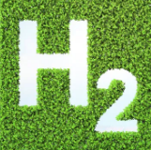
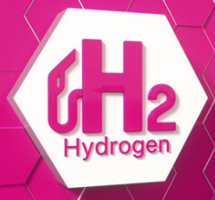
Black/Grey Hydrogen
Blue Hydrogen
Green Hydrogen
Pink Hydrogen
White H2 refers to the naturally occurring H2 (rarely) found in underground deposits.
Thus, different processes are used to generate H2 artificially.
Grey H2 accounts for most of the production today and emits about 9.3 kg of CO2/kg of H2 production.
Black H2 produced from coal gasification; Grey H2: produced via steam reforming of natural gas or methane
100% carbon emissions
Blue H2 produced from steam reforming of methane or natural gas while utilizing CCS to negate emissions with 85-95% efficiency
Green H2 produced using renewable energy in electrolysis
Zero-carbon emissions, ideally suitable for green energy transition
Pink H2 produced using nuclear energy in electrolysis
Zero-carbon emissions. Not commercialized yet
Notes:
To distinguish between different types of hydrogen production resources we are using a colour code nomenclature.

Slide 14
Hydrogen Potential in Supporting the Scottish Net Zero Energy Transition
Implementing green H2, as a form of energy storage with renewables, can support the Net Zero transition of many end-users while addressing the renewables’ intermittency

Slide 15
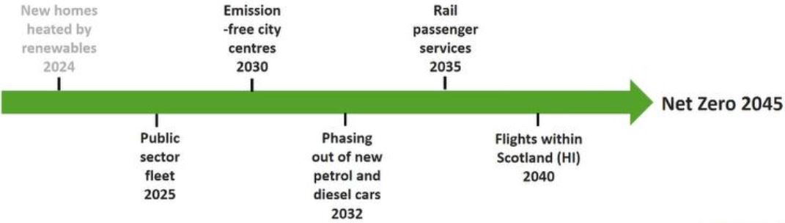
Scottish Government Timeline for Decarbonisation
Scotland set an ambition to support the development of 5GW of renewable and low-carbon hydrogen production by 2030 and 25GW by 2045.
Scotland's unique selling points to become producer of lowest cost hydrogen in Europe by 2045 are its energy natural resources, infrastructure and skilled energy workforce.
Scotland supports demonstration, development and deployment of hydrogen for decarbonisation of critical industry functions and processes, transport and heat.

Slide 16
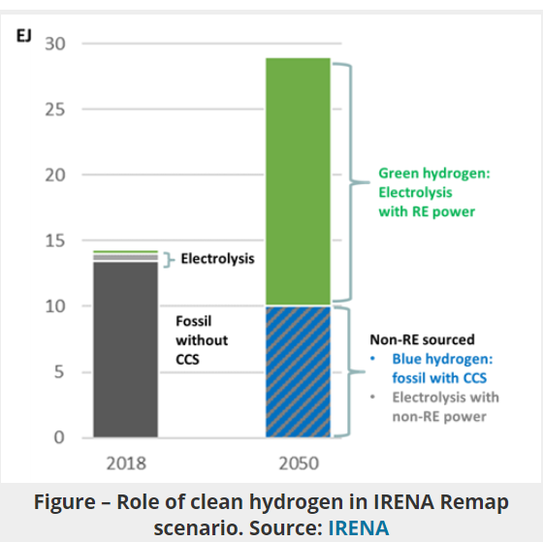
From Where Scotland can get the Needed H2?
Scotland has:
Significant offshore wind resources to produce Green H2 from Renewables by electrolysis at scale (Timeframe 5-20 years)
Industrial Carbon Capture, Utilization and Storage (CCUS) for producing Blue H2 from methane reforming (Available now)
BH to support Green Hydrogen production at this stage
Notes:
Scotland have plenty of renewable resources that can be used to generate green hydrogen, particularly offshore renewables. We can also benefit from the hydrogen that is already available now from the process of steam methane reforming and integrate with it CCUS technologies to negate emissions.

Slide 17
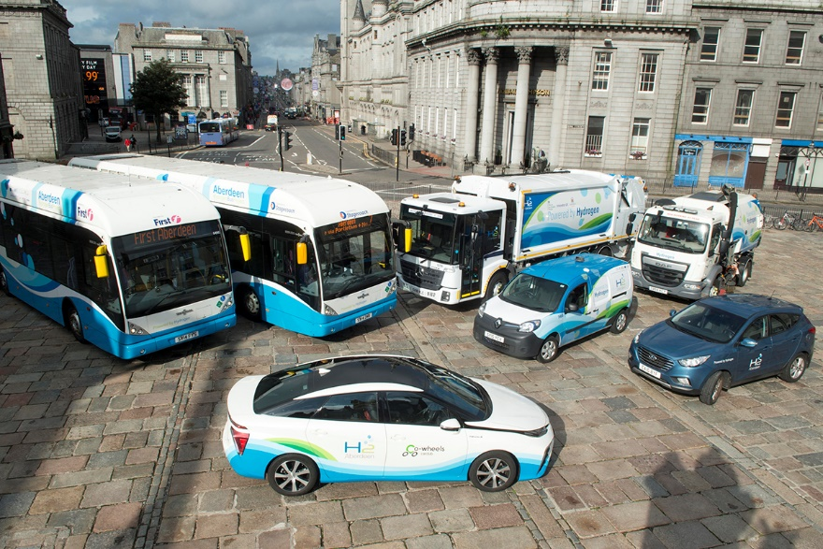
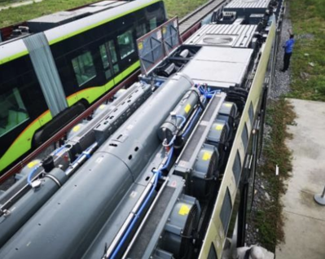
H2 Potential in decarbonizing the hard-to-abate sectors
H2 holds a great potential in decarbonizing hard-to-abate sectors such as heavy industry and heavy-duty transport (Transport accounted for 34% of the UK CO2 emissions in 2019).
H2 trains allow hybrid configurations of batteries and fuel cells thus increasing performance & range
Fuelling a H2 train is faster than charging a battery-based train.
H2 trains demonstrated in Europe high-performance and adaptability as diesel-powered trains of similar range while eliminating emissions.
Electric cars & trains are not essentially clean (electricity source).
Railway Electrification has high CAPEX and visual impact.
Deploying Renewable-H2 trains can support the electrical network when integrating large-scale renewables, and help creating new jobs.
Aberdeen City Council continues to grow their hydrogen vehicle fleet
Hydrogen tank and Ballard fuel cell system on CRRC-Sifang light rail - https://blog.ballard.com/fuel-cell-trains

Slide 18
Future H2 Markets
Market 1 – Ammonia
  $48 billions of ammonia sales in 2016 and will reach over $76 billion in 2025
  Green ammonia by using green H2
Market 2 – Methanol
  Methanol generates $55 billion/year and creates 90,000 jobs globally.
  Green methanol by using green H2
Market 3 – H2 Trains
  The market for H2 trains for the next 30 years is €44 billion for the CAPEX alone
  H2 trains use fuel cells
Market 4 – H2 Boats
  Using H2 fuel cell boats
  Using H2 internal combustion engines
  New H2 production systems to supply fuel for boats
Notes:
Also, H2 can pave the way for plenty of future H2 markets from which I can generate more money. Green H2 can be used to generate green ammonia, green methanol, H2 trains as we just mention in the previous slide and also it is expected to

Slide 19
Renewable-Hydrogen Energy Storage Systems

Slide 20
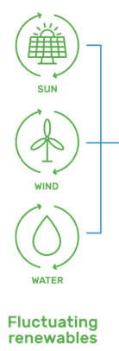
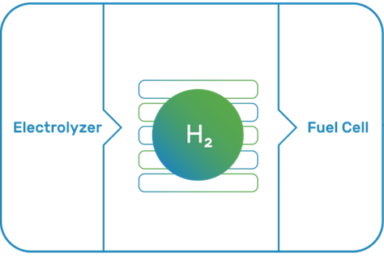
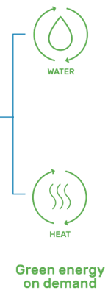
Renewable-Hydrogen Energy Storage Systems
By-Products
H2 Storage System
Electrical Energy Input
Electrical Energy Output
H2 Gas
H2 Liquid
Solid-state
O2 Commodity
O2 can be utilized to improve efficiency
H2 Commodity
H2 can be used for other end-uses

Slide 21
Cost of Renewable/Green Hydrogen
Green H2 is currently more expensive than conventional H2 produced from fossil fuels
Cost of green H2 is falling rapidly due to combined effects of reduced electrolyzer cost and reduced renewable power costs
Costs associated with CO2 emissions from fossil fuels could be considered to further improve the competitiveness of green H2
Renewable-H2 will compete in the next 5 years with fossil fuels
Wind-H2 will allow wind farms with expiring feed-in tariffs/incentives to identify new revenue streams. Integrating Electrolysers into wind farms will:
  Allow CAPEX reduction by replacing high cost HV infrastructure with pipes network
  Increase system efficiency due to lower HV electrical loses
  Increase plant load factor as electrolyzer load is more flexible than electrical network requirements

Slide 22
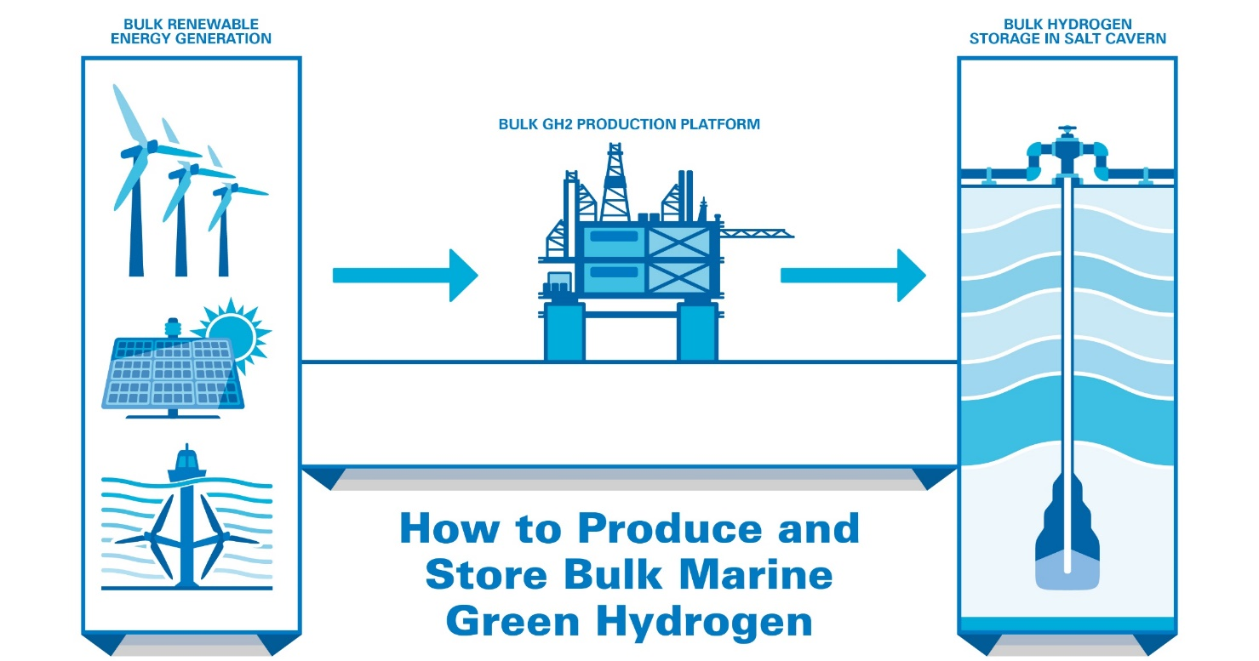
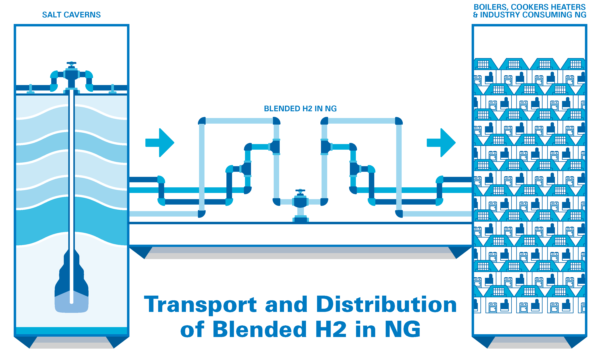
Large-Scale Renewable-Hydrogen Production & Storage
To fully unlock the potential of renewable-hydrogen, costs of hydrogen technology should be reduced through large-scale implementations.
Notes:
So, to enable reducing the costs of green hydrogen production we need to produce green hydrogen at large-scale. An what I mean by large-scale I mean this can be produced from bulk generation of renewables meaning more than one renewable resource wind farms together with solar parks and marine resources and this can be used to generate bulk amounts of green hydrogen and can be stored offshore in salt caverns or depleted natural gas reservoirs and be transported by the pipelines of the existing gas grid, so by this way I am reducing the cost because I use the same infrastructure already available for natural gas either for hydrogen storage or transportation and then deliver this generated hydrogen into the end users to be used in boilers, heaters or industry or to be transformed back into electricity.

Slide 23
Hybrid Renewable-Hydrogen Energy Systems Case Studies

Slide 24
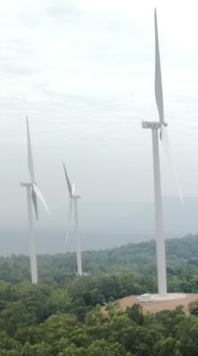
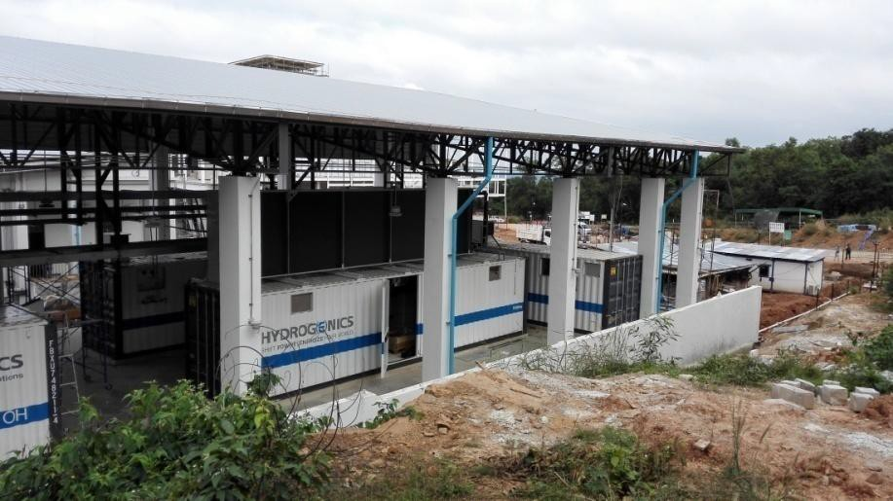
Case Study 1 (Power to Power): Lam Takhong Wind Hydrogen Hybrid Project - Thailand
  Use the curtailed energy from 24 MW wind farm with limited injection capacity
  Implement 1 MW PEM electrolyzer, 3 MWh (10 hours) of compressed hydrogen storage (250 bar), and 300 kW PEM fuel cell
  Use the hydrogen through a 300-kW fuel cell to power the new energy center
24 MW Wind Farm
1MW Electrolyser
3 MWh (10 hours) compressed hydrogen storage (250 bar)
300 kW Fuel Cell

Slide 25

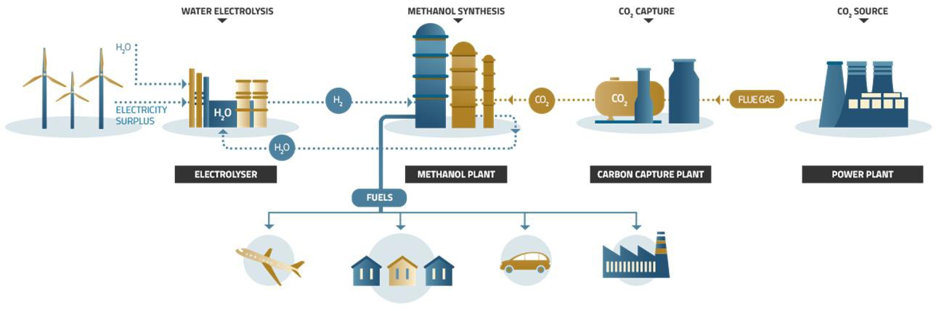
Case Study 2 (Power-to-Methanol): Niederaußem - Germany
Produce green methanol as energy vector from captured CO₂ and the hydrogen produced using surplus renewable energy.
Implement 1x HyLYZER®-200-30 (PEM, single cell stack design) with all peripherals to produce 200 Nm³/h H₂ (power: 1 MW)
1MW PEM Electrolyser
CO2 Capture Plant
Methanol Plant
www.mefco2.eu

Slide 26
Case Study 3 (Remote operation): Highly flexible Electrolysers - Norway
A 45 MW wind park implementing 1x HyLYZER®-500-30 (PEM) with all peripherals to produce 400 Nm³/h H2 (power: 2.5 MW).
Demonstrate enhanced wind integration through hydrogen storage
Demonstrate multiple control systems and remote operation (difficult access to grid and upgrading the existing grid infrastructure is very expensive)
More information: www.haeolus.eu

Slide 27
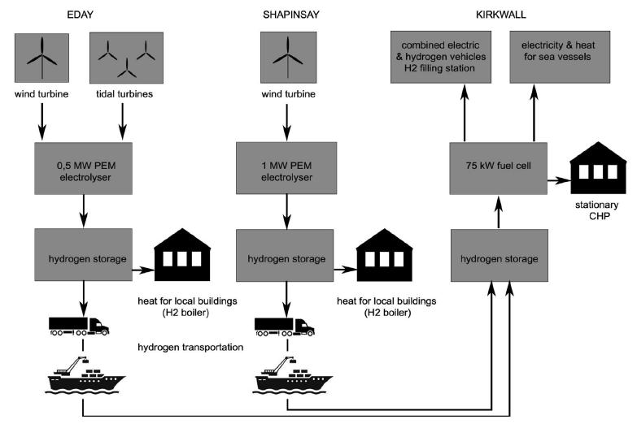
Case Study 4 (Utilizing Curtailed Renewable Capacity): The BIG HIT Project, Orkney/Scotland
The Orkney Islands have over 50 MW of installed wind, wave and tidal capacity and produce over 100% of their electricity demand from renewables on an annual basis.
Two PEM electrolysers are used in the islands of Eday and Shapinsay to produce H2 that can be transported to mainland Orkney, or consumed locally, or can be stored to be converted later into heat and power.
A 75-kW fuel cell is used to convert the stored H2 to heat and power for several harbour buildings and 3 ferries in Kirkwall.

Slide 28
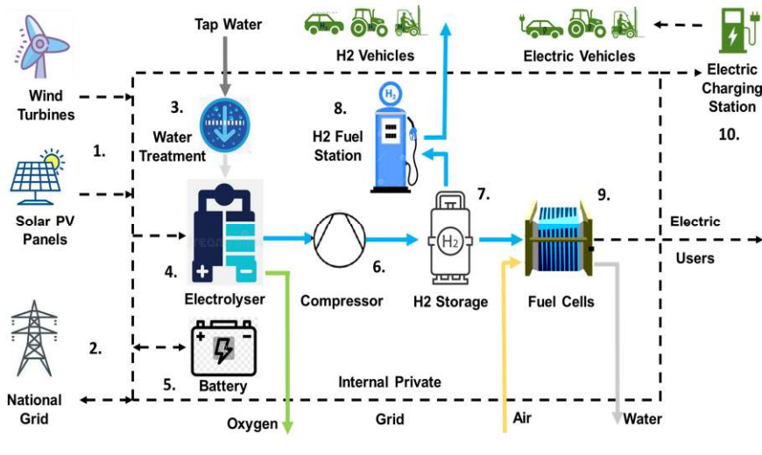
Case Study 5 (Power-to-Power and Fuel): The HydroGlen Project (Glensaugh Aberdeenshire)
Renewable Generators (Solar PV and Wind)
Grid Connection with import/export
Battery (for short term storage of renewables electricity and grid-balancing)
PEM Electrolyser producing H2 at higher pressure (30 bar)
H2 Compressor (to 200 bar)
H2 Storage (modular and scalable, 200 bar gas bottles)
Hydrogen refuelling station typically operating at 900 bar discharging to vehicle fuel tank at 700 or 350 bar. Refuelling a Hydrogen Fuel Cell Electric Vehicle (FCEV) takes 3-5 minutes like petrol or diesel.
Hydrogen fuel cells for additional power generation by reconverting hydrogen back to electricity.
ERM Dolphyn and Source Energie announce plans to develop Gigawatt scale “green hydrogen” floating wind sites in the Celtic Sea
Notes:
arg - (Gauge Pressure) Pressure reading relative to current atmospheric pressure. BarA - (Absolute Pressure) Pressure reading relative to absolute vacuum

Slide 29
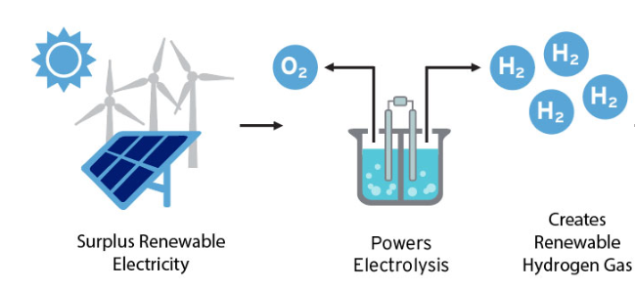
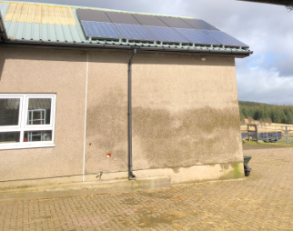
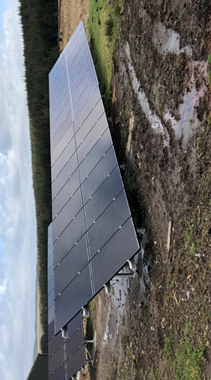
Case Study 7 (Solar Power-to-Power Small-Scale Grid-Connected Building Decarbonization): The Farmhouse Research Project, Scotland
This project aimed decarbonising a grid-connected farmhouse while avoiding its grid power import/export.
A 24kW/h Solar PV capacity is installed to supply the farmhouse power needs during summer, and the excess in its summer generation is stored in the form of Green H2 to be utilized during winter to reduce/eliminate grid power import/export.
An electrolyser was sized based on the excess in solar generation during summer for the given PV size and location. H2 storage tanks are sized based on the generated H2 from electrolyser, the storage pressure, and on the storage period.
The proposed PV-H2 system was simulated to demonstrate the H2 production over the different months based on the PV excess supplied to the electrolyser.

Slide 30
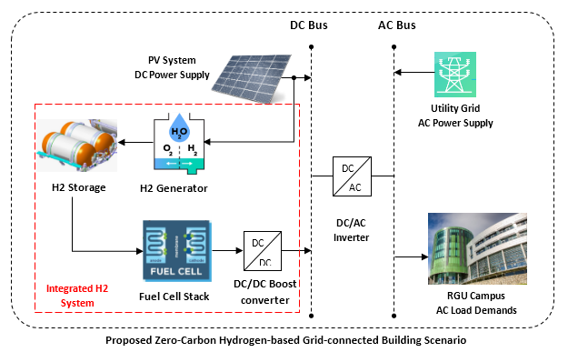
Case Study 8 (Solar Power-to-Power Large-Scale Grid-Connected Building Decarbonization): RGU Campus Research Project, Scotland
This project aims developing an energy optimization tool for realizing a Zero-Carbon Hydrogen-Based Grid-Connected Building-Scenario to be implemented on any grid-connected building
Research Project Objectives:
Size the PV capacity needed to minimize the building GHG based on the building annual energy demands together with the electrolyzer and fuel cell needed to complement the Solar capacity and mitigate its intermittency
Develop a precise dynamic model for simulating the dynamic generation and consumption of renewable H2
Address the optimal sizing of system components from economic and environmental prospects.
Develop a GUI tool for the optimal design, sizing, energy management and simulation of Real-World PV-H2 energy systems within grid-connected buildings (Disclosed).
RGU Campus as a case-study

Slide 31
Case Study 8 (Solar Power-to-Power Large-Scale Grid-Connected Building Decarbonization): RGU Campus Research Project, Scotland
PV System | Electrolyser | H2 Storage tank | Fuel Cell
4.0 MW | 1.083 MW | 80 kg | 607 kW
Reduction in carbon footprint
47%
LCOE = 0.3697 £/kWh

Slide 32
Conclusion
Hydrogen is a key player in the world clean energy transition and major contributor to the UK Net Zero Future. H2 will play a pivotal role in achieving an affordable, clean and prosperous economy.
For Hydrogen to play such a key role, the following is needed:
  Technology breakthroughs to reduce costs across the entire supply chain
  Favourable Government Policies for the widespread of hydrogen implementation
  Development of Local Skilled Workforce and Service Infrastructure
  Further Research, Analysis and Modelling that allows the effective deployment of hydrogen across different sectors

Slide 33


