Slide 1



GOVERNING THE TRANSITION OF SOCIO-TECHNICAL GRID-BASED SYSTEMS:
PROMOTING SECURITY OF SUPPLY AND ACCELERATING RENEWABLE ENERGY INNOVATION IN NIGERIA
Racheal Adedokun r.adedokun@rgu.ac.uk
Prof. Peter Strachan p.a.strachan@rgu.ac.uk
Dr Anita Singh a.singh13@rgu.ac.uk
Aberdeen Business School

Slide 2
Presentation Overview
Background and motivation
Study Aim
Theoretical framework
Methodology
Key findings
Forward plan

Slide 3

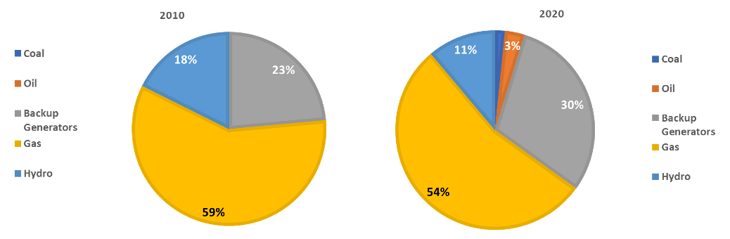
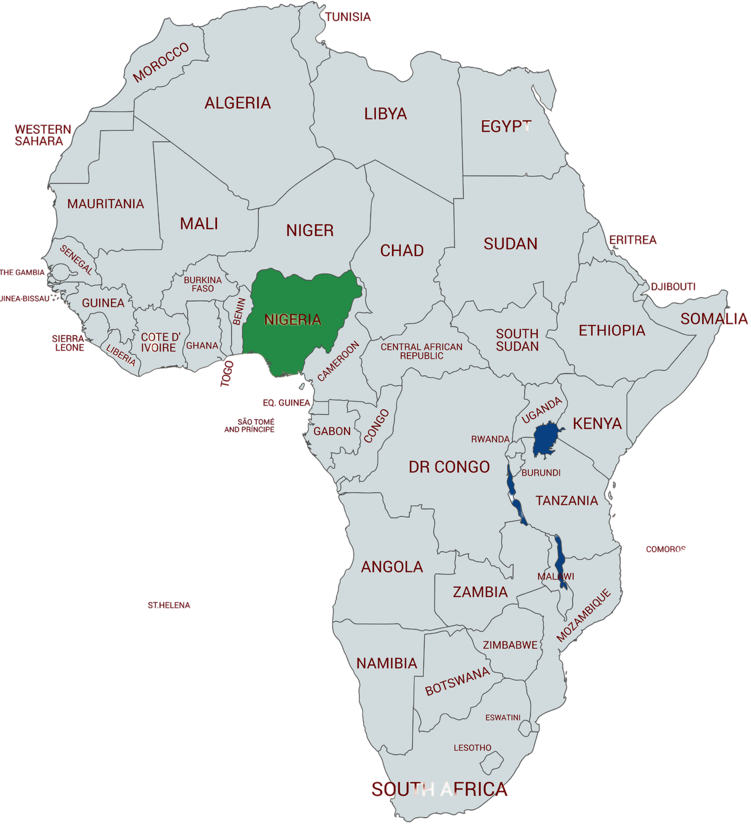


Introduction

Slide 4



Research Problem
80.1
Nigerians are without access to electricity (IEA 2020)
4K
Electricity supply in 2019 (IEA 2020)
MILLION
MW
35
Urban area has no access (residential
and industrial) (IEA 2020)
6K
Electricity demand in 2019 (IEA 2020)
PER-CENT
MW
12.5K
Nigeria’s population is projected to double by 2050 and energy demand increase (Cookson C 2019)
75
75% of the industrial areas are off grid (IEA 2020)
MW
PERCENT
RENEWABLE ENERGY DEVELOPMENT
The REMP aimed that renewable will account for 30% of the planned 30 GW generation by 2030 i.e available electricity
Energy access will increase from 2016 to 75% (2020) and 90% (2030)
However major milestones have been missed with projections looking poor for 2030 target
Literature have looked at this issue specifically to the grid from technical, financial, economic aspect (Edomah et al 2017, Ujumadu 2018, Adeniyi 2019, Gungah 2019, Ovwigho et al 2020, Nwozor 2021 )

Slide 5


Aim
This research aims to critically investigate the enablers and inhibitors for the implementation of grid-based renewable electricity generation strategies in Nigeria.
Objectives
To critically assess the grid-based renewable energy development status in Nigeria.
To investigate the enablers of the grid-based renewable energy strategies implementation in Nigeria.
To investigate the inhibitors of the grid-based renewable energy strategies implementation in Nigeria

Slide 6
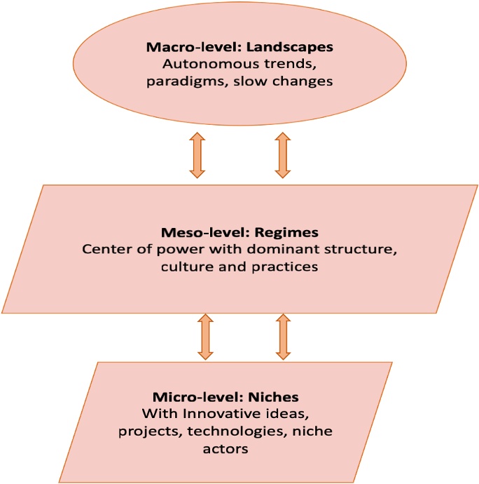
Theoretical Underpinning
Source: Multi-level Perspective (MLP) Framework (adapted from Geels 2002)
Notes:
The MLP draws on various field including technology studies
beneficial for explaining technological transitions and analysing socio-technical transitions to sustainability
widely used in transition studies
MLP posits three analytical levels on which processes interact and align to result in socio-technical system transformations.
landscape (macro-level), regimes (meso-level) and niches (micro-level).
Regime level = represent current structures and practices characterised by dominant rules, institutions and technologies that are self-reinforcing.
The socio-technical regime is dynamically stable in the sense that innovation still transpires but incrementally and along a predictable trajectory.
^{T}his makes the regime 'locked-in' and resistant to both technological and social transitions.
landscape level is = defined as the exogenous, broader contextual developments in deep-seated cultural patterns, macro-economics, macro-politics and spatial structures, potentially arising from shocks associated i.e war, climate change
Additionally, landscapes are beyond the direct influence of actors, yet stimulate and exert pressure on the regime and niche levels.
Niche level =. Is defined as a protected spaces for the development and use of promising technologies by means of experimentation. The niche innovations are
Incubated from market and regulation influences, the niche fosters innovations that differ fundamentally from the prevailing regime and usually require landscape developments that open windows of opportunity in at the regime level.^{[19]} Therefore, summary : the MLP attributes socio-technical transitions to the interaction of stabilising forces at the regime level with destabilising forces from both the landscape and niche levels^{[20]}

Slide 7
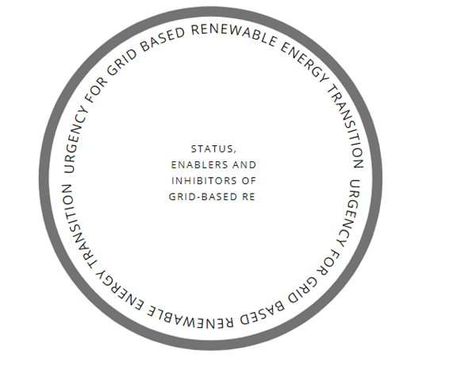
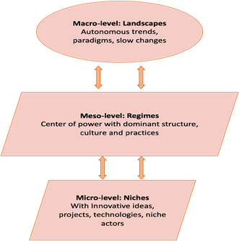

Theoretical Underpinning
MULTI-LEVEL PERSPECTIVE (MLP) FRAMEWORK (ADAPTED FROM GEELS 2002)
Author: Urgency for grid-based renewable energy generation in Nigeria

Slide 8








Research Methodology
Research Philosophy
Research Approach
  Interpretivism
  Inductive
Data Analysis Technique
Methodological Choice
  Mono method- Qualitative
  Thematics Analysis (NVivo Software)
Data collection
Research Strategy
  Semi- Structured Interview
  Case Study

Slide 9
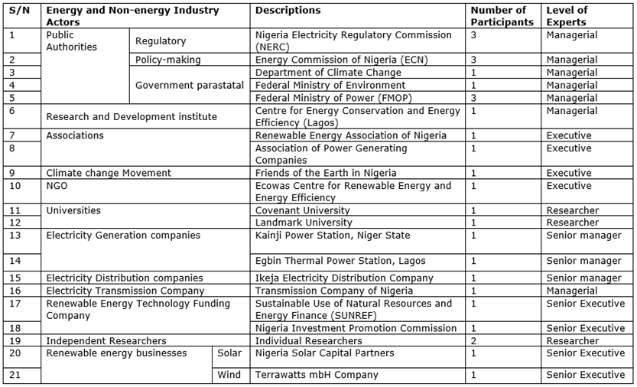
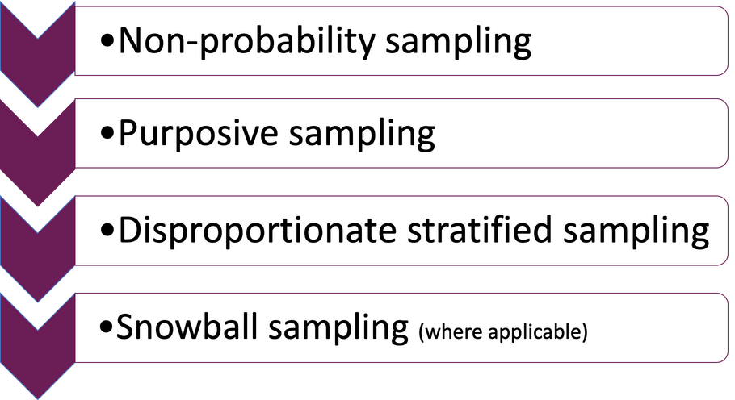

Energy and non-energy industry actors

Slide 10
Results and findings: Enablers of grid RE systems using NVivo
Energy Access and Security | Environmental Enablers | Financial Enablers | International Influence | Political Enablers | Support Networks | Technological Enablers
Energy access Energy security Quality power supply | Climate change mitigation Global warming | Environmental Trust Fund Financing Private investment arrangement | International agreement i.e, Kyoto protocol, Paris Agreement International grants and funding International trends and pressure | Government partnerships Government policies | Emerging support networks Improved technology standards and regulations (i.e., SON) | Cheaper maintenance Competitive cost of renewable energy Pressure from new technology
Availability of RE resources | Economic development | Emerging Information | Energy mix and diversification | Geographical expansion of power stations | Growing energy demand | Growing population | Societal acceptance | Sustainability

Slide 11
Results and findings: Inhibitors of grid RE systems using NVivo
Administrative Inhibitors | Economic Inhibitors | Financial Inhibitors | Infrastructural Inhibitors | Institutional Inhibitors | Legal Inhibitors
Accountability and transparency Existing bureaucracy Management challenge | Devaluation of Naira Foreign exchange Social budget gains | Existing financing structure of the power sector Funding challenges Investment in gas Lack of incentives RE Investments drawback | Grid expansion challenge (Grid capacity) Grid unreliability Lack of infrastructure security Maintenance culture Metering Obsolete infrastructure Transmission line and distribution challenges | Existing players inhibiting new entrants Government control of the system Lack of institutional synergy Lack of specific agency for grid renewable energy The power sector structure Too many agencies without institutional leadership | Legal Framework Challenge
Market-related Barrier | Policy and Regulatory Inhibitors | Political Inhibitors | Social Inhibitors | Technical Inhibitors | Technological Inhibitors
Comparable advantages of gas Ease of doing business Ineffective revenue collections Lack of cost-reflective tariff Liquidity challenge Petroleum subsidies and support Pre-existing industry agreements Resistance and sabotage from current energy producers | Favourable gas policies - PIA Unattractive Feed-in Tariff Lack of continuity in policy and government synergy Lack of regulations No clear implementation action plan for the policies | Influence of the political regime Lack of government commitment Lack of state and federal government synergy | Corruption Disinterest of industrial players on the grid Distrust in management of the national grid Insecurity (kidnapping, banditry and vandalism) Lack of awareness of benefit Land use issues Unethical behaviours Wastage culture | Incompetence in the sector Project delay and cost over-run Research and Development initiative Technical challenge | Cost of technology Lack of technological expertise Narratives from off-grid systems Technology implementation challenge Technology maintenance Technology technical challenges

Slide 12
Result samples: Enablers
Main Category | Interpreted repetitions | Sample Quotes
Societal acceptance |  | …that's what I'm saying for the solar wind, it would be a welcome idea for those times of the year, because they'll be 24 hours power supply for everybody, which I know every Nigerian will be excited and happy to have… IR 05 …Yeah, Nigerians has receive it very well, in the sense that…IR 11
Growing energy demand |  | …So that's basically it's what the government has been able to do. But in terms of the former question that you asked about, what drives it, I said one population, which is very key, we have had like an increase in population over a period of time. Then we have had, when I said increase I mean growth, then we have had also because of the growth in population, more demand for energy…IR13 …Also, there's a need for transition, because even with our excess energy, resources, we are still not been able to sort of, you know, provide the required energy for our population…IR12
Energy Access and Security | Energy access | …in reality, it's really all about addressing energy access in the end…IR02 …So basically, it was out of necessity. So that's basically it was necessity that drove a lack of access. So that's basically what started driving it… IR 08

Slide 13
Result samples: Inhibitors
Main Category | Interpreted repetitions | Sample Quotes
Policy and Regulatory Inhibitors | Lack of continuity in policy and government synergy | …the issue of synergy is a challenge? All the key players I mentioned are playing their game not as stakeholders, they are playing their games individually… IR13 …taking renewable energy to a different level, but what we have right now is, several agency objecting to one thing or the other on renewable energy, and there is no synergy, that synergy among them is lacking and that is why I'm canvasing for having institutional and regulatory support if there is an institutional leadership then all these agency that are actually doing one or two things on renewable energy can… IR15
Administrative Inhibitors | Existing bureaucracy | …all of them are also the various levels of check. So yeah, the bureaucracy is much and all of these people in one way or another, you interact, keep you on your toes and ensure that the right things are been done…IR09 …I don't have any problem, but because of that bureaucracy introduced, you know, so, so, the thing now is that there are so many people that need power and so many they want to sell power, because of … and the distribution companies, these solutions have not seen the light of day. And that is reason why I feel that, you know, you know, something needs to be done. And this is this something is a total U-turn in policy… IR01
Infrastructural Inhibitors | Obsolete infrastructure | …Because there are other issues that are connected to the centralised grid, for example, we have cases lots of losses, we have lots of old infrastructure that needs upgrade… IR O2 …Because you have old technologies on it the eight of them cannot work… IR05

Slide 14
Key findings
A strong societal acceptance of RE technologies.
Socio-technical landscape pressure from electricity demand on existing regime and the multifaceted challenges of the grid system has created opportunities for niche development. However, the strong incumbent socio-technical regime, conflicting multiple actors’ interests, Government petroleum subsidies and policy and the system’s inefficiency is reinforcing the incumbent regime (technology lock-in).
This study demonstrates that there is a need to protect renewable energy niche innovation to provide an enabling environment for growth and maturity of the technology.

Slide 15
Conclusions
The study shows that inhibitors to Grid- based renewable energy is higher than the drivers. Government involvement, deficiencies in governance system and Financing challenge coupled with Grid infrastructure challenges and no clear implementable action plan challenges is identified as a major bottleneck for transition to renewable energy. The need to address energy access, enhance the energy supply and meet the growing energy demand to achieve energy security have been identified as the pertinent enablers of the transition in Nigeria.
The study also found out that there Is a lack of a dedicated agency handling Grid RE just like the REA. Hence, this study proposes the establishment of an agency to beef-up the niche and RE innovations with appropriate support mechanism i.e., financing established to accelerate transition and create an actionable implementation plan.
MLP was useful at understanding the enablers and inhibitors of Energy transition in Nigeria.
The state of the transition arena is unable to exert strong pressure n the incumbent sociotechnical regime to foster transition.

Slide 16
Forward Plan
To critically assess the renewable energy planning process and governance incorporating accountability for sustainable development in Nigeria using the developed framework.
To propose to policymakers and other stakeholders a roadmap for the implementation of grid-based renewable electricity strategies in Nigeria to promoting security of supply and accelerating renewable energy innovation in Nigeria.

Slide 17










Thank
you!
Questions, Comments and feedbacks
  Energy Poverty
  Economic stagnation
  Low energy access
  Power outage
  Energy sufficiency
  Economic growth
  100% energy access
  Stable power
TMF+ MLP
Accountability

Slide 18
References
ABUBAKAR, A. M. ET AL., 2015. AN ASSESSMENT OF RENEWABLE ENERGY READINESS IN AFRICA: CASE STUDY OF NIGERIA AND CAMEROON: RENEWABLE AND SUSTAINABLE ENERGY REVIEWS. 51(1), PP. 775-784.
ABUBAKAR, S. ET AL., 2013, NIGERIA ELECTRICITY CRISIS: POWER GENERATION CAPACITY EXPANSION AND ENVIRONMENTAL RAMIFICATIONS. [ONLINE]. AVAILABLE FROM: HTTPS://WWW.SCIENCEDIRECT.COM/SCIENCE/ARTICLE/PII/S0360544213007627?CASA_TOKEN=WXXICS0M_GSAAAAA:3J48JOI19SXXGWAEPEU8GVG6JP-FZ7IMI1FVEIVPC18KOIBI4GNLX8B78HFLL2ML-GY4J7_U [ACCESSED ON 25TH OCTOBER 2020].
ADENIYI, F., 2019. OVERCOMING THE MARKET CONSTRAINTS TO ON-GRID RENEWABLE ENERGY INVESTMENTS IN NIGERIA. AVAILABLE FROM: HTTPS://WWW.SCOPUS.COM/RECORD/DISPLAY.URI?EID=2-S2.0-84893340960&ORIGIN=INWARD&TXGID=7049CA2DE3BC47E48DE89EF4C7BA3B36 [ACCESSED ON 2ND APRIL 2020].
ADESOLA, S. AND BRENNAN, 2019. ENERGY IN AFRICA: POLICY MANAGEMENT AND SUSTAINABILITY. CHAM: PALGRAVE MACMILLAN.
AJAYI, O. AND AJAYI, O., 2013. NIGERIA'S ENERGY POLICY: INFERENCES, ANALYSIS AND LEGAL ETHICS TOWARD RE DEVELOPMENT. ENERGY POLICY, 60(1), PP. 61-67.
AKINDELE, D. ET AL., 2019. POSSIBILITY OF SOLAR THERMAL POWER GENERATION TECHNOLOGIES IN NIGERIA: CHALLENGES AND POLICY DIRECTIONS. RENEWABLE ENERGY FOCUS. PP. 24-41.
AKURU, AND OKORO., 2014. RENEWABLE ENERGY IN NIGERIA. [ONLINE]. AVAILABLE FROM: HTTP://LARGE.STANFORD.EDU/COURSES/2017/PH240/NWAGBO2/ [ACCESSED ON 28 MAY 2020].
ALADEJARE, S., 2014. ENERGY, GROWTH AND ECONOMIC DEVELOPMENT: A CASE STUDY OF THE NIGERIAN ELECTRICITY SECTOR. [ONLINE]. AVAILABLE FROM:

