Slide 1
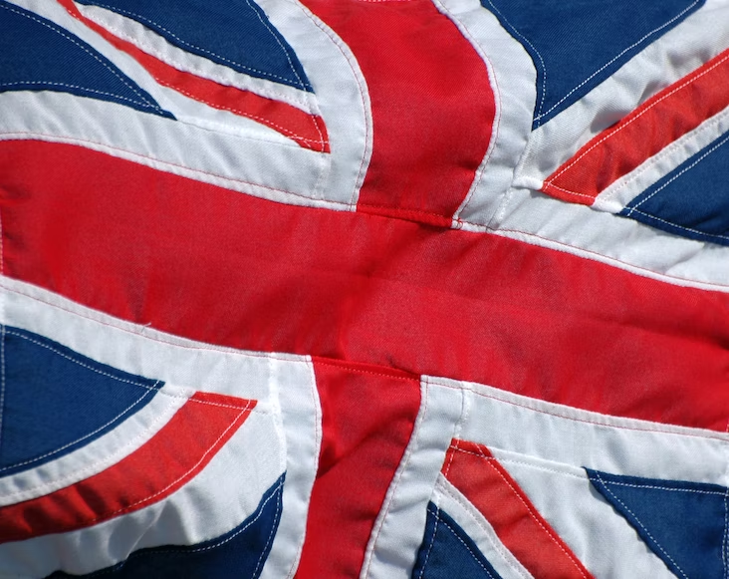
THANK YOU Any questions?
Land of Woke and Glory?: the conceptualisation and framing of 'wokeness' in UK media and public discourses.
David S. Smith
Adapted from Smith et al., (2024)

Slide 2
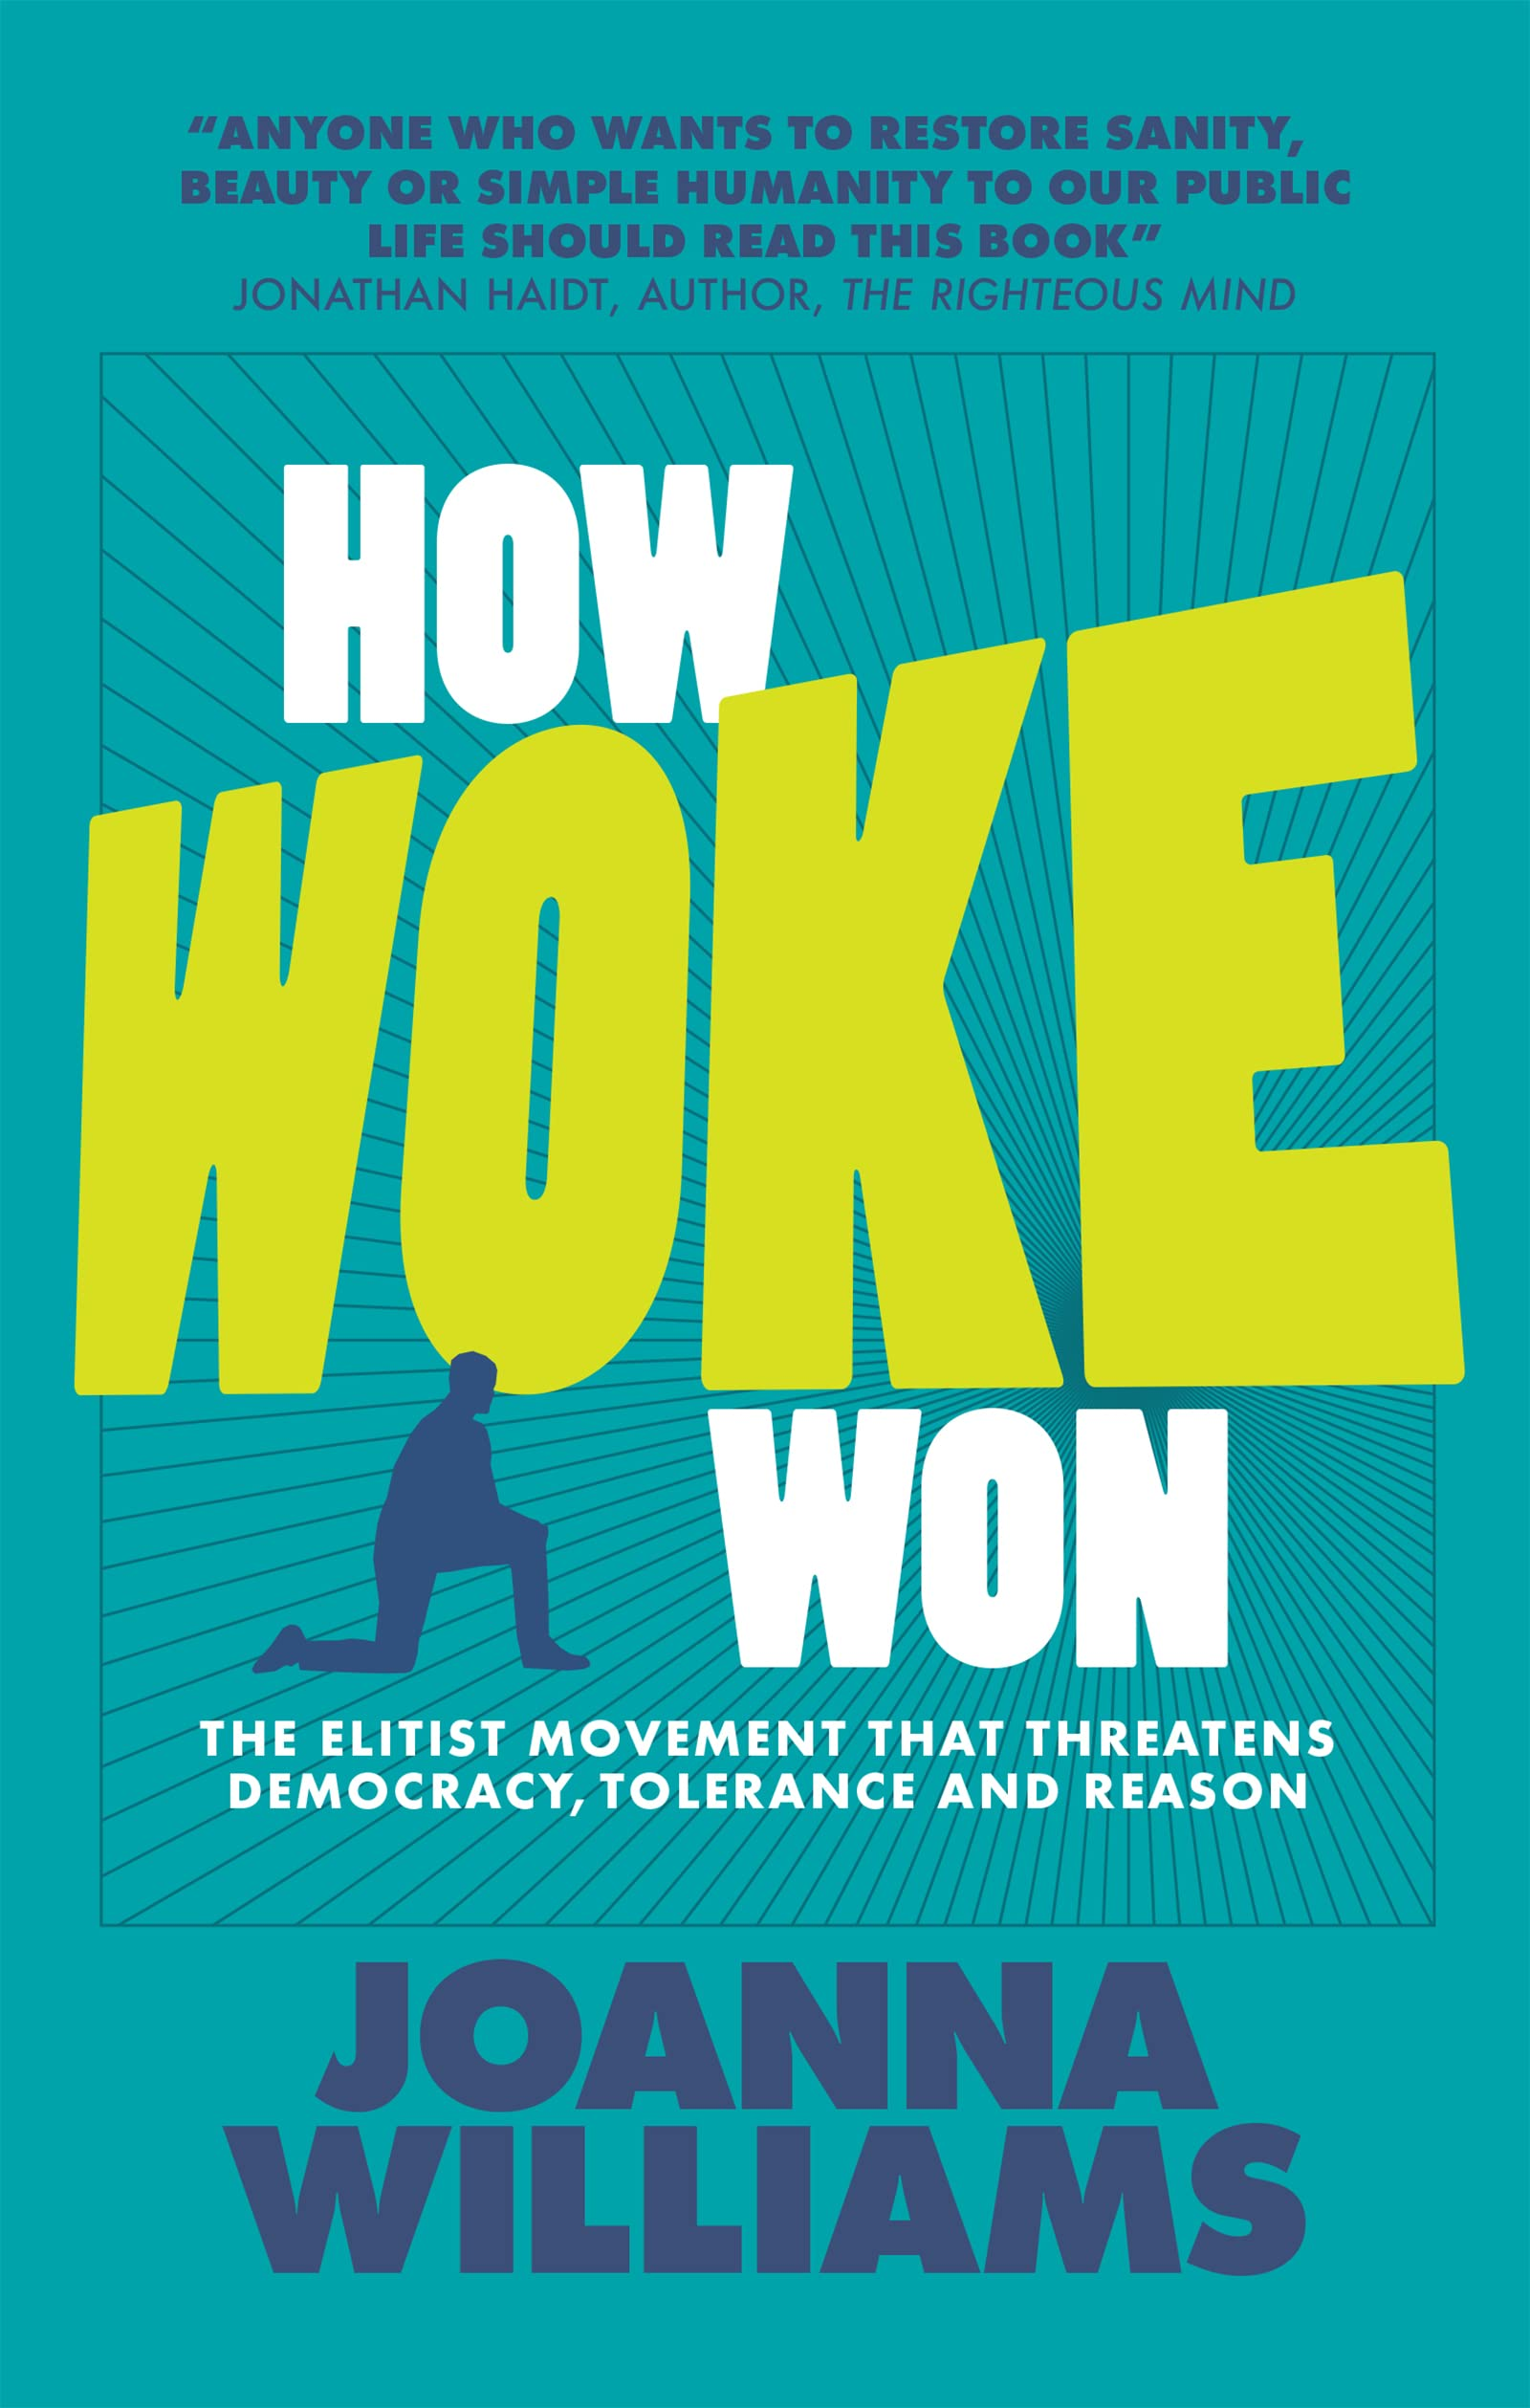
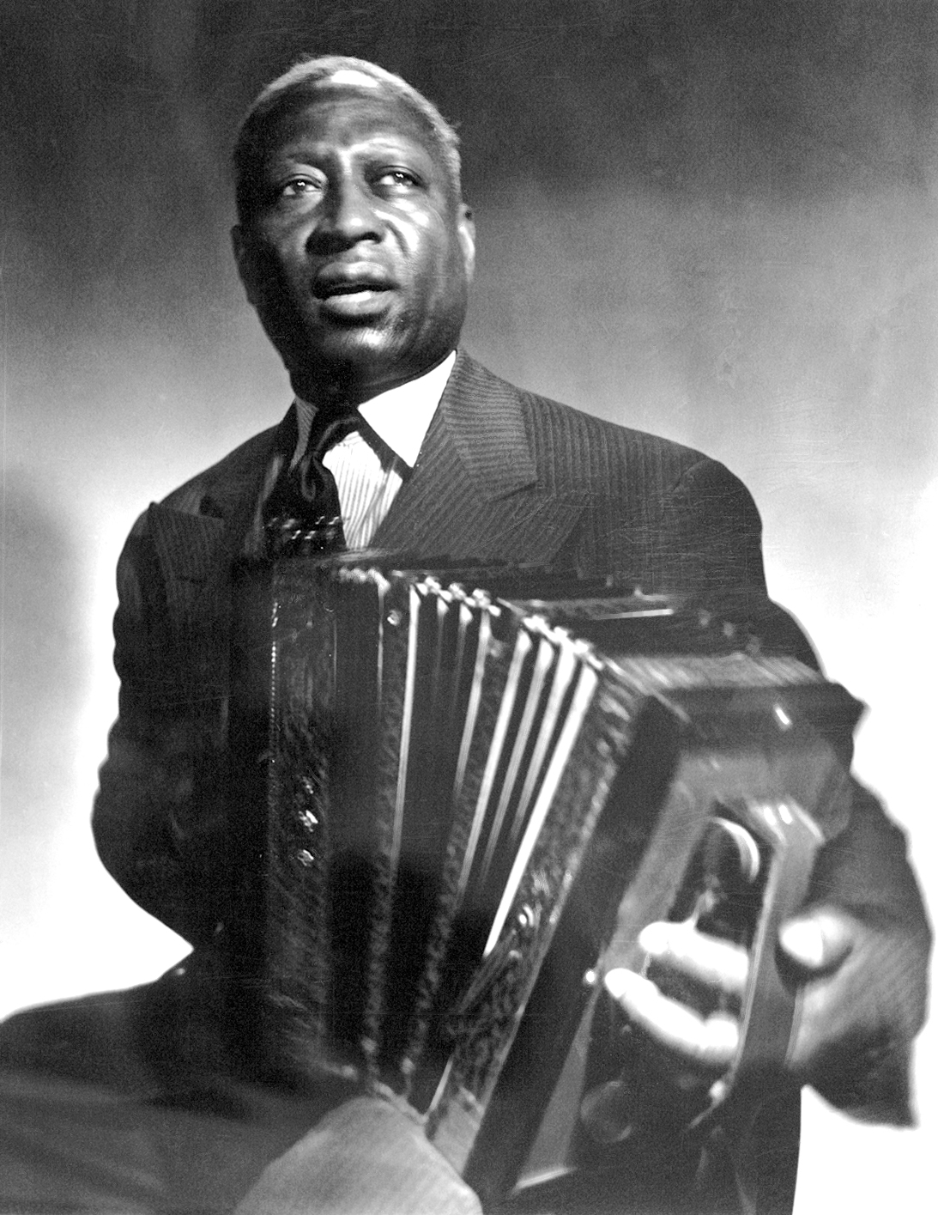
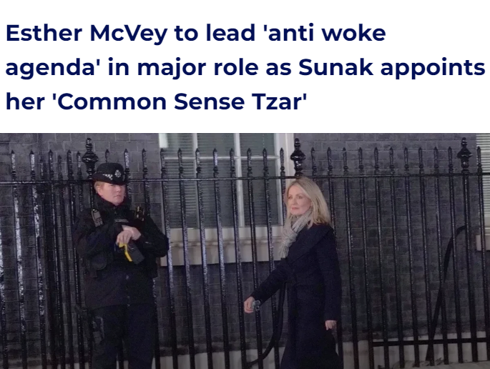
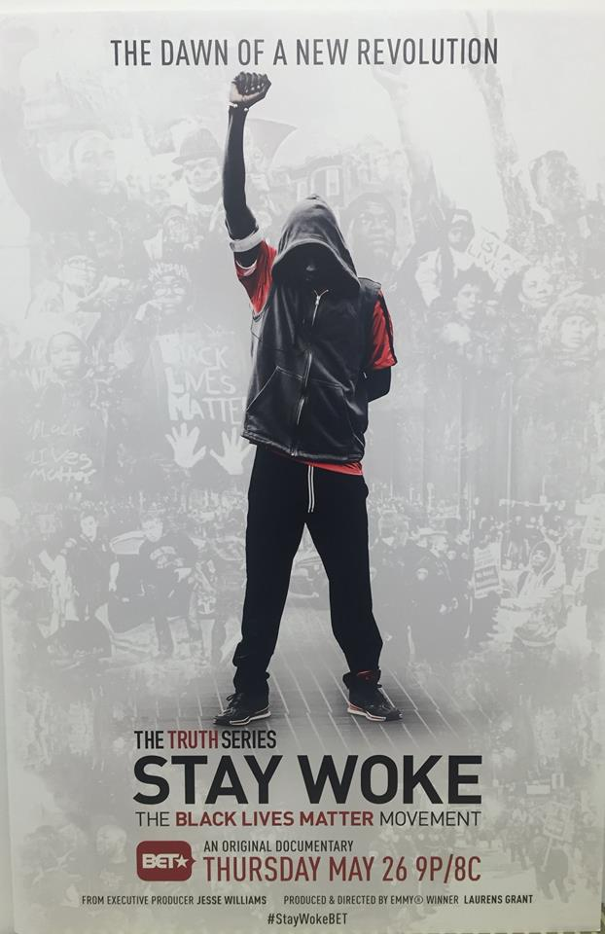
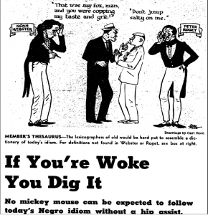
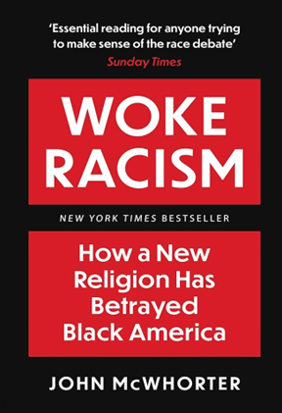
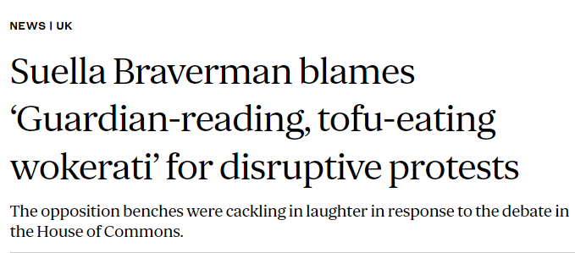
Wokeness then and now
Marcus Garvey (1923), Leadbelly (1938): William Melvin Kelley (1962)
2014: BLM slogan, following the murder of Michael Brown – “stay woke”
War on woke: “One of the biggest threats to modern civilisation” (Elon Musk, 2022)
Centre for Policy Studies (2021): the third most concerning belief, > homophobia
YouGov (2021) 12% UK identify as being woke; 60% do not know what it means
Notes:
Activist background: being socially conscious
Progressive causes including anti-racism, anti-colonialism, anti-fascism, anti-capitalism, anti-sexism, anti-ableism, environmentalism, feminism, gender inclusivity, and pro-LGBTQ + attitudes.
From dinosaurs and hobbits to academic freedom, attitudes to colonialism or gender identity

Slide 3
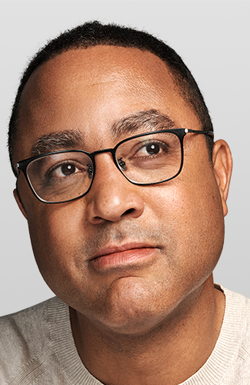
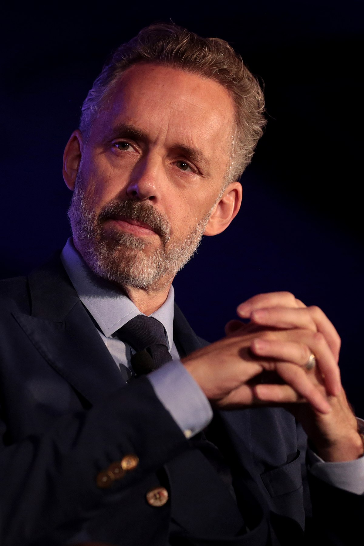
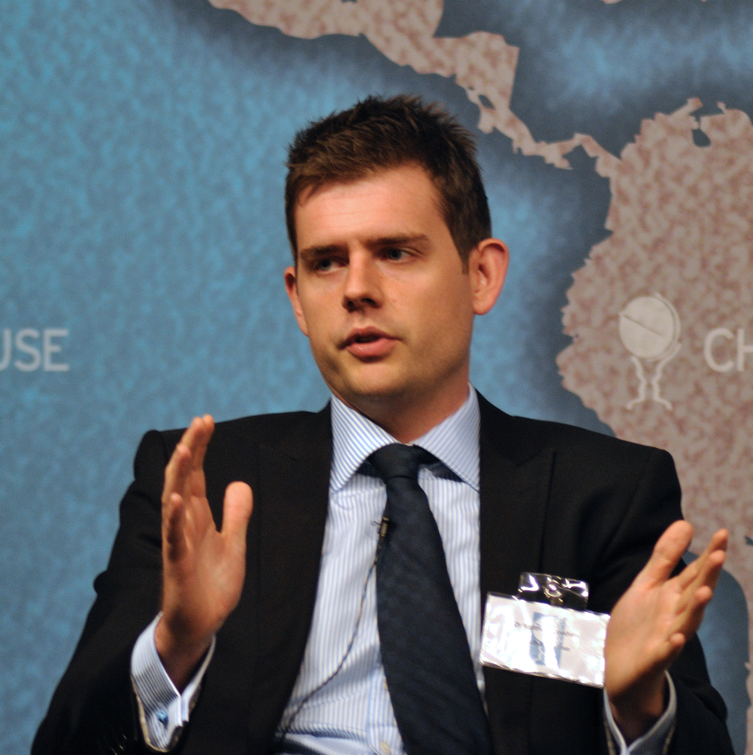
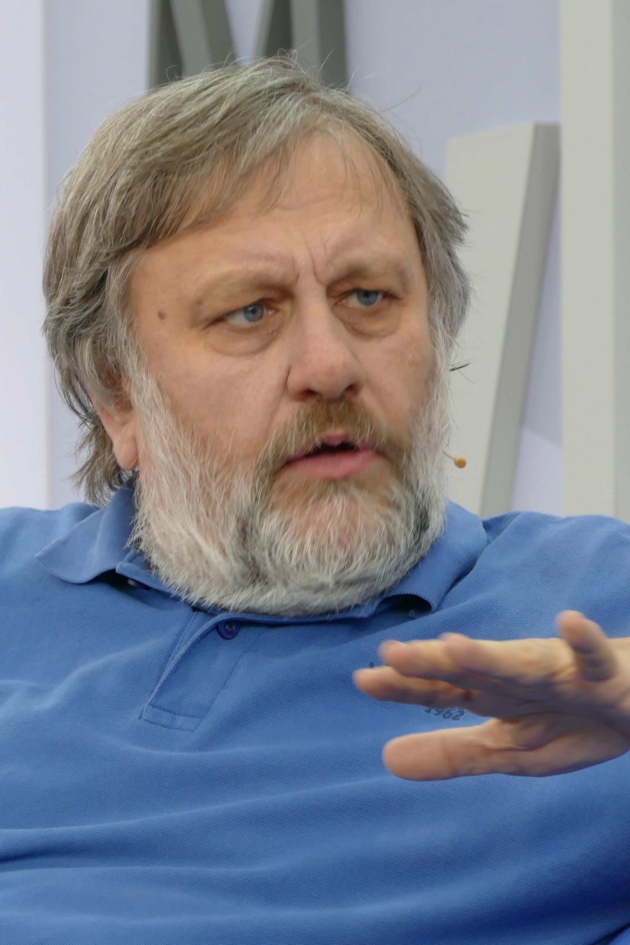
What is wokeness?
Current use
Positive
Crucial for pedagogy (Babulski, 2020)
Aspirational: not achieved (Whiteout, 2018)
Essential part of holding others to account despite the online discourse (Atkins, 2020)
Negative
Anti-racist religion (McWhorter, 2021)
Basking in work being complete (Boyce, 2019)
‘Madness’ taking over educational institutions (Peterson, 2021)
The new elite (Goodwin, 2023), e.g., Gary Lineker, Carol Vorderman
Perpetuated by privileged few elites for moral authority (Zizek, 2023)
Rhetorical style, upholds white power structures (Zavattaro & Bearfield, 2022)
Notes:
Positive: orientation to the world built upon prioritizing the experiences of marginalised groups
Negative: social scripts for the appearance of moral purity to oneself or others and influencing behaviour/thought
Not the same as political power – those with cultural influence – acknowledging cultural liberalism

Slide 4
The present study
Land of woke and glory?
How is wokeness conceptualised by the press and public?
Research questions
How is the concept produced? (press)
How is the concept reproduced? (social media)
How is the concept maintained? (general public)
Method
Press analysis: items using the term in May 2022
Social media analysis: subset from Twitter scrape in May 2022
Survey: open/closed questions, distributed to the general public
Triangulation
More holistic (Ayoub et al., 2014)
Increases probability findings are credible (Nowell et al., 2017)
Reduces overgeneralising, e.g., low trust in the press (Smith, 2023)
Analysis
Thematic analysis: salience vs frequency (Braun & Clarke, 2019)
Latent coding: insight beyond standard semantic groupings

Slide 5
Press analysis
Method
Lexis library ‘news’ articles
May 2022, search term: woke
Every tenth article download
Filter for relevance/duplicates
Sample
Final yield: 64 articles
From regional/national newspapers
Analysed for:
1. Specific term
2. Meaning ascribed to the term
3. General context of the article
Meaning of ‘woke’ in news articles
Summary of use
Used more by right-leaning press – derogatory label
Byword for left-wing: gender identity, environmental, anti-racism, cancel culture
Sometimes woke framed as anti-British, i.e., national identity = anti-woke
Notes:
Articles about systemic inequalities, such as racism, sexism and anti-LGBT attitudes/legislation, were written from the perspective that they were not real problems or that attempts to address them were illegitimate on account of them being woke.

Slide 6
Twitter analysis
Method
Data gathered via Python + two modules:
Snscrape: collects data from social media
Pandas: exports data to Excel for examination
Sample
May 2022 – search “woke” on Twitter
Separate samples for each week – approx. 50,000 PW
Randomised order of Tweets per week: cover range of topics
First 300 relevant used tweets used in analysis, i.e., 1200 total
Paraphrased: meaning and metaphor retained (Smith et al., 2022)
No Geotags: Twitter = international platform
Only allows miles from post-code
Cannot control who is a visitor
Summary of use
Very negative: 79% anti-woke (based on week 1)
Trolling: sincere and sarcastic use – easy to tell apart (Aspray, 2019)
Post-musk: increase in hate speech/decrease in moderation (Hickey et al., 2023)

Slide 7
Survey analysis
Findings
116 participants recruited via social media
Wokeness:
I am woke (M = 3.2, SD = 1.3)
I would openly identify as woke (M = 2.6, SD = 1.3)
I do not think my society is woke enough (M = 3.1, SD = 1.4)
Total (M = 8.9, SD = 3.6)
Anti-wokeness:
I am anti-woke (M = 2.1, SD = 1.2)
I would openly identify as anti-woke (M = 2, SD = 1.2)
I think my society has gotten too woke (M = 2.6, SD = 1.4)
Total (M = 6.8, SD = 3.6)
Patterns:
No significant gender or age diffs p > .05
More woke vs. anti-woke t(115) = 3.43, p < .001
Less likely to openly identify by label: both sides
Wokenss diff: t(115) = 6.40, p > .05
Anti-woke diff: t(115) = 3.02, P < .004 - sig
Identification with anti-woke < strong disagreement with woke: apathy?
Notes:
Sample more woke than anti-woke – a significant difference
Less likely to openly identify with the label on both sides vs identify in survey
Identification with anti-wokeness lower than strong disagreement with being woke: not the same

Slide 8
Characterising wokeness
Woke as a contrived or neutral trait
The anti-woke agenda
The corporate woke
Woke as a positive trait
The aware woke
“Awareness of the often-concealed structures of power in society and how they reinforce and maintain patriarchal white supremacy in Western cultures.” (Survey)
“I won’t EVER forgive white conservatives for stealing and bastardising the word.” (Twitter)
Global corporations who adorn their social media accounts in the west with LGBTQI + flags, but not in other parts of the world where it conflicts with their business model” (survey)
Woke washing (Vredenburg et al., 2020)
Disliked by woke & anti-woke alike: varied in perceived sincerity
Detachment between a company’s purpose/values/practices and messaging
Notes:
The aware woke: Social structures privilege some individuals over others and direct action Used most about trans issues: learning/respecting/stating pronouns – current frontier?
The anti-woke agenda: Label like political correctness = right-wing victimhood. Used to demean progressive movements and causes and distract from material conditions
The corporate woke: Cynical attempts to look good – ignores real issues, e.g., companies with bad treatment of staff and minorities

Slide 9
Characterising wokeness
Woke as a negative trait
The weak woke
The privileged woke
The woke agenda
The authoritarian woke
The religious woke
“A Marxist tool to destroy western culture, society, values and standards” (Survey)
“Having been taught words can be violence, it is unsurprising that students campaign to have statues torn down or speakers banned from campus.” (Sunday Express)
“Bleeding heart”
Can’t take a joke
“Privileged white people who profess to empathise with POC but don’t recognise the harm their policing of words/tone/opinion has.” (Survey)
Pushed by elite unis
No material analysis
“Walk the woke line or the SJWs will cancel you” (Twitter)
Parallels: McCarthyism/fascism
“Witch hunts, denunciation of heretics, and demands for penance” (Survey)
Woke institutions or groups
Activists, NGOs, LGBT+ communities, media, education (social sciences), social workers, young people, digital vs. real world, the establishment?
Notes:
The weak woke: fragile, need safe spaces
The privileged woke: Mitigate own privilege by calling out others/making self-victim
The woke agenda: Need rebels to fight it – JK Rowling, Elon Musk, Ricky Gervais, Dave Chapelle etc
The religious woke: Secular creed/doctrine – against reason/science, and followers do not question it. Devout: “Witch hunts, denunciation of heretics and demands for penance”
The authoritarian woke: Despises diversity of thought, controlling others’ behaviour via social penalties and shaming – cultural vs political power. Not legality.

Slide 10
Discussion
Conclusions
Contradictory: Feeble, privileged or elites?
Status quo a threat to status quo?
Awareness, compassion vs. weakness, puritanism
Power: Cultural insurgent vs. political/legal
Imprecise: pressures facing different communities stripped of nuance
May reflexively dismiss all “woke” topics, e.g., trans rights, homophobia, climate change
Intentionally shrinking debate to woke vs unwoke (Cammaerts, 2022)
Survey: Participants mostly identified as being woke – sampling bias?
Further research: Can woke vs. neutral framing impact support for policies?
‘Privilege’ drops white support for renaming (Quarles & Bozarth, 2022)
Is near unanimity of media the real threat to free speech?
Acknowledgments:
Lee Boag, Connor Keegan, Alice Butler-Warke
Notes:
By dismissing structural critiques as “woke,” activists are contextualised as part of an unpatriotic, authoritarian crusade launched by ideologues and the possible merits behind their claims are disregarded

Slide 11
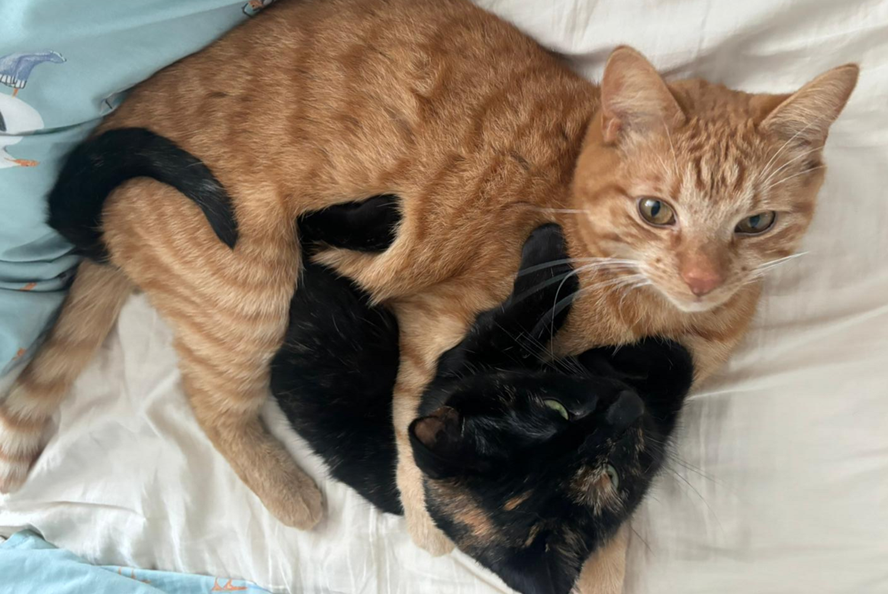
Any questions?

