Slide 1
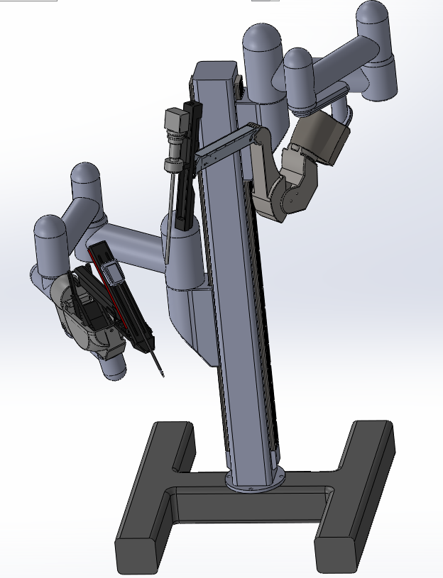
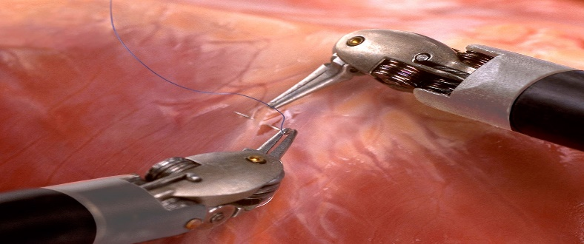
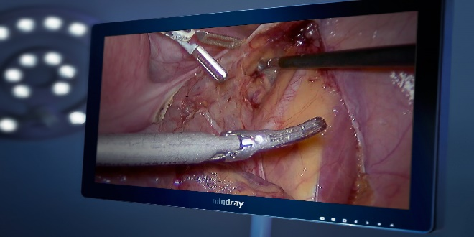
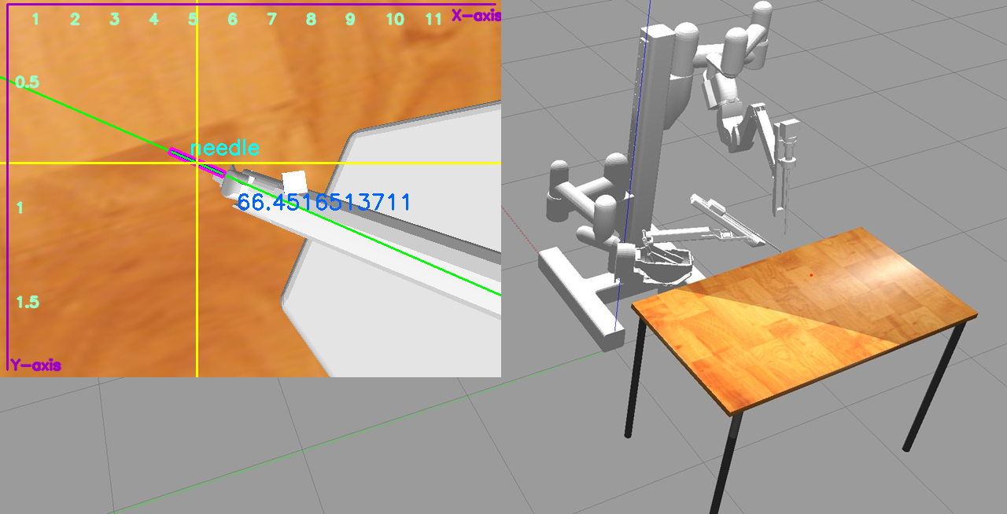
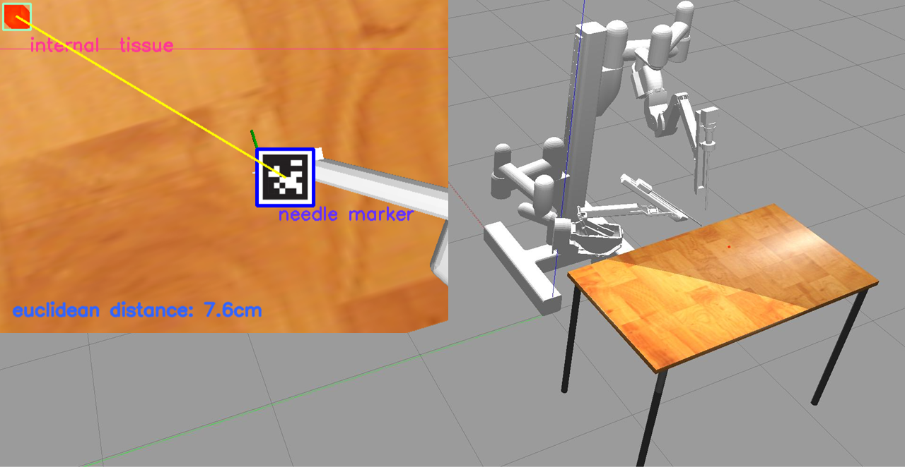
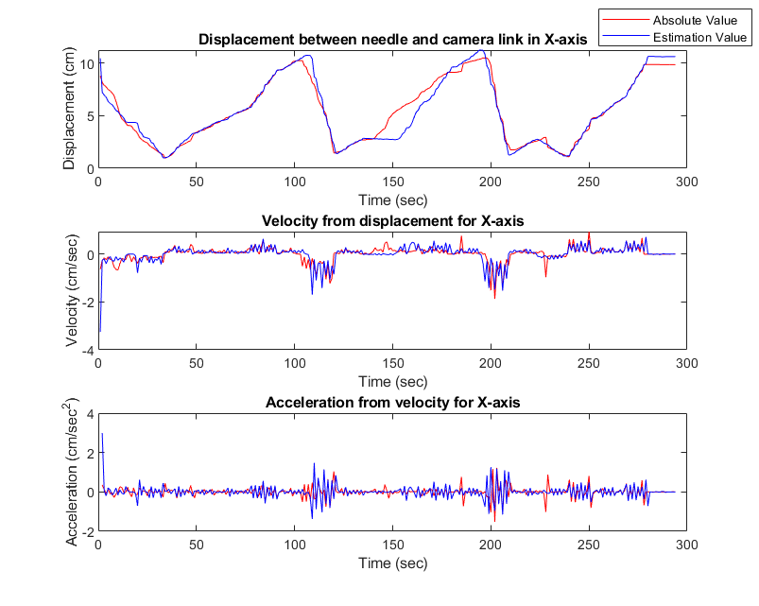
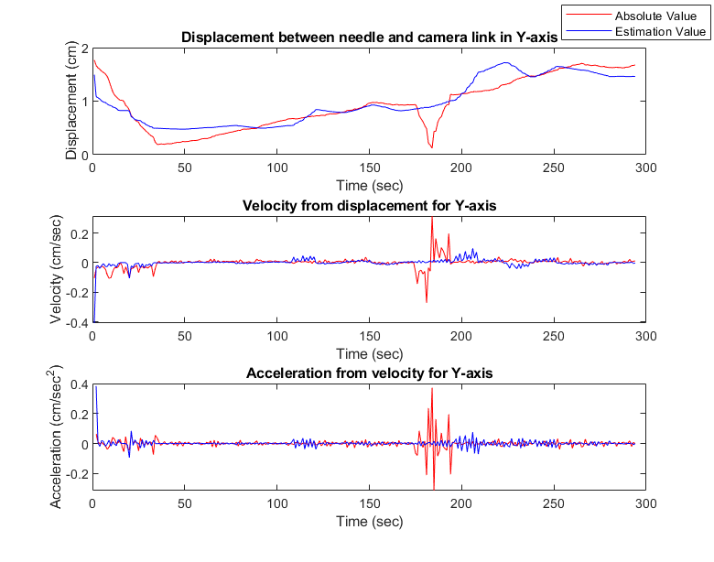
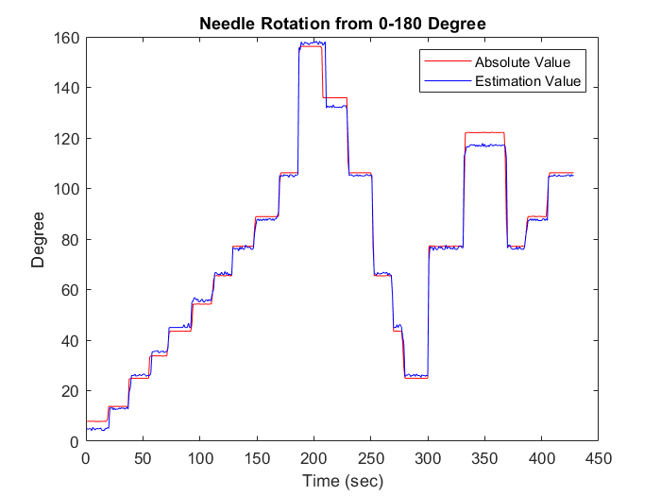
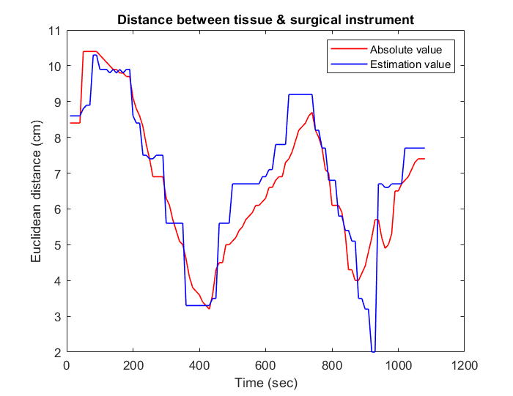
Tracking & estimation of surgical tool relative-pose and angle based on the vision system for surgical robot
Ramkumar Muthukrishnan, Somasundar Kannan, Yafan Zhao, Radhakrishna Prabhu
School of Engineering, Robert Gordon University, Aberdeen, AB10 7GJ, UK
(r.muthukrishnan@rgu.ac.uk; s.kannan1@rgu.ac.uk; y.zhao@rgu.ac.uk; r.prabhu@rgu.ac.uk)
Vision
Mission
This research presents a Virtual Dynamic Tri-crossbar and a Virtual Stable Graph (VDT-VSG) which simplifies the task of tracing the needle angle and location in 2D plane.
In addition, Virtual Dynamic Line (VDL), helps to quantify the displacement between organ and surgical needle.
The significant objectives of this research are to achieve,
Surgical tool detection
Tool Tracking
Tool observation
Distance, velocity, acceleration and angle estimation with respect to time in seconds
Customized Surgical Robot
Algorithm Flowchart
Problem Statement
Scene Processing
RGB-HSV conversion
Binary conversion
Obtain tool location coordinates
Develop & overlay VM
Frame conversion
Binary threshold
Get VM location coordinates
Develop VDT-VSG with VDL
There are several issues exist in this Robot-Assisted-Surgery (RAS) realm, especially:
Tedious to detect & tract micro range surgical tool
Challenging to work in different illumination condition
Limited field of perspective
Complex eye-hand coordination
Mild tremor during surgery
Ambiguous view
Rigorous to perform for prolonged time
Restricted tool manipulation, etc.
Stitching Operation [1]
View from Endoscopic Camera [2]
Simulation
Robot Operating System (ROS) was utilized as middleware to process & obtain data from Gazebo simulation platform.
Tracking and estimating the location and angle of surgical needle
Detecting and estimating the relative displacement between organ and surgical needle
Results
Differentiation
s”(t) = v’(t) = a (t); S= Displacement, RSP = cos−1 ∗ (DP) = Radian
v = ds/dt; v=Velocity, RSP = rollSP ∗ ((180)/ π) = Degree
a = dv/dt; a=Acceleration, edisp(SP ) = $\sqrt{X^{2}\text{+}Y^{2}}$ ,
a = 𝑑^2s/d𝑡^2 t=Time
Tracking in cell and development biology
Autonomous/semi-autonomous surgical robots
Sensing in surgical operations using vision.
Applications
References
https://www.google.co.in/url?sa=i&url=https%3A%2F%2Frobots.ieee.org%2Frobots%2Fdavinci%2F&psig=AOvVaw0zu4W-rGXZtlEZCOva1yT3&ust=1670105968654000&source=images&cd=vfe&ved=0CBAQjhxqFwoTCIjbs8792_sCFQAAAAAdAAAAABAJ
https://www.google.co.in/url?sa=i&url=http%3A%2F%2Fmindrayendoscopy.com%2F&psig=AOvVaw2qzyMR_fvE7cxD_9VRkEHY&ust=1670106620088000&source=images&cd=vfe&ved=0CBAQjhxqFwoTCIjruJD-2_sCFQAAAAAdAAAAABAJ

