Slide 1

Embedding academic study skills within a module to support student achievement and sustained engagement with assessment
Dr Katherine Burgess
Robert Gordon University, Aberdeen.

Slide 2

Background
The number of students entering Higher Education who possess inadequate study skills is rising (Groves, Bowd and Smith 2010)
Support with study skills has been traditionally provided by ‘Study Skills Centres’ within universities (Haggis and Pouget 2002)
Dunkin and Main (2002) have shown that embedding study skills support withing courses enhances students’ engagement with the support.
The aim of this study was to investigate the impact of embedding academic study skills within a module to support student achievement and sustained engagement with assessment.
Notes:
As the diversity and number of the student population entering higher education are increasing worldwide, it is observed that the number of students who possess inadequate study skills is also rising (Groves, Bowd and Smith 2010). Support with study skills has been traditionally provided by ‘Study Skills Centres’ within universities which provide courses and individual support to help students study and become independent learners (Haggis and Pouget 2002). This tradition of bolt on courses is apparent as Wingate (2006) showed through a search of university websites that 90% of universities offered such courses through support departments. Studies have shown that student engagement with such services is low, and often only the higher achieving students engage with these learning opportunities (Dunkin and Main 2002). An alternative approach is embedding/integrating study skills within a degree course itself. Dunkin and Main (2002) showed that by embedding study skills sessions within a degree programme attendance increased from 0% the optional bolt on sessions to 80% when sessions were embedded. The aim of this study was to investigate the impact of embedding academic study skills within a module to support student achievement and sustained engagement with assessment

Slide 3
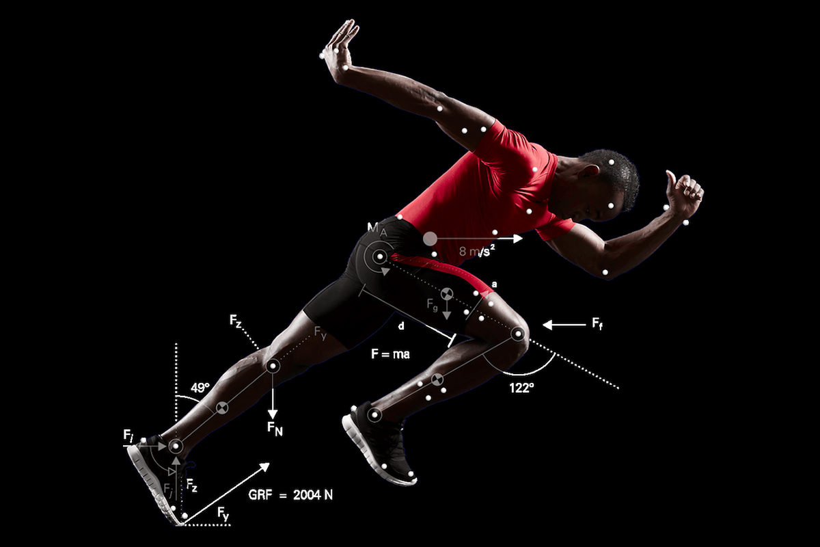

Methods – The case study
The module ‘Human Movement and Skill Acquisition’ SCQF Level 8 – 15 Credits
Data was collected over two consecutive academic sessions (2022-23 and 2023-24)
The topic specific content, delivery and assessment (both formative and summative) remained unchanged.
Notes:
The module is part of the BSc(Hons) Applied Sport and Exercise Science degree, this module is undertaken in semester one of stage 2 of the 4 year programme.
The teaching runs for 11weeks followed by submission of assessment
The level one achievement profiles between the cohorts were similar
Mention N numbers for cohorts
Blended learning content delivery: with online resources which supported in person tutorials, practical’s and analysis(IT) workshops
Assessment was a written coursework
2 formative assessment opportunities:
The 1st took place in week 4 – in the form of a group presentation- they delivered this in front of the class and received feedback on presentation skills from their peers and academic content from the lecturer.
The second took place in week 6 – in the form of a draft of one written section of their coursework assessment – students received individualised written feedback/feedforward (comments function in word) 10 days later.
I inherited a module with traditionally low achievement – biomechanics can be a weak sport for sports science students – but during the 1st one identified achievement might be related to general academic skills as well as the topic.

Slide 4




Methods – The Intervention
In 2023-24 students were given additional integrated academic study skills teaching
  Searching for literature,
  How to read journal articles,
  Academic writing,
  Identifying key ingredients in an academic method,
  Microsoft Excel skills.

Slide 5

Methods – The outcome measures
The following data was collected:
Module attendance,
Student engagement with Moodle (the University’s virtual learning environment),
Engagement with formative assessment opportunities,
Student feedback (via online questionnaire)
Student attainment.
Notes:
Attendance – Attendr (university app)
Moodle Engagement – number of clicks
Formative assessments – did they present, did they submit a draft
Student feedback – both years – their perception of their engagement in the previous 3 areas, there perceived engagement with and helpfulness of the assessment support resources/sessions provided within the module, - For 23/24 how helpful they found the specific embedded skills sessions.

Slide 6
Results - Attendance
Attendr
2022/23 Mean Attendance % = 92.0±7.1
2023/24 Mean Attendance % = 91.4±11.9
No significant difference in attendance percentage between years (P>0.05)
No association between perceived attendance and year of attendance (P>0.05)
Figure 1: Students’ perceptions of their levels of attendance
Notes:
So attendance isn’t a factor

Slide 7
Results – Moodle Engagement
No association between perceived engagement and year of attendance (P>0.05) – See figure 2.
Figure 2: Students’ perceptions of their engagement with Moodle

Slide 8
Results – Moodle Engagement
Figure 3: Students’ Moodle interactions categorised by summative grade achieved
Notes:
Moodle engagement doesn’t appear to be affected – but it does seem to have a bearing on grade or pass/fail.

Slide 9
Results – Engagement with formative assessment
Figure 4: Students’ engagement with formative assessment
Notes:
Student engagement in formative assessments in 23/24 enhanced - especially 1st opportunity

Slide 10
Results – Student feedback
Table 1: Students’ engagement with assessment support resources and perception of helpfulness
Notes:
although engagement with assessment support was similar in each year. In 23/24 the found them more helpful

Slide 11
Results – Student feedback
Figure 6: Students’ report of how well they stuck to the week-by-week assessment guide
Figure 5: Students’ account of when they began working on the assessment
Notes:
Students in 23/24 started working on their assessments earlier P<0.05
when conducting a chi squared test of association there is an association between when students began their assessment and year of assessment
Students potentially stuck more to the week-by-week schedule (although not statistically significant)

Slide 12
Results – Student feedback
Figure 7: Students’ view of the helpfulness of the additional embedded academic skills support

Slide 13
Results – Student Attainment
Figure 8: Student attainment for both academic sessions
Notes:
The students grade profile was improved in 23/24 (supported by inferential stats)
when conducting a chi squared test of association there is an association between grade obtained and year of assessment
Pass rate rose from 50% to 95%
% A&B rose from 17% to 38%

Slide 14

Summary
The aim of this study was to investigate the impact of embedding academic study skills within a module to support student achievement and sustained engagement with assessment
Following embedding academic study skills, the following results were evident:
  Module attendance and engagement with Moodle were similar
  Enhanced attainment (45% rise in pass rate and 21% rise in % A&B Grades)
  Students started assessment earlier & engaged more with the week-by-week assessment guide
  Students found the existing assessment support more helpful
  Students showed greater engagement with formative assessment

Slide 15
References
Durkin, K. and Main, A. (2002) ‘Discipline-based study skills support for first-year undergraduate students’, Active Learning in Higher Education, 3(1), pp. 24–39.
Groves, M., Bowd, B. and Smith, J. (2010) ‘Facilitating experiential learning of study skills in sports students’, Journal of Further and Higher Education, 34(1), pp. 11–22.
Haggis, T. and Pouget, M. (2002) ‘Trying to be Motivated: perspectives on learning from younger students accessing higher education’, Teaching in Higher Education, 7(3), pp. 323-336.

Slide 16

Questions

