Slide 1


Decarbonising Heating and Fuel Poverty in the UK: Causes, Policy Implications, and Next Steps
Dr. Anita Singh
Prof. Peter Strachan
Aberdeen Business School
Robert Gordon University

Slide 2
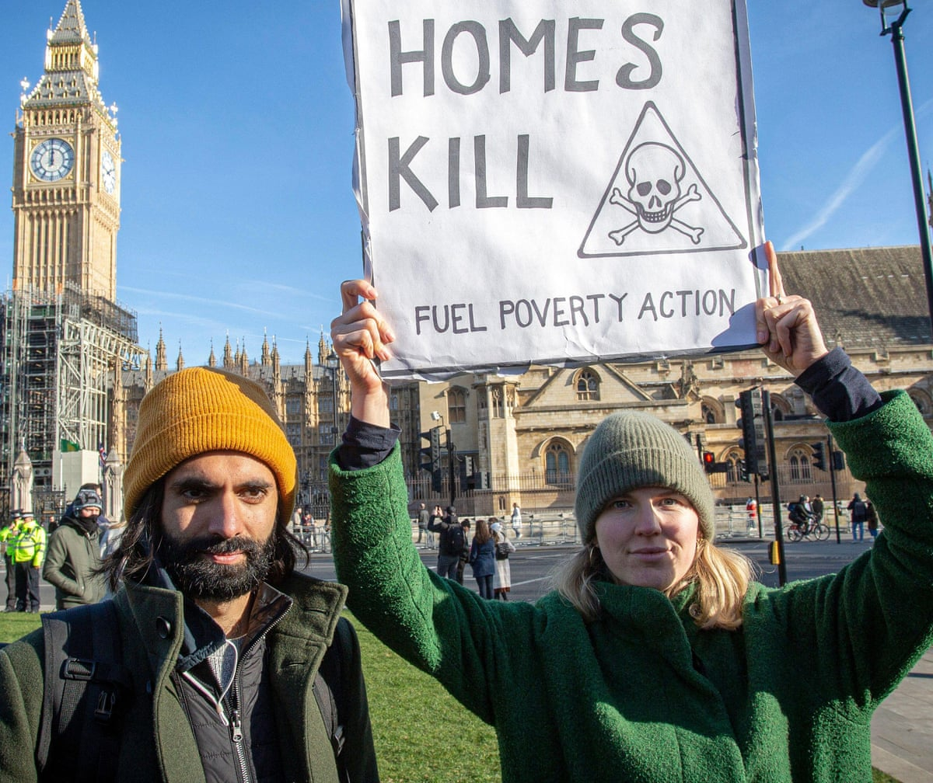
Introduction
Fuel poverty occurs when a household cannot afford to adequately heat their home or meet basic energy requirements.
National Energy Action’s figures for April 2024, show 6 million UK households are in fuel poverty.
Fuel poverty problem needs to be addressed along with decarbonisation of heating and achieving the net zero target.

Slide 3

Aim & Objectives of the Research
This study aims to identify the main causes of fuel poverty and critically analyse the impact of policy measures taken by the UK government, with a view to provide alternative green approaches to combat the crisis. The objective of the research is to:
Evaluate the main causes and impact of fuel poverty within the UK by drawing parameters from various definitions.
Analyse the impact of government policy on the fuel poverty.
Identify the renewable energy options.
Recommend policy measures.

Slide 4

Fuel Poverty Definitions
Inability to afford adequate warmth at home (Bradshaw and Hutton 1983)
Energy expenditure exceeding 10% of the household income (Boardman 1991) Northern Island and Wales
Fuel poverty in the England is now measured using the Low Income Low Energy Efficiency (LILEE) indicator. Under this indicator, a household is considered to be fuel poor if:
  they are living in a property with a fuel poverty energy efficiency rating of band D or below
  and
  when they spend the required amount to heat their home, they are left with a residual income below the official poverty line.
Notes:
Boardman (1991) developed the concept, using the focus on disproportionate energy expenditure by low income households as the basis for defining 10% EP; this was based on findings (from the 1988 UK Food and Expenditure Survey) that the 30% of households with the lowest incomes devoted on average 10% of their income to energy, about twice the median proportion for the population as a whole.

Slide 5
Existing Studies on Fuel Poverty
Fuel poverty and energy poverty have been used interchangeably. (Deller Turner & Price 2021; Li et at 2014)
Several studies have been conducted to analyse the definition of fuel poverty (Thomson & Snell 2012, Hill 2012).
Drivers of fuel poverty analysed in the literature (Thomson & Snell 2012, Fillipidou et al 2018, Bouzarouski et al 2018).
Impact of fuel poverty on the health and wellbeing of individuals especially vulnerable groups studied (Awaworyi & Smyth, 2020; Llorca et al. 2020; Wang et al 2022).
The government policy and interventions have been critically analysed (Matiolli et al 2018).
In addition to managing the fuel poverty issues, decarbonising heating is also an additional challenge that the UK policy makers. Several studies have evaluated the renewable energy options available (Chaudry et al., 2015; Risinggård et al., 2023)

Slide 6
Gap in the Literature and Contribution
Most of the existing literature focuses on the association of fuel poverty with a limited number of parameters and lacks a robust multi variable analysis.
Causes of fuel poverty and its impacts are linked to each other such that if a variable A impacts a variable B (A->B) and B affects C (B->C), it is possible that A may have an influence on C (A->C) or vice versa. It is therefore important to study the causes and effects in a single model.
While most studies have used cross-sectional data for analysis this research is based on representative panel data for 13 years, focusing on the objective and quantifiable subjective measures of fuel poverty, using Structured Equation Model.
The findings from SEM analysis are then evaluated to consider the options of resolving the fuel poverty issues along with reducing GHG emissions.
Most recent definition of Fuel Poverty has been used.

Slide 7
Research Methodology
Philosophy
Approach
Methodology
Data
Time Horizon
Analysis
Systematic Equation Modelling
And Regression Analysis
Published (Secondary Sources)
Panel Data 2011-2020
Positivism
Deductive
Quantitative

Slide 8
Methodology
Partial Least Squares (PLS) Structural Equation Modelling (SEM) used for building the theory.
Secondary data from various sources have been analysed.
Data set for 13 years (2010-2022) used for analysis to accommodate comparable renewable energy data.
SEM helps in modelling causal networks of effects simultaneously—rather than in a piecemeal manner.
SEM can model multiple independent variables (IV) and multiple dependent variables (DV), chains of causal effects and indirect effects, and the latent constructs that variables are meant to measure.
Notes:
One of the prime advantages of SEM is the ability to include latent (unobserved) variables in causal models. Thus, the researcher may model abstract constructs comprised of many indicators (observed variables), each of which is a reflection or a dimension of the latent construct. Another key advantage of SEM is that it enables the researcher to estimate complete causal networks simultaneously. For example, the effect of can be estimated while also estimating the effects of and , as well as the indirect effect of A on C through B. In addition, these effects can all be estimated across multiple groups

Slide 9
The Theoretical Model
Natural gas imports , Inflation
Cause1
Oil price, Gas price
Cause2
Cause 3
Household expenditure
Fuel Poverty
Cause 4
Winter fuel payments, Environmental taxation
Impact
Number of disconnections for nonpayment electricity and gas , excess winter deaths

Slide 10

Theoretical model Proposed
x₁ | Total Environmental tax (ET)
x₂ | Net Gas Imports (NGI)
x₃ | Total Household Expenditure (THE)
x₄ | Oil Price (OP)
x₅ | Gas Price (GP)
x₆ | Winter fuel payments (WFP)
x₇ | Inflation (IFL)
z₁ | Electricity disconnections (NDE)
z₂ | Gas disconnections (NDG)
z₃ | Excess winter deaths (EWD)
$$M1−NFP=f\left(x1,,x2,x3,x4,x5,x6,x7\right)$$
$$M2−NFP ⋯(z1,z2,z3)$$
Therefore
$$\left(x1,,x2,x3,x4,x5,x6,x7\right)⋯(z1,z2,z3)$$

Slide 11
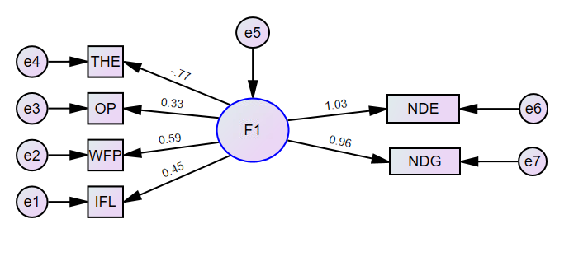
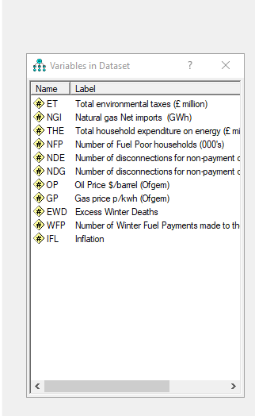
Structural Equation Model for Fuel Poverty
Notes:
The above analysis demonstrates that the impact of THE and WFP is high though THE has a negative loading factor. This could be attributed to the relation of Household Income to the expenditure. Studies have demonstrated that the household expenditure or income have a direct impact on the fuel poverty (Moore 2012; Siksnelyte-Butkiene et al, 2021). Winter Fuel Payment has a positive impact. Oil Prices and Inflation have a low loading factor but do impact fuel poverty. The influence of fuel poverty is highest on the gas and electricity disconnections as observed in the regression analysis also.

Slide 12
Results
Total household expenditure of energy has strong & significant relationship with FP and regression weight of -0.8
FP is strongly influenced by total environmental tax with regression weight of 0.5, result is statistically significant
Winter Fuel Payment also has a strong and significant impact on FP
FP has a direct bearing on electricity and gas disconnections due to non-payment.
Though FP impact Extra Winter Deaths results are not statistically significant

Slide 13


Interpretation of Results
Household Expenditure
Winter Fuel Payments
Oil Prices
Inflation
Disconnection of Gas and Electricity
High
Env Tax
Gas Price
Excess Winter Deaths

Slide 14

Solving Fuel Poverty in a Green Way
There is a drive to move to low carbon energy vectors like electricity, hydrogen and district heating that does not generate CO2 at the source.
In order to meet the target of reducing GHG emissions from buildings to near zero by 2050 there is a need for wholistic strategy.
The policy needs to address the issues of the cost of energy heating technologies and incentives for use of renewable energy
A post hoc regression analysis conducted to evaluate the impact of use of green energy on Fuel Poverty in the UK.

Slide 15
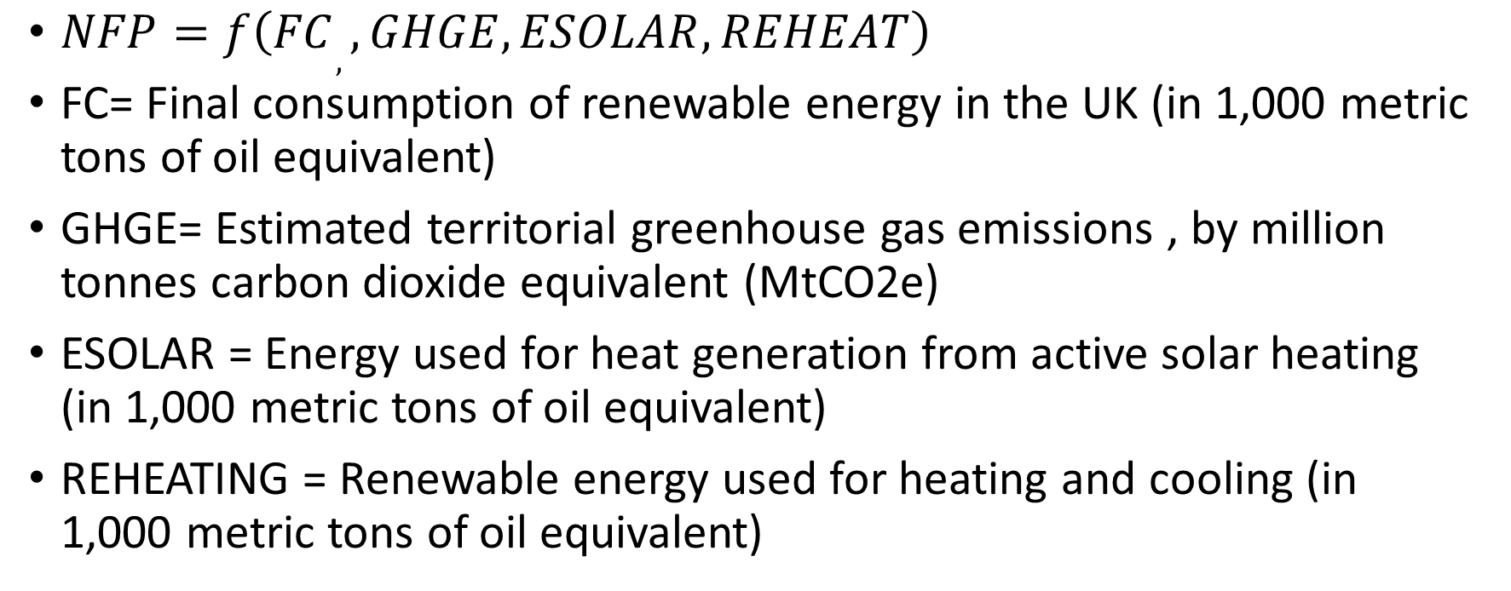
Regression Analysis
$NFP=f\left(FC,,GHGE,ESOLAR,REHEAT\right)$
FC= Final consumption of renewable energy in the UK (in 1,000 metric tons of oil equivalent)
GHGE= Estimated territorial greenhouse gas emissions , by million tonnes carbon dioxide equivalent (MtCO2e)
ESOLAR = Energy used for heat generation from active solar heating (in 1,000 metric tons of oil equivalent)
REHEATING = Renewable energy used for heating and cooling (in 1,000 metric tons of oil equivalent)

Slide 16
Regression Results
 |  | NFP | FC | GHGE | ESOLAR | REHEATING
Pearson Correlation | NFP | 1 | -0.97 | 0.735 | -0.871 | -0.882
 | FC | -0.97 | 1 | -0.691 | 0.778 | 0.869
 | GHGE | 0.735 | -0.691 | 1 | -0.843 | -0.552
 | ESOLAR | -0.871 | 0.778 | -0.843 | 1 | 0.717
 | REHEATING | -0.882 | 0.869 | -0.552 | 0.717 | 1

Slide 17
Significance (Model Summary)
Model | R | R Square | Adjusted R Square | Std. Error of the Estimate | Change Statistics
 |  |  |  |  | R Square Change | F Change | df1 | df2 | Sig. F Change
 | .989a | 0.979 | 0.965 | 103.722 | 0.979 | 68.928 | 4 | 6 | <.001
a Predictors: (Constant), REHEATING, GHGE, ESOLAR, FC

Slide 18
Model Summary
 | Unstandardized Coefficients |  | Standardized Coefficients | t | Sig.
 | B | Std. Error | Beta
(Constant) | 7315.354 | 1239.647 |  | 5.901 | 0.001
FC | -0.085 | 0.018 | -0.673 | -4.775 | 0.003
GHGE | -4.842 | 9.264 | -0.061 | -0.523 | 0.62
ESOLAR | -55.697 | 22.476 | -0.334 | -2.478 | 0.048
REHEATING | -0.085 | 0.119 | -0.091 | -0.711 | 0.504

Slide 19
Post Hoc Regression Results
Use of Renewable energy for heating has a positive impact.
Use of Solar Energy for heating has significant impact.
Use of Renewable energy has an impact on GHG.
Consumption of renewable energy has a significant impact.

Slide 20
Result as compared to policy
The UK government is aiming to combat the fuel poverty crisis by improving household incomes. As per this study, that is a step in the right direction.
The government also seeks to improve the energy efficiency by improving the efficient housing stock. This has not come out as a significant variable.
Government is also implementing programmes such as the Winter Fuel Payment to help vulnerable customers. This study demonstrates that Winter fuel payment is counterproductive as some of existing studies have also concluded.
UK Government’s Energy Company Obligations including environmental taxation which does not have a significant impact on fuel poverty.
The government needs to control inflation which has a significant bearing on the fuel poverty. Oil prices affect fuel poverty but are driven by international market. Government needs to focus on alternative energy sources to reduce the dependence on oil because of the lack of control on the oil price.
Notes:
Winter fuel payment policy needs to be revaluated to ensure that it reaches the most vulnerable and low-income households and not just the targeted old aged population. Such payments can also lead to complacency amongst the population and people may be dissuaded to increase their household incomes to be eligible for such payments.
UK Government has introduced Energy Company Obligations including environmental taxation which does not have a significant impact on fuel poverty primarily because of the regressive nature of these taxes, which are passed on to the consumer bills as demonstrated in several studies.

Slide 21
References
BOARDMAN, B., 1991. Fuel Poverty: From Cold Homes to Affordable Warmth. Belhaven Press.
BOUZAROVSKI, S., 2018. Energy Poverty. Cham: Springer International Publishing.
BRADSHAW, J. and HUTTON, S., 1983. Social policy options and fuel poverty. Journal of Economic Psychology, 3(3–4), pp. 249–266.
CRERAR, P., 2022. Two-thirds of UK families could be in fuel poverty by January, research finds. The Guardian Labs. Available from: https://www.theguardian.com/society/2022/aug/17/two-thirds-of-uk-families-could-be-in-fuel-poverty-by-january-research-finds [Accessed 23 Oct 2022].
DELLER, D., TURNER, G. and PRICE, C.W., 2021. Fuel Poverty: Potentially Inconsistent Indicators and Where Next? Available from: https://ssrn.com/abstract=3706321.
FILIPPIDOU, F. et al., 2019. Mapping energy poverty in the EU: policies, metrics and data.
FILIPPIDOU, F., NIEBOER, N. and VISSCHER, H., 2018. Effectiveness of energy renovations: a reassessment based on actual consumption savings. Energy Efficiency, 12(1), pp. 19–35.

Slide 22
References
HILL, J., 2012. Independent Review Projects Fuel Poverty to Worsen and Calls for Reinvigorated Strategy. Available from: www.decc.gov.uk/hillsfuelpovertyreview.
MATTIOLI, G., WADUD, Z. and LUCAS, K., 2018. Vulnerability to fuel price increases in the UK: A household level analysis. Transportation Research Part A: Policy and Practice, 113, pp. 227–242.
Li, K., LLOYD, B., LIANG, X.J. and WEI, Y.M., 2014. Energy poor or fuel poor: What are the differences?. Energy Policy, 68, pp.476-481.
PYE, S. et al., 2016. Addressing Energy Poverty and Vulnerable Consumers in the Energy Sector Across the EU. L’Europe En Formation, n° 378(4), pp. 64–89.
THOMSON, H. and SNELL, C., 2013. Quantifying the prevalence of fuel poverty across the European Union. Energy Policy, 52, pp. 563–572.
THOMSON, H., SNELL, C. and LIDDELL, C., 2016. Fuel poverty in the European Union: a concept in need of definition? People Place and Policy Online, 10(1), pp. 5–24.
WANG, C., WANG, J. and NORBÄCK, D., 2022. A Systematic Review of Associations between Energy Use, Fuel Poverty, Energy Efficiency Improvements and Health. International Journal of Environmental Research and Public Health.

