Slide 1
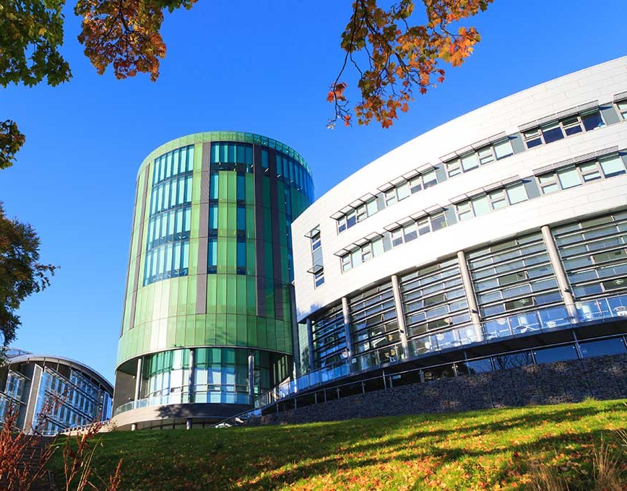
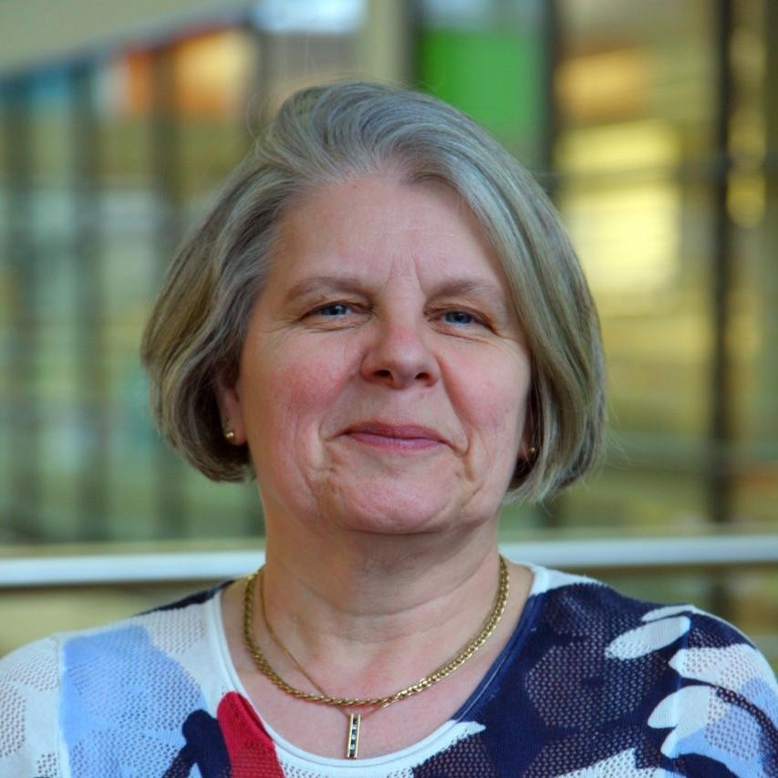
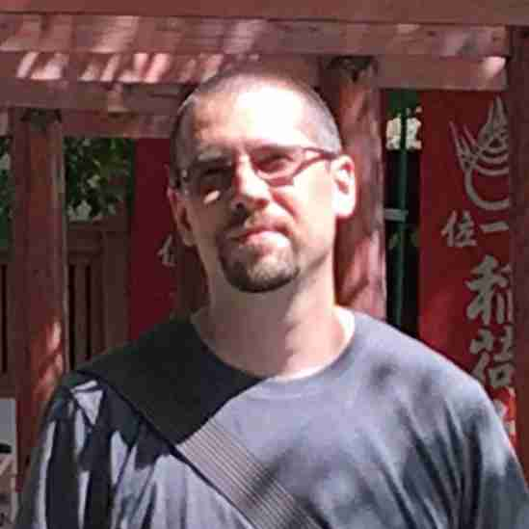
Dr Pauline A M Bremner Associate Professor
Dr Elliot Pirie Associate Dean

Slide 2
What is the RGU Innovation Award?
Session Plan
Introduction to the workshop
Background
Activity one
Activity two
Feedback Menti

Slide 3
Background
Qualitative research was conducted over an academic year
6 Modules in 6 creative degrees
Main findings – staff and students could not clearly articulate what meta skills they have learned on a module

Slide 4
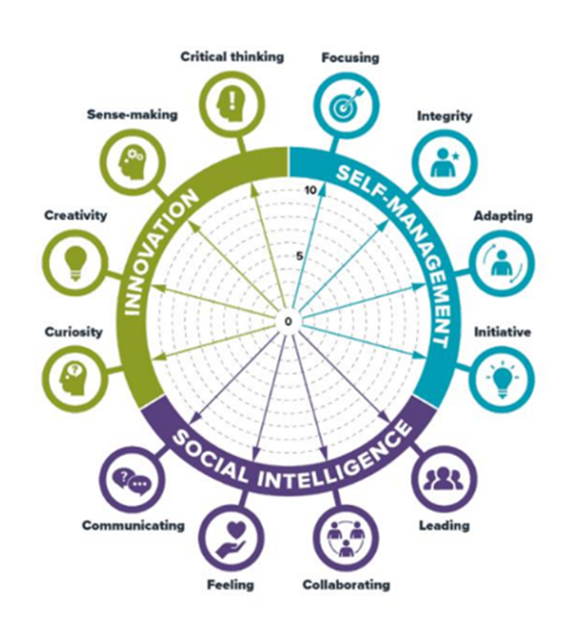
Background

Slide 5
Activity One
Activity One 10 minutes
In small teams what Meta Skills do you think exist in the following Level Learning Outcomes

Slide 6
LLOs for a Module
Learning Outcomes for Module/Unit/Course
On completion of this module, students are expected to be able to:
1 | Demonstrate knowledge of the principal research methods and approaches in the creative, cultural and service industries.
2 | Propose a research topic that is appropriate for further research pursuits.
3 | Critically evaluate and present research approaches and methods suited to the topic chosen.

Slide 7
Menti.com
Menti.com task

Slide 8
Problem Gaps
Modules | Gaps
Hospitality/Practical Assessment | Students recognised meta skills more than staff
Events/ Theoretical Assessment | Students recognised meta skills more than staff
Fashion/Practical Assessment | Students recognised meta skills more than staff
Tourism /Practical Assessment | Students and staff recognised meta skills more than each other in places
Media/Practical Assessment | Students recognised meta skills more than staff
Digital Marketing/ Theoretical Assessment | Staff recognised meta skills more than students

Slide 9
Activity two
There is a clear disconnect so..
How do we communicate these meta skills better ?

Slide 10
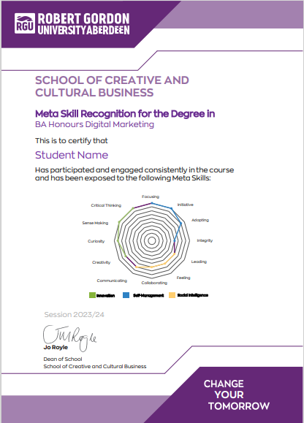
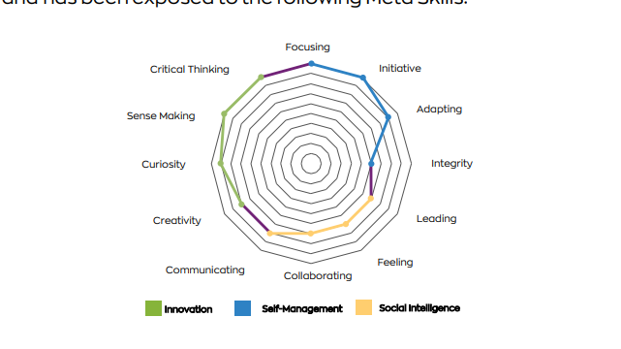
Our Steps
ADDITIONAL NOTES
Students who engage with this module through attendance and participation will be exposed to the following Meta Skills: Critical Thinking, Focusing and Initiative.

Slide 11
Menti task
What have you learned today?
Menti.com
Thank you for listening and participating hope you have enjoyed the session p.bremner@rgu.ac.uk

