Slide 1
“It made me feel powerful in a way”: the role of suicidality in incel communities.
Dr. David S. Smith

Slide 2
The manosphere
What it is
Anti-feminist/male hegemony online coalition
Feminism has reduced rights of men - battle for masculinity (Smith, 2024)
Red pill: unfair dating market; black pill: insurmountable dating market
Distance from ideal = identities in manosphere (Ging, 2019)
Alpha masculinity
Beta masculinity
Manosphere
Pick Up Artists
Incels
Porn reboot communities?
Men’s Rights Activists
Men Going Their Own Way
Crossover/migration between groups (Ribeiro, 2021)

Slide 3
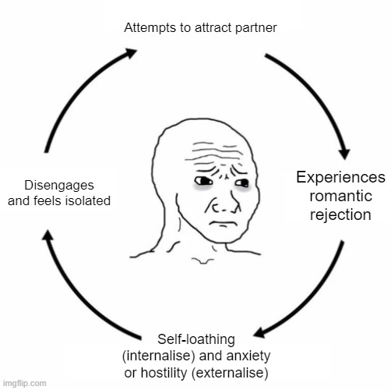
Incels
Inceldom
60-100k members (18-30)
Diverse: 55% white (Blake & Brooks, 2023)
Regional inequality: activity (Brooks et al., 2022)
50%: with parents/caregivers (Costello et al., 2022)
Groups within groups (Decook & Kelly, 2021)
Cycle: rejection - embitterment - alienation
Incels and mental health
“Hope, cope, and rope” (Sparks, 2022)
Body dysmorphia? fixation (Broyd et al., 2023)
75% depression, 45% anxiety (Costello et al., 2022)
20% daily self-harm ideation (Commission for Countering Extremism, 2024)
Suicidality: 71.4% (incels.co survey, 2020); 66% (Daly & Laskovtsov, 2022): social capital?
Suicide posts directly linked to philosophy (Daly & Laskovtsov, 2021)
How do suicidality and self-harm bond incel communities?
Do these groups exacerbate members’ feelings?

Slide 4
Smith et al (in revision)
Participant | Age | Region | Incel from | Incel until | Dominant pill
1 | 23 | United Kingdom | 2016 | 2018 | Black
2 | 21 | Central Europe | 2017 | 2020 | Black
3 | 23 | USA | 2018 | 2020 | Black then red
4 | 28 | Eastern Europe | 2016 | 2018 | Red
5 | 29 | Canada | 2016 | 2019 | Black then red
6 | 28 | USA | 2017 | 2021 | Black
7 | 33 | Canada | 2010 | 2011 | Black
8 | 25 | Italy | 2010 | 2021 | Mixed
9 | 29 | Brazil | 2011 | 2018 | Red
10 | 32 | USA | 2009 | 2011 | Red
11 | 40 | Canada | 1996 | 2014 | Red

Slide 5
Smith et al (in revision)
“Anger feels better than sadness”
Naturalising inferiority: secret information
“It made me feel like nothing is my fault - it's just women doing this to me”
Failing with women = failing at life
Nihilism and sense of failing at life: nothing can change
Trying = “taking part in my own humiliation”
"People come for the truth and stay for the lies. When I first joined, I was drawn to them because of my truth (no one had ever been attracted to me), but eventually, my truth became the truth (no one could be attracted to me)"

Slide 6
Smith et al (in revision)
A safe space
Mental health: validation
A secret life: sharing socially taboo topics
“I liked being vulnerable there - was less judgment because they’re in the same position”
“I couldn't have expressed my romantic alienation without being branded a creep or misogynist”
“You could say "I wanna kill myself" and instead of being met with 'oh no, please don't do it’ etc., someone would say 'same'”

Slide 7
Smith et al (in revision)
The downward spiral
Race to the bottom: transactional and competitive
New reasons to feel insecure
“The alpha is the guy who spent the most years a virgin”
Body dysmorphia: “finding what you're insecure about and blowing it up”
Conclusions
Short-term relief/long-term despair: validation without emotional support
Normalises open discussions about sexuality and mental health
Permanency of position becomes overwhelming with repeat visits
Increased self-consciousness and nihilism
Therapy: CBT (Maxwell et al., 2020), online/group (Broyd et al., 2022)
Acknowledgments
Dr. Alice Butler-Warke, Dr. Gemma Stevens

Slide 8
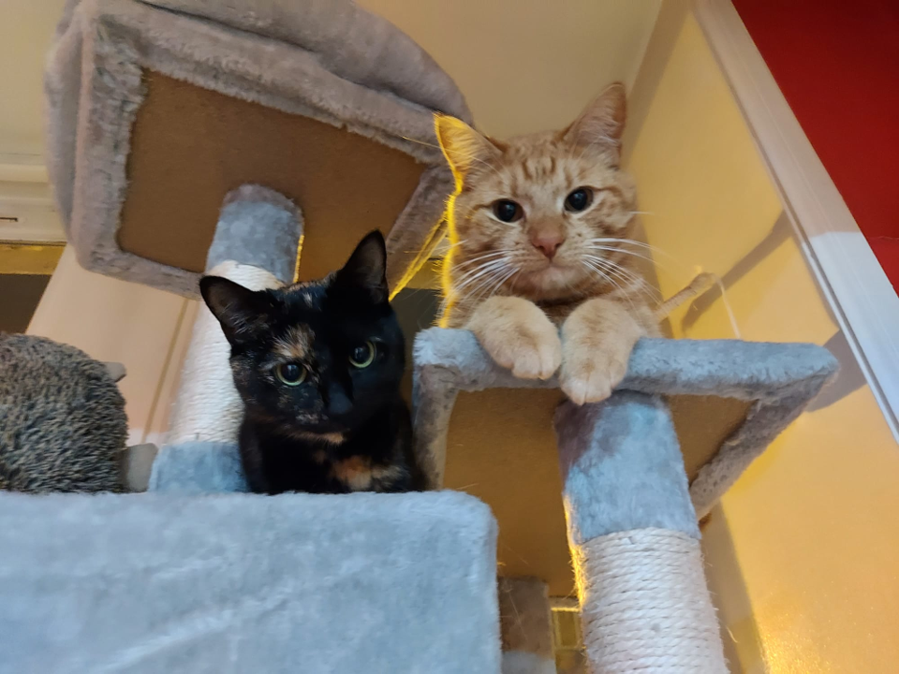
The end
Dr David S. Smith
d.smith47@rgu.ac.uk

