Slide 1



SPE-221670-MS
A Comparative Study of Acoustic Emissions from Pencil Lead Breaks on Steel and Aluminum Substrates Using Signal Analysis
Oluseyi. S. Fatukasi*,
C. J. Abolle-Okoyeagu
K. Pancholi
School of Engineering, Robert Gordon University, UK.

Slide 2

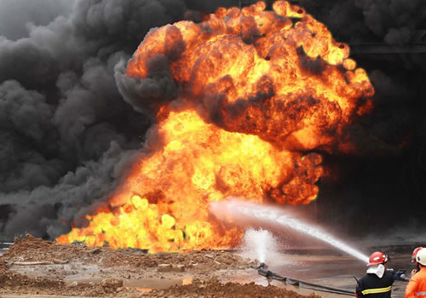
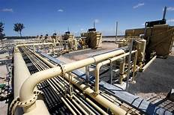
Introduction
Pipellines are made from different types of metals.
Carbon steel pipes for oil and gas transportation.
Aluminium pipes used compressed air systems.
Pipe defects starts as micro-cracks. and progressess to failure
Failures of pipelines are associated with disasters.
2023 Pipelines’ significant incident consequences is $216,784,416. .
About 41% of Nigerian Oil and gas pipeline are over 30 years old.
Hence, the need for SHM.
Aim
To compare AE response from steel and aluminium cylinders to Pencil Lead Break (PLB).
1. Abolle-Okoyeagu, C. J., Torralba, J. P., Chen, Y., Droubi, G., & Reuben, R. (2023). Measurement and simulation of the propagation of impulsive a coustic emission sources in cylinders, with potential application to pipeline monitoring.
2. Nor, N. M. (2018). Structural health monitoring through acoustic emission. Eco-Efficient Repair and Rehabilitation of Concrete Infrastructures
2. https://www.phmsa.dot.gov/data-and-statistics/pipeline/pipeline-incident-20-year-trends

Slide 3
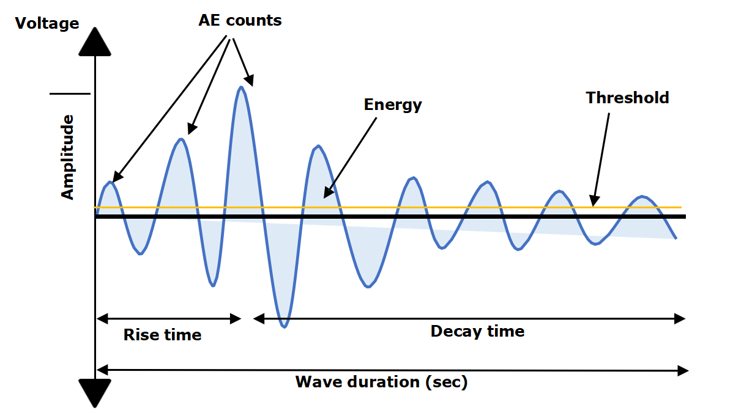
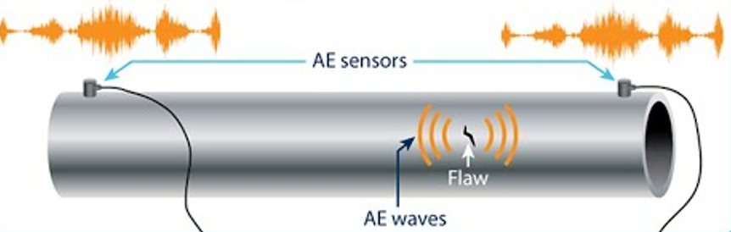
AET for Pipe Monitoring
Acoustic Emission Testing is a Passive NDT.
AE waves frequency: 100 kHz to 1 MHz
Materials crack initiation and growth, degradation release the elastic stress waves.
Characterization of wave signals can be used to identify and locate the defect sources.
Potential use of multiple sensor is suitablbe for source location.
AE Signal fatures

Slide 4
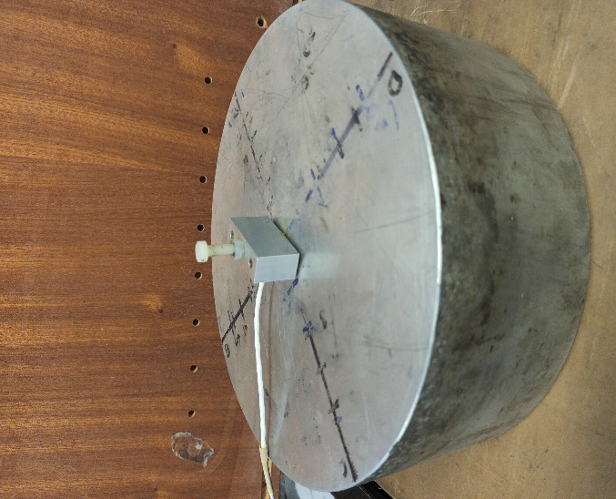
Pencil Lead Break and AET
(PLB) Hsu Nielson Source
PLB is a standardized and controlled acoustic emission source. ASTM standard (E976-99)
Provides a reproducible method for simulating AE events.
Allows characterization of acoustic wave extract parameters.
It produces energy in the form of elastic stress waves, similar to actual defects.
Cylinderical substrate

Slide 5
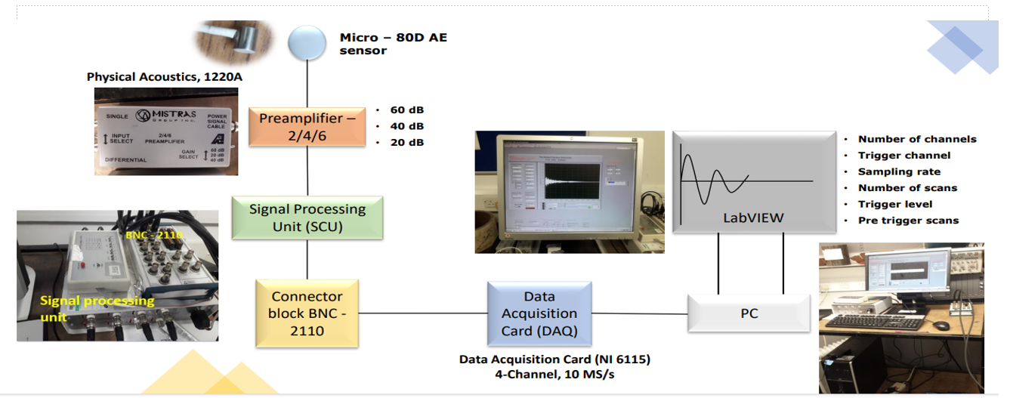
Sensing and Instrumentation

Slide 6
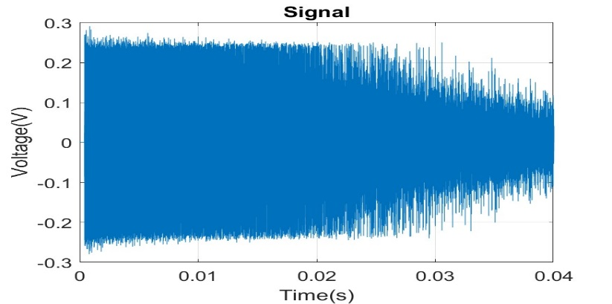
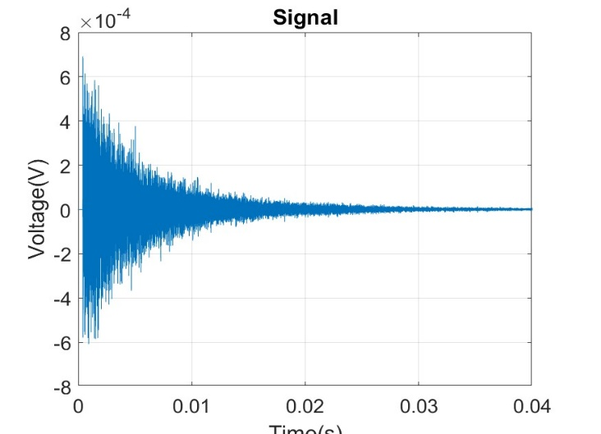
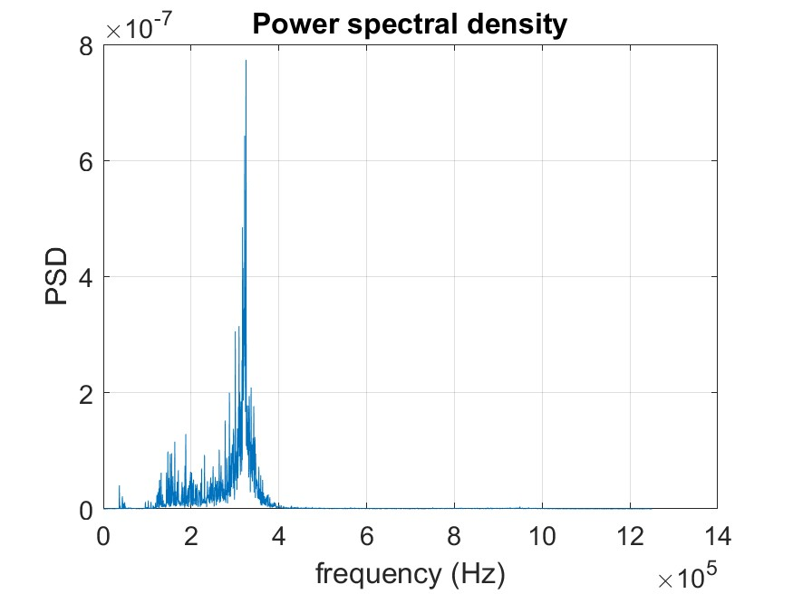
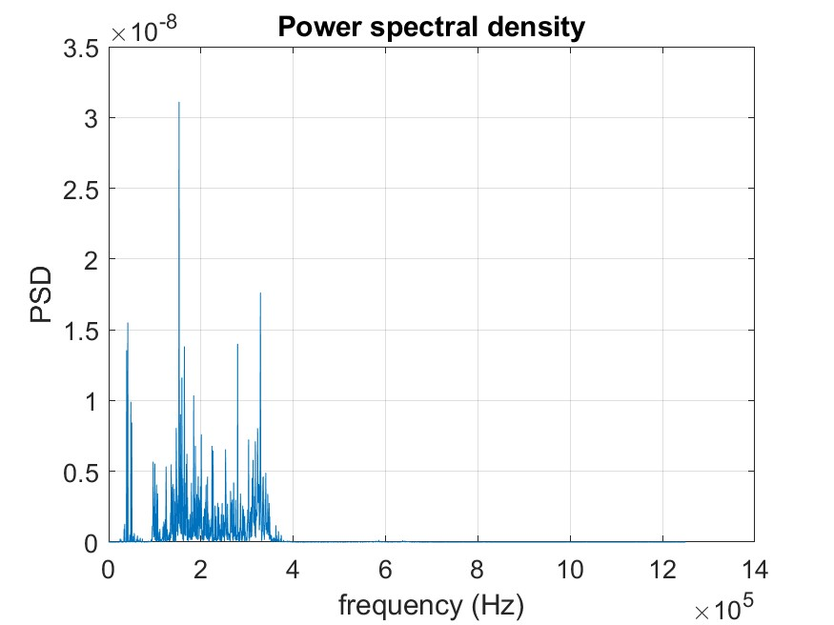
Aluminium Steel
Raw AE Time domain & PSD
The two substrates produced burst signals from PLB impacts.
Wave propagation pattern and frequency differ.
Time and frequency domains signals produced are influenced by material properties (Young’s modulus of Elasticity, density).
Aluminum's density (2.7 g/cm³) and Young's modulus (69 GPa).
Steel density (7.85 g/cm³) and a substantially higher Young's modulus (215 GPa).

Slide 7
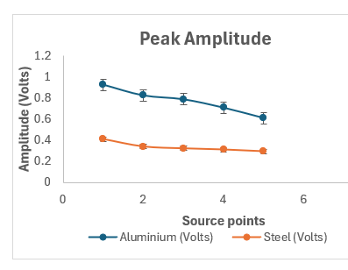
Time Domain
The highest amplitude for aluminium 0.93V.
Maximum amplitude for steel substrate is 0.41V.
Higher number of rise in Aluminium cylinder
than steel substrate.
The number of rise decreases as the PLB
source is farther away from sensor.

Slide 8
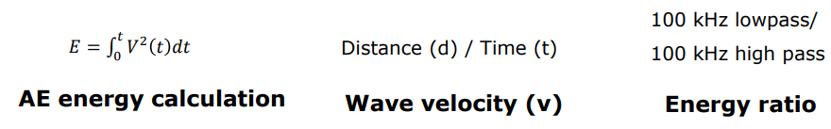
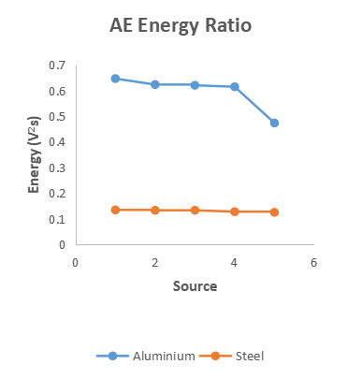
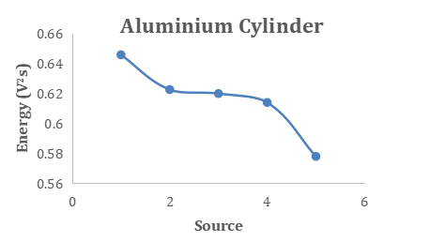
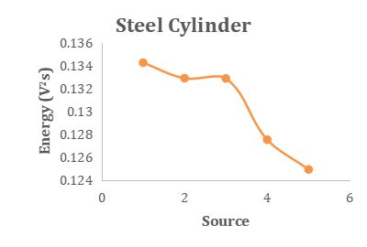
Frequency Domain
Digital filtering is applied to frequencies below and above 100KHz.
Aluminium substrate exhibit higher energy levels at frequencies (below and above 100 kHz)
The lower density and young modulus of elasticity in Aluminium allow faster wave velocity.

Slide 9
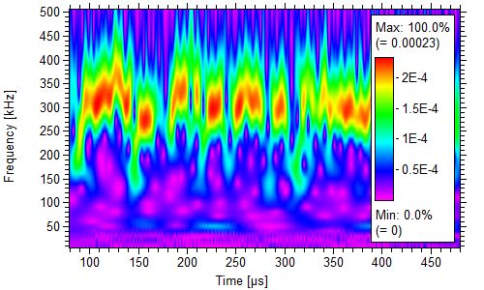
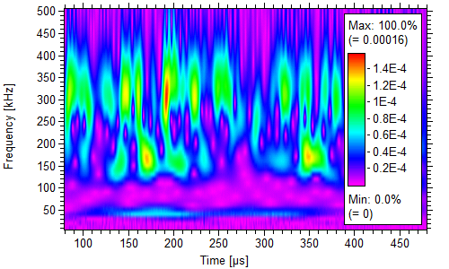
AE Energy & Wavelet Transform
Wavelet transform is a combination of time and frequency domain.
Showed the distributed energy zones across the frequency level
Both materials shared a peak frequency of about 380 kHz
Aluminium has dominant frequency range: 200 kHz to 380 kHz, from 90ᶙs to beyond 400ᶙs.
Steel’s peak frequency of 380KHz occured at 190ᶙs time.

Slide 10
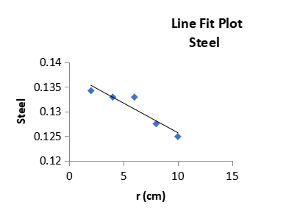
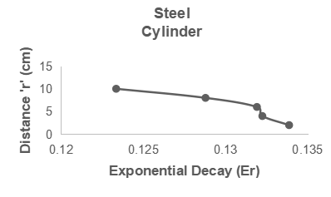
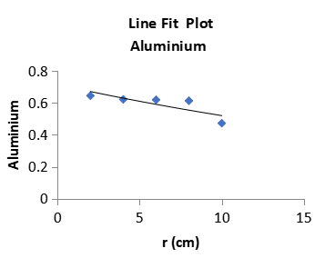
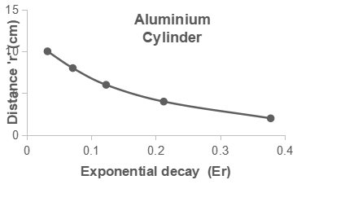
AE Waves Attenuation Coefficient
Aluminium
Steel
AE signal attenuation quantified using exponential decay model.
Fitted AE energy values to decay model
Linear regression analysis was performed
Aluminium: α = 0.263/cm
Steel: α = 0.00125/cm
Aluminium shows significantly higher attenuation rate than steel.

Slide 11
Summary
Material properties - density and strength influence acoustic wave behaviours.
AE Energy and Frequency differs in Steel and Aluminium Cylinders
Solid steel cylinders have lower AE energy and frequency.
The applicability of PLB for calibrating acoustic emission experiment set-up.
Study emphasizes importance of understanding material-specific acoustic behaviours and attenuation mechanism in metals.
The Response model provides theoretical foundation for future structural AE monitoring of pipes.

Slide 12
Acknowledgements / Thank You / Questions
The authors express gratitude to PTDF Nigeria for funding research project via Robert Gordon University (RGU) UK.
Special thanks to Dr. Judith Abolle-Okoyeagu and Dr Ketan Pancholi who offered professional supervision for this research work.
Thank you all.
              o.fatukasi@rgu.ac.uk

Slide 13


Oluseyi Samuel Fatukasi
Chief Superintendent of Fire
Federal Fire Service Nigeria
Oluseyi Fatukasi is a distinguished professional in the field of disaster risk management and fire safety. He holds a master's degree in Disaster Risk Management and Development Studies from Ahmadu Bello University, Zaria, which has provided him with a solid academic foundation in his area of expertise.
With over a decade of experience as a fire safety officer, Fatukasi has risen through the ranks to become a Chief Superintendent of Fire in the Federal Fire Service Nigeria. His extensive experience encompasses critical areas such as fire risk assessment of buildings and pipeline safety and disaster management.
Fatukasi's research interests reflect his commitment to advancing the field of disaster prevention and management. He focuses on innovative approaches, particularly the use of Acoustic Emission techniques and the application of machine learning for pipeline monitoring. This cutting-edge research aims to enhance safety measures and reduce the risk of disasters in pipeline infrastructure.

