Slide 1
NIBES Research Spotlight: The Energy, Sustainability and Society Research Group
Professor Peter Strachan
Research Group Leader
p.a.strachan@rgu.ac.uk

Slide 2
RGU: Interdisciplinary Research Themes
Living in a Digital World
Health & Wellbeing
Environment, Energy and Sustainability
Inclusive and Creative Societies
“Environment, Energy and Sustainability”
“Focused on addressing many of the global challenges set out in the UN Sustainability Goals, this theme brings together researchers who approach these issues from a breadth of disciplinary perspectives that include the life sciences, engineering and computing but also embraces the social sciences and business disciplines”

Slide 3
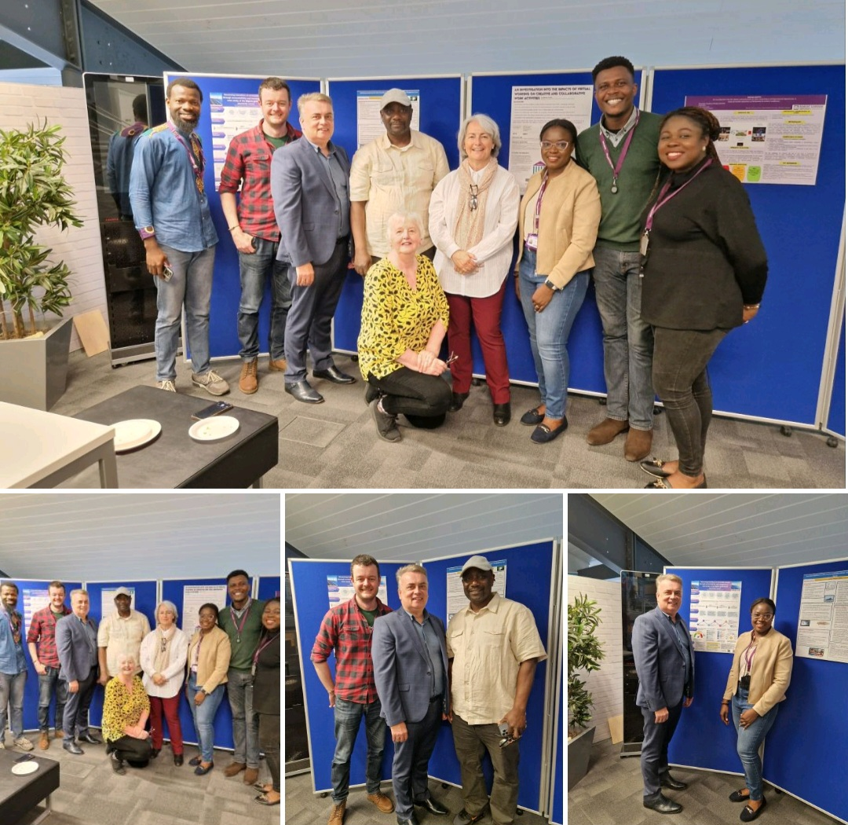
The Energy, Sustainability and Society Research Group
Scholarly Focus
The Group aims to facilitate an inclusive forum to share current and planned research-centred scholarly activities, stimulate considered debate, and inspire new investigations of contemporary societal issues, with a particular but not restrictive focus on issues relating to energy and sustainability, to enhance and enrich our research environment, activities and outputs

Slide 5
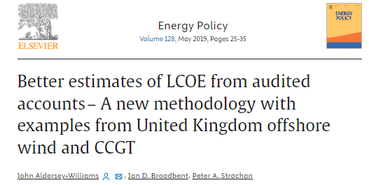
Accelerating Global Pathways to Sustainable Energy Deployment – Professor Peter Strachan
Research Focus: Energy Policy, 100% Renewable Energy Pathways, Energy Transition, and Net Zero
Global Decarbonisation Pathways, with recent published output in Applied Energy.
European Wind Power Deployment, with past published outputs in Energy Policy.
Sub-National Government and Pathways to Sustainable Energy, with past published outputs in a variety of journals including Regional Studies.
Professor Strachan’s work is closely aligned with SDGs 7, 9, 11 and 13.

Slide 6
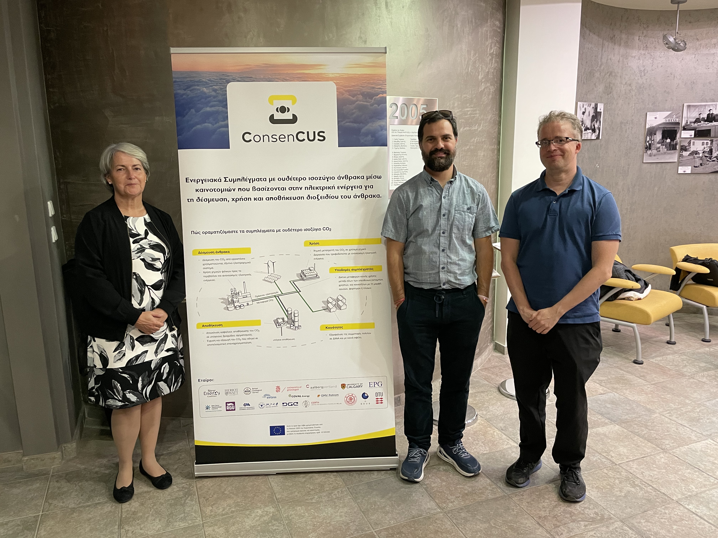
ConsenCUS: Carbon Neutral Clusters through Electricity Based Innovations in Capture Utilisation and Storage
A four-year Horizon project funded by the EU. Collaboration with 19 partners in 7 countries.
Peer Review Publications:
Nielsen, J. A., Stavrianakis, K., & Morrison, Z. (2022). Community acceptance and social impacts of carbon capture, utilization and storage projects: A systematic meta-narrative literature review. PLoS One, 17(8), e0272409.
Stavrianakis, K., Nielsen, J., & Morrison, Z. (2023). Public perception and acceptance of CCUS: preliminary findings of a qualitative case study in Greece. Open Research Europe, 3.
This project is closely aligned with SDGs 7 and 13.
Professor Zoe Morrison, Dr Kostas Stavrianakis and Dr Jacob Nielsen

Slide 7
Localisation of Sustainable Development Goals in a Developing Country Context: Accounting and Reporting Implications
A three-year funded project by the Social Sciences and Humanities Research Council of Canada to understand the dynamics of translating the SDGs into national policy/strategy, infrastructure and regulatory circles.
The project investigates the interplay between the technical and political (state-coordinated process of ‘counting’ and ‘count-ability’) underpinnings of accounting and reporting, and the development policy implications focusing on SDGs 1, 3 and 4.
The project focuses on four African countries: Tanzania, Ghana, Benin and Mauritius.
Professor Sarah Lauwo

Slide 8
Decarbonisation Pathways for African Cities (Book)
Published as part of the Palgrave Studies in Climate Resilient Societies book series, Dr Ayodele Asekomeh’s co-edited book examines the pathways to decarbonising African cities, structured around strategies and applications in renewable energy, waste management, healthcare, telecommunication, education and governance reconfigurations for Petro-cities.
At the book launch (a hybrid online and in-person event hosted by Durham University) on 24 May 2023, Professor Peter Strachan was the book reviewer. Dr Asekomeh served as a discussant and presented his chapter contribution, “To Opt-in or to Cop Out: COP26 and the Policy Dynamics of Decarbonising African Cities” (Chapter 9), that proposes mechanisms for translating COP26 takeaways to decarbonisation policies.
Dr Asekomeh’s work is aligned with SDGs 7, 9, 11 and 13.

Slide 9
Promoting Renewable Energy Transition Pathways in Africa
Research Focus: Clean Technology, Energy Transition and
Net Zero
Presented and participated in the Resilient Planet Symposium by the International Science partnership funds in collaboration with the British Council in Delhi, India, 2024 on “Clean energy development”.
Presented at the online seminar by The Progress Playbook in collaboration with Cambridge Institute for Sustainable Leadership 2024 on “Advancing grid-connected wind and solar energy adoption in Nigeria: exploring the dynamics of socio-technical transitions”.
Presented at NIBES 2024 on “Making the net zero transition: is it a case of the beginning of the end of the fossil fuel era?”.
Dr Adedokun’s research is aligned with SDGs 7, 9, 11, 13 and 16.
Dr Racheal Adedokun

Slide 10
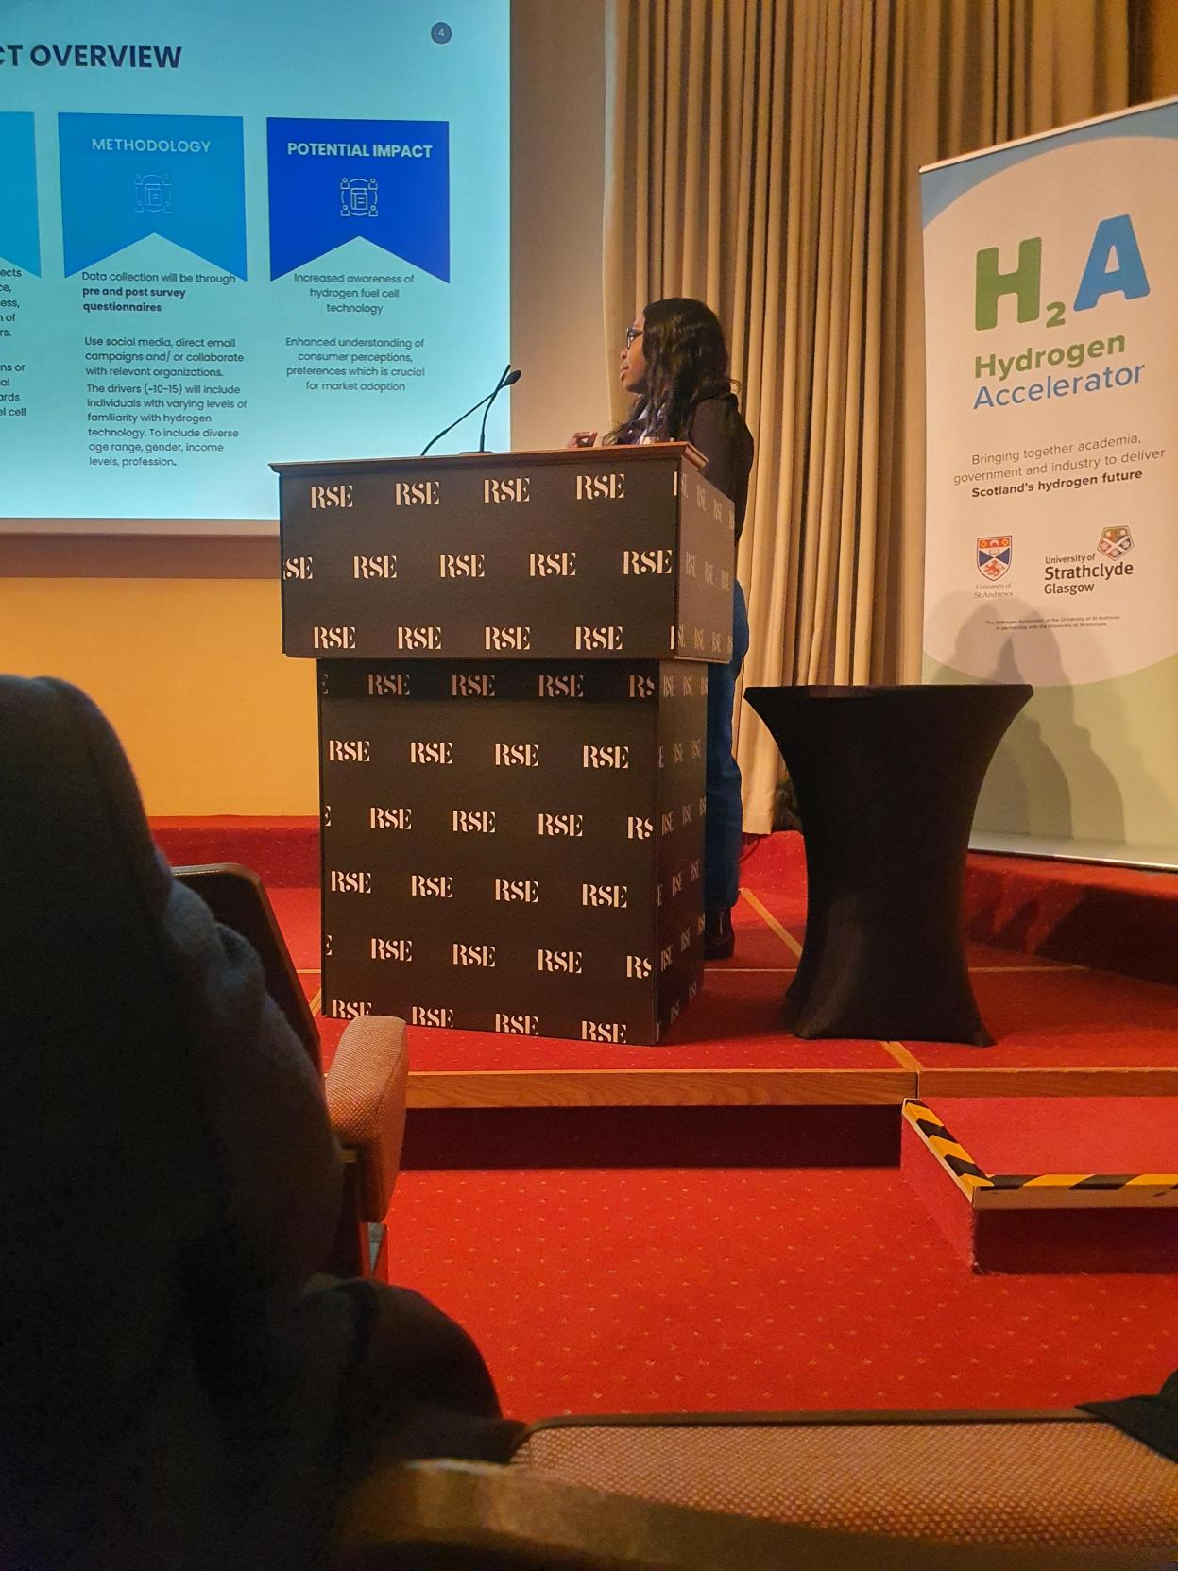
Consumer Preferences for Environmental Goods and Services
Dr Bridget Menyeh’s research focuses on understanding human behaviour and decision-making processes related to environmental sustainability.
Her past work has examined investor preferences for renewable energy investments using discrete choice modelling and other participatory research techniques.
Current work is focused on hydrogen vehicle public awareness and perception.
Dr Menyeh’s work is aligned with SDGs 7 and 13.
Dr Bridget Menyeh presenting at the H2A Accelerator workshop at the RSE

Slide 11
The Environmental Impact of Decommissioning: Quantifying Greenhouse Gas Emissions
Dr Abigail Davies has developed new methods and models for quantifying GHG emissions from decommissioning in the marine environment by combining the circular economy, waste hierarchy and UN’s value retention model to holistically quantify GHG emissions.
Current methods under-report GHG emissions by at least 50%, and therefore are not fit for purpose.
Future challenges of decommissioning have been highlighted, with GHG emissions due to decommissioning modelled to reach over 5GtCO₂e by 2067 – 17 years after Net Zero should have been achieved.
Dr Davies work is aligned with SDG 13.

Slide 12
Human Factors in Wind Energy
Human Factors in offshore wind for safety and training
Dr Ruby Roberts is currently a PI on a Royal Society of Edinburgh Small Grant (2024-25) project:
Stakeholder mapping of human factors influencing wind technician safety and performance (workshop 1 n=34; workshop 2 August 2024)
Renewable UK Global Offshore Wind Conference (June 2024)
Psychology of Technology Adoption (2018-2022; Net Zero Technology Centre)
Dr Roberts has developed a novel framework of the less visible psychological factors impacting on corporate technology and innovation adoption (PTAF) in the oil industry,
Resulted in three publications including a case study (Roberts et al. (2021). Technovation, DOI:10.1016/j.technovation.2020.102219) with over 8,000 Elsevier downloads with 87 citations to date.
Commercial output: organisational technology adoption culture measure.
Dr Roberts work aligns with SDGs 7, 8 and 9.
Dr Ruby Roberts, Chancellor’s Fellow of Industrial Psychology

Slide 13
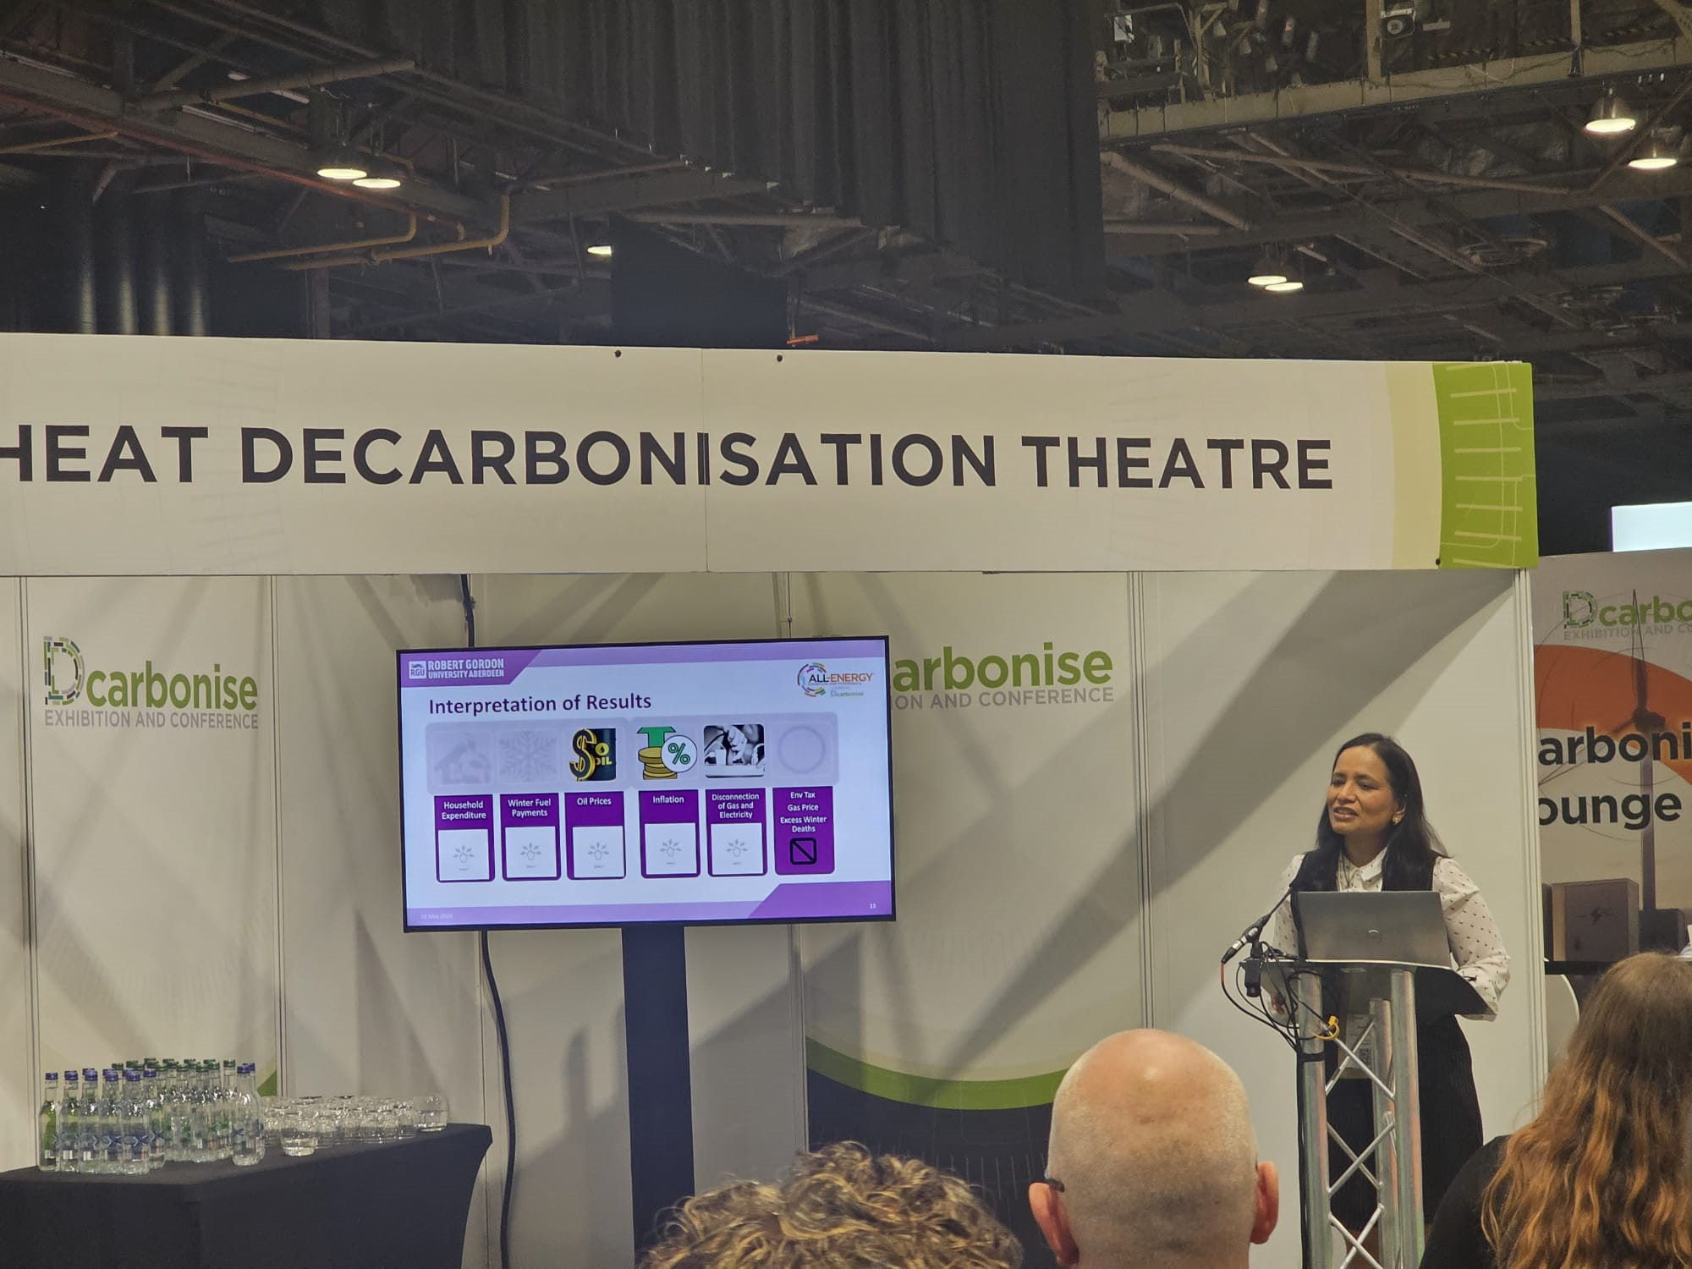
Decarbonising Heating and Fuel Poverty: Causes, Policy Implications, and Next Steps
Dr Anita Singh’s work is currently focused on decarbonising heating and tackling fuel poverty - two of the biggest challenges before the UK economy.
Using Structural Equation Modelling her research evaluates the main causes and immediate impacts of fuel poverty and how decarbonisation targets can be achieved while combating the problem.
Dr Singh’s work is aligned with SDGs 7 and 13.
Dr Anita Singh presenting at All Energy Conference, Glasgow

Slide 14
Pathways to Sustainability: An investigation into the challenges and opportunities for SMEs in Scotland
Dr Nicola Croxton and Dr Eleni Kesidou’s research seeks to understand how SMEs operating in the oil and gas supply chain navigate the net zero agenda, to become a more sustainable enterprise.
Taking an interdisciplinary approach and combining entrepreneurship and nonmarket strategy, they are investigating how SMEs utilise their resources to address challenges and opportunities in this context.
Dr Croxton and Dr Kesidou’s work is aligned with SDGs 7, 9 and 11.
Dr Nicola Croxton and Dr Eleni Kesidou

Slide 15
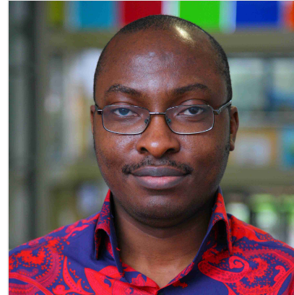
Application of the Systemic Lessons Learned Knowledge model to Learning in Complex Projects: How Project Practitioners are Shaping their Learning
Dr Oluyomi Osobajo’s current research project seeks to explore how learning is articulated, and knowledge creation encouraged among project practitioners in complex projects.
His previous research has addressed contemporary issues in the field of Project Management, Supply Chain Management and General Management.
Dr Osobajo’s work is aligned with SDGs 9, 11, 12 and 17.
Dr Oluyomi Osobajo

Slide 16
AI for Risk Management in Energy Companies
Professor Fernando Oliveira has an impressive research portfolio.
His research interests include:
Risk Management;
AI for long-term decision making and planning;
Renewable energy;
Energy poverty; and,
Power purchasing agreements.
Professor Oliveira’s work is aligned with several of the SDGs including SDG 7.

Slide 17
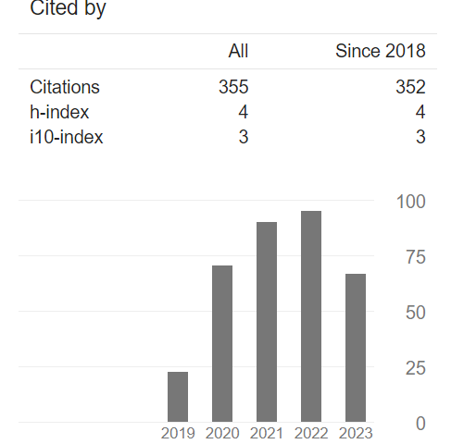
PhD Student – Case Study

Slide 18
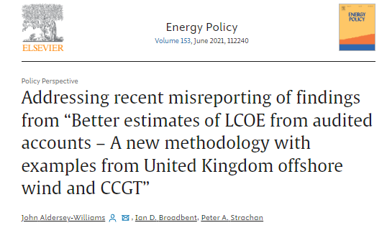

Slide 19
NIBES: Building New Research Collaborations

