Slide 1
UNCOVERING THE DARKSIDE OF ENTREPRENEURSHIP IN NIGERIA, THROUGH A GENDERED LENS
Theme: Achieving transformation for greater good: Societal, organisational and personal barriers and enablers.
Chioma Onoshakpor, Bridget Irene, Eunice Oluwakemi Chukwuma-Nwuba, Tabitha Sindani, Sunita Dewitt, Charlotte felix-Faure

Slide 2
Background 1
Context of Darkside of entrepreneurship
Research shows that:
Despite the benefits of entrepreneurship and the positive contribution to economic growth and development, recent streams of research critique this all-positive narrative and call for entrepreneurship scholars to uncover the darker and downside of enterprise (Shepherd, 2019; Kim, Mueller and Dey, 2024).
Several studies suggest that entrepreneurship also presents a variety of negative forms of impacts on entrepreneurs which can be sources of their miseries and afflictions (Biju & Kandathil, 2019).
The downside of engaging in entrepreneurship has negative impacts on individuals psychological and emotional well-being on entrepreneurs, their lives are not as alluring as they seem (Shepherd, 2019).

Slide 3
Background 2
Gender dynamics would also mean differences in these negative experiences.
Notably, due to structural inequalities, women are more disadvantaged than their male counterparts (Marlow, 2020; Shepherd, 2019).
Socio-cultural norms also has limiting patriarchal beliefs which restrict women’s agency and engagement in entrepreneurship, make a trade-off between (Vossenberg, 2013).
Institutionalised sexism and the sole responsibility of household and childcare

Slide 4
Aim/Objectives/research questions
The aim of this paper is therefore to unpack the darker side of entrepreneurship in Nigerian Context.
The study examines how men and women respond to limitations they experience as everyday entrepreneurs and how it causes them to enact unethical entrepreneurial actions.

Slide 5
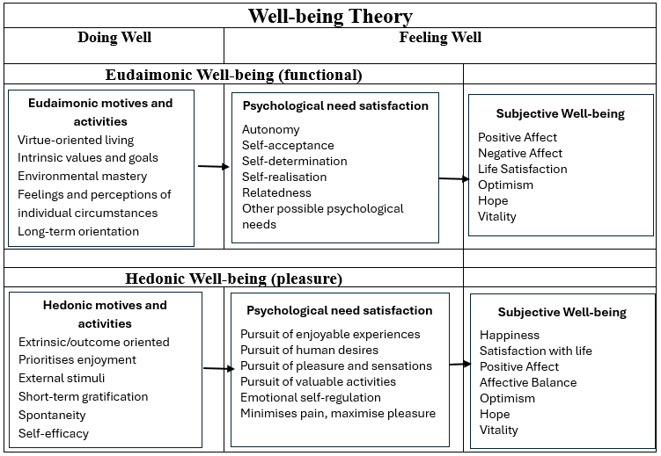
Wellbeing theory
The well-being of women entrepreneurs is crucial for gender equality and sustainable development. However, defining wellbeing is a challenging task due to its varied interpretations and usage in different contexts, making it appear adaptable like a chameleon

Slide 6
Data structure
Main theme or 1st order code | Sub-theme or 2nd order codes | Interpretation of themes
Narratives around the loss of finance caused by corruption, experienced by the entrepreneur | Impact of corrupt practices | Systemic corruption embedded in institutions leads to stress, loss and harassment.
Narratives around the loss of finance caused due to multiple taxation demands by the entrepreneur | Policy inaccuracies
Narratives around the need in developing relationships to help facilitate loan approvals in formal financial institutions | Helpful Relationships or strong ties
Narratives around the need in developing sexual relationships to help facilitate loan approvals in formal financial institutions | Sexual Harassment
Narratives around legislation and regulations that hinder them from growing successful businesses, therefore, encourage a feeling of despair and discrimination | Influence of inheritance laws | The influence of culture leads to distrust and social isolation
Narratives around gender stereotyping in the sector of operation and in accessing business finance that limit business growth aspirations | Gender bias and stereotyping

Slide 7
Research Sample
14 male entrepreneurs
16 female entrepreneurs
Semi-structured interviews

Slide 8
Result and Findings
Findings suggest that both male and female entrepreneurs faced the dilemma of systemic corruption embedded in institutions quite similarly.
In contrast, both males and females have different experiences of the Influence of socio-cultural practices on how they ‘do’ entrepreneurship that continuously forces the females to feel disadvantaged, social isolation and distrust thereby making them experience the darker side of entrepreneurship.

Slide 9
Power Quotes: systemic corruption embedded in institutions
Well, it's really challenging, that's very obvious, you know, because the system is really not working honestly. Corruption is everywhere, you have to pay to get your way up there, so these are most of the challenges and others which of course, are caused by corruption: a lack of enabling environment…Okon (male entrepreneur)
…and yeah, I mean some government rules from government laws and regulations make it just really difficult to run smoothly so you are paying multiple taxation to every arm of the government that could really be a pain in the neck...Chi (female entrepreneur)

Slide 10
Power Quotes: the Influence of socio-cultural practices
Well, it's really challenging, that's very obvious, you know, because the system is really not working honestly. Corruption is everywhere, you have to pay to get your way up there, so these are most of the challenges and others which of course, are caused by corruption: a lack of enabling environment…Okon (male entrepreneur)
is that the conditions are also not friendly, ….so sometimes for the conditions, they'll tell you to bring collateral like, landed documents, property. For a woman, I don't think that is possible…Anem (female entrepreneur)

Slide 11
Contribution to research and practice
This study engages with the literature of the dark side of entrepreneurship extending what we understand of this phenomenon.
Furthermore, the paper contributes to wellbeing theory.
This expands the
body of knowledge
on critical
entrepreneurialism
debate by highlighting
the dark side of
entrepreneurship from
a Global South context

