Slide 1
Challenges and Barriers to Interdisciplinary Research
Presentation By: Dr Bridget Menyeh
September 06, 2024
Notes:
Image Attribution: Image by katemangostar on Freepik

Slide 2
Why Interdisciplinary (IR) Research Matters
Definition? Combining knowledge, methods, and perspectives from different disciplines to address complex problems.
Current societal challenges require an intersection of disciplines and integrated solutions. However, numerous challenges exist.

Slide 3
Barriers Encountered/Observed as an Interdisciplinary Researcher
Institutional
Situations where departments are siloed, each with its own set of priorities, resources, and administrative protocols
2. Method
Communication and Language barriers. Here, this could be discipline-specific jargon and terminology and/or differences in fundamental concepts and approaches
Collaboration Challenges from differing expectations and outputs across disciplines, power dynamics, poorly understood roles and responsibilities or juggling individual career goals with collective project goals

Slide 4
Barriers Encountered/Observed as an Interdisciplinary Researcher
3. Medium
Interdisciplinary Work may be challenging from a peer review and publication angle. Experts from a single discipline may not fully appreciate interdisciplinary work or difficulty in finding suitable journals
4. Audience and Implementation Challenges
Identifying relevant stakeholders across disciplines and ensuring their engagement
Evaluating the impact of interdisciplinary work in ways that satisfy different disciplinary standards

Slide 5
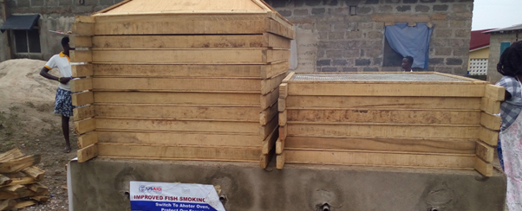
Case Example from an International Development Project
Designing a new fish smoking stove under a funded project for fish smoking communities.
Brought together Engineers, Food scientists, Environmental Scientists, Business Analysts, Policymakers,Users
Clear end goal was beneficial in this project.
Notes:
Image source: Modern Ghana (2016)

Slide 6
Conclusions
Barriers exist but they are not INSURMOUNTABLE
Solutions require promoting a research culture that values and supports interdisciplinary work. Advocating for policies that address structural and institutional barriers.
Exploring how to facilitate learning and how technology and tools can facilitate communication and collaboration across disciplines.

