Slide 1
SPE-221795-MS. Assessment of polymer resins as alternative abandonment barrier materials for high pressure high temperature (HPHT) wells: A multi criteria decision making approach
Augustine Okechukwu Chukwuemeka | James Njuguna | Gbenga Oluyemi | Suhail Attar. School of Computing and Engineering, The Robert Gordon University, Aberdeen,
United kingdom.

Slide 2
Outline
Present P and A practices and Barrier materials
Alternative Resin solutions
Application of MCDM for solving emerging P and A challenges in HPHT scenario
Source: Pennsylvania Department of Environmental Protection (2019)

Slide 3
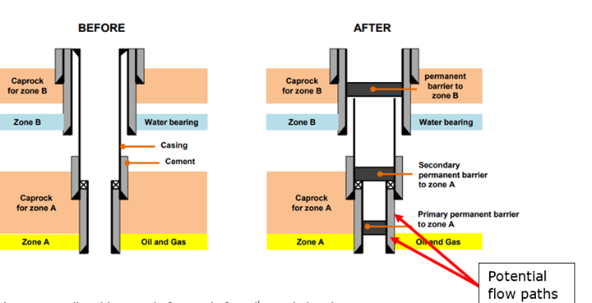
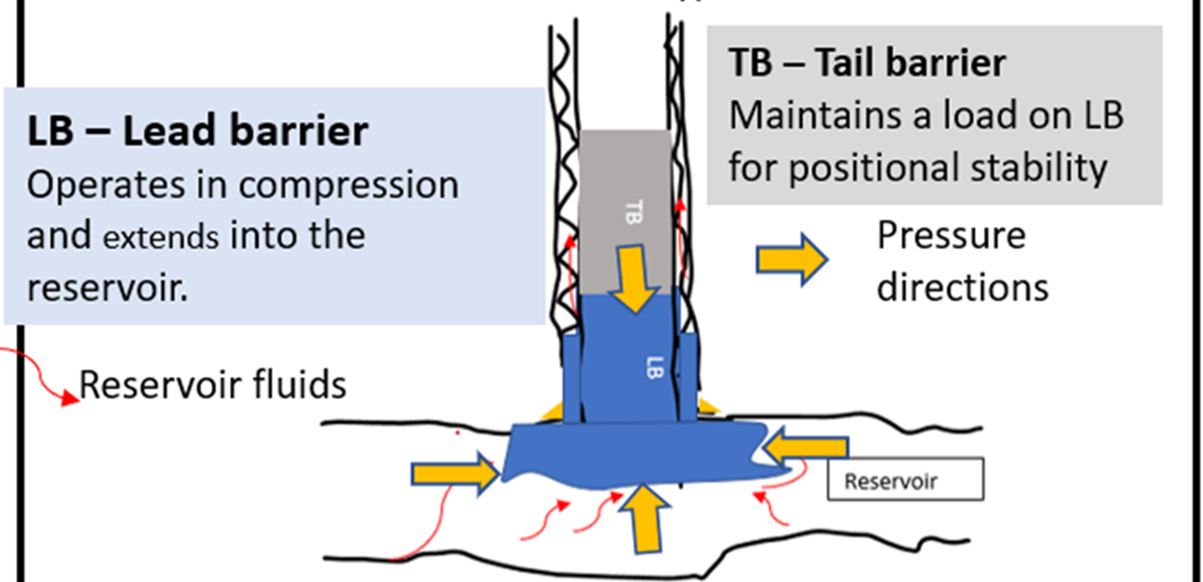
Present Abandonment Practices and Challenges
Regulatory uncertainties & constraints
Cost
Risk of failure
A driving force and
A leakage path
A fluid source
Lack of/Poor Well records
A Field level Approach

Slide 4
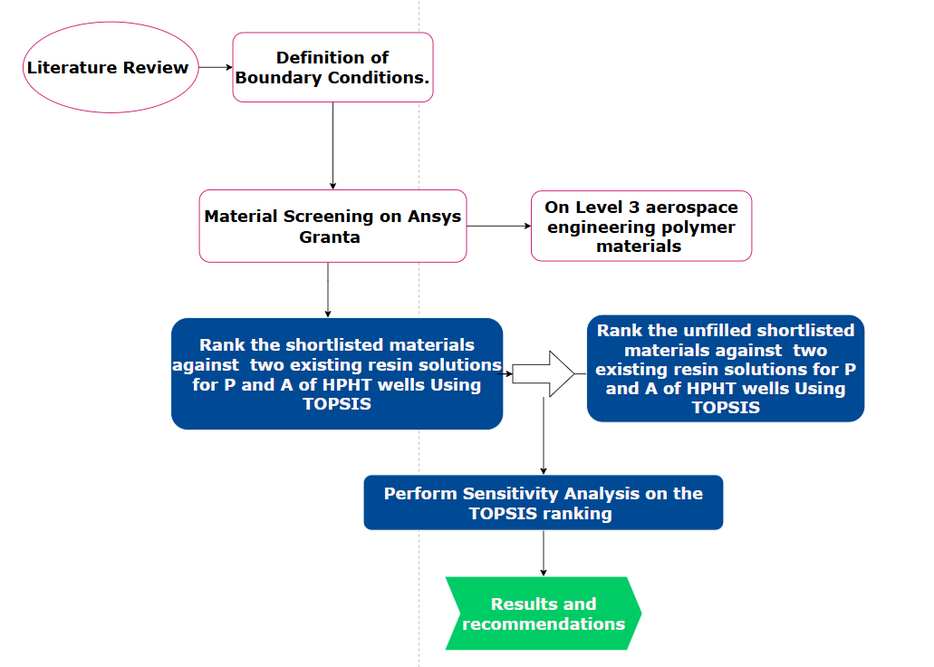
Study Methodology
Thermal boundary conditions
Durability in reservoir fluids
Mechanical properties/
index

Slide 5
Boundary Conditions for Materials Screening
Mechanical and thermal boundary conditions
Organic solvents
Weak Acids
Water and Brine
Minimum compressive 115 MPa
Minimum service temperature 150oC
Maximum service temperature 220 oC
Excellent
Boundary conditions for material durability
in selected reservoir fluids

Slide 6
Level 3 aerospace polymer materials screening results

Slide 7
Material ranking by TOPSIS
Themaset
ResAmber
Decide and assign weights to individual criterion
Calculate normalized and weighted normalized values criteria
Determine the positive and negative ideal material solutions
Calculate separation measures of each material from the positive and negative ideal solutions
Calculate each material’s similarity to the positive ideal solution.
Rank the materials based on their distances from the positive ideal solution
Compressive strength - 0.2
Flexural strength
- 0.1
Tensile
Strength -
0.1
E modulus - 0.125
Durability in brine & weak acids - 0.225
Durability in organic solvents - 0.25

Slide 8
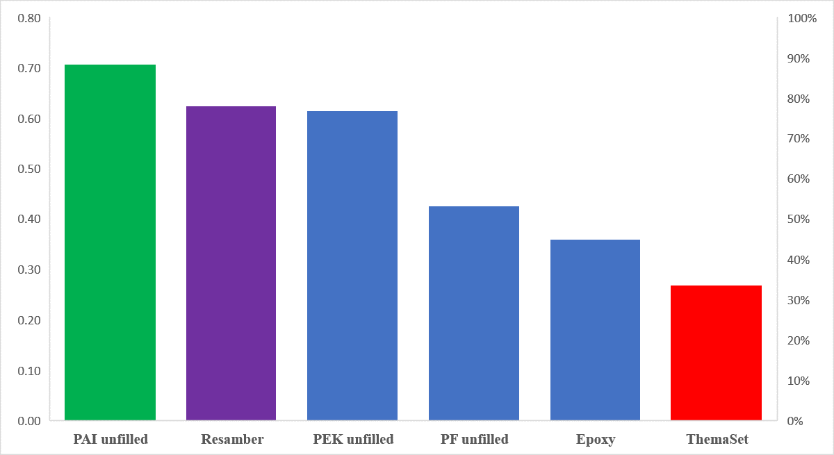
TOPSIS Ranking of polymer resins for well abandonment
PAI (30% glass fibre)
PAI (30% carbon fibre)
PEK (40% glass fibre, modified)
PF (high strength glass fibre M)
ResAmber
ThermaSet

Slide 9
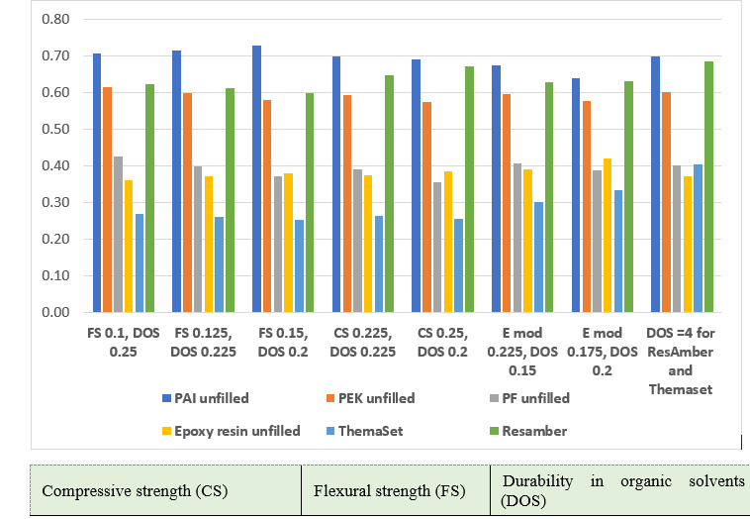
Sensitivity Analysis of the Ranking Process.

Slide 10
Conclusion.
Well abandonment and decommissioning are the reality of our industry’s future.
Polymer resins are promising alternative barrier materials to cement.
MCDM is a viable tool for the assessment and selection of barrier materials for P and A
P&A presents a huge challenge but also and amazing opportunity if we plan.
Shortlisted materials are recommended for further laboratory studies.

Slide 11
Acknowledgements / Thank You / Questions
I would like to specially Acknowledge
my funder, the Petroleum Technology Development Fund, PTDF, for the full sponsorship of my PhD research
Engineaust@gmail.com
+447708577718, +2348162103915

Slide 12
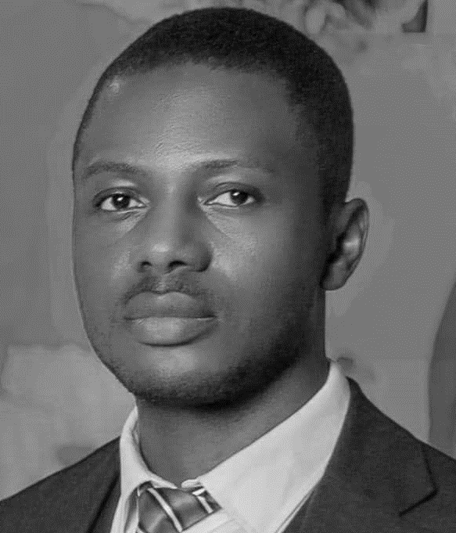
PhD Researcher – The Robert Gordon University, Aberdeen, United Kingdom
Augustine .O. Chukwuemeka
A well engineer with a first class degree in oil and gas engineering, a master's degree with distinction in well engineering both from Kuban State Technological University, Russia under the Federal Scholarship Board’s BEA scholarship. He is currently doing his PhD in Well Plug and Abandonment at Robert Gordon University, UK, under the Petroleum Technology Development Fund OSS scholarship. He combines industry experience with research to simplify complex challenges and proffer sustainable solutions to the pain points of the oil and gas industry in every phase of the well lifecycle including wells with integrity issues from yet to be identified sources. In addition, he mentors students and young professionals from low-income countries on scholarship winning strategies and professional networking at Academy of Scholarships and Transitions.

