Slide 1


SPE-223135-MS
Energy Transition in Nigeria: A Decarbonisation Strategy for the Oil and Gas Value Chain through Integrated Renewable Energy Technologies
Datimfon Nkang, Dr Ibiye Iyalla, Dr Ruissein Mahon, Dr Ityona Amber
School of Engineering, RGU, Aberdeen, Scotland, UK

Slide 2
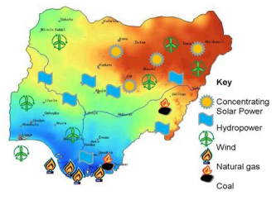
Nigerian Energy Landscape
One of the largest hydrocarbon reserves in the world.
A leading producer of oil and gas products in Africa.
Oil and gas products account for ~10% of the country’s GDP, contributing more than 70% of the country’s foreign exchange.
Proven track record of legislatively promoting renewable energy, having developed and operationalised several clean energy policies, programmes, initiatives, and regulations:
  To reduce carbon emissions while
  To bolster the country’s energy security agenda.
Geographic Distribution of Nigeria’s Energy Portfolio (Olanrele, 2021)
Energy Potential of Renewable Energy Sources in Nigeria (Energy Commission of Nigeria, 2014)
Energy Source | Potential
Hydropower | 14,750 MW
Biomass | Very high potential
Solar radiation | 3.5 to 7.0 kWh/m²/day
Wind | 2 to 4 m/s (average)
Geothermal | 5 known sources
Ocean, tidal and wave | Low prospects

Slide 3
Energy Transition: Case Study of Nigeria
2005 Renewable Energy Master Plan: aims at reducing dependence on hydrocarbons.
Energy Transition Plan: focuses on renewable energy systems to reduce ~ 60% of GHG emissions across critical sectors.
Electricity Vision 30:30:30 (V30): aims to generate 30,000 megawatts (MW) of power with 30% renewable by 2030.
Nigerian Renewable Energy and Energy Efficiency Plan: provides a framework for promoting renewable power generation addressing energy security and climate objectives.
Nationally Determined Contribution: commits to reducing GHG emissions by 20% below the business-as-usual scenario by 2030 and increases its conditional target to 47% reduction in emissions by the same year.
Emission Profile of Nigeria’s Key Sectors in 2020 (Dioha, 2022)

Slide 4




Renewable Energy Development in Nigeria
Solar energy: Year-round high solar intensity; rural electrification projects being developed by private sector engagement with the support of the World Bank.
Wind energy: Jos, Gombe, and Kano have significantly high wind speeds, whereas Lagos, Enugu, and Maiduguri have moderate winds; severely underutilised energy resource as there is no strong state or federal mandate.
Hydropower: Three hydroelectric units in Kainji, Jebba, and Shiroro with 1,930 MW installed capacity; investment and management issues limits the country’s potential to produce 15 GW.
Biomass energy: Widespread due to the tropical environment and extensive rainforests, cattle, and arable land; funding, legislation, awareness, infrastructure, and technical capacity are obstacles.
Geothermal energy: Hot springs and geysers exist in Ikogosi, Jos, and Biu plateaus, Borno and Sokoto basins; lack of feasibility studies.

Slide 5
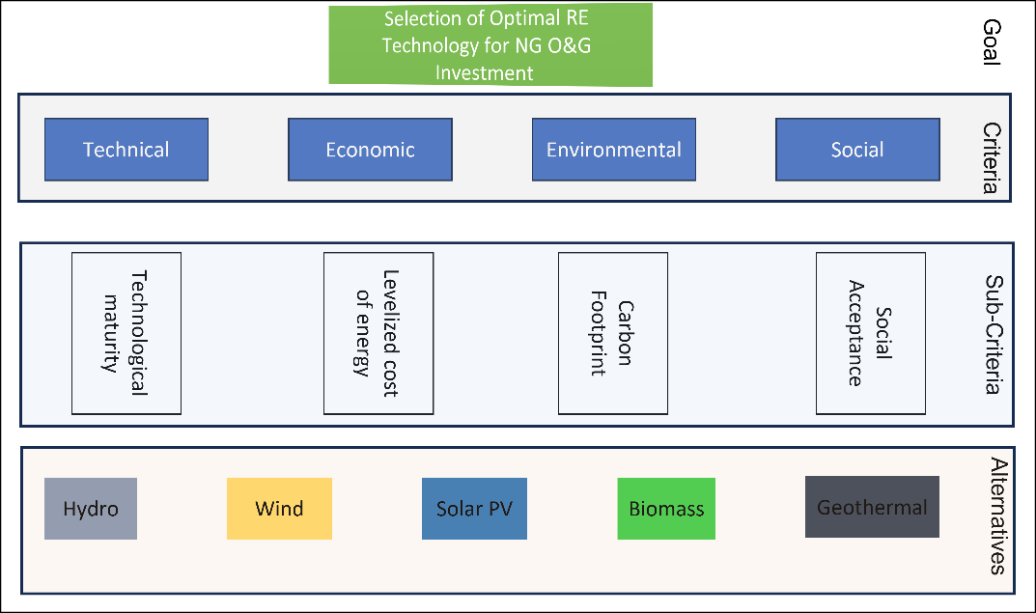
Methodology
Aim: To analyse the viability and investment case of a suitable renewable energy resource to support Nigeria’s NDC and energy transition within the downstream oil and gas supply chain (OGSC) – techno-economic study applying two multicriteria decision tools and a financial modelling scheme.
Method: Criteria Importance through Intercriteria Correlation (CRITIC) to perform the weighting; Technique for Order of Preference by Similarity to Ideal Solution (TOPSIS) and Weighted Aggregated Sum Product Assessment (WASPAS) to determine the best renewable energy option to be adopted by the petrol station.
Summary of MCDM Goal, Criteria, and Alternatives
Factors and criteria used in this research work
Technical (F1) |  | Economic (F2)
Factor | Variable | Factor | Variable
Technology Maturity | Beneficial | LCOE ($/MWh) | Non-beneficial
Environment (F3) |  | Social (F4)
Factor | Variable | Factor | Variable
Carbon footprint (gCO₂/kwh) | Non-beneficial | Social acceptance (%) | Beneficial

Slide 6
Case Study: Petrol Station
Based on the load profile, the daily demand is 58.8 kWh.
A sample electricity bill reveals a lower electricity consumption of 46.21 kWh/day as data logger only utilises grid usage data.
This usage is significant as the Southwest of Nigeria is a major commercial hub of trade.
Load Profile for a Petrol Station in Southwest Nigeria
Summary of Key Load Profile Output Parameters
Parameter | Value
Daily demand (kWh) | 58.8
Scaled daily demand @ 1.09 scaling factor (kWh) | 63.85
Max average load (kW) | 3.90
Conversion factor | 0.65
Peak load (kW) | 6.01

Slide 7
Techno-economic Analysis
Result of CRITIC Application
Technical factor Highest weighting and Social factor the lowest
TOPSIS Application
Solar PV ranks highest
WASPAS Application
Solar PV ranks highest
CRITIC Application Outcome for Different Factor Types
 | F1 | F2 | F3 | F4 | Sum | Q_{ij} | W_{j}
F1 | 0.000 | 1.616 | 1.425 | 1.010 | 4.050 | 0.153 | 0.057
F2 | 1.616 | 0.000 | 0.064 | 0.433 | 2.113 | 0.841 | 0.314
F3 | 1.425 | 0.064 | 0.000 | 0.584 | 2.073 | 0.860 | 0.321
F4 | 1.010 | 0.433 | 0.584 | 0.000 | 2.027 | 0.828 | 0.309
TOPSIS method result using CRITIC weighting
 | F1 | F2 | F3 | F4 | Si+ | Si- | Pi | Rank
Solar PV | 0.017 | 0.049 | 0.055 | 0.185 | 0.051 | 0.346 | 0.872 | 1
Wind | 0.000 | 0.032 | 0.015 | 0.136 | 0.065 | 0.380 | 0.853 | 2
Hydropower | 0.043 | 0.119 | 0.032 | 0.134 | 0.102 | 0.320 | 0.757 | 3
Geothermal | 0.000 | 0.089 | 0.051 | 0.110 | 0.109 | 0.316 | 0.743 | 4
Biomass | 0.033 | 0.270 | 0.310 | 0.110 | 0.387 | 0.033 | 0.079 | 5
WASPAS method result using CRITIC weighting
 | Qi (1) | Qi (2) | Q(i) | Rank
Solar PV | 0.6224808 | 0.544664 | 0.584 | 1
Wind | 0.8610254 | 0 | 0.431 | 3
Hydro | 0.5116247 | 0.466794 | 0.489 | 2
Geothermal | 0.3898939 | 0 | 0.195 | 5
Biomass | 0.2807617 | 0.162315 | 0.222 | 4

Slide 8
Techno-economic Analysis
Key Outcome of Off-grid Standalone System Simulation
Parameter | Unit Cost
PV modules | $292/kWp
Panel frame/mounting | $13/kWp
Batteries | $4.05/Ah
PV inverter | $192/kWp
Charge controller | $179/kWp
Labour | $93/kWp
Balance of system | $160/kWp
Output | Value
PV size (60 Wp, 14 V) | 16.38 kWp
Average daily energy need | 64 kWh/day
Battery capacity (62 Ah, 12.8 V) | 4340 Ah
Solar fraction | 93.11%
Performance ratio | 72.16%
Specific production | 1388 kWh/kWp/yr
Cost benefit analysis of the system developed using a PVSyst consisting of a 16.38 kWp PV and 220 kWh battery pack -
$25,400 project cost with a $0.09/kWh levelised cost of energy
Operating Costs
Power and distribution systems | $15/kWp
System monitoring | $2/kWp
Reporting | $1/kWp
Logistics | $1/kWp
Overheads | $3/kWp
Key Outcome
Project CAPEX | $25,403.36
LCOE (15 years) | $0.09/kWh
Total production (15 yrs) | 341,031.60 kWh
Project OPEX (15 yrs) | $5,405.40
Key Financial Parameter of the PVSyst Model
System Information (PV Syst)
PV capacity | 16.38 kWp
Battery pack | 4,340 Ah
Yield factor | 1,388 kWh/kWp
Annual production | 22,735.44 kWh/yr
Project life | 20 yrs
Energy need | 64 kWh/day
Solar fraction | 93.11%

Slide 9
Concluding Remarks
Solar PV was the top-ranked renewable energy source.
$25,400 was the estimated project cost with a $0.09/kWh levelised cost of energy. This is significantly less than $0.08/kWh for grid electricity (excluding diesel powered electricity generation).
Incorporating a solar PV hybrid system to a petrol station will result in cost savings and added environmental benefits of CO₂ emissions reductions, howbeit, higher tariff (> $100/kWh) is required to achieve competitiveness.
As more data is available and supporting policies are more robust, the LCOE should reduce in the coming years.

Slide 10

Nigeria’s Pathway Forward: An Opportunity
Globally, wind has achieved significant cost savings and is a major component of the energy transition plans of many countries.
Opportunity for Nigerian policymakers to stimulate growth and develop more robust wind energy programmes and incentivise support for renewable energy adoption in the mainstream energy system.
Synergy between oil and gas operations, has the potential to unlock other marine renewable energy industries through robust local content policies and knowledge transfer.

Slide 11

Acknowledgements
Thank You
Robert Gordon University www.rgu.ac.uk

Slide 12




Authors
Datimfon Nkang
Dr Ibiye Iyalla
Graduate Engineer
Expertise: Oil and Gas Engineering, Renewable Energy, Energy Efficiency, Sustainable Energy, and Net Zero
Associate Dean ESCD
Expertise: Sustainable Oil & Gas Production, Decommissioning, Subsea Engineering, Energy Transition / Net Zero, and Renewable Energy Technologies
Dr Ruissein Mahon
Dr Ityona Amber
Lecturer, Energy Engineering
Expertise: Low Carbon Operations, Renewables, Oil & Gas, Drilling & Well and Subsea Engineering
Lecturer, Mechanical Engineering
Expertise: Heat Transfer, Thermo-fluids, Energy and Renewable Energy (Solar), and CFD

