Slide 1


SPE-223134-MS
Environmental and Economic Considerations for the Decommissioning of Oil and Gas Infrastructure in Nigeria
Micheal Ayeni, Dr Ibiye Iyalla, Dr Ruissein Mahon
School of Engineering, RGU, Aberdeen, Scotland, UK

Slide 2
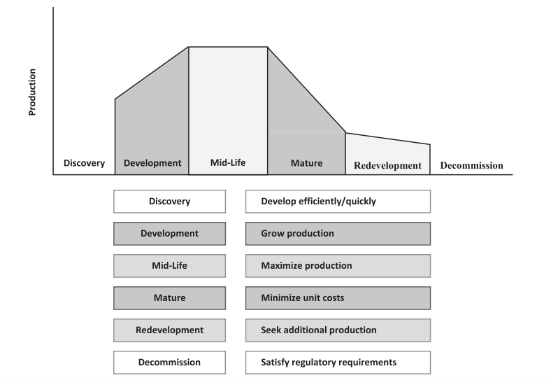
Introduction
The lifecycle of oil and gas infrastructure begins with discovery and development.
This is followed by a midlife phase where the infrastructure is fully operational, and then a mature phase where production may start to decline – asset redevelopment may occur to maximise resource recovery.
Finally, the lifecycle ends with decommissioning, which is the process of safely retiring the infrastructure and returning the area to its original state.
Decommissioning process considerations for offshore oil and gas platforms: types of offshore platforms, subsea infrastructure, topsides and facilities, well plugging and abandonment, environmental cleanup, regulatory compliance, site restoration, stakeholder engagement.
Lifecycle of Oil and Gas Infrastructure (Kaiser and Liu, 2014)

Slide 3
Decommissioning Options
Complete Removal: Involves the full removal of the offshore structure from the marine environment, returning the seabed to its original state. Environmental impacts include the loss of biodiversity and destruction of seabed habitat.
Partial Removal: Involves the removal of a portion of the platform structure while keeping the remaining part intact. Preserves a portion of the existing fish population and their associated secondary production.
Leave-in-Place: Involves leaving the platform in place and allowing it to deteriorate naturally. Commonly employed for platforms situated in deep water or those with low environmental risk. Topside of the structure would be dismantled and cleaned, and navigational aids would be installed.
The choice of option takes into consideration, economic environmental, technical, safety, stakeholders, and regulatory factors.

Slide 4
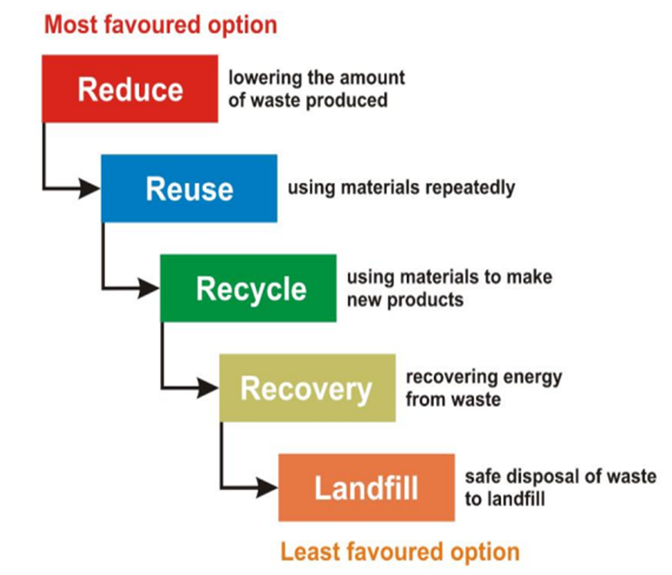
Impacts & Implications of Decommissioning
Environmental Impacts
Chemical emissions and discharges impacts on air and water
Noise and vibrational disturbances
Direct physical disturbance
Biodiversity
Impacts on energy consumption and carbon emissions
Waste disposal
Environmental clean-up
Economic Implications
Accurate cost estimation
Variability in costs
Strategic decision-making
Information gathering
Need for innovation
Waste Hierarchy (GOV.UK, 2023)

Slide 5
Decommissioning Regulation
Global Legislations
The United Nations Convention on the Law of the Seas 1982 (UNCLOS)
Convention on the Prevention of Marine Pollution by Dumping of Wastes and Other Matter 1972
National Legislations
Petroleum Act of 1969 grants broad powers to the Petroleum Minister
The Petroleum (Drilling and Production) Regulations of 1969
Harmful Waste Act of 1988
Environmental Guidelines and Standards for the Petroleum Industry in Nigeria (EGASPIN) 2003
Gaps in Regulatory Laws
Existing regulations primarily focus on onshore decommissioning activities.
Advanced framework for offshore decommissioning, with costs and environmental/economic implications is lacking.
Responsibilities laid on operators (IOCs) are basic and do not cover all aspects of decommissioning activities.
Need to review laws from more developed jurisdictions to fill gaps.
The Nigerian government seems to place importance on the income generated from petroleum activities.

Slide 6
Methodological Approach
Aim: To establish a robust framework for evaluating alternative decommissioning strategies for offshore oil and gas structures, utilising the Multi-Criteria Decision Analysis (MCDA) methodology.
Method: Application of the Analytic Hierarchy Process (AHP) to determine the optimal decommissioning strategy by linking each of the three alternatives to the six criteria, ultimately guiding the decision-making process which is characterised by multifaceted environmental, economic, and technical considerations.
Analytical Hierarchy Process for Decommissioning Strategy

Slide 7
Case Scenario: Field X
Decommissioning of a hypothetical Field X, an offshore jacket structure situated in the Nigerian oil and gas sector is representative of a common decommissioning challenge.
The structure has contributed to energy production over its operational years. However, current indications suggest that its continued operations are no longer economically or structurally viable.
Decommissioning Justification for Field X
Decommissioning Justification | Reason
Operational Lifetime | Field X has already produced for 28 years, nearing, or surpassing the typical operational lifecycle of such structures.
Maintenance Costs | The maintenance costs have tripled in recent times, making continued operation economically unviable.
Structural Fatigue | Signs of wear and tear are evident, leading to concerns about the structural integrity of the jacket. Continued operation could pose safety risks to personnel and the environment.

Slide 8
Pairwise Comparison Of Criteria and Weights
A comprehensive list of criteria essential for the evaluation of decommissioning strategies were identified, ensuring clarity in evaluation.
The alternatives considered in this study are Complete Removal (CR), Partial Removal (PR), and Leave in Place (LiP).
For each criterion used in the study, the three decommissioning strategies underwent a pairwise comparison.
To ensure the reliability of the decision-making process, AHP incorporates a measure of consistency among pairwise comparisons using a Consistency Index (CI).
Pairwise Comparison Matrix and Consistency Analysis
 | Envir. | Econ. | Safety | Regs. | STKH. | Tech. | Weights 100%
Environmental | 1 | 2 | 3 | 1 | 1 | 3 | 0.267951
Economic | 0.5 | 1 | 3 | 2 | 2 | 2 | 0.228028
Safety | 0.333333 | 0.333333 | 1 | 2 | 2 | 2 | 0.152814
Regulations | 1 | 0.5 | 0.5 | 1 | 1 | 0.5 | 0.111647
Stakeholders | 1 | 0.5 | 0.5 | 1 | 1 | 0.5 | 0.111647
Technical | 0.333333 | 0.5 | 0.5 | 2 | 2 | 1 | 0.127911
Maximum Eigen Value | 6.67838
C.I. | 0.135675
Alternative Weights for each Criterion
Criteria | CR | PR | LiP
Environmental Consequences | 0.218443 | 0.630098 | 0.15146
Economic Impacts | 0.0779588 | 0.287203 | 0.634838
Safety Considerations | 0.304254 | 0.575003 | 0.120743
Adherence to Regulations | 0.71471 | 0.218494 | 0.0667961
Concerns of Stakeholders | 0.687086 | 0.243741 | 0.0691729
Technical Viability | 0.093616 | 0.279688 | 0.626696

Slide 9
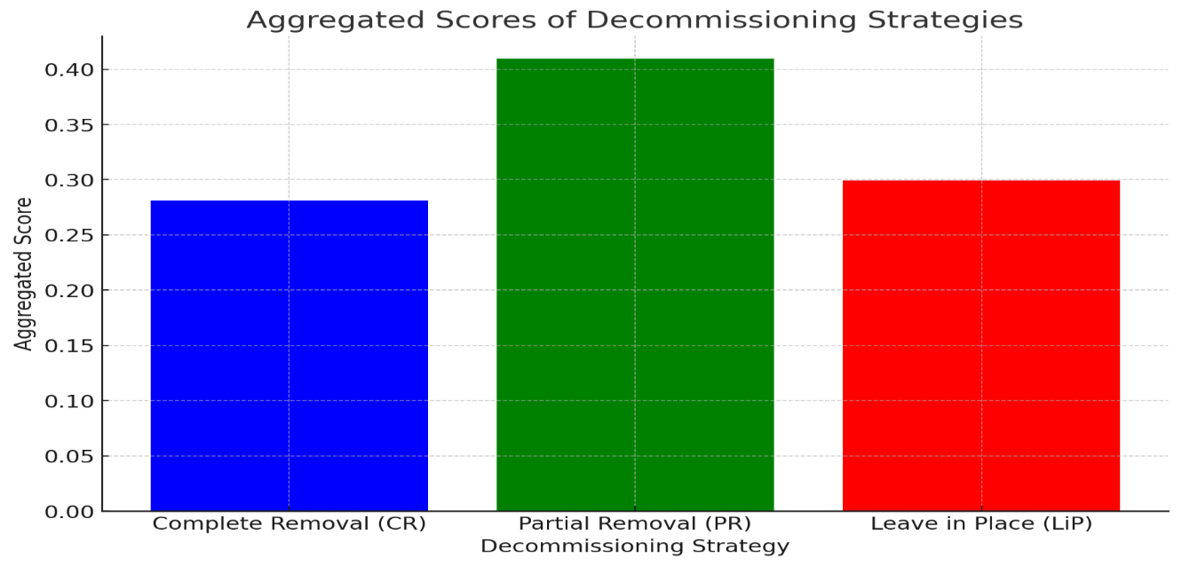
Analysis and Ranking
A ranking system was used to determine the suitability of each strategy to offer clarity on which strategy features more prominently.
'Partial Removal' emerges as the leading strategy, highlighted by the highest aggregated score of 0.4095, earning it the top position.
'Complete Removal' secures the second rank with a score of 0.2991.
'Leave in Place' is identified as the third rank option, with its score noted at 0.2812.
Ranking of Decommissioning Strategies
Decommissioning Strategy | Aggregated Score | Rank
Complete Removal | 0.2812 | 3
Partial Removal | 0.4095 | 1
Leave in Place | 0.2991 | 2
Ranking of Decommissioning Strategies

Slide 10
Sensitivity Analysis
Recalibration of weights assigned to different criteria with environmental reduced by 10% and enhancing the focus on economic impacts by 15% for Scenario A, with an inverse approach for Scenario B. Identifies the nuanced impacts these changes have on the prioritisation of decommissioning strategies.
Scenario A, which simulates a decrease in environmental concerns in favor of economic incentives, and Scenario B, offering a counter perspective, consistently highlights 'Partial Removal' as the optimal decommissioning strategy for Field X, with aggregated scores of 0.3969 and 0.4237 in both scenarios, respectively.
Adjusted Criteria Weights and Decommissioning Strategy Scores
Criteria | Adjusted Weight (%) (Env -10% Econ +15%) | Adjusted Weight (%) (Env +15% Econ -10%)
Environmental | 0.241156 | 0.308245
Economic | 0.262232 | 0.205225
Safety | 0.152814 | 0.152814
Regulations | 0.110384 | 0.111147
Stakeholders | 0.110384 | 0.111147
Technical | 0.110384 | 0.111147
Ranking of Decommissioning Strategies
Decommissioning Strategy | Aggregated Score (Scenario A) | Rank (Scenario A) | Aggregated Score (Scenario B) | Rank (Scenario B)
Complete Removal | 0.284822 | 3 | 0.296120 | 2
Partial Removal | 0.396893 | 1 | 0.423706 | 1
Leave in Place | 0.305823 | 2 | 0.280376 | 3

Slide 11
Concluding Remarks
Development of a robust framework for assessing decommissioning options requires relationships between environmental considerations, economic impacts, safety measures, and technical viability.
Importance of stakeholder engagement demonstrates the need for cooperative efforts and consensus and showcases the need for shared responsibility.
The creation of a Decommissioning Fund and introduction of Tax Incentives is a strategic move towards promoting sustainability and encouraging future decommissioning investments.
The integration of advanced technologies in decommissioning tasks points to the opportunity to transform operations through increased efficiency, safety, and cost savings.
Alignment of Nigeria’s decommissioning policies with global standards and frameworks, including the UNSDGs, UNFCCC, and guidelines from the UK's OGA and IOGP.
An integrated approach is required regarding financial planning, technological advancements, and adherence to international best practices.

Slide 12

Acknowledgements
Thank You
Robert Gordon University www.rgu.ac.uk

Slide 13



Authors
Micheal Ayeni
Graduate Engineer
Expertise: Oil and Gas Engineering, CCUS, Renewable Energy, Energy Efficiency, Sustainable Energy, and Net Zero
Dr Ibiye Iyalla
Associate Dean (Economic, Social & Cultural Development)
Expertise: Sustainable Oil & Gas Production, Subsea Engineering, Decommissioning, Energy Transition / Net Zero and Renewable Energy Technologies
Dr Ruissein Mahon
Lecturer, Energy Engineering
Expertise: Low Carbon Operations, Renewables, Oil & Gas, Drilling & Well and Subsea Engineering

