Slide 1
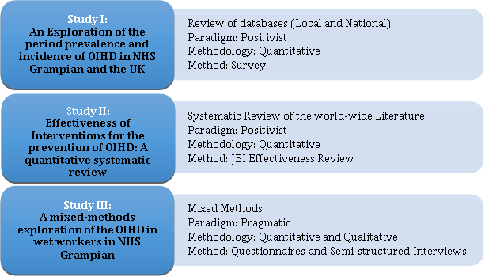
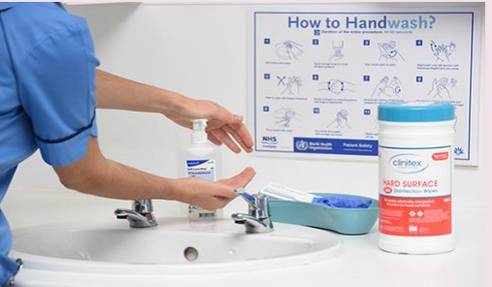
Exploring Occupational Irritant Hand Dermatitis amongst healthcare workers in NHS Grampian
Zoi Papadatou^{1,2}, Hector Williams², Kay Cooper ²
1. School of Nursing Midwifery and Paramedic Practice, Robert Gordon University, Aberdeen Scotland 2. School of Health Sciences, Robert Gordon University, Aberdeen, Scotland
Background
Aims
Occupational Irritant Hand Dermatitis (OIHD) is emerging as an important risk caused by or made worse by work. OIHD can be responsible for significant and long-term health issues and can impact on the individual’s employment. Healthcare workers are amongst the occupations with the highest incidence rates of OIHD (Gimenez-Arnau and Skudlik 2021).
The principle aim of this Doctoral research study was to explore OIHD amongst healthcare workers (HCWs) in NHS Grampian, Scotland. In order to provide a broad overview of the subject matter, this research used a three-study approach to explore, appraise and assess OIHD amongst HCWs.
Methods
Methodology
The three studies made a standalone contribution towards:
i) understanding the prevalence and incidence of OIHD on a local and
national level by conducting a retrospective review of the available
databases,
ii) identifying, appraising and synthesising the best available evidence on the effectiveness of interventions to prevent OIHD by conducting a
systematic review of the world-wide literature and
iii) collecting information on the distribution and determinants of OIHD in a sample of NHS Grampian HCWs by analysing and discussing their views, experiences and perceptions.
Study I
Study III
The key findings outlined that the numbers of wet workers in healthcare locally affected by OIHD accounted for higher incidence percentages (35%) between 2020-22 than during 2010-19 (21%). The estimated numbers of new cases as reported in HSE’s 2023 annual report has reduced steadily during the period 2018/19-2022/23 (HSE 2023). The coronavirus pandemic has impacted recent trends, and this should be considered when comparing across time periods the estimated rate of annual new cases (HSE 2023).
Other contributory factors to this discrepancy between reported cases locally and nationally are: adherence to different reporting routes, use of different reporting criteria and effective management of skin disease.
Questionnaire findings:
Wet work, hand hygiene products as well as use of PPE (particularly rubber gloves) were risk factors for both the development and/or exacerbation of OIHD amongst HCWs.
Strong association was found between OIHD and the development of atopic symptoms.
The findings highlighted the potential for severe and long-term impact on the health and well-being of the individual.
Interview findings:
Skin health and care facilitators:
Hand hygiene/care products, teamwork and provision of supportive mechanisms at work for skin care.
Skin care self-awareness and adequate time to carry out skin care at work were amongst the most strongly voiced facilitators.
Skin health and care inhibitors:
Lack of support at work including lack of understanding from the patients.
Work environment.
Lack of information/training/knowledge at work for skin care.
Physical and mental effects of skin issues:
Increased risk of infection, visual and sensory aspects, as well as quality of life outside work.
A range of psychological issues were raised by the interviewees
Specifically, feelings of embarrassment, being aware of how patients will perceive the HCWs (fitness for work), ‘not looking professional’ (to themselves, their colleagues and patients) and having distorted self-image about their skin (Schutte et al. 2023).
Study II
A three-step search strategy aimed to find both published and unpublished studies to determine the effectiveness of interventions in OIHD. No studies were located that fulfilled the inclusion criteria for this review. Studies were excluded due to:
i) populations not meeting wet workers definition criteria, and/or
ii) pre-existing skin conditions within samples resulting in studies not testing primary prevention.
There is currently no evidence available to determine the effectiveness of interventions for primary prevention of OIHD (Papadatou, Williams and Cooper 2018).
Initial database searching
n=3173
Title and abstract screening
n=3051
Full text article screening
n=121
Studies included in quantitative synthesis
n=0
Recommendations
To better understand the identified behaviours and to develop an intervention based upon effective principles of behaviour change.
To determine the effectiveness of an educational intervention for the prevention of OIHD amongst wet workers in healthcare.
To conduct a pilot study using the above findings to test the feasibility of the proposed intervention.
References
HEALTH AND SAFETY EXECUTIVE (HSE), 2023. Work-related skin disease statistics, 2023. https://www.hse.gov.uk/statistics/assets/docs/skin.pdf [Accessed 01/07/2024].
PAPADATOU, Z., WILLIAMS, H. and COOPER, K., 2018. Effectiveness of interventions for preventing occupational irritant hand dermatitis: a quantitative systematic review. The JBI Database of Systematic Reviews and Implementation Reports, 16(6), pp. 1398-1417.
3. GIMENEZ-ARNAU and SKUDLIK, 2021. Occupational contact dermatitis: health personnel. Contact Dermatitis, pp.483-497.
4. SCHUTTE, M.G., et al., 2023. Work‐related and personal risk factors for occupational contact dermatitis: A systematic review of the literature with meta‐analysis. Contact Dermatitis, 88(3), pp.171-187.
Contact Details: Dr Zoi Papadatou
z.papadatou1@rgu.ac.uk

