Slide 1
European Human Rights in the era of “Pushbacks”
Some Current Issues

Slide 2
Overview
1. Pushbacks – concept and in practice
2. EU legal framework
3. ECHR legal framework
4. EU pushback case law
5. ECHR pushback case law
6. Pushbacks in context; Pushbacks and “Dignity”

Slide 3
Pushbacks
No precise legal definition at EU or ECHR level
UN Report (2021) "measures, actions or policies effectively resulting in the removal of migrants, individually or in groups, without an individualized assessment in line with human rights obligations and due process guarantees.“
UN - Various measures taken by states which result in migrants, including applicants for international protection, being summarily forced back to the country from where they attempted to cross or have crossed an international border without access to international protection or asylum procedures or denied of any individual assessment on their protection needs which may lead to a violation of the principle of non-refoulement.
States have a sovereign right to control the entry and continued presence of non-nationals on their territory subject to the obligations deriving from international humanitarian law and international human rights law, including in particular the prohibition of refoulement as enshrined in the 1951 Refugee Convention

Slide 4
Pushbacks
Refusals of entry and expulsions without any individual assessment of protection needs have become a documented phenomenon at Europe’s borders
Council of Europe Committee for the Prevention of Torture and Degrading Treatment (2023) – critical of states on the EU's external border for "inhuman and degrading treatment" of migrants pushed back from their borders
Subjected to "punches, slaps blows with truncheons, other hard objects [...] by police or border guards,“
"numerous consistent and credible allegations" of mistreatment "at the borders of several Council of Europe member states.“
Other forms of inhuman and degrading treatment were also deployed, such as firing bullets close to the persons' bodies while they lay on the ground, pushing them into rivers (sometimes with their hands still tied),"

Slide 5
Pushbacks
Council of Europe Parliamentary Assembly Report (2019)
Persistent reports and evidence of inhuman and degrading treatment of migrants by member states and their agencies in the framework of these pushbacks, through intimidation, confiscating or destroying migrants’ belongings, and even through the use of violence and by depriving migrants of food and basic services. Clear violation of the rights of asylum-seekers and refugees, including the right to asylum and the right to protection against refoulement
European Parliament’s Subcommittee on Human rights Report 2020 - grave human rights violations, including 'pushbacks’
UNHCR and the IMO have meanwhile called on the EU and its Member States to take urgent action to end pushbacks, collective expulsions, and the use of violence against migrants and refugees
NY Times investigation: people were loaded into an unmarked van, put onto a Greek coast guard boat, offloaded onto an emergency dinghy and set adrift

Slide 6
Pushbacks – EU borders
“Migrant instrumentalisation” or “weaponisation” by the Belarusian and Russian regimes
Three EU Member States bordering Belarus – Latvia, Lithuania and Poland – introduced radical changes to their domestic legislation by severely restricting the right to seek asylum and openly authorising pushbacks
Lithuanian authorities declared an “extraordinary situation” due to a “mass influx” of foreigners
Latvia introduced a blanket prohibition of the right to claim asylum for irregular entry from Belarus
Poland allows border guards to disregard asylum applications

Slide 7
Pushbacks – EU Borders
Border violence and turned the EU’s border with Belarus into a highly securitised exclusion zone where protection seekers are exposed to numerous types of inhuman and degrading treatment
Forced to remain in the forest for months where deaths, disappearances and amputated limbs have become an everyday reality
Instrumentalisation discourse taken up by Finland – July 2024
Legislation allowing the authorities to turn away people seeking asylum – in other words, to exercise pushbacks – at the border with Russia
Helsinki has accused Moscow of orchestrating a “hybrid attack” by sending asylum seekers from countries in Africa and the Middle East to their shared border — a charge the Kremlin denies.

Slide 8
LEGAL FRAMEWORKS RELEVANT TO PUSHBACKS

Slide 9
EU Legal Framework
Art. 18 of the Charter of Fundamental Rights of the European Union guarantees the right to asylum
Art. 19 prohibits collective expulsions
Directive 2011/95/EU (Recast Qualification Directive) codifies in Art. 21(1) the prohibition of non-refoulement as defined in Art. 33 of the Geneva Refugee Convention and
Directive 2008/115 on the return of illegally staying third-country nationals sets out the standards and procedures governing their return, ‘in accordance with fundamental rights as general principles of Community law as well as international law, including refugee protection and human rights obligations'.
Art. 78 TFEU stipulates that the EU must provide a common policy for asylum, subsidiary protection and temporary protection with a view to offering appropriate status to any third-country national requiring international protection and ensuring compliance with the principle of non-refoulement.

Slide 10
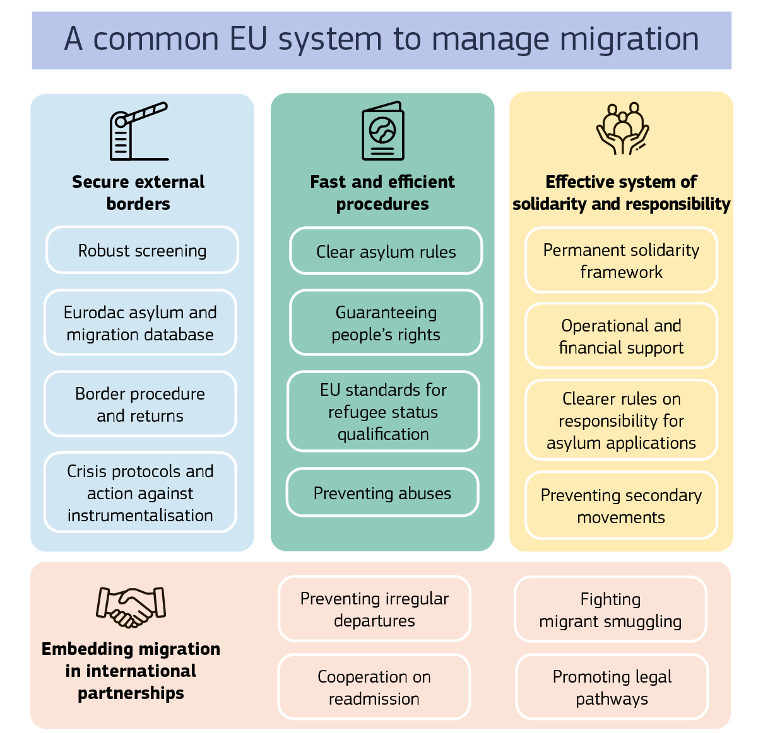
EU Migration and Asylum Pact 2024

Slide 11
ECHR Legal Framework
Art. 3 of the European Convention on Human Rights (ECHR)
Prohibits removal expulsion of an individual to a State where there is a serious risk that they would be subjected to the death penalty, torture or other inhuman or degrading treatment or punishment
Art 4 of Protocol No 4 ECHR - Prohibition of collective expulsions of aliens
Purpose of Article 4 was to formally prohibit collective expulsions of aliens “of the kind which was a matter of recent history”
The core purpose of the Article is to prevent States from being able to remove a certain number of aliens without examining their personal circumstances and, consequently, without enabling them to put forward their arguments against the measure taken by the relevant authority

Slide 12
PUSHBACK CASE LAW

Slide 13
CJEU Pushback Case Law
C‑808/18 Commission v Hungary December 2020
Hungary had failed to fulfil its obligations under the Returns Directive - Hungarian police forcibly escorted illegally staying third-country nationals to a strip of land between the border fence and the Serbian-Hungarian border without prior compliance with the substantive and procedural safeguards provided for in that directive. the CJEU stresses the need for the domestic authorities to ensure effective access to procedures for international protection
Case C‑123/22 Commission v Hungary (June 2024) - Hungary to pay the European Commission a lump sum in the amount of EUR 200 000 000 and a penalty payment of EUR 900 000 per day
Case C‑72/22 PPU Valstybės sienos apsaugos tarnyba June 2022
The Court declared that Lithuanian legislation effectively depriving a non-EU national of an opportunity to apply for asylum solely because they had crossed the border irregularly is incompatible with the Asylum Procedures Directive – even in the event of declared emergency due to a “mass influx of aliens”

Slide 14
CJEU Pushback Case Law
Case C‑392/22 Staatssecretaris van Justitie en Veiligheid (February 2024)
The referring court takes the view that objective, reliable, specific and properly updated information shows that the Republic of Poland has, for a number of years, systematically infringed a number of fundamental rights of third-country nationals by subjecting them to pushbacks, regularly accompanied by the use of violence, and by systematically detaining, in what are described as ‘appalling’ conditions, third-country nationals who enter its territory illegally
Syrian national claims to have been subjected to pushbacks to Belarus on three occasions after entering Polish territory, one of which was at night and that he stayed in the woods before being picked up and handed over to border guards. He adds that, while staying in the woods, his living conditions had become unbearable
According to the referring court, X had indicated that he was afraid that his fundamental rights would be infringed again if he were to be transferred to Poland.
.X stated that he had then been held in detention for approximately one week in the border guard centre, like all other applicants for international protection, where he had been very badly treated, particularly because of a lack of food and the absence of any medical checks

Slide 15
CJEU Pushback Case Law
Member State responsible for examining a third-country national’s application for international protection has carried out pushbacks with respect to third-country nationals seeking to make such applications at its border and has detained them at its border control posts does not in itself preclude the transfer of that third-country national to that Member State
The Member State which has sought to have an applicant for international protection taken back by the Member State responsible and wishes to transfer that applicant to the latter Member State must, before it can carry out that transfer, take into consideration all of the information provided to it by that applicant, in particular as regards the possible existence of a real risk of inhuman or degrading treatment, within the meaning of Article 4 of the Charter, at the time of that transfer or thereafter
Member State must refrain from carrying out that transfer if there are substantial grounds for believing that there is a real risk of such treatment in the event of transfer
Member State may nevertheless seek to obtain individual guarantees from the Member State responsible and, if such guarantees are provided and appear to be both credible and sufficient to rule out any real risk of inhuman or degrading treatment, may carry out that transfer

Slide 16
ECHR Pushback case law
European Court of Human Rights (ECtHR) has condemned pushback practices as collective expulsions based on Article 4 of Protocol No 4 ECHR
Sharifi and others v Italy and Greece - applicants have been prevented from applying for asylum or from having access to an effective remedy
M.K. and others v Poland - applicants refused entry to state territory without giving proper regard to their individual situation as part of policy of refusing to receive asylum applications
Hirsi Jamaa and others v Italy - ECtHR condemned Italy for a 'pushback' practice when its coastguard physically intercepted a migrant boat and returned its approximately 200 passengers to Libya. Confronted with the question of the extraterritorial application of the ECHR, the Court asserted that the applicants had been 'under the continuous and exclusive de jure and de facto control of the Italian authorities'. In this case, the ECtHR found a breach of the prohibition on collective expulsions under Article 4 of Protocol No 4 to the Convention

Slide 17
ECHR Pushback Case Law
N.D. and N.T. v. Spain
Push-back practices against migrants at the Moroccan-Spanish border fence surrounding the city of Melilla – the so-called devoluciones en caliente or ‘hot returns’ by the Spanish border police.
Controversial case, concerning the interpretation of Article 4 of the Protocol no. 4, the Grand Chamber introduced a “genuine and effective access to means of legal entry” test
Concluded that third-country nationals not using legal pathways of entry despite having such a possibility are acting culpably and can be faulted for being collectively expulsed.
Grand Chamber was restricted to evaluating the prohibition of collective expulsions (Art. 4 Prot. 4)
“Lukewarm” protection from the ECtHR?

Slide 18
ECHR Pushback Case Law
C.O.C.G. and Others v. Lithuania (no. 17764/22)
H.M.M. and Others v. Latvia (no. 42165/21)
R.A. and Others v. Poland (no. 42120/21)
All concerning pushbacks at Belarus border
All relating to state legislation authorising pushbacks
All relinquished to Grand Chamber (rare)
Hearing in all three February 2025

Slide 19
Context and Conclusion

Slide 20
EU Accession to the ECHR
Article 6(2) TEU - “The Union shall accede to the European Convention for the Protection of Human Rights and Fundamental Freedoms”
CJEU Opinion 2/13 (2014)
Negotiations resumed in 2020 – Ongoing…
Draft Accession Agreement (2023)
Make EU subject to human rights respect
Consistency and compatibility between EU law and the Convention
Application of EU secondary legislation is accordingly presumed to be compliant with the Convention - “Bosphorus presumption” (2005 ECHR)

Slide 21
Dignity and Pushbacks
EU – Art 1 Charter - Human dignity
Human dignity is inviolable. It must be respected and protected
ECHR - the concept of human dignity is absent from the text of the European Convention on Human Rights, it is mentioned in more than 2100 judgments of the European Court of Human Rights.
Human Rights Bill for Scotland - dignity to be a key threshold for defining the content of minimum core obligations (MCOs)

Slide 22
Conclusion
Democracies are asphyxiated over time (Teitgen)
“…Once they left their homeland they remained; homeless, once they left their state they became stateless; once they were deprived of their human rights they were rightless, the scum of the earth.” (Arendt)
Christ stopped at……
Bypassed by Christianity, by morality, by history itself — that they have somehow been excluded from the full human experience
Pushback victims…. Being bypassed by European human rights?
What impact might EU Accession have on this?

