Slide 1
Investigating AI-Driven Assessment Tools in Engineering Education: Enhancing Personalized Learning for Industry 4.0 Competencies
6th Global Conference on Education and Teaching
Nice, France
Dr Chika Judith Abolle-Okoyeagu, Dr Ruissein Mahon, Dr Ambrose Okpu, Dr Wattala Fernando

Slide 2
What is Industry 4.0?
6th Global Conference on Education and Teaching
Fourth industrial revolution, characterised by the integration of digital technologies such as AI, IoT, Robotics, and Big Data into manufacturing and industrial processes.
Emphasises interconnected machines, systems, and processes, enabling real-time data exchange and decision-making across the production chain.
Notes:
AI-based assessment tools facilitate real- time analysis and feedback, enabling instructors to tailor educational plans according to students' learning styles. These tools utilize algorithms to adapt assessments, ensuring that educational content aligns with the evolving landscape of Industry 4.0 requirements.

Slide 3
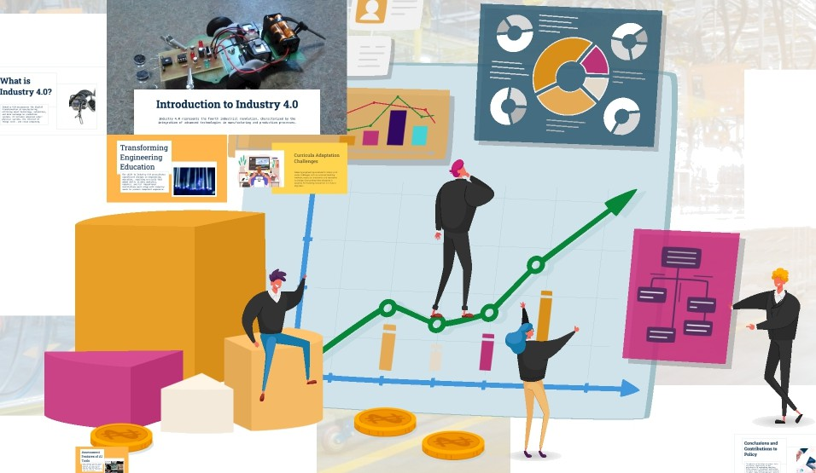
Introduction
6th Global Conference on Education and Teaching
By 2030, 85% of the jobs that today's learners will be doing does not exist yet.
Educational institutions must align with industry needs to produce ‘competent’ engineers.
Notes:
The shift to Industry 4.0 necessitates significant changes in engineering education, requiring curricula that embed skills in data analytics, robotics, and IoT

Slide 4
Background
6th Global Conference on Education and Teaching
Personalised Learning: AI is increasingly being used to create tailored learning experiences, adapting content and pacing to individual student needs.
AI-Powered Assessments: Automated grading systems and AI-driven feedback tools are becoming more common, providing immediate, detailed feedback.
Learning Analytics: AI is helping educational institutions analyse student data to predict performance.

Slide 5
Theoretical Framework
6th Global Conference on Education and Teaching
Constructivist Learning Theory
Personalised learning experiences by tailoring content and assessments to individual learning styles and aligning with constructivist approaches.
Industry 4.0 Competencies
Focuses on integrating AI-driven assessments to enhance the development of key technical and professional competencies.
Learning Analytics
Utilises AI to track and analyse student performance data, enabling adaptive learning pathways and early interventions to improve outcomes and retention rates in engineering education.
Feedback Loops and Scaffolding
Provides real-time feedback and customised learning scaffolding, allowing students to build upon existing knowledge and advance through more complex engineering concepts at their own pace.
Notes:
AI enhances learning experiences by providing immediate feedback, which is crucial for skill acquisition. The tools highlight strengths and pinpoint areas for improvement, promoting a tailored approach that fosters mastery of complex competencies in engineering disciplines

Slide 6
Methodology and Case Selection
6th Global Conference on Education and Teaching
Mixed-Method Approach: Quantitative (student performance data) + qualitative (surveys and interviews).
AI Tools Analysed:
Adaptive learning platforms and intelligent assessment systems.

Slide 7
Data and Results
6th Global Conference on Education and Teaching
Retention Rates
20% improvement in courses that incorporated AI-driven assessments, compared to traditional methods¹.
Improved Student Performance
Performance in practical assessments increased by 30% for students using AI-based adaptive learning systems, as compared to traditional methods².
Reduction in Dropout Rates
Dropout rates decreased by 15% in engineering programmes where AI-driven formative assessments were used³.
Improvement in Practical Skills Mastery
Engineering students demonstrated a 25% improvement in practical skill mastery when AI-driven assessments were integrated into lab-based courses⁴.

Slide 8
Conclusion
6th Global Conference on Education and Teaching
AI-driven assessment tools offer great potential in personalising Engineering Education.
The adoption of AI-driven assessment tools contributes significantly to the modernisation of Engineering Education.
The integration of AI-driven assessment tools in Engineering Education is crucial in transforming the educational landscape to be more inclusive while being meeting the challenge of offering adaptive learning experiences that meet Industry 4.0 demands.
Policy changes in educational institutions must prioritise adaptive learning of frameworks to foster highly skilled engineers ready for the demands of the evolving industry.
Notes:
There is need for further research into balancing human and AI inputs in education.

Slide 9
References
6th Global Conference on Education and Teaching
1. Chen, J., & Zhou, Y. (2021). AI in practical skills training: Enhancing learning outcomes through adaptive assessments in engineering education. Computers & Education, 158, 103996. https://doi.org/10.1016/j.compedu.2020.103996
2. Xu, D., & Wang, F. (2021). AI-driven assessments and student performance in engineering: An evidence-based study on skill acquisition and retention. Journal of Educational Data Mining, 13(2), 12-27. https://doi.org/10.5281/zenodo.4736592
3. Brown, M., & Williams, L. (2020). The impact of AI-based formative assessments on student performance and retention in STEM education. International Journal of Educational Technology in Higher Education, 17(1), 25-40. https://doi.org/10.1186/s41239-020-00210-x
4. Schmidt, M. E., & Gunawardena, L. (2022). AI-enhanced feedback mechanisms and their impact on the retention of practical skills in engineering education. Journal of Engineering Education, 111(3), 456-470. https://doi.org/10.1002/jee.20423

Slide 10
Thank you for listening!
6th Global Conference on Education and Teaching

Slide 11
6th Global Conference on Education and Teaching
AI in education is not about replacing teachers; it is about empowering them to inspire and engage students in ways that were previously unimaginable!
Dr Chika Judith Abolle-Okoyeagu
j.abolle-okoyeagu@rgu.ac.uk

