Slide 1
Investigating the role of Diversity and Inclusion in STEM Education in the UK
6th Global Conference on Education and Teaching
Nice, France
Dr Chika Judith Abolle-Okoyeagu, Dr Chioma Onoshakpor, Dr Ambrose Okpu, Emmanuel Akerele

Slide 2
6th Global Conference on Education and Teaching
Introduction
Diverse Perspectives
Representation Matters
1
2
Diverse teams bring unique backgrounds, experiences, and problem-solving approaches, leading to more innovative solutions.
Seeing role models who share their identities inspires students from underrepresented groups to pursue STEM careers.
3
Inclusive Environments
Fostering inclusive learning environments where all students feel welcome and supported boosts engagement and achievement.

Slide 3
6th Global Conference on Education and Teaching
Theoretical Framework
Social Identity Theory
Intersectionality Theory
Students from underrepresented backgrounds often experience a “minority status” that can influence their sense of belonging, self-esteem, and motivation
Individual identities and social categories overlap, creating unique, layered experiences of advantage or disadvantage.

Slide 4
6th Global Conference on Education and Teaching
Methodology and Case Selection
Mixed-method approach: Surveys (quantitative) + In-depth interviews (qualitative).
Draws on various studies and frameworks to build a comprehensive understanding of the current state of D&I in this field.

Slide 5
6th Global Conference on Education and Teaching
Data and Results
Gender Representation
Racial and Ethnic Gaps
Female enrolment in full-time undergraduate STEM courses in the UK rose from 33.6% in 2011 to 41.4% in 2020, reflecting initiatives to close gender gaps, particularly in fields like engineering.
Black students continue to be underrepresented in STEM courses, with only around 5% enrolled at the undergraduate level, compared to 18% of white students.
Socioeconomic Influence
Outcomes for Inclusive Programs
Statistics indicate that students from lower socioeconomic backgrounds in the UK have an 8.2% lower likelihood of enrolling in higher education compared to their peers.
Schools and universities with specific (EDI) programs have seen a 15% increase in improved retention and graduation rates for underrepresented groups.

Slide 6
6th Global Conference on Education and Teaching
Addressing the Gender Gap in STEM
Early Exposure
Introducing girls to STEM subjects and role models at a young age can spark their interest and confidence.
Skill-Building
Providing girls with opportunities to develop technical skills and hands-on experience can help close the gender gap.
Supportive Environments
Creating safe, welcoming, and inclusive STEM learning spaces can encourage girls to persist and excel in these fields.

Slide 7
6th Global Conference on Education and Teaching
Promoting Racial and Ethnic Diversity in STEM Pipelines
Community Engagement
Partnering with local organizations and communities to raise awareness and provide STEM opportunities can widen the pipeline.
Scholarships and Funding
Increasing access to financial support can help underrepresented students overcome economic barriers to STEM education.
Targeted Outreach
Proactive recruitment and outreach efforts can identify and nurture talented students from diverse backgrounds.

Slide 8
6th Global Conference on Education and Teaching
Strategies for Increasing Diversity and Inclusion in STEM Classrooms
Inclusive Curriculum
Mentorship Programs
Incorporating diverse perspectives, contributions, and real-world applications into STEM curricula can make it more relevant and engaging.
Connecting underrepresented students with successful STEM role models can provide guidance, inspiration, and a sense of belonging.
Active Learning
Teacher Training
Emphasizing hands-on, collaborative learning experiences can help all students, especially those from underrepresented groups, thrive.
Equipping educators with strategies to recognize and mitigate biases can foster more inclusive and supportive classroom environments.

Slide 9
6th Global Conference on Education and Teaching
Collaborative Efforts and Policy Recommendations
Stakeholder Engagement
Bringing together educators, industry leaders, and policymakers to develop comprehensive strategies for increasing diversity and inclusion.
Policy Reform
Advocating for policies that address systemic barriers, provide funding and resources, and prioritize inclusive STEM education.
Community Partnerships
Collaborating with local organizations, community groups, and underrepresented communities to create meaningful and sustainable change.

Slide 10
6th Global Conference on Education and Teaching
Conclusion
Early Exposure
Diversity and inclusion initiatives in UK STEM education show promise but require further institutional commitment.
Skill-Building
Call for more targeted interventions to support minority groups in STEM
Social Identity Theory and Intersectionality Theory
The theoretical perspectives employed highlight that challenges related to identity and compounded disadvantages significantly impact students’ sense of belonging, persistence, and academic success in STEM fields

Slide 11
References
6th Global Conference on Education and Teaching
British Science Association, 2023. Report on equity in STEM education released.
https://www.britishscienceassociation.org/News/report-on-equity-in-stem-education-released
2. Yu, Y., 2024. Where are inequalities produced? Comparing the variations of graduate employment between the UK’s districts and universities. Socio-Economic Review, p.mwae052.
Where are inequalities produced? Comparing the variations of graduate employment between the UK’s districts and universities | Socio-Economic Review | Oxford Academic
3. Ramiah, R., Godinho, L. and Wilson, C., 2022. Tertiary STEM for all: Enabling student success through teaching for equity, diversity and inclusion in STEM. International Journal of Innovation in Science and Mathematics Education, 30(3).
https://doi.org/10.30722/IJISME.30.3.1150

Slide 12
Thank you for listening!
6th Global Conference on Education and Teaching

Slide 13
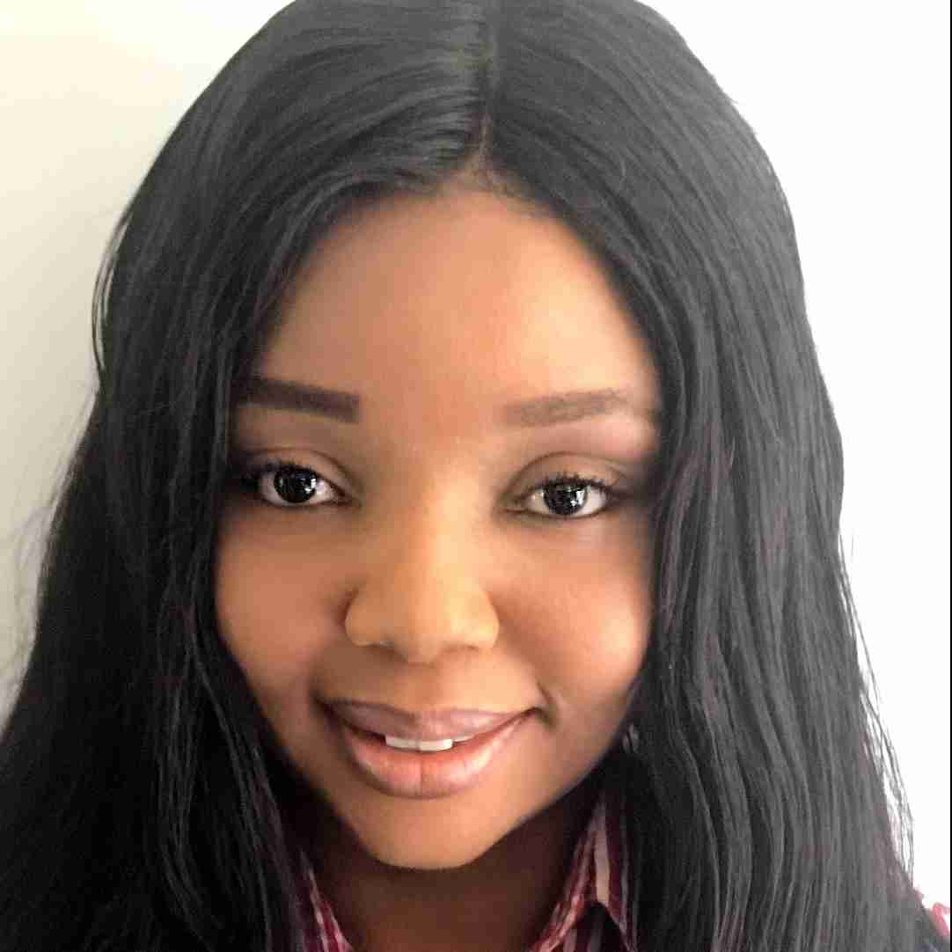
6th Global Conference on Education and Teaching
"Diversity in STEM is not just about bringing different voices to the table; it’s about ensuring that each voice is heard and valued, leading to innovative solutions that can only arise from a rich tapestry of perspectives."
Dr Chika Judith Abolle-Okoyeagu
j.abolle-okoyeagu@rgu.ac.uk

